Slide 2
WARM-UP
Choose the best answer

Slide 3
5
4
1
_______is that? That is Ms Huyen
3
2
A. What
B. Who
C. When

Slide 4
5
4
1
2. ______is this? It’s a book.
3
2
A. Where
B. Who
C. What

Slide 5
5
3. ______ do you live? I live in Khanh Yen Trung
4
1
3
2
A. Who
B. What
C. Where

Slide 6
5
4
1
4. ______ books do you have? I have ten books.
3
2
A. How many
B. When
C. Where

Slide 7
How many
Where
Wh- questions
What
Who

Slide 8
Unit 7
TELEVISION
PERIOD 57th: A closer look 2

Slide 9
01
Wh-questions

Slide 10
1. Read and underline WH-questions (P.9)
Hi, Phong. What are you doing tomorrow?
I’m going to a book exhibition.
I’m going to a book exhibition.
ask about things
Where is it?
It’s in Van Ho Street.
ask about place
It’s in Van Ho Street.
How long is it on?
From the 4th to the 7th January.
From the 4th to the 7th January.
ask about the length of time

Slide 11
WH-QUESTIONS WORDS
2
Match each question word with the information it needs.
people
When
thing
How many
place
How often
What
repetition
time
Where
reason
Who
number
Why

Slide 12
LET’S CHANT.
Notes:
Link video hoạt hình: https://hoclieu.vn/hop-phan-bo-tro/video-hoat-hinh/203?gidzl=92okFGyK4JiWCwOu3mqMD24oe3WI2HLjEJAgQKPOJcu-OVXg4b1FQ6fX-3XEMKSwOc7oEpCT2OOq2nKGE0

Slide 13
When is for time What is for thing Where is for place Who is for person Why is for reason How many is for number How often is for repetition

Slide 14
3. Fill in the blanks. Use the questions words in the box.
When
Who
What
Where
How often
Conversation 1
A: ____________ do you watch TV?
B: Not very often. Two or three times a week.
A: ____________ do you watch?
B: It depends. But I like talent shows the most.
How often
Two or three times a week.
(repetition)
What
It depends.
talent shows
(things)

Slide 15
3. Fill in the blanks. Use the questions words in the box.
When
Who
What
Where
How often
Conversation 2
A: ____________ do you like the most in Doraemon?
B: Nobita. He's so funny.
Nobita.
Conversation 3
A: ____________ do you play football?
B: Usually on Saturday or Sunday.
A: ____________ do you play?
B: In the yard.
on Saturday or Sunday.
In the yard.

Slide 16
3. Fill in the blanks. Use the questions words in the box.
When
Who
What
Where
How often
Conversation 2
A: ____________ do you like the most in Doraemon?
B: Nobita. He's so funny.
Who
Conversation 3
A: ____________ do you play football?
B: Usually on Saturday or Sunday.
A: ____________ do you play?
B: In the yard.
When
Where

Slide 17
02
Conjunction in compound sentences

Slide 18
Combine 2 sentences into 1.
1. I like watching cartoons. My brother likes watching sports.
I like watching cartoons, but my brother likes watching sports.
CONJUNCTION
2. I enjoy sports. I spend a lot of time outdoors.
I enjoy sports, so I spend a lot of time outdoors.
CONJUNCTION
We use conjunctions to combine two clauses into a compound sentence.

Slide 19
Conjunctions

Slide 20
CONJUNCTIONS
And
(Và)
But
(nhưng)
So
(vì vậy)
Dùng để nối các ý tương đồng hoặc bổ sung.
Ex: She’s very kind, and she’s also a hard worker.
Dùng để nối các ý tương phản hoặc trái ngược
Ex: She likes cats, but she hates dogs.
Dùng để chỉ kết quả hoặc hệ quả.
Ex: I enjoy sports, so I spend a lot of time outdoors.

Slide 21
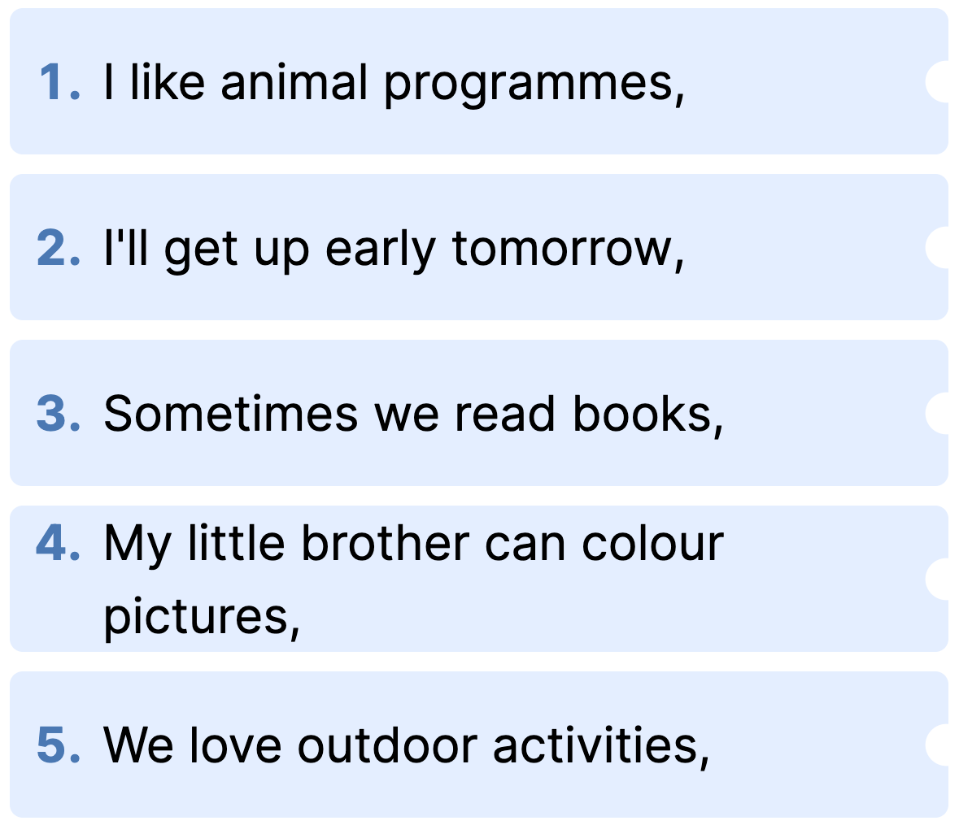
CONJUNCTIONS IN COMPOUND SENTENCES
4
Match the beginnings with the endings.

Slide 22
CONJUNCTIONS IN COMPOUND SENTENCES
4
Match the beginnings with the endings.

Slide 23
CONJUNCTIONS IN COMPOUND SENTENCES
5
Use and, but or so to complete the sentences.
﻿1. I’m tired, _______ I’ll go to bed early.
2. My sister is good at school, _______ I'm not.
3. We trained hard, _______ we won the game.
4. The programme is interesting, _______ it’s too long.
5. I'll write him some instructions, _______ I hope he’ll follow them.

Slide 24
LUCKY BOX
1
2
3
4
5
6
7
8

Slide 25
5
Use and, but or so to complete the sentences
1. I’m tired, _______ I’ll go to bed early.
.
so

Slide 26
5
Use and, but or so to complete the sentences
2. My sister is good at school, _______ I'm not.
but

Slide 27
5
Use and, but or so to complete the sentences
.
3. We trained hard, _______ we won the game.
so

Slide 28
5
Use and, but or so to complete the sentences.
4. The programme is interesting, _______ it’s too long.
but

Slide 29
5
Use and, but or so to complete the sentences.
and
5. I'll write him some instructions, _______ I hope he’ll follow them

Slide 30
LUCKY NUMBER!

Slide 31
LUCKY NUMBER!

Slide 32
LUCKY NUMBER!

Slide 33
CONJUNCTIONS IN COMPOUND SENTENCES
5
Use and, but or so to complete the sentences.
﻿1. I’m tired, _______ I’ll go to bed early.
2. My sister is good at school, _______ I'm not.
3. We trained hard, _______ we won the game.
4. The programme is interesting, _______ it’s too long.
5. I'll write him some instructions, _______ I hope he’ll follow them.
so
but
so
but
and

Slide 34
Homework
Review Wh-questions and conjunctions (but, and, so) And do the ex again.
Prepare for the next period: Unit7- communication
+ Asking for and giving information about TV programmes.
+ TV programmes.

Slide 35
Thank you
See you next time!

