Slide 1
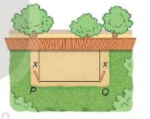
Activity 1:
Problem identification activities
Problem: The perimeter of a rectangular garden is 20 meters.
a) Calculate the area of the rectangular garden if it has width x (meters).
b) What is the width such that the area is not less than 48 m²?

Slide 2
Solution
Problem: The perimeter of a rectangular garden is 20 meters.
a) Calculate the area of the rectangular fenced garden if it has width x (meters).
a) Assume, the width of the garden is x (m) (0 < x <10).
Then, length of the garden is (m).
Therefore, the area of the garden is (m²)

Slide 3
Solution
Problem: The perimeter of a rectangular garden is 20 meters.
b) What is the width such that the area is not less than 48 m²?
The area of garden is not less than 48 m² if and only if

Slide 4
THAI NGUYEN DEPARTMENT OF EDUCATION AND TRAINING
ALGEBRA 10
SIGNS OF QUADRATIC TRINOMIALS
Teacher:

Slide 5
CONTENTS
01
Quadratic trinomial
02
Signs of a quadratic trinomial
03
Practice
04
Aplications

Slide 6
01
Quadratic trinomial

Slide 7
1. Quadratic trinomial
A quadratic trinomial in x is an expression of the form
where a, b and c are coefficients and .
Note 1
The solutions of quadratic equation are also called the solutions of quadratic trinomial .
Quadratic trinomial /kwɒˈdrætɪk trai´noumiəl/

Slide 8
Example
Example 1
Which of the following expressions is a quadratic trinomial in x? If it is a quadratic trinomial in x, determine a, b, c.
, where m is a parameter.

Slide 9
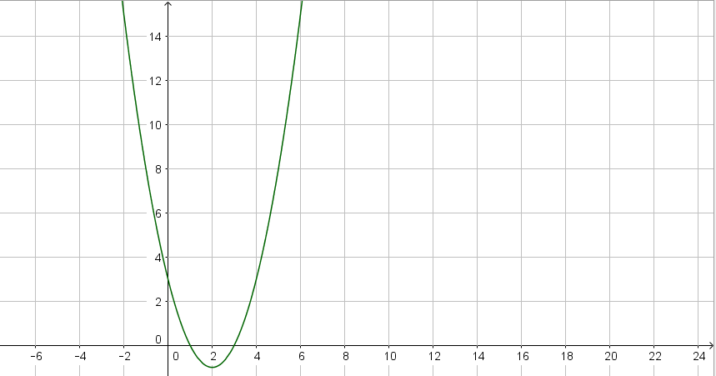

Slide 10
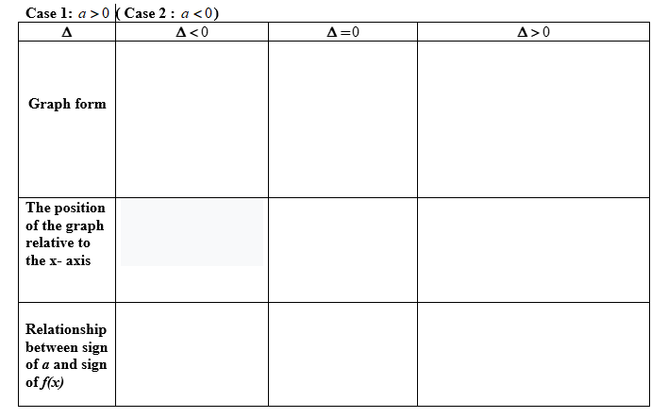
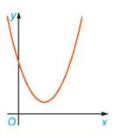
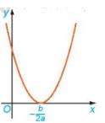
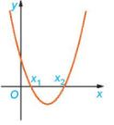
Activity 2.1:
Complete the following table:
Case 1: a > 0
Above the x-axis.
Above the x-axis
Above the x-axis if
Below the x-axis

Slide 11
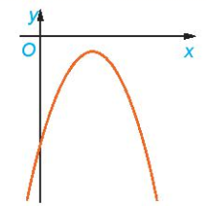
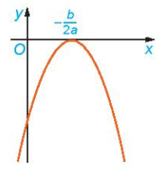
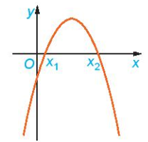
Activity 2.2:
Complete the following table:
Case 2: a < 0
Below the x-axis
Below the x-axis if
Below the x-axis.
Above the x-axis

Slide 12
2. Signs of a quadratic trinomial
Theorem
Given a quadratic trinomial
If then f(x) always has the same sign as coefficient a for all .
If then f(x) always has the same sign as coefficient a except .
If then f(x) has two distinct roots and . Therefore,
f(x) has the same signs as the coefficient a for all ;
f(x) has opposite signs to the coefficient a for all .
Note 2: + In the above theorem, it is possible to replace by .
+ We can replace the calculation of by finding the solutions of f(x).

Slide 13
Consider signs of a quadratic trinomial:
Step 1: Determine signs a.
Step 2: Calculate and compare with 0 ( or find the solutions of f(x) )
Step 3: Apply theorem on the signs of a quadratic trinomial
+) If (or f(x) has no solution) then a.f(x)>0,
+) If = 0 (or f(x) has 1 solution) then a.f(x)>0,
+) If >0 ( or f(x) has 2 distinct solutions) then
.

Slide 15
HOMEWORK
Find values of parameter m such that the following quadratics trinomial have positive .

Slide 16
Our leson ends here.
Thank you.

Slide 17
03
Practice

Slide 18
ROTATION LUCKY
30
20
1
2
3
40
10
50
80
4
5
6
60
70
TURN

Slide 19
Question1: Which of the following statements is true?
is a quadratic trinomial.
is a quadratic trinomial.
is a quadratic trinomial.
is a quadratic trinomial.
19
20
13
14
11
8
10
16
3
0
15
2
4
1
18
12
5
9
17
6
7
Answer: A
TIME
RETURN

Slide 20
Question 2: Given a quadratic trinomial .
Which of the following statement is true?
A. If then f(x) always has the same sign as the coefficient a for all .
B. If then f(x) always has the same sign as coefficient a except .
C. If then f(x) always has the same sign as coefficient a for all .
D. If then f(x) always has the same sign as the coefficient b for all .
19
20
13
14
11
0
8
10
16
3
15
2
4
1
18
12
5
9
17
6
7
Answer: C
TIME
RETURN

Slide 21
Question 3: Given a quadratic trinomial .
A. B. C. D.
The condition for is
19
20
13
14
11
8
10
16
3
0
15
2
4
1
18
12
5
9
17
6
7
Answer: C
TIME
RETURN

Slide 22
Question 4: The quadratic trinomial
is positive if and only if
A. B.
C. D.
19
20
13
14
11
8
10
16
3
0
15
2
4
1
18
12
5
9
17
6
7
Answer: D
TIME
RETURN

Slide 23
Question 5: The quadratic trinomial
is non-positive if and only if
A. B.
C. D.
19
20
13
14
11
8
10
16
3
0
15
2
4
1
18
12
5
9
17
6
7
Answer: C
TIME
RETURN

Slide 24
Question 6: The number of integer values ​​of x which the quadratic trinomial has a negative value is
A. 4 B. 5 C. 3 D. 6
19
20
13
14
11
8
10
16
3
0
15
2
4
1
18
12
5
9
17
6
7
Answer: B
TIME
RETURN

Slide 25
04
Aplications

Slide 26
Example
Examle 3
Find values of parameter m such that the following quadratic trinomial is positive .

Slide 27
Thank You!
FOR LISTENING

