Slide 2


Unit
8
SPORTS AND GAMES
Period 65 - LESSON 3: A CLOSER LOOK 2
Grammar
1
The past simple
Imperatives
1

Slide 3
LESSON 3: A CLOSER LOOK 2
LESSON 1: GETTING STARTED
WARM-UP
Pelmanism
Task 1: Choose the correct answer A, B, or C.
Task 2: Write the correct form of verbs to complete the conversation.
Task 3: Work in groups. Ask and answer questions about your last weekend.
THE PAST SIMPLE
Task 4: Look at each picture and choose the correct answer.
Task 5: Tell your friends what to do and what not to do at the gym
IMPERATIVES
CONSOLIDATION
Wrap-up
Homework

Slide 4
Game: Pelmanism
WARM-UP

Slide 5
WARM UP
Match infinitive form with its correct past simple form.
went to school
watch TV
had lunch
play computer games
played computer games
have lunch
was/were at home
drink water
teach English
did homework
learn French
taught English
go to school
watched TV
do homework
learnt French
be at home
drank water

Slide 6
I. PAST SIMPLE
THE PAST SIMPLE

Slide 7
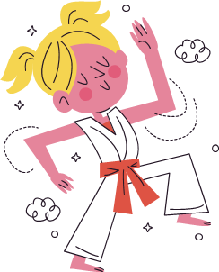
Past simple
THE PAST SIMPLE
1
was
an interesting match
There
an interesting match on TV last night.
singular
→ be: was
To be:
I/ he/ she/ it
+
was
you/ we/ they
+
were

Slide 8
Past simple
THE PAST SIMPLE
1
My dad
played
a lot of tennis some years ago.
play + ed
→ V + ed
Positive (+)
S
+
V-ed/ Irregular verb

Slide 9
Past simple
THE PAST SIMPLE
1
I
didn’t see
you there.
I was at the gym last Sunday, but I
didn’t + see
→ didn’t/ did not + V
The teacher
didn’t ask
The teacher
us about our homework this morning.
didn’t + ask
→ didn’t/ did not + V
Negative (-)
S
+
didn’t/ did not + V

Slide 10
THE PAST SIMPLE
1
Choose the correct answer A, B or C.
1. There _____ an interesting match on TV last night
A. is B. were C. was
2. My dad _____ a lot of tennis some years ago.
A. plays B. played C. is playing
3. I was at the gym last Sunday, but I _____ you there.
A. not saw B. don’t see C. didn’t see

Slide 11
THE PAST SIMPLE
1
Choose the correct answer A, B or C.
4. The teacher _____ us about our homework this morning.
A. didn’t ask B. not asking C. doesn’t ask
5. _____ sleep well last night?
A. Do you B. Did you C. Were you

Slide 12
THE PAST SIMPLE
2
Write the correct form of the verbs to complete the conversation.
Nick: Hi, there.
Sonny: Hello, Nick. Did you have a nice weekend?
Nick: Yeah, it was OK. On Sunday, I (1. go) _______ fishing with my dad. How about you?
Sonny: Oh, I (2. have) _______ a good weekend, too.
Nick: Really? What _______ you (3. do) _______?
Sonny: I (4. visit) _______ the museum with my family, then we (5. eat) _______ at my favourite restaurant.
Nick: Did you watch football last Sunday
Sonny: Oh, yeah! My favourite team (6. score) _______ a fantastic goal!
went
had
did
do
visited
ate
scored

Slide 13
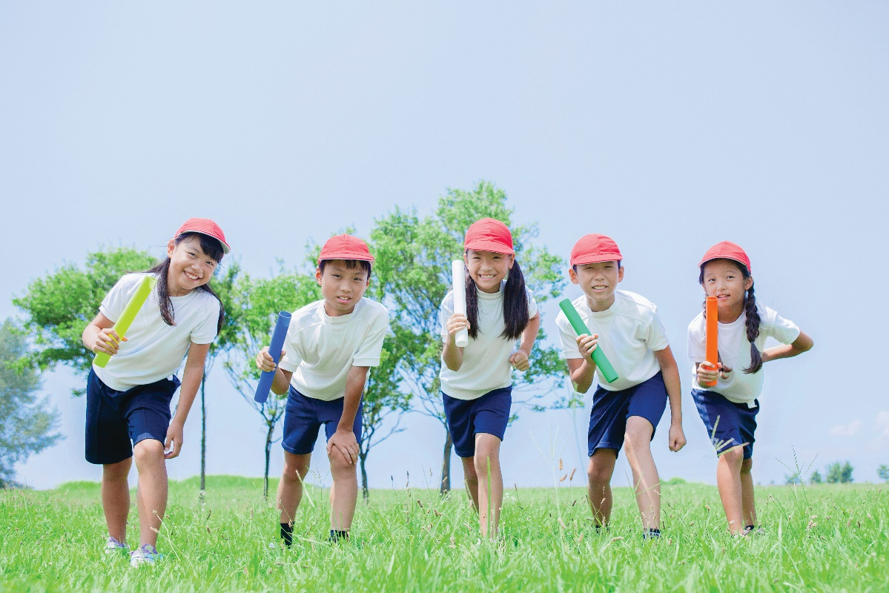
THE PAST SIMPLE
3
Look at each picture and answer questions about your last weekend.
Example:
A: Did you do any sport last weekend?
B: Oh yes, and I was exhausted.
C: Really? What did you do?
…

Slide 14
II. IMPERATIVES
IMPERATIVES

Slide 15
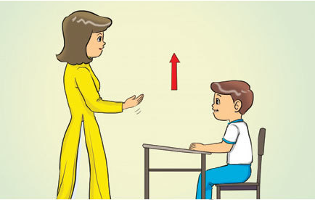
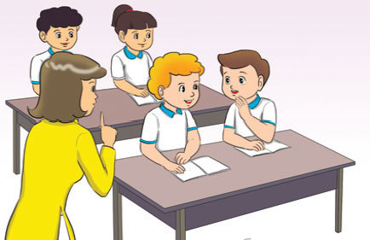
IMPERATIVES
IMPERATIVES
Stand up.
Stand up.
(+)
V
Don’t
Don’t talk.
(-)
Don’t
+
V

Slide 16

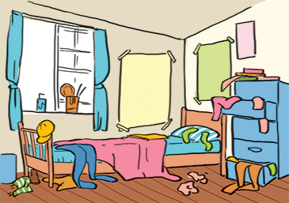


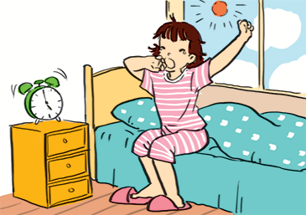
IMPERATIVES
4
Look at each picture and choose the correct answer.

Slide 17
IMPERATIVES
4
Look at each picture and choose the correct answer.
1.
(Park / Don’t park) here.
1. Don’t park here.

Slide 18
IMPERATIVES
4
Look at each picture and choose the correct answer.
(Close / Open) the window. It’s windy outside.
2.
2. Close the window.
It’s windy outside.

Slide 19
IMPERATIVES
4
Look at each picture and choose the correct answer.
3. Tidy up your room.
3.
(Tidy up / Don’t tidy up) your room.

Slide 20
IMPERATIVES
4
Look at each picture and choose the correct answer.
4.
(Use / Don’t use) the lift when there is ﬁre.
4. Don’t use the flit
when there is fire.

Slide 21
IMPERATIVES
4
Look at each picture and choose the correct answer.
5.
(Try / Don’t try) to get up early to do some exercise.
5. Try to get up early
to do some exercise.

Slide 22

IMPERATIVES
5
Tell your friends what to do and what not to do at the gym.
GYM RULES
Example:
Change your clothes.
Don’t speak loudly.
_______
_______
_______

Slide 23

CONSOLIDATION
1
Wrap-up
What have we learnt in this lesson?
Use past simple tense
Use imperatives

Slide 24

CONSOLIDATION
2
Homework
Make 3 sentences about yourself, using the past simple
Give 3 orders or tell your friends to do an activity/ every day routine
Do exercises in the workbook

Slide 25






Website: hoclieu.vn
Fanpage: facebook.com/www.tienganhglobalsuccess.vn/

