Slide 1
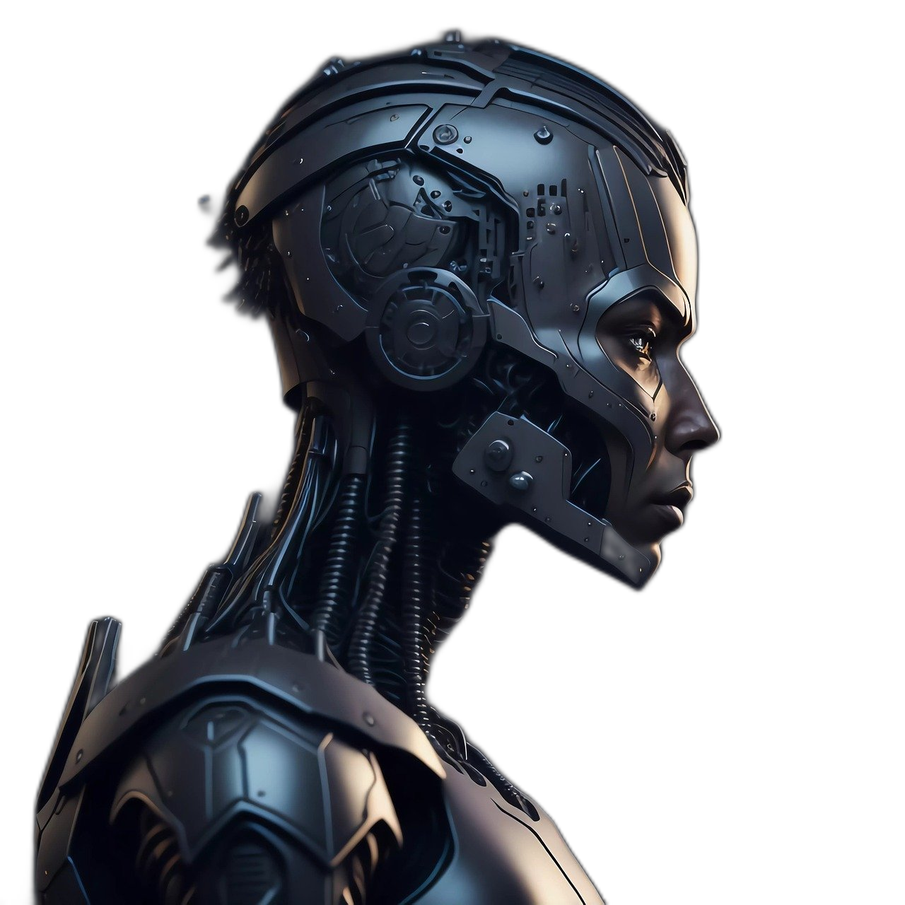
Unit
12
ROBOTS
LESSON 1: GETTING STARTED
At an International Robot Show

Slide 2
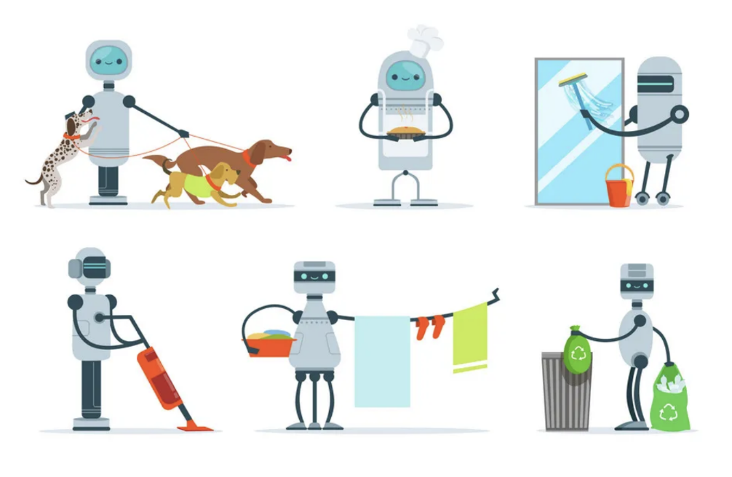
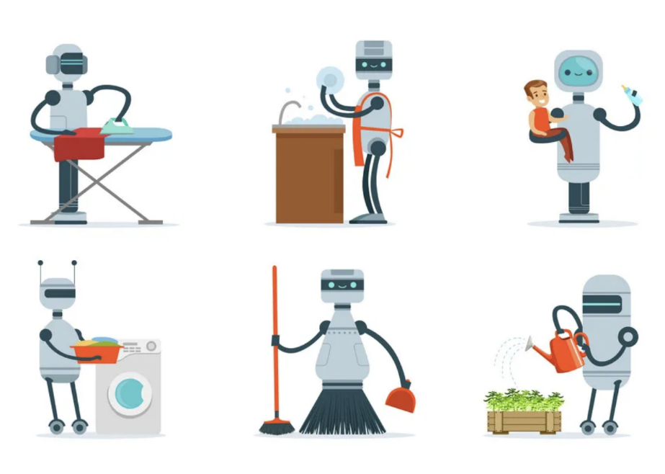
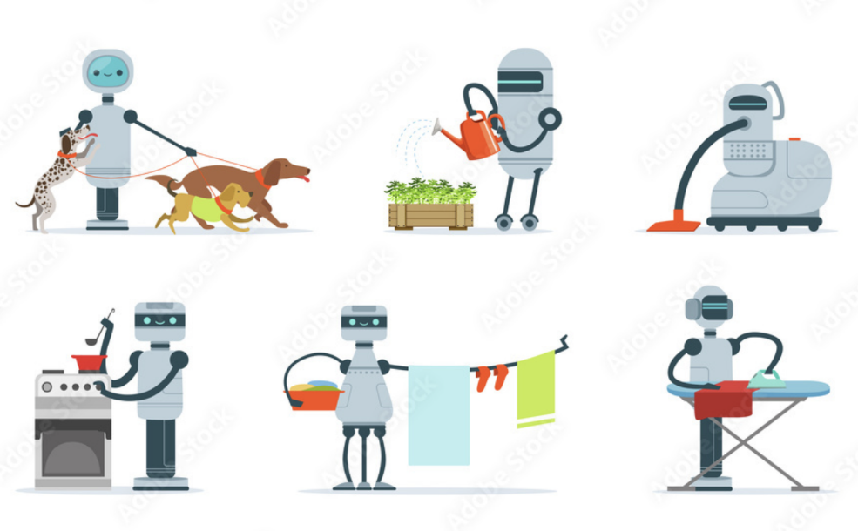
WARM-UP
CHITCHATTING
Do you think robots can do housework? Give some examples?

Slide 3
PRESENTATION
robot (n)
/ˈrəʊbɒt/
a machine that is made to look like a human and that can do some things that a human can do

Slide 4
PRESENTATION
do the dishes
/duː ðə dɪʃiz/
to wash plates, glasses, bowls, etc. with soap and water after a meal.

Slide 5
PRESENTATION
iron (v)
/ˈaɪən/
to make clothes, etc. smooth by using an iron

Slide 6
PRESENTATION
broken (adj)
/ˈbrəʊkən/
no longer whole or working correctly

Slide 7
PRESENTATION
New words | Pronunciation | Meaning
1. robot (n) | /ˈrəʊbɒt/ | người máy
2. do the dishes | /duː ðə dɪʃiz/ | rửa bát
3. iron | /ˈaɪən/ | là (ủi) quần áo
4. broken (adj) | /ˈbrəʊkən/ | bị hỏng

Slide 8
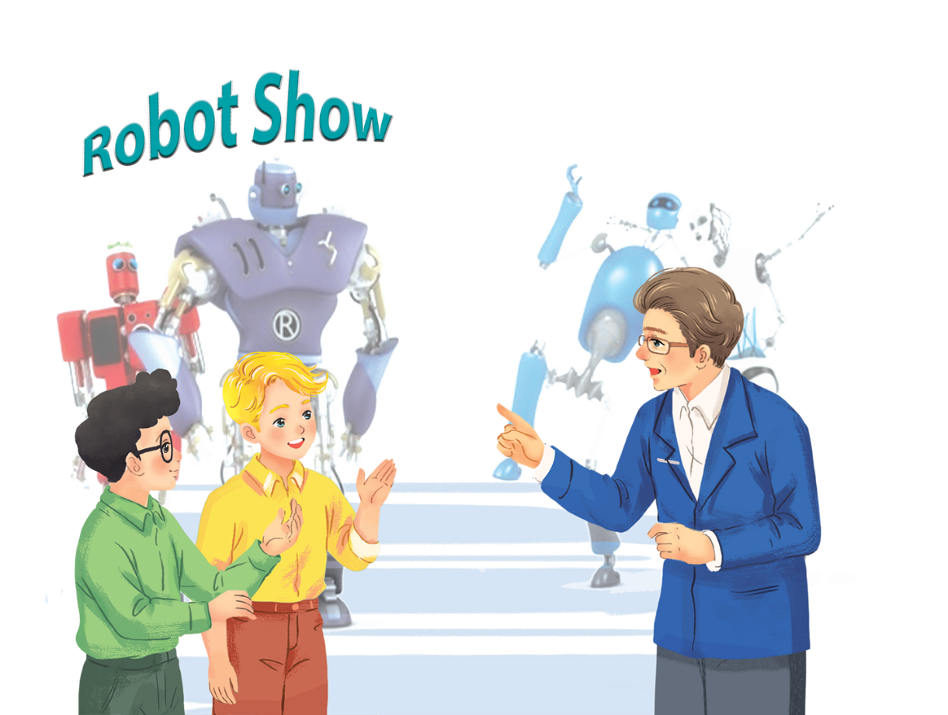
PRACTICE
Listen and read.
At an International Robot Show
- Where are Nick, Phong and Dr Adams?
- What are they talking about?

Slide 9
PRACTICE
Read the conversation again and tick () T (True) or F (False).
 | T | F
1. H8 is a very useful robot.
2. WB2 can’t repair broken machines.
3. Shifa is a doctor robot.
4. H8 is the fastest in the robot show.
5. Shifa is very smart.






Slide 10
PRACTICE
Complete the following sentences, using the adjectives in the box.
fast | smart | useful | heavy | strong
useful
1. My dad bought me a very _______ home robot last week. It helps me to do many household chores.
2. This is a very _______ car. It can travel at a speed of 300 km per hour.
3. He’s very _______. He can move a big car!
4. They’re making a very _______ robot. It can understand 30 languages.
5. The table is too _______ for me to move on my own.
fast
strong
smart
heavy

Slide 11
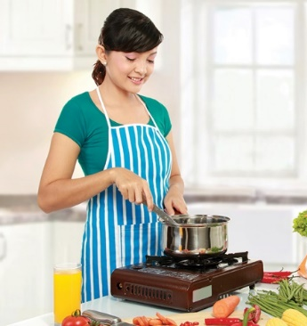
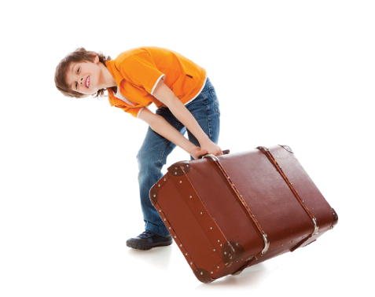
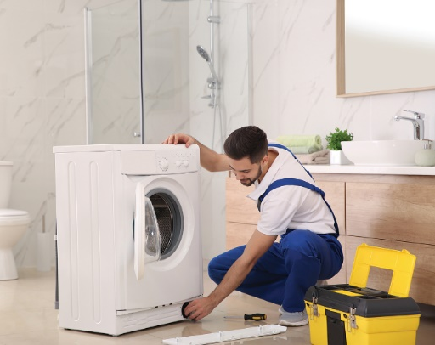
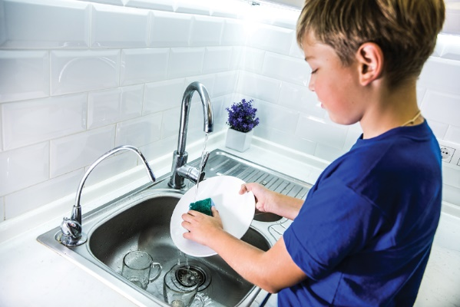
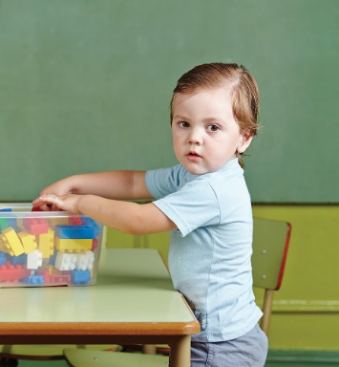
PRACTICE
Match the following activities with the pictures.
a.
c.
e.
ironing clothes
moving heavy things
repairing a broken machine
b.
d.
f.
making meals
doing the dishes
putting toys away
1
2
3
4
5
6

Slide 12
PRACTICE
a.
ironing clothes
c.
moving heavy things
e.
repairing a broken machine
b.
making meals
d.
doing the dishes
f.
putting toys away
1
2
3
b.
making meals
c.
moving heavy things
e.
repairing a broken machine

Slide 13
PRACTICE
a.
ironing clothes
c.
moving heavy things
e.
repairing a broken machine
b.
making meals
d.
doing the dishes
f.
putting toys away
4
5
6
d.
doing the dishes
f.
putting toys away
a.
ironing clothes

Slide 14
PRODUCTION
Miming
Work in groups. A student mimes one of the activities in 4 and the others try to guess. Then swap.
- Work in groups
- Choose an activity in task 4.
- Take turns to act it out and ask the question: What am I doing?
- Other students answers
- Respond: Yes, that’s right. / No, try again.

Slide 15
PRODUCTION
Miming
Work in groups. A student mimes one of the activities in 4 and the others try to guess. Then swap.
Example:
A: What am I doing?
B: You’re doing the dishes.
A: Yes, that’s right. / No, try again.

Slide 16
Homework
- Write about 5 sentences to describe what a robot can do.
- Prepare: A closer look 1.

