Slide 1

Welcome to our class!

Slide 2
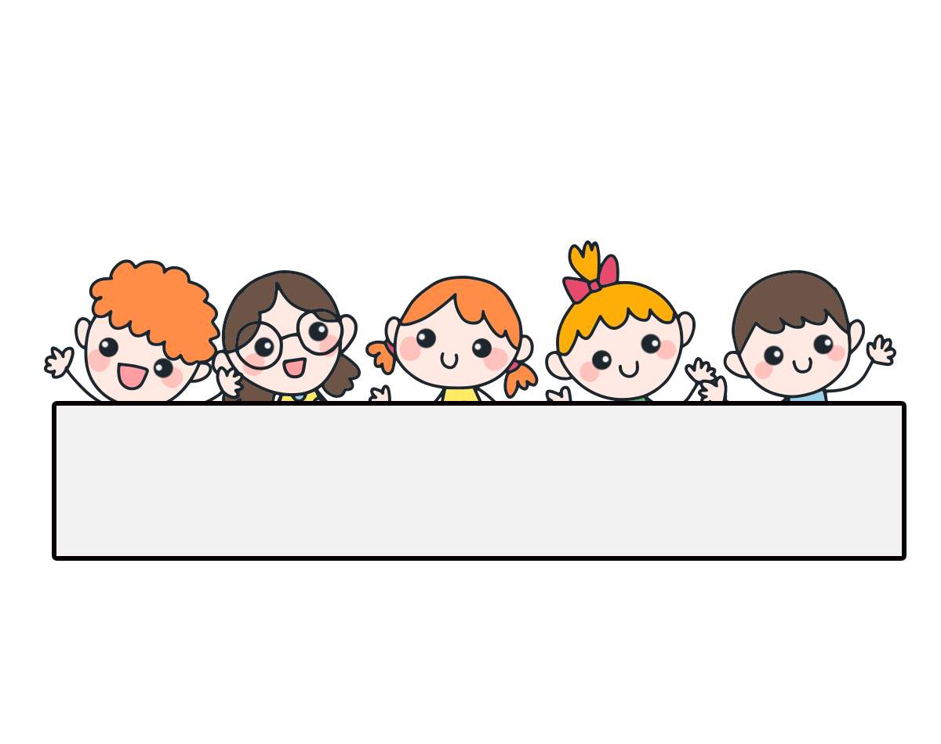
Warm-up

Slide 3









Ms Huyền Phạm
0936.082.789

Slide 4
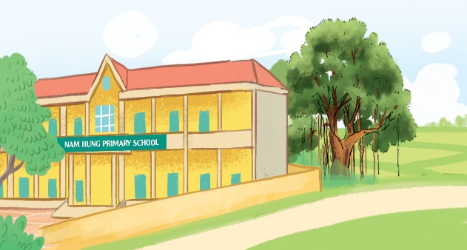

A: Where’s your school?
B: It’s in the ______.
A. town
B. village
Ms Huyền Phạm
0936.082.789

Slide 5

A: Where _____ your school?
B: It __ in the town.
A. are - are
B. is - is
Ms Huyền Phạm
0936.082.789

Slide 6
A: Where’s your school?
B: _____________.
A. It’s in the city.
B. There is one.
Ms Huyền Phạm
0936.082.789

Slide 7
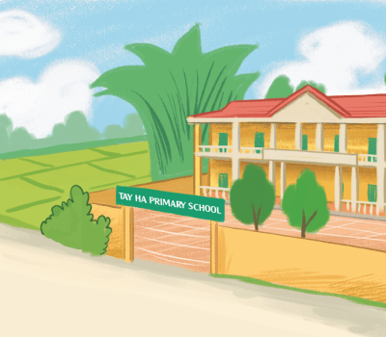
A: ______ your school?
B: It’s in the village.
A. Where’s
B. When’s
Ms Huyền Phạm
0936.082.789

Slide 8
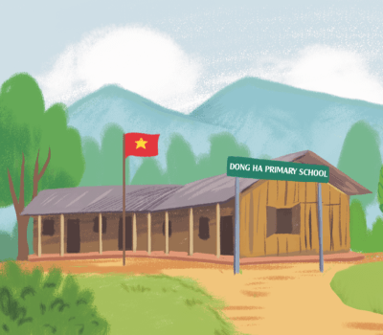
A: Where’s your school?
B: It’s in the _______.
A. mountains
B. village
Ms Huyền Phạm
0936.082.789

Slide 9
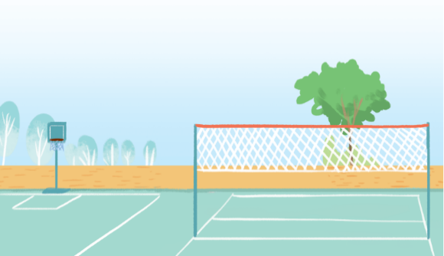
A: How many _____ are there at your school? B: There is one.
A. playgrounds
B. gardens
Ms Huyền Phạm
0936.082.789

Slide 10
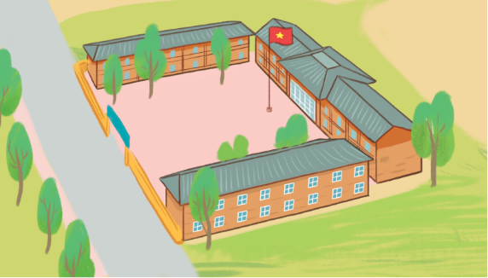
A: How many _____ are there at your school?
B: There are three.
A. gardens
B. buildings
Ms Huyền Phạm
0936.082.789

Slide 11
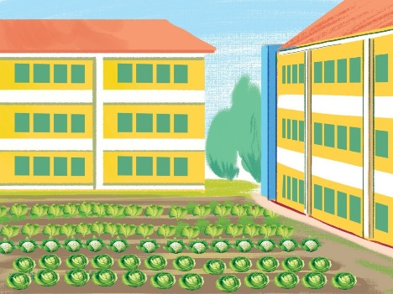
A: ____ many gardens are there
at your school?
B: There is one.
A. How
B. What
Ms Huyền Phạm
0936.082.789

Slide 12

A: How many computer rooms ____ there at your school?
B: There are two.
A. is
B. are
Ms Huyền Phạm
0936.082.789

Slide 13
A: How many buildings are there at your school?
B: _______ three.
A. There is
B. There are
Ms Huyền Phạm
0936.082.789

Slide 14

Good job!
Ms Huyền Phạm
0936.082.789

Slide 15

Monday, May 10th 2024
Unit
7
Our timetables
Lesson 1 (1+2+3)
Facebook: Bùi Liễu Powerpoint
0968142780

Slide 16



Contents
Look, listen and repeat.
Listen, point and say.
Let’s talk.

Slide 17

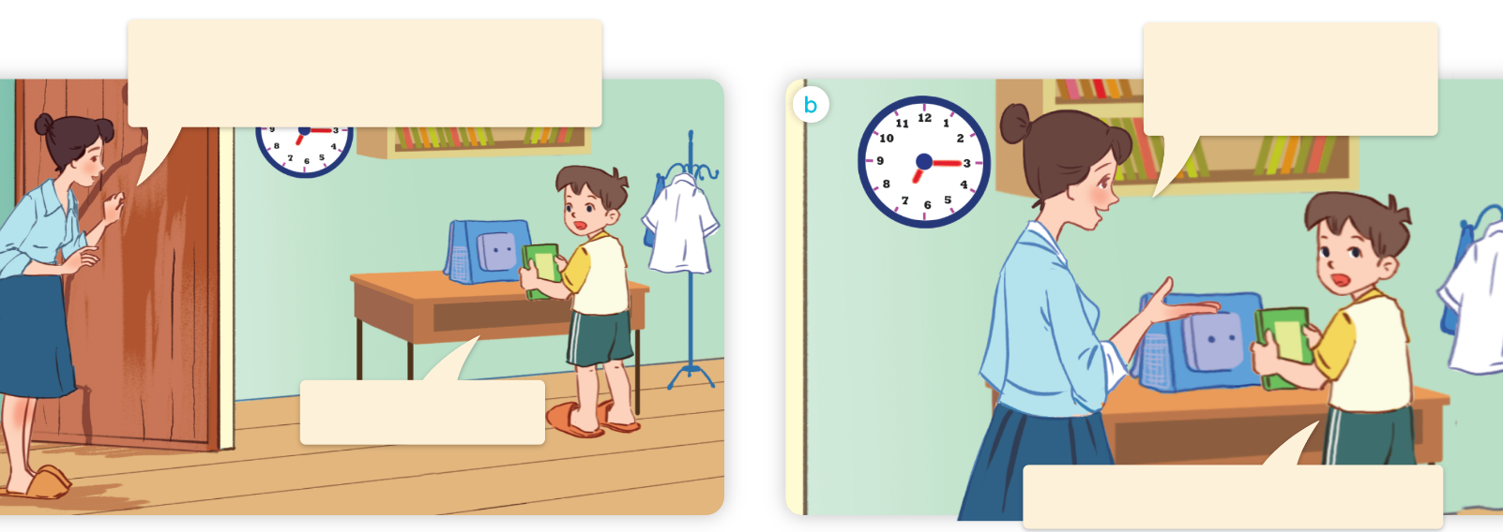
1. Look, listen and repeat.
What time do you have class today, Minh?
What subjects do you have today?
a
b
At eight, Mum.
I have English and maths.
What are they talking about?
Where are they?
Who are they?

Slide 18
Vocabulary

Slide 19
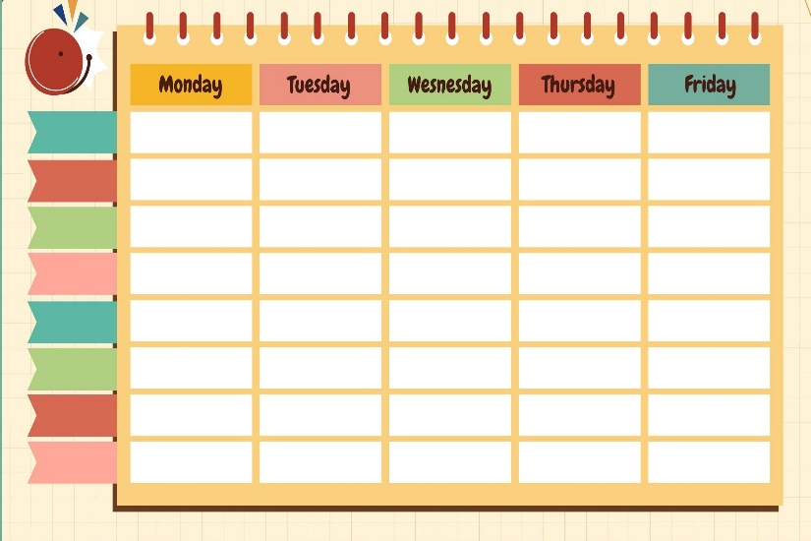
timetable
/ˈtaɪmˌteɪbəl/
thời khóa biểu

Slide 20

subject
/ˈsʌb.dʒekt/
môn học

Slide 21

Vietnamese
/ˌviːetnəˈmiːz/
môn Tiếng Việt

Slide 22

maths
/mæθs/
môn Toán, toán học

Slide 23

science
/ˈsaɪəns/
môn Khoa học

Slide 24

English
/ˈɪŋɡlɪʃ/
môn tiếng Anh

Slide 25






Review
timetable
subject
Vietnamese
English
maths
science

Slide 26
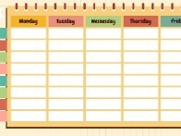





Vocabulary
1. timetable
: thời khóa biểu
2. subject
: môn học
3. Vietnamese
: môn Tiếng Việt
4. English
: môn Tiếng Anh
5. maths
: môn Toán
6. science
: môn Khoa học

Slide 27




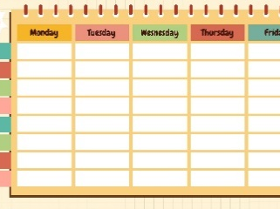

Checking vocabulary
Look and match.
1
2
3
4
5
6
a
b
c
d
e
f
science
English
maths
Vietnamese
subject
timetable

Slide 28
Structures

Slide 29
Structures
Hỏi “ngày hôm nay bạn có môn học gì”:
What subjects do you have today?
I have _______.
(Hôm nay bạn có môn học gì?)
(Tôi có ______.)

Slide 30






Unit 7 lesson 1 (1+2+3)
What subjects do you have today?
I have______.
i
Vietnamese
maths
English
science

Slide 31




2. Listen, point and say.
a
b
What subjects do you have today?
Vietnamese
English
I have______.
c
d
maths
science

Slide 32



2. Listen, point and say.
a
What subjects do you have today?
I have______.
Vietnamese
What subjects do you have today?
I have Vietnamese.
Click on the sentences to listen again.

Slide 33

2. Listen, point and say.
What subjects do you have today?
b
I have______.
English
What subjects do you have today?
I have English.

Slide 34

2. Listen, point and say.
c
What subjects do you have today?
I have______.
maths
What subjects do you have today?
I have maths.

Slide 35

2. Listen, point and say.
d
What subjects do you have today?
I have______.
science
What subjects do you have today?
I have science.

Slide 36

3. Let’s talk.
What subjects do you have today?
_______.

Slide 37

3. Let’s talk.
What subjects do you have today?
____________.
I have English

Slide 38
3. Let’s talk.
What subjects do you have today?
___________.
I have maths

Slide 39
3. Let’s talk.
What subjects do you have today?
_______________.
I have Vietnamese

Slide 40
3. Let’s talk.
What subjects do you have today?
I have science
____________.

Slide 41
Wrap up

Slide 42
Unit 7 lesson 1 (1+2+3)
What subjects do you have today?
I have______.
i
Vietnamese
maths
English
science

Slide 43
Homework
Learn by heart all the new words and the model sentences.
Read again the dialogue in part 1.

Slide 44

Facebook : Bùi Liễu
0968142780
Thank you!

