Slide 1
Unit 1: Life Stories
Lesson 3.1: Listening & Reading
Pages: 12 & 13

Slide 2
Lesson Outline
Warm-up
Listening
Reading
Consolidation
Wrap-up

Slide 3
By the end of this lesson, students will be able to…
- practice listening and reading for gist and specific information.

Slide 4
WARM-UP

Slide 5
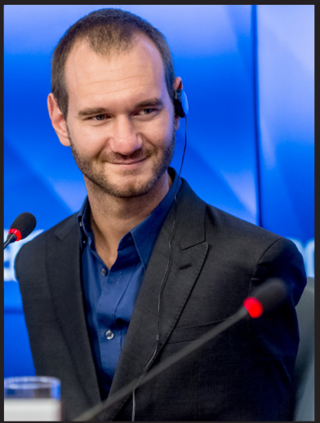
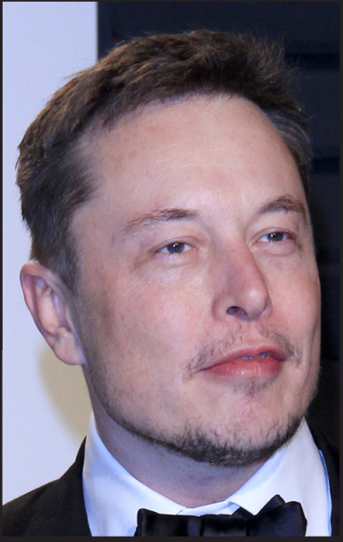
In pairs: Look at the pictures. Do you know these people and what they have done? Do you think they are inspiring? What do you think makes a person inspiring?

Slide 6
Suggested answers:
• First picture: Nick Vujicic. He was born with no arms and just two small feet, but he overcame his physical challenges. • Second picture: Taylor Swift. She's won lots of awards for her music and inspired millions of young girls around the world. • Third picture: Elon Musk. He's started several important tech companies. • Things that make people inspiring: being the first to do something, putting others before themselves, doing something people didn't believe they could

Slide 8
Pre - listening
How many people are there?
What jobs are they? Can you guess what job each talks about?
Listen to three students talking about inspiring people. Match the student with the person he/she finds inspiring.

Slide 9
While - listening
Listen to three students talking about inspiring people. Match the student with the person he/she finds inspiring.
She was the first woman ever to receive the award. She worked as a scientist
He was the leader of many important battles that led to Vietnam's freedom, including his most famous one, the Battle of Điện Biên Phủ
Bruce Lee. He was a Hong Kong and American martial artist and actor.

Slide 10
Read the statements and underline the key words.
Pre - listening

Slide 11
Read the statements and underline the key words.
While - listening

Slide 12
While - listening
Now, listen and circle True or False.
True
1. Bruce Lee was a martial artist. ________
Carol: Bruce Lee. He was a Hong Kong and American martial artist and actor. He inspired millions of people with his ideas. He believed that people should always improve themselves, believe in themselves, and aim to achieve great things.

Slide 13
While - listening
Now, listen and circle True or False.
2. Bruce Lee believed people should aim to do great things. ________
True
Carol: Bruce Lee. He was a Hong Kong and American martial artist and actor. He inspired millions of people with his ideas. He believed that people should always improve themselves, believe in themselves, and aim to achieve great things.

Slide 14
While - listening
Now, listen and circle True or False.
False
3. Marie Curie won the Nobel Prize three times. ________
Carol: She's the woman who won the Nobel Prize twice, right? Andy: Yeah, that's right. She was the first woman ever to receive the award. She worked as a scientist when very few women did. Men didn't treat her well, but she worked hard and found things that helped us all understand things better.

Slide 15
While - listening
Now, listen and circle True or False.
4. Marie Curie inspired more women to work as scientists. ________
True
Carol: She's the woman who won the Nobel Prize twice, right? Andy: Yeah, that's right. She was the first woman ever to receive the award. She worked as a scientist when very few women did. Men didn't treat her well, but she worked hard and found things that helped us all understand things better.
Carol: Wow. I didn't know that. Andy: She has inspired so many other women to work in science.

Slide 16
While - listening
Now, listen and circle True or False.
5. General Võ Nguyên Giáp built the Vietnamese army from only 54 soldiers to over a million. ________
False
Amanda: He really was. He built the Vietnamese army from only thirty-four soldiers to over a million. He was the leader of many important battles that led to Vietnam's freedom, including his most famous one, the Battle of Điện Biên Phủ. I want to be a great leader like him when I'm older.

Slide 17
While - listening
Now, listen and circle True or False.
6. Amanda wants to be a scientist when she gets older. ________
False
Amanda: He really was. He built the Vietnamese army from only thirty-four soldiers to over a million. He was the leader of many important battles that led to Vietnam's freedom, including his most famous one, the Battle of Điện Biên Phủ. I want to be a great leader like him when I'm older.

Slide 18
Script:
Narrator: Listen to three students talking about inspiring people. Andy: Hey, Carol, who are you going to write about for the assignment about inspiring people? Carol: Bruce Lee. He was a Hong Kong and American martial artist and actor. He inspired millions of people with his ideas. He believed that people should always improve themselves, believe in themselves, and aim to achieve great things. Amanda: Wow. He does sound inspiring. Carol: Yeah. He also had a big impact on popular culture. He inspired many other people to start doing martial arts as well as some other sports.

Slide 19
Script:
Amanda: What about you, Andy? Andy: Marie Curie Carol: She's the woman who won the Nobel Prize twice, right? Andy: Yeah, that's right. She was the first woman ever to receive the award. She worked as a scientist when very few women did. Men didn't treat her well, but she worked hard and found things that helped us all understand things better. Carol: Wow. I didn't know that. Andy: She has inspired so many other women to work in science.

Slide 20
Script:
Carol: Great. Who are you going to write about, Amanda? Amanda: I'm going to write about General Võ Nguyên Giáp. Carol: Who's he? Amanda: He was a Vietnamese man who fought very hard to help win control of Vietnam. Andy: Cool. Amanda: He really was. He built the Vietnamese army from only thirty-four soldiers to over a million. He was the leader of many important battles that led to Vietnam's freedom, including his most famous one, the Battle of Điện Biên Phủ. I want to be a great leader like him when I'm older.

Slide 21
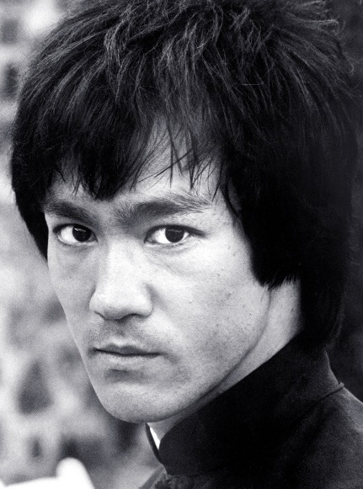
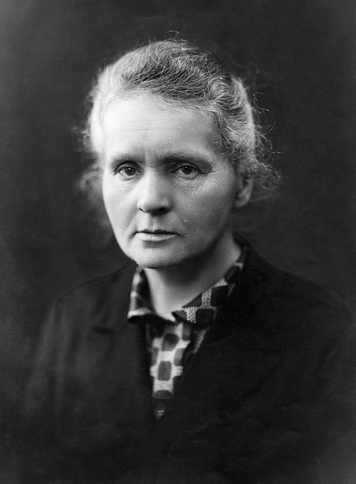
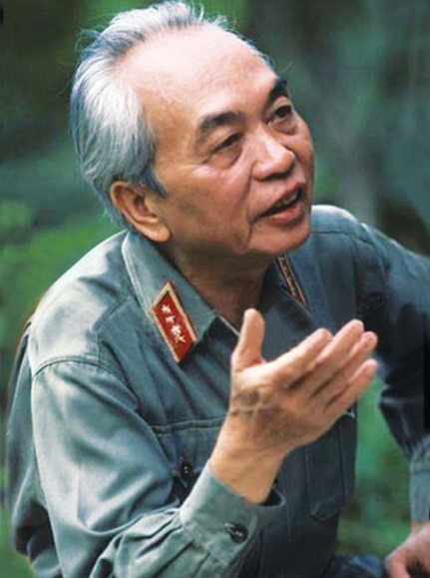
In pairs: Do you think the people in the pictures and the Listening are inspiring? Who do you find the most inspiring?
Post - listening
Nick Vujicic
Taylor Swift
Elon Musk
Bruce Lee
Marie Curie
Võ Nguyên Giáp

Slide 23
Pre - reading
Read the biography about Nellie Bly. What can be said about her? Choose the correct answer.
Read the statements and underline the key words.
1. She was a brave woman who changed her field and the world.
2. She was a highly successful woman who was inspired by other women.

Slide 24
While - reading
Listen and read the text to find the answer.
Nellie Bly was an American journalist, best known for her investigative reporting. She also made the fastest trip around the world.
She was born in 1864 in Pennsylvania, the United States. Her parents named her Elizabeth Jane Cochran. She started her career in 1885 after writing an angry response to an article called What Girls Are Good For in the Pittsburgh Dispatch. They were impressed and gave her a job. In her first article, she argued that not all women needed to get married, and that they should have better opportunities. She then used the name Nellie Bly for the rest of her career.

Slide 25
After leaving the Pittsburgh Dispatch, Nellie was rejected from jobs because newspapers wouldn't hire a woman. She finally got a job at the New York World by agreeing to pretend to be mentally unwell to investigate a mental asylum. Her report exposed the asylum's conditions, and it was forced to improve its patient care. During her career, she wrote about many difficult issues, and most of them are in support of women's lives.

Slide 26
In 1889, inspired by Jules Verne's novel Around the World in Eighty Days, she took a trip around the world. The idea was rejected by her newspaper at first because "no one but a man can do this", but finally her editor agreed. She traveled alone for most of it, an unusual thing for women to do at the time. She actually met Jules Verne in France and completed the trip after 72 days, setting a world record.
In her later years, Nellie Bly returned to journalism. She wrote reports about World War I and problems that impacted women. Nellie Bly died in 1922 at the age of 57. Her life has inspired dozens of movies, TV series, and books.

Slide 27
While - reading
Read the biography about Nellie Bly. What can be said about her? Choose the correct answer.
1. She was a brave woman who changed her field and the world.
2. She was a highly successful woman who was inspired by other women.

Slide 28
Vocab in context
Can you guess the meaning of the words in bold in the reading text?
Read the text again and find their meanings.

Slide 29
Match the bold words in the text with their definitions.
Vocab in context
investigative | impress | reject | expose | asylum
asylum
investigate
impress
reject
expose

Slide 30
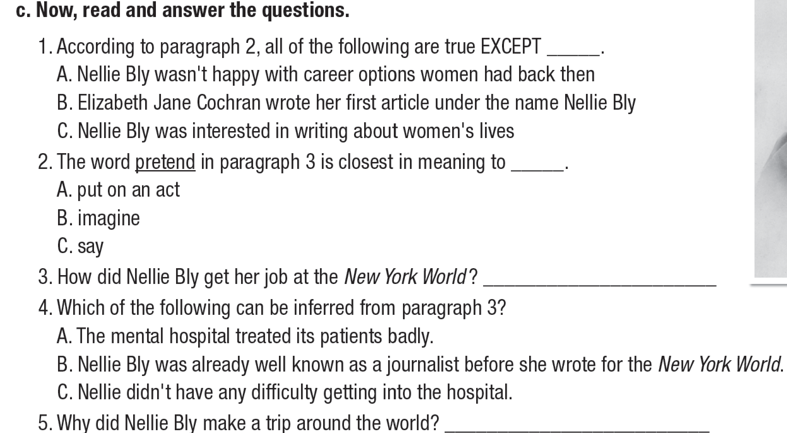

Slide 31
Read the questions and underline the key words.
Pre - reading
1. According to paragraph 2, all of the following are true EXCEPT _____. A. Nellie Bly wasn't happy with career options women had back then.
B. Elizabeth Jane Cochran wrote her first article under the name Nellie Bly.
C. Nellie Bly was interested in writing about women's lives.

Slide 32
Read the questions and underline the key words.
Pre - reading
2. The word pretend in paragraph 3 is closest in meaning to ____. A. put on an act B. imagine C. say

Slide 33
Read the questions and underline the key words.
Pre - reading
3. How did Nellie Bly get her job at the New York World ?
4. Which of the following can be inferred from paragraph 3? A. The mental hospital treated its patients badly. B. Nellie Bly was already well known as a journalist before
she wrote for the New York World. C. Nellie didn't have any difficulty getting into the hospital.
5. Why did Nellie Bly make a trip around the world? ____

Slide 34
While - reading
Now, read and answer the questions.
Nellie Bly was an American journalist, best known for her investigative reporting. She also made the fastest trip around the world.
She was born in 1864 in Pennsylvania, the United States. Her parents named her Elizabeth Jane Cochran. She started her career in 1885 after writing an angry response to an article called What Girls Are Good For in the Pittsburgh Dispatch. They were impressed and gave her a job. In her first article, she argued that not all women needed to get married, and that they should have better opportunities. She then used the name Nellie Bly for the rest of her career.
1. According to paragraph 2, all of the following are true EXCEPT _____. A. Nellie Bly wasn't happy with career options women had back then.
B. Elizabeth Jane Cochran wrote her first article under the name Nellie Bly.
C. Nellie Bly was interested in writing about women's lives.

Slide 35
While - reading
Now, read and answer the questions.
After leaving the Pittsburgh Dispatch, Nellie was rejected from jobs because newspapers wouldn't hire a woman. She finally got a job at the New York World by agreeing to pretend to be mentally unwell to investigate a mental asylum. Her report exposed the asylum's conditions, and it was forced to improve its patient care. During her career, she wrote about many difficult issues, and most of them are in support of women's lives.
2. The word pretend in paragraph 3 is closest in meaning to ____. A. put on an act B. imagine C. say

Slide 36
While - reading
Now, read and answer the questions.
After leaving the Pittsburgh Dispatch, Nellie was rejected from jobs because newspapers wouldn't hire a woman. She finally got a job at the New York World by agreeing to pretend to be mentally unwell to investigate a mental asylum. Her report exposed the asylum's conditions, and it was forced to improve its patient care. During her career, she wrote about many difficult issues, and most of them are in support of women's lives.
3. How did Nellie Bly get her job at the New York World ? _________________________________________________________________
by agreeing to pretend to be a mentally unwell to investigate a mental asylum.

Slide 37
While - reading
Now, read and answer the questions.
After leaving the Pittsburgh Dispatch, Nellie was rejected from jobs because newspapers wouldn't hire a woman. She finally got a job at the New York World by agreeing to pretend to be mentally unwell to investigate a mental asylum. Her report exposed the asylum's conditions, and it was forced to improve its patient care. During her career, she wrote about many difficult issues, and most of them are in support of women's lives.
4. Which of the following can be inferred from paragraph 3? A. The mental hospital treated its patients badly. B. Nellie Bly was already well known as a journalist before she wrote for the New York World. C. Nellie didn't have any difficulty getting into the hospital.

Slide 38
While - reading
Now, read and answer the questions.
In 1889, inspired by Jules Verne's novel Around the World in Eighty Days, she took a trip around the world. The idea was rejected by her newspaper at first because "no one but a man can do this", but finally her editor agreed. She traveled alone for most of it, an unusual thing for women to do at the time. She actually met Jules Verne in France and completed the trip after 72 days, setting a world record.
5. Why did Nellie Bly make a trip around the world? _________________________________________________________________
➔ She was inspired by Jules Verne's novel Around the World in Eighty Days.

Slide 39
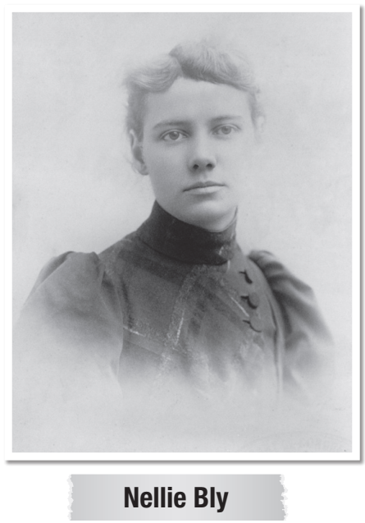
Post - reading
Work in pairs
What do you think about Nellie Bly?
Suggested answer:
Bly was not an individual who would speak before her actions, but she was a strong woman who sought to achieve her hopes and goals.

Slide 40
CONSOLIDATION

Slide 41
WRAP-UP

Slide 42
Today’s lesson
Listening & Reading
- practice listening and reading for gist and specific information.
Speaking:
- talk about what you think about Nellie Bly

Slide 43
Homework
Learn by heart new vocabularies in the reading text and make sentences using them.
Do the exercises on page 6 WB.
Prepare the next lesson (Speaking & Writing pages 13 & 14 SB)
Play the consolidation games on www.eduhome.com.vn

Slide 44
Lesson 3
Stay positive and have a nice day!

