Slide 1
Unit 1: Life Stories
Lesson 2.2: Grammar
Pages: 9 & 10

Slide 2
Lesson Outline
Warm-up
Presentation
Practice
Production
Wrap-up

Slide 3
By the end of this lesson, students will be able to…
- practice and use Adverbial clauses of manner (like, as if, as though) correctly.

Slide 4
WARM-UP

Slide 5
PRESENTATION

Slide 6
Watch the short video and study the example
The baby acts as if/ as though she was crying.
The dad acts as if/ as though he didn’t care the baby.

Slide 7
The cat acts as if/ as though she was/ were the chicks’ mother.
The hen acts as if/ as though nothing happened.

Slide 8
The baby acts as if/ as though she was/ were crying.
The dad acts as if/ as though he didn’t care the baby.
The cat acts as if/ as though she was/ were the chicks’ mother.
The hen acts as if/ as though nothing happened.
……… as if / as though + S + past subjunctive
……… as if / as though + S + ?

Slide 9
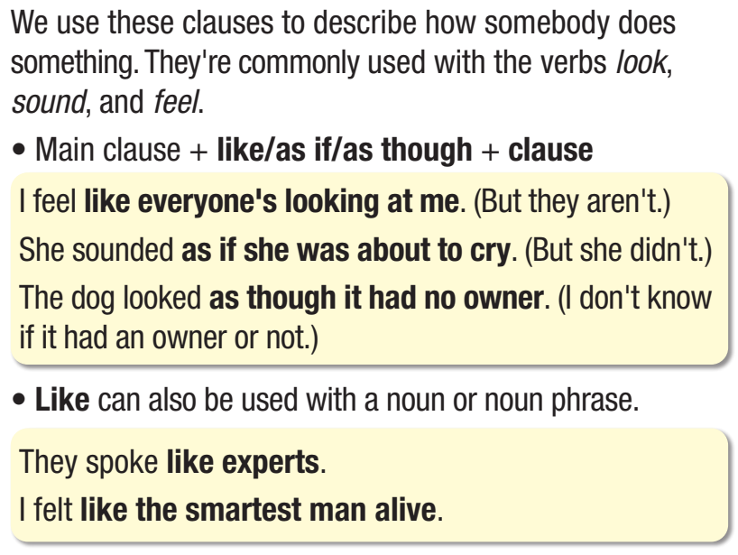

Slide 10
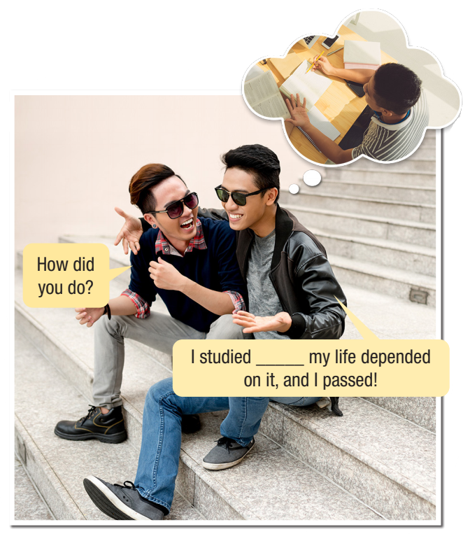
as if

Slide 13
PRACTICE

Slide 14
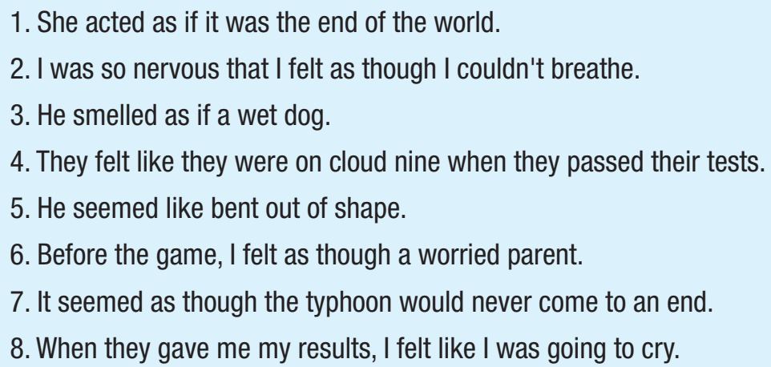
✓
➔ unreal idea
✓
➔ unreal idea
✓
➔ unreal idea
✓
➔ unreal idea

Slide 15
Extra practice
WB – p5
a. Fill in the blanks with the correct form of the verbs in brackets.
1. Tony acts as though winning the prize ___________ (be) beyond his wildest dreams. 2. He spends money as if he ___________ (be) the richest man alive. (But he isn’t.) 3. She looks as though she ___________ (have) the answer. (Perhaps she does.)
was
was/ were
has

Slide 16
Extra practice
WB – p5
a. Fill in the blanks with the correct form of the verbs in brackets.
4. It seemed as though they ___________ (not like) my presentation, and I felt like it was the end of the world. 5. John acts as if he ___________ (know) everyone. (But he doesn’t.)
didn’t like
knew

Slide 17
Extra practice
WB – p5
b. Write sentences using as if, as though, like and the prompts.
1. I had a very important exam next week. I studied really hard. (life/depend/it) I studied _________________________________________
2. We won the game last night. We were all extremely happy. (make/us/feel/on cloud nine) Winning __________________________________________ _________________________________________
as if/as though/like my life depended on it.
the game last night made us feel as if/as though/ like we were on cloud nine.

Slide 18
3. John joined the drama club, but he felt so uncomfortable. (fish out of water) John felt _________________________________________ ____________
4. I think someone made Jenny very angry.
(bent out of shape) Jenny looked ______________________________________ _________________
like a fish out of water when he joined the drama club.
as if/as though/like she was/got bent out of shape.

Slide 19
5. When I taught my little brother math, he pretended he didn’t understand. (not/wrap/head/around it) My little brother acted _____________________________ ________________________________________________
6. Sarah speaks fluent French. (native French speaker) Sarah speaks French ______________________________
as if/as though he couldn’t wrap his head around it when I taught him math.
like a native French speaker.

Slide 20
1. She looked nervous.| as though/butterflies/in/stomach
➔ She looked as though she had butterflies in her stomach.
2. I felt really smart. | like/be/smartest student/at school
➔ I felt like I was the smartest student at school.

Slide 21
3. He studied hard. | as if/life/depend/it
➔ He studied hard as if his life depended on it.
4. They act really smart. | as though/they/be/experts (perhaps they're experts)
➔ They act as though they're/they are experts.

Slide 22
5. He looks scared. | as if/see/a ghost (but he didn't see any ghosts)
➔ He looks as if he saw a ghost.

Slide 23
PRODUCTION

Slide 24
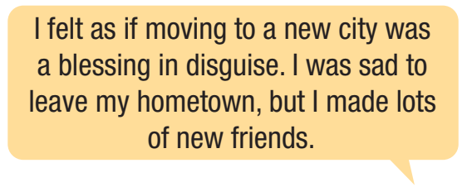

Slide 25
Suggested answers:
2. Winning the lottery made me feel as if I was the richest person alive. I shopped as if my life depended on it. 3. I lost my wallet and felt as if it was the end of the world. But then my friend found it.

Slide 26
Suggested answers:
4. When I argued with my friend, I felt like I got bent out of shape. I said some mean things. 5. I felt like I had butterflies in my stomach when I didn’t prepare for a presentation. 6. I felt like I was on cloud nine when I got a perfect score. I celebrated by going out to lunch.

Slide 27
WRAP-UP

Slide 28
Today’s lesson
Grammar
Adverbial clauses of manner (like, as if, as though)

Slide 29
Today’s lesson
Grammar:
practice and use Adverbial clauses of manner (like, as if, as though) correctly.
Speaking:
- practice making sentences, using Adverbial clauses of manner (like, as if, as though)

Slide 30
Homework
Review Adverbial clauses of manner (like, as if, as though) and make sentences using them.
Do the exercises on page 5 WB.
Prepare the next lesson (Pronunciation & Speaking pages 10 & 11 SB)
Play the consolidation games on www.eduhome.com.vn

Slide 31
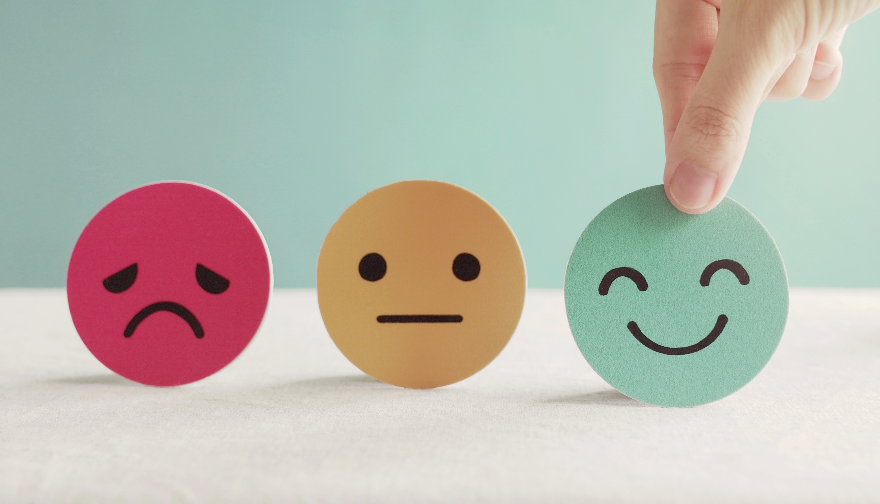
Lesson 3
Stay positive and have a nice day!

