Slide 1
Unit 1: Life Stories
Lesson 2.1: Vocab & Listening
Pages: 8 & 9

Slide 2
Lesson Outline
Warm-up
Vocabulary
Listening
Consolidation
Wrap-up

Slide 3
By the end of this lesson, students will be able to…
- learn and use idioms related to life stories.
- practice listening for the main idea and specific information.
- learn and practice functional English (Introducing a story).

Slide 4
WARM-UP

Slide 6
Suggested answers
The woman is happy. She's holding the key of her new e-bike.
The family is happy. There's a new baby in the family.
Situations or events that would make me happy: getting good grades, getting a gift, making new friends, traveling to a new place

Slide 8
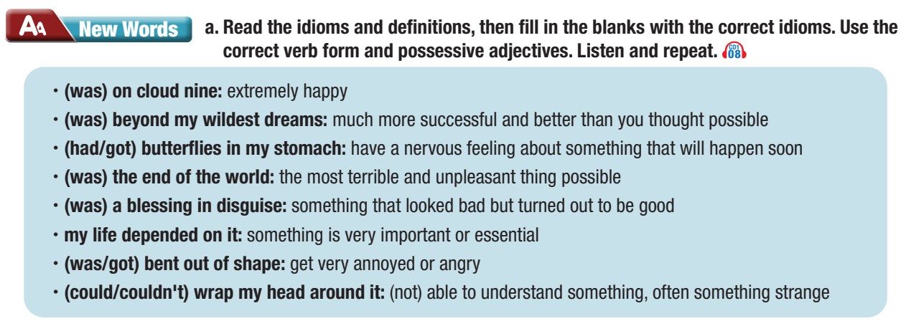

Slide 9
1. That test was so difficult. I __________________________ at all.
couldn’t wrap my head around it
was on cloud nine
2. I ________________ after I passed my university entrance exam.
was/got bent out of shape
3. I _______________________ when my sister used my phone without asking.
4. Having the chance to study abroad in Australia __________ _________________. I couldn't believe it happened to me.
was beyond my wildest dreams

Slide 10
5. I had to stay late at school yesterday, but it _____________ ____________ because I made a new friend.
was a blessing in disguise
6. When I heard my mom scream, I ran upstairs like ________ _______________.
my life depended on it
7. Right before I gave my presentation, I felt like I __________ ______________________.
had/got butterflies in my stomach
8. I forgot my wallet at home, but it wasn't _______________ _______. My friend let me borrow some money
the end of the world

Slide 11
Now, listen and repeat.
couldn’t wrap my head around it
was on cloud nine
was/got bent out of shape
was beyond my wildest dreams
was a blessing in disguise
my life depended on it
had/got butterflies in my stomach
the end of the world
Notes:
GV click vào cụm từ để mở file âm thanh

Slide 12
Listen and repeat. Practice saying them with a partner.
was on the cloud nine (idiom)
/wɒz ɑːn klaʊd naɪn/ vui sướng tột độ
was beyond my wildest dreams (idiom)
/ wɒz bɪˈjɑːnd maɪ ˈwaɪldɪst driːm/có mơ cũng không dám nghĩ tới
had/got butterflies in my stomach (idiom)
/hæd/ɡɒt ˈbʌtərˌflaɪz ɪn maɪ ˈstʌmək/ hồi hộp, lo lắng
the end of the world (idiom)
/ðiː end əv ðə wɜːrld/ giống như tận thế
Notes:
GV click vào từng cụm nghe âm thanh

Slide 13
was a blessing in disguise (idiom)
/ wɒz ə ˈblesɪŋ ɪn dɪsˈɡaɪz/ trong cái rủi có cái may
(was/got) bent out of shape (idiom)
/ wɒz /ɡɒt bent aʊt əv ʃeɪp/ rất tức giận hoặc buồn
my life depended on it (idiom)
/wʌnz laɪf dɪˈpendɪd ɑːn ɪt/bán sống bán chết (cố gắng hết sức)
couldn’t wrap my head around it (idiom)
/ˈkʊd.ənt ræp maɪ hed əˈraʊnd ɪt/ có/không thể hiểu hoặc chấp nhận điều gì
Notes:
GV click vào từng cụm nghe âm thanh

Slide 14
Extra practice WB p.4
a. Match the phrases to the definitions.

Slide 15
Suggested answers
look/feel like a million bucks
➔ to look/feel extremely good đáng giá nghìn vàng
cost an arm and a leg
➔ to cost/pay a lot of money đắt như cắt cổ
a piece of cake
➔ easy dễ như ăn bánh (rất dễ)

Slide 16
Suggested answers
go round in circles
➔ to work hard at or discuss something without making any progress vòng vo, phí thời gian, công sức vào việc vô bổ
a fish out of water
➔ a person who feels uncomfortable because they are in an environment that is not familiar cá mắc cạn (không thoải mái)

Slide 17
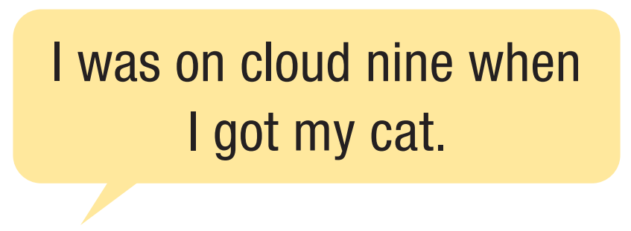

Slide 19
Pre - listening
You will hear a girl talking about a presentation she did. What feelings do you think the girl will mention? Circle three.

Slide 20
While - listening
b. Now, listen and put the feelings she mentions in the order you hear. Write a number on the line. How many feelings did you guess correctly?
3
1
2
Alice: When I got my score, I was so happy. I felt like I was on cloud nine!
Alice: I prepared as if my life depended on it, but I still had butterflies in my stomach this morning.
Alice: Once I finished my introduction, I was really confident, actually.

Slide 21
c. Listen again and fill in the blanks with no more than four words.
Pre - listening
Read the statements and guess what type of words are missing. Are they verbs?/ nouns? / adjectives? etc…?
1. Mr. Stevens thought it looked as though Alice __________ _________ for her presentation.
verb
2. Alice tells Bob she felt like she _______________ when she got her score.
verb
verb
3. Alice had to _______, but she wanted to _______.
verb

Slide 22
Pre - listening
c. Listen again and fill in the blanks with no more than four words.
4. Bob thinks it's important not to get bent out of shape when __________________.
clause
5. Alice tells Bob about the presentation because Bob helped Alice _______________.
verb

Slide 23
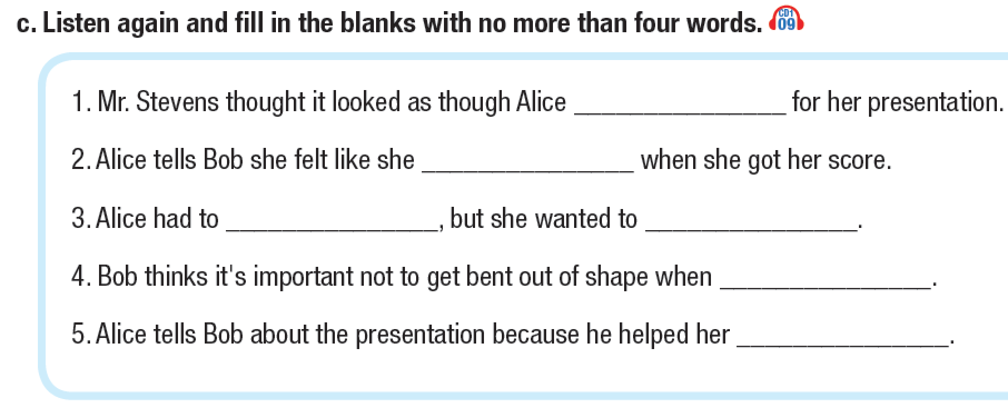
Pre - listening
How many words are we allowed to write in each blank?

Slide 24
While - listening
Listen and fill in the blanks.

Slide 25
While - listening
c. Listen again and fill in the blanks with no more than four words.
1. Mr. Stevens thought it looked as though Alice __________ _________ for her presentation.
practiced really hard
2. Alice tells Bob she felt like she _______________ when she got her score.
was on cloud nine
go last
3. Alice had to _______, but she wanted to _______.
go first

Slide 26
While - listening
c. Listen again and fill in the blanks with no more than four words.
4. Bob thinks it's important not to get bent out of shape when __________________.
little things go wrong
5. Alice tells Bob about the presentation because Bob helped Alice _______________.
choose her topic

Slide 27
Script:
Mr. Stevens: Congratulations, Alice. You looked as though you practiced really hard for your presentation. I'm giving you a nine. Alice: Really? Thanks so much, Mr. Stevens. Mr. Stevens: Congratulations again, and have a nice weekend.
Alice: Thanks. You too.
Alice: Hey, Bob. You're not going to believe it, but I did great on my presentation! When I got my score, I was so happy. I felt like I was on cloud nine!

Slide 28
Bob: Nice! I guess you're not scared of speaking in front of people anymore, huh? Alice: Haha. I'm not sure about that. All week, I prepared as if my life depended on it, but I still had butterflies in my stomach this morning. Bob: I'm sure. So, what happened? Alice: I wanted to go last, but I got called up first. It was a blessing in disguise, though. I didn't have to worry about my classmates doing better before me. Bob: Oh, nice.

Slide 29
Alice: Once I finished my introduction, I was really confident, actually. Then, I thought it was the end of the world when a video didn't play on my laptop, but I just connected my phone to the screen and played the video on it. Bob: Good. It's important not to get bent out of shape when little things go wrong. Alice: Yeah, you're right. Bob: Did you tell your parents? Alice: No, not yet. I wanted to tell you since you helped me choose my topic. I'm going to go home and tell my mom now. See you! Bob: See you!

Slide 30
d. Read the Conversation Skill box, then listen and repeat.
Post - listening

Slide 31
e. Now, listen to the conversation again and circle the phrase you hear.
Post - listening
Alice: Hey, Bob. You're not going to believe it, but I did great on my presentation! When I got my score, I was so happy. I felt like I was on cloud nine!

Slide 32
f. In pairs: What would make you experience the feelings Alice had? Why?
Post - listening
I had the same feelings that Alice had when I had joined in IELTS speaking test.

Slide 33
CONSOLIDATION

Slide 34
WRAP-UP

Slide 35
Today’s lesson
Vocabularies
(be) on cloud nine
(be) beyond (one’s) wildest dreams
(have/get) butterflies in my stomach
(be) the end of the world
(be) a blessing in disguise
my life depended on it
(be) bent out of shape
(could/couldn’t) wrap one’s head around it

Slide 36
Today’s lesson
Vocabulary:
learn and use idioms related to life stories.
Listening:
- practice listening for the main idea and specific information.
Speaking:
- learn and practice functional English (Introducing a story).

Slide 37
Homework
Learn by heart vocabularies, make sentences using them and functional English.
Do the exercises on page 4 WB.
Prepare the next lesson (Grammar pages 9 & 10 SB)
Play the consolidation games on www.eduhome.com.vn

Slide 38
Lesson 3
Stay positive and have a nice day!

