Slide 1
Unit 1: Life Stories
Lesson 1.2: Grammar
Pages: 5 & 6

Slide 2
Lesson Outline
Warm-up
Presentation
Practice
Production
Wrap-up

Slide 3
By the end of this lesson, students will be able to…
- practice and use Past continuous (with while) correctly.

Slide 4
WARM-UP

Slide 5
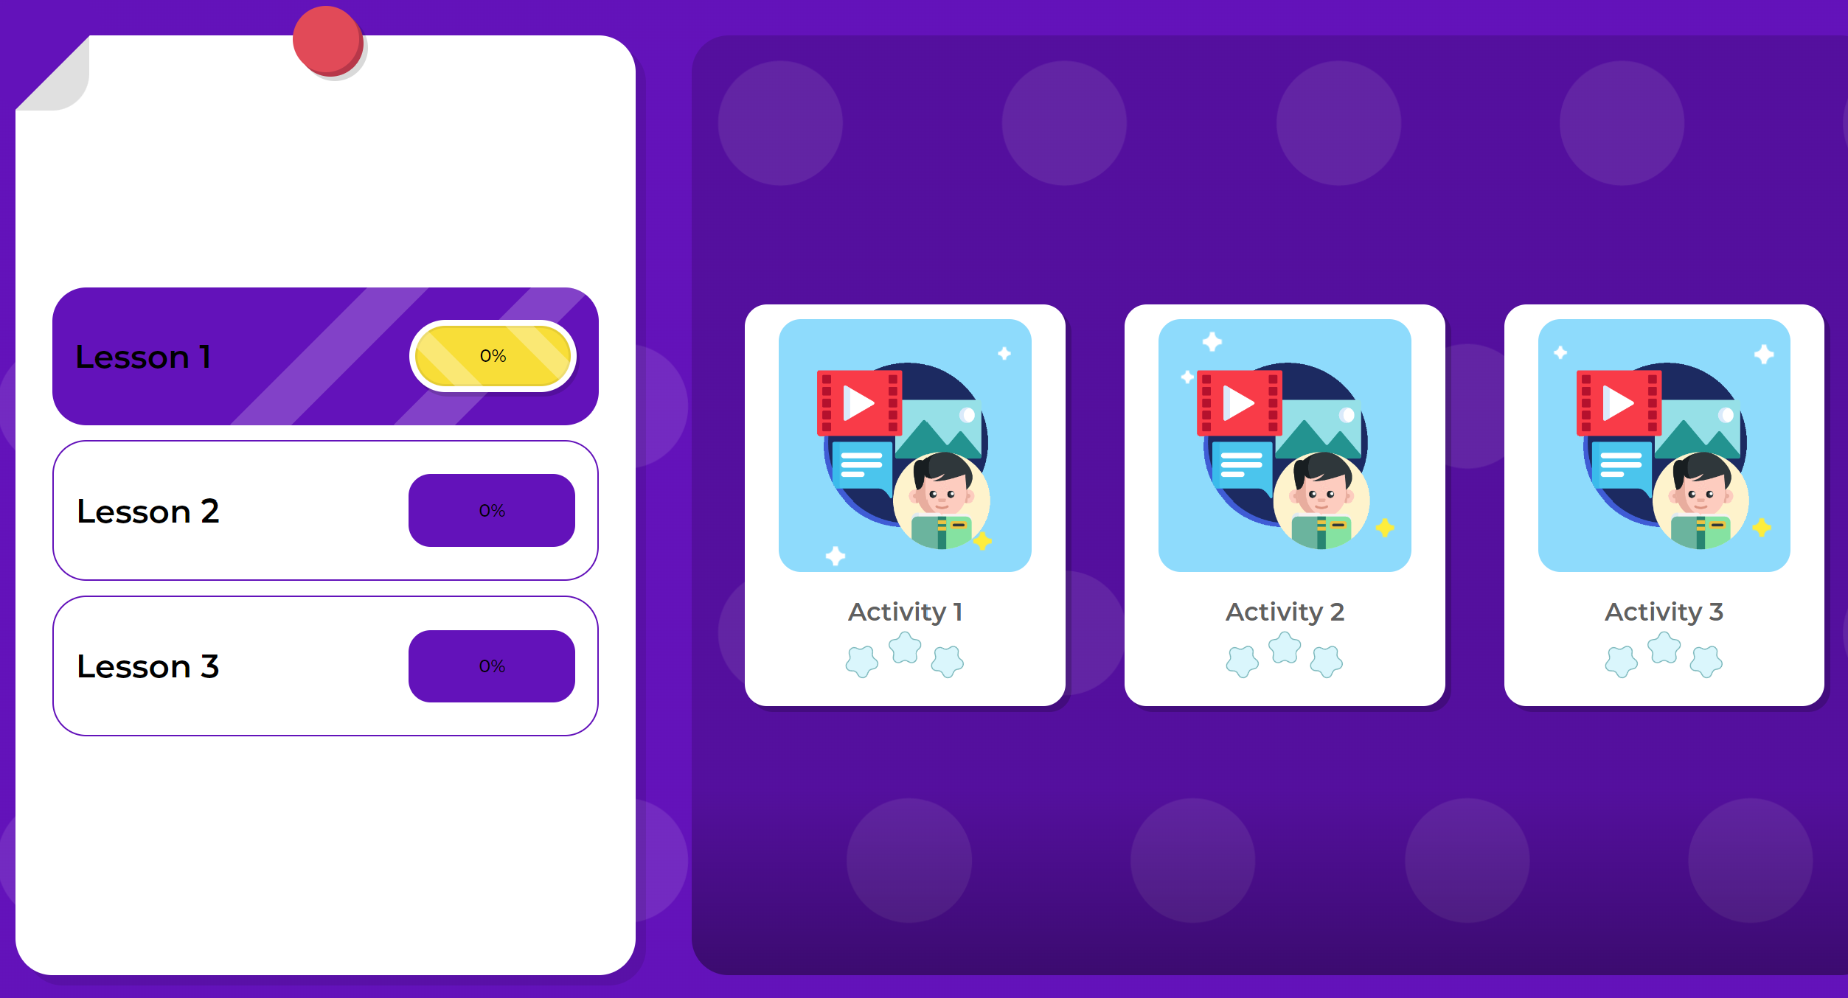
Play the vocabulary game on DHA on Eduhome
https://ln.run/PqWI3

Slide 6
PRESENTATION

Slide 9
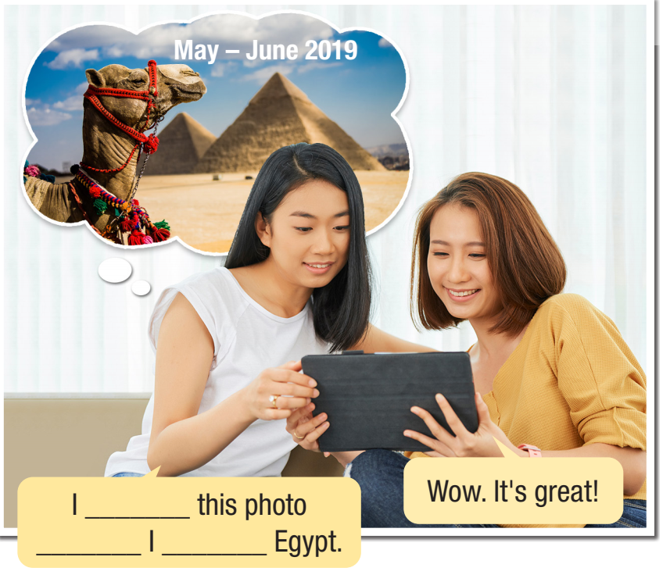
took
while
I _______ this photo ________ I _____________ Egypt.
was visiting

Slide 10
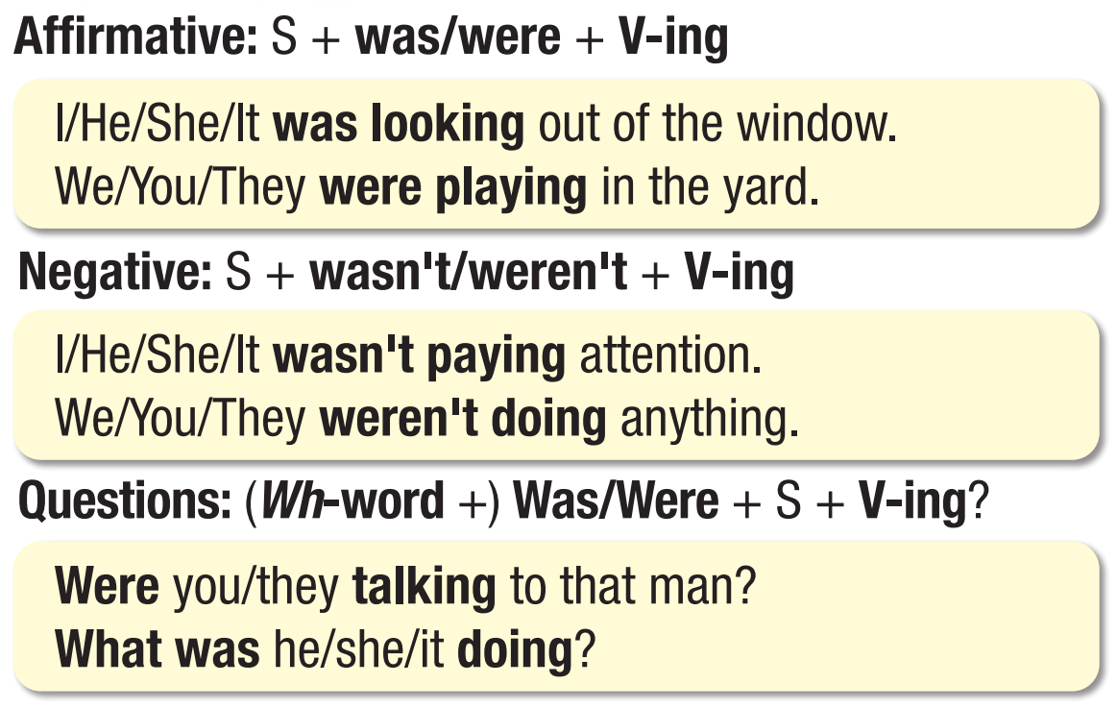

Slide 11
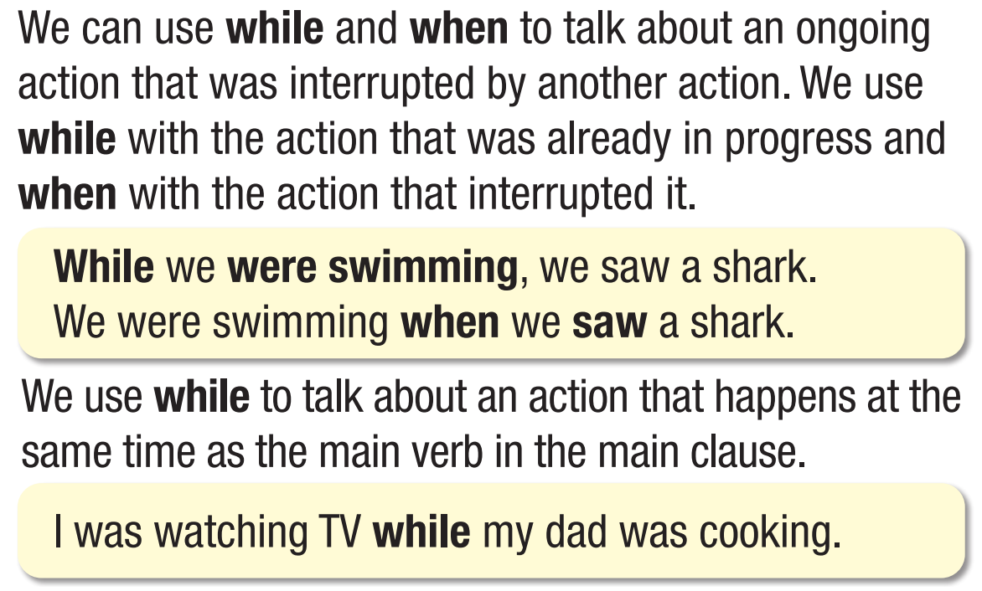

Slide 12
1. One action was happening and another interrupted
When / While + S + was/were + V-ing + O, S + V-ed/ irre. + O
E.g. When/ while we were swimming, we saw a shark.
S + was/were + V-ing + O when S + V-ed/ irre. + O
E.g. We were swimming when we saw a shark.
E.g. We saw a shark when we were swimming.

Slide 13
2.Two action were happening at the same time.
While + S + was/were + V-ing + O, S + was/were + V-ing + O
E.g. While we were swimming, my brother was sleeping.
S + was/were + V-ing + O while S + was/were + V-ing + O
E.g. We were swimming while my brother was sleeping.
3. A past action that was in progress for period of time
E.g. She was waiting for you all yesterday morning

Slide 14
PRACTICE

Slide 15
Our class (1) ____________ (visit) the zoo last week when a funny thing (2) ___________ (happen). At about 9:30 a.m. that day, we (3) _________________ (look) at the gorillas. We (4) _______________ (take) photos when someone saw a snake on the floor. It was my pet snake!
was visiting
happened
were looking
were taking

Slide 16
While I (5) ____________ (get) ready at home that morning, my pet snake (6) ____________ (fall) into my school bag, but I didn’t see it. At the zoo, it (7) _________ (get) out of my bag. I (8) ___________ (pick) up my snake and calmly put it back into my bag. My classmates were all so amazed.
was getting
fell
got
picked

Slide 17
While my teacher (9) ____________ (call) the zookeepers for help, my classmates (10) _____________ (take) selfies with me. Everyone was so grateful and relieved.
was calling
were taking

Slide 18
1. She was traveling in Australia. She saw lots of exciting places. (while)
She saw lots ___________________________________
___________.
of exciting places while she was traveling in Australia
2. I took a photo of my sister. She was swimming in the ocean. (when)
My sister was __________________________________
_____________________.
was swimming in the ocean when I took a photo of her/my sister

Slide 19
3. He was studying in university. He was working in a restaurant. (while)
While_________________________________________
___________.
he was studying in university, he was working in a restaurant
4. He started to feel depressed about his exam results. He was cycling home. (when)
He was ________________________________________
_____________________________.
was cycling home when he started to feel depressed about his exam results

Slide 20
5. The adults were chatting about the news. All the children were playing. (while)
The adults ____________________________________
___________________.
were chatting about the news while all the children were playing

Slide 21
PRODUCTION

Slide 23
Suggested answers:
2. I felt embarrassed while I was giving my presentation. 3. While he was packing to go to university, he was anxious. 4. It started to rain while I was riding my bike home.

Slide 24
a. Fill in the blanks with the correct form of the verbs in brackets.
Extra Practice
WB – P3
1. She ___________ (read) her book while they ___________ (play) outside. 2. ___________ you ___________ (notice) anything strange while you ___________ (live) at their house? 3. They ___________ (hang) out all day yesterday.
was reading
were playing
Did notice
were living
were hanging

Slide 25
4. We ___________ (walk) home when we ___________ (see) a kitten in a parking lot. 5. She ___________ (ride) her bike home when someone ___________ (call) her name. 6. We ___________ (run) home yesterday at 3:30 in the afternoon.
were walking
saw
was riding
called
were running

Slide 26
b. Write sentences using the prompts and when or while.
Extra Practice
WB – P3
1. She/make/lots/new friends – she/study/university ____________________________________________________________ 2. The dog/make/lots/noise – I/try/sleep _____________________________________________________
She made lots of new friends while she was studying in/at university.
The dog was making lots of noise while I was trying to sleep.

Slide 27
3. I/study/math test – mom/ask me/look after/little brother ___________________________________________________________________________________
4. They/make/pizza – the lights/go out
_________________________________________________
I was studying for my math test when my mom asked me to look after my little brother.
They were making pizza when the lights went out.
5. He/do/homework – sister/chat/on the phone _______________________________________________________________
He was doing his homework while his sister was chatting on the phone.

Slide 28
Make sentences using While/ When and Past continuous/ Past simple. Share your sentences with the class.
While I was writing this sentence, some of my classmates were talking.
While I was writing this sentence, my classmate dropped her book on the floor.
While I was writing this sentence, ……………………………..

Slide 29
Complete the half of the sentences using While/ When and Past continuous/ Past simple. Share your sentences with the class.
When my classmate dropped her book on the floor, ……………
While I was writing this sentence, ……………………………..

Slide 30
WRAP-UP

Slide 31
Today’s lesson
Grammar
Past Continuous (with while)

Slide 32
Today’s lesson
Grammar:
practice and use Past Continuous with while
practice and use Simple Past form of verbs
Speaking:
- practice making sentences, using Past Continuous with while

Slide 33
Homework
Review Past Continuous (with while) and make sentences using them.
Do the exercises on page 3 WB.
Prepare the next lesson (Pronunciation & Speaking pages 6 & 7 SB)
Play the consolidation games on www.eduhome.com.vn

Slide 34
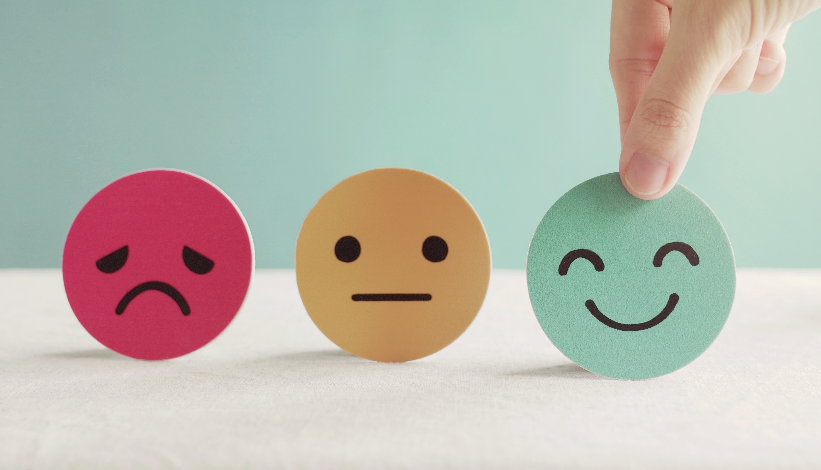
Lesson 3
Stay positive and have a nice day!

