Slide 2
Our toys
17
LESSON 3
Period 6

Slide 3
Content
01
Warm up
02
Read and circle
03
Let’s write
04
Project
05
Fun corner and wrap up

Slide 4
Warm up
1
1
Game: What’s in the box?
4
4

Slide 5
What’s in the box?
Notes:
Game: What’s in the box?
Review the previous lesson by having the class play the game, using the words: kite, plane, doll, train, bus, car, ship
Step 1: Divide class into 4 teams.
Step 2: Set rules: invite 1 pupil go to the board and touch into the monitor, then say aloud the toy. The fastest has one point for your team.
Step 3: Encourage pupil join in the game.
Step 4: Give point for pupils.

Slide 6
trains
i s a t r n
NEXT
Click on the box to check.

Slide 7
car
a c
r
NEXT
Click on the box to check.

Slide 8
kite
t i
k e
NEXT
Click on the box to check.

Slide 9
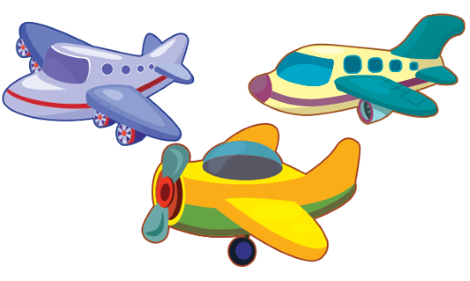
planes
l a p e n s
NEXT
Click on the box to check.

Slide 10
ships
h p i s s
NEXT
Click on the box to check.

Slide 11
teddy bears
t e d
y d s b
e a r
NEXT
Click on the box to check.

Slide 12
Read and circle
2
2

Slide 13
c
b
a
Notes:
Step 1: Draw pupils’ attention to the passage about Linh’s and Lucy’s toys and read it together as a class.
Step 2: Draw pupils’ attention to the pictures showing their toys. Have pupils spot the differences between the pictures (the quantity of toys in each picture). Check comprehension.
Step 3: Get pupils to read and circle the correct letter.
Step 4: Get pupils to swap books with a partner, then check answers together as a class.

Slide 14
c
b
a
Notes:
Step 1: Draw pupils’ attention to the passage about Linh’s and Lucy’s toys and read it together as a class.
Step 2: Draw pupils’ attention to the pictures showing their toys. Have pupils spot the differences between the pictures (the quantity of toys in each picture). Check comprehension.
Step 3: Get pupils to read and circle the correct letter.
Step 4: Get pupils to swap books with a partner, then check answers together as a class.

Slide 15
Let’s write
3
3

Slide 16
Notes:
Step 1: Tell the class the goal of this activity: Pupils read the passage about Lucy’s toys and fill in the gaps.
Step 2: Have pupils fill in the first gap together as an example. Write the first gapped sentence on the board. Ask them to look at the gap and guess what is missing (the word She). Let them write down the word in the gap. Repeat the same procedure with the other incomplete sentences.
Step 3: If time allows, invite a few pupils to read aloud the paragraph they have completed in front of the class. The class observes and praises their work.

Slide 17
1. Lucy is my ____.
a. sister
b. friend

Slide 18
2. She has a ____.
a. car
b. doll

Slide 19
3. Minh is my ____.
a. friend
b. mom

Slide 20
4. He has a ____.
a. plane
b. kites

Slide 21
5. Lucy and Minh are my ____.
a. friend
b. friends

Slide 22
6. They have ____.
A. a plane and a kite
B. a car

Slide 23
Project
5
5

Slide 24
Notes:
Step 1: Elicit the language needed to do the task: He / She has ___. Write it on the board. Ask pupils to repeat it several times
Step 2: Ask pupils to work in groups of six. Ask them to show the paper toys that they have made at home, then tell the group about them. Check comprehension.
Step 3: Give pupils time to do the task. Encourage them to decorate their toys. Go around the classroom to offer help where necessary.
Step 4: Invite some pupils to show and tell the class about the toys they have made using the language learnt. Have pupils display their toys on the classroom walls.
Step 5: If there is not enough time, ask pupils to do the project as homework and check by giving pupils time to share their work in the next lesson.

Slide 25
He has …
Notes:
Step 1: Elicit the language needed to do the task: He / She has ___. Write it on the board. Ask pupils to repeat it several times
Step 2: Ask pupils to work in groups of six. Ask them to show the paper toys that they have made at home, then tell the group about them. Check comprehension.
Step 3: Give pupils time to do the task. Encourage them to decorate their toys. Go around the classroom to offer help where necessary.
Step 4: Invite some pupils to show and tell the class about the toys they have made using the language learnt. Have pupils display their toys on the classroom walls.
Step 5: If there is not enough time, ask pupils to do the project as homework and check by giving pupils time to share their work in the next lesson.

Slide 26
He has two boats.
Notes:
Step 1: Elicit the language needed to do the task: He / She has ___. Write it on the board. Ask pupils to repeat it several times
Step 2: Ask pupils to work in groups of six. Ask them to show the paper toys that they have made at home, then tell the group about them. Check comprehension.
Step 3: Give pupils time to do the task. Encourage them to decorate their toys. Go around the classroom to offer help where necessary.
Step 4: Invite some pupils to show and tell the class about the toys they have made using the language learnt. Have pupils display their toys on the classroom walls.
Step 5: If there is not enough time, ask pupils to do the project as homework and check by giving pupils time to share their work in the next lesson.

Slide 27
She has …
Notes:
Step 1: Elicit the language needed to do the task: He / She has ___. Write it on the board. Ask pupils to repeat it several times
Step 2: Ask pupils to work in groups of six. Ask them to show the paper toys that they have made at home, then tell the group about them. Check comprehension.
Step 3: Give pupils time to do the task. Encourage them to decorate their toys. Go around the classroom to offer help where necessary.
Step 4: Invite some pupils to show and tell the class about the toys they have made using the language learnt. Have pupils display their toys on the classroom walls.
Step 5: If there is not enough time, ask pupils to do the project as homework and check by giving pupils time to share their work in the next lesson.

Slide 28
She has a plane.
Notes:
Step 1: Elicit the language needed to do the task: He / She has ___. Write it on the board. Ask pupils to repeat it several times
Step 2: Ask pupils to work in groups of six. Ask them to show the paper toys that they have made at home, then tell the group about them. Check comprehension.
Step 3: Give pupils time to do the task. Encourage them to decorate their toys. Go around the classroom to offer help where necessary.
Step 4: Invite some pupils to show and tell the class about the toys they have made using the language learnt. Have pupils display their toys on the classroom walls.
Step 5: If there is not enough time, ask pupils to do the project as homework and check by giving pupils time to share their work in the next lesson.

Slide 29
Fun corner and wrap up
5
5

Slide 30
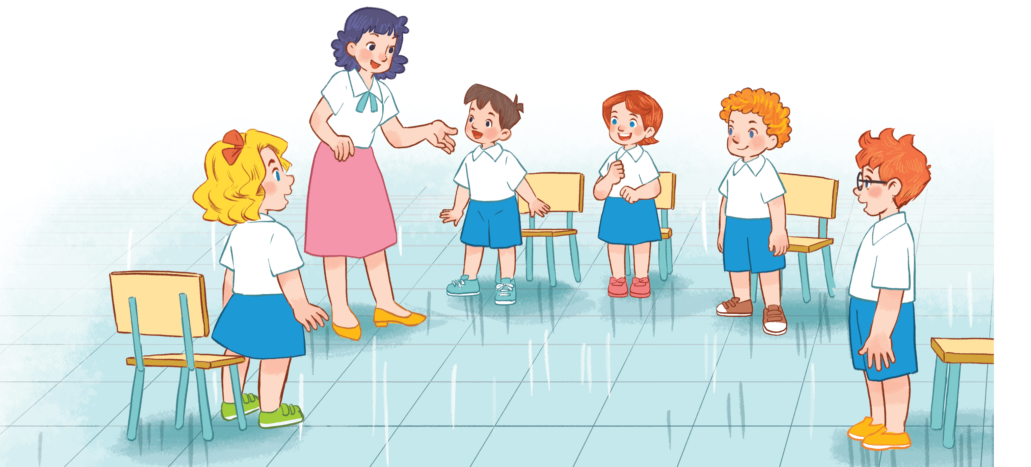
Game time
Look and say!
Notes:
Step 1: Divide class into 4 teams.
Step 2: Set rule: invite 1 pupil from each team look at the picture on the monitor and say aloud 3 times. The fastest have correct answer will have one point for team.
Step 3: Encourage pupils practice speaking English.
Step 4: Give points for pupils.

Slide 31
She has three boats.
She has ….

Slide 32
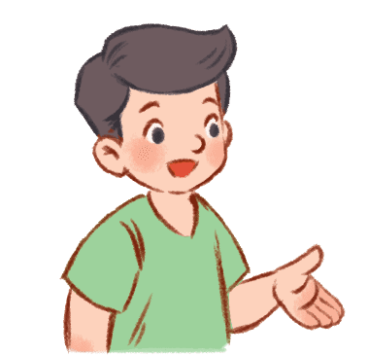
He has ….
He has a car.

Slide 33
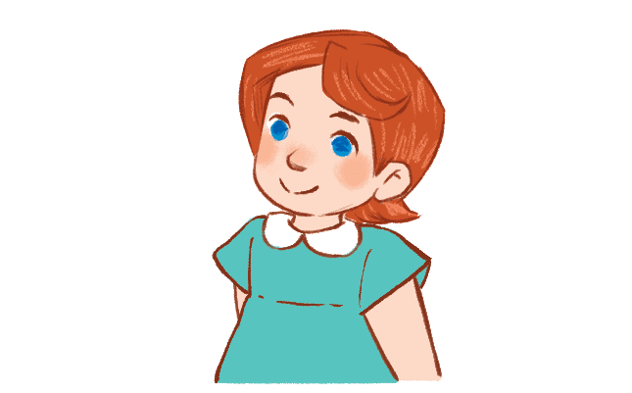
She has ….
She has two teddy bears.

Slide 34
She has two boats.
She has ….

Slide 35
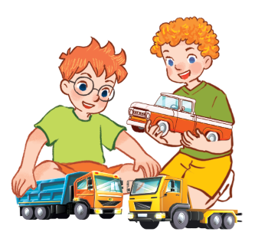
They have…
They have three trucks.

Slide 36
She has a kite.
She has ….

Slide 37
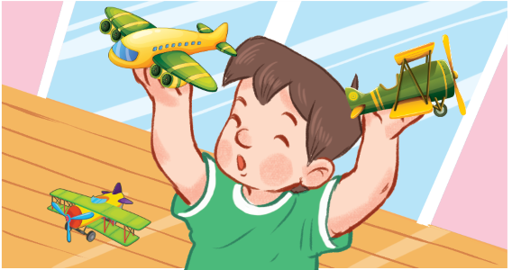
He has three planes.
He has ….

Slide 38
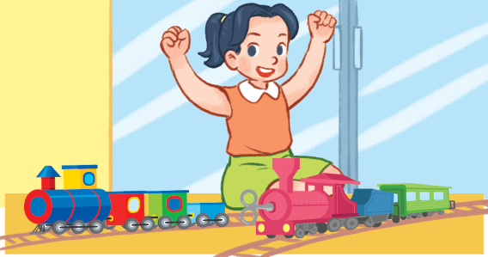
She has two trains.
She has ….

Slide 39
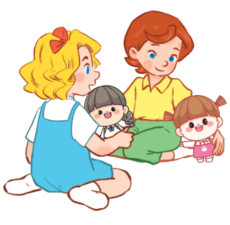
They have two dolls.
They have…

Slide 40
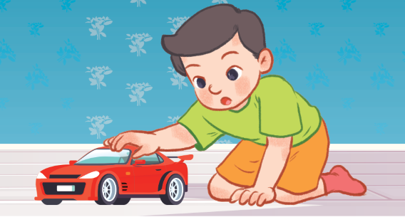
He has ….
He has a car.

Slide 41
Homework
Workbook, page …

Slide 42
THANK YOU

