Slide 1


Slide 2




Our toys
17
LESSON 1
Period 1

Slide 3
Contents
Warm up
Look, listen and repeat
Listen, point and say.
Let’s talk
Fun corner and wrap up
2
1
2
1
3
3
5
4
5
4

Slide 4
Warm up
1
1
Game: Animals quiz

Slide 5
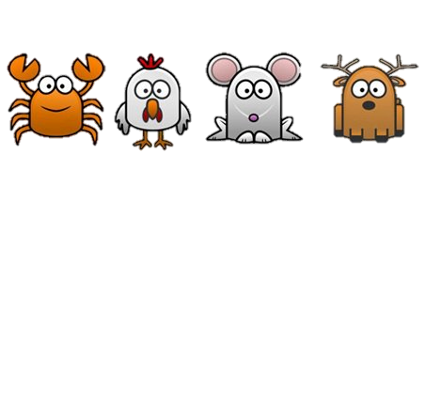
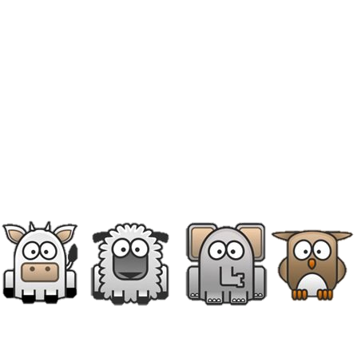

START
Notes:
Step 1: Divide class into 4 teams.
Step 2: Set rules: invite 1 pupil go to the board and touch into the monitor, then say aloud animal. The fastest has one point for your team.
Step 3: Encourage pupil join in the game.
Step 4: Give point for pupils.

Slide 6






Catch the goldfish

Slide 7


Catch the octopus

Slide 8
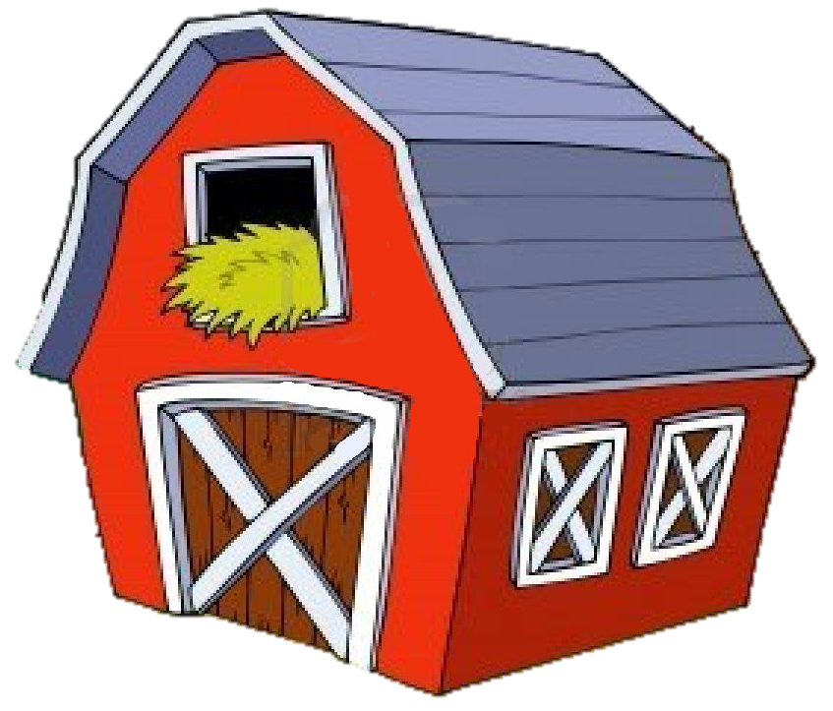

Click on the speaker and guess the animal
a duck
a pig
a hen

Slide 9
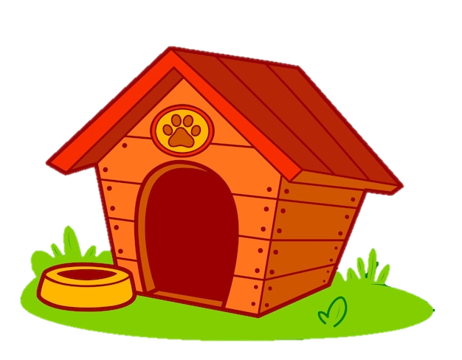

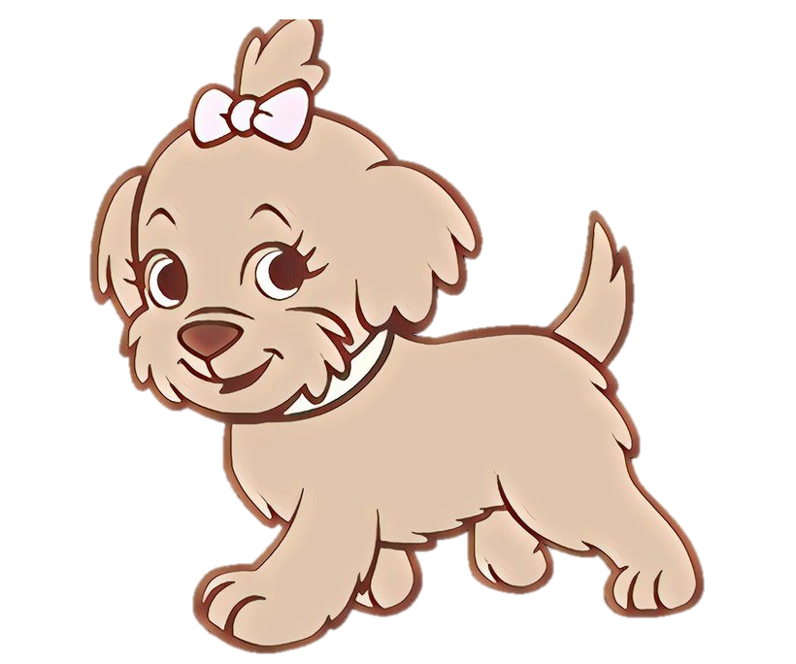
Click on the speaker and guess the animal
a parrot
a chicken
a dog

Slide 10

Click on the speaker and guess the animal
a duck
a turkey
a hen

Slide 11

What animal is this?
It’s an elephant.
CHECK

Slide 12


What animal is this?
It’s a cat.
CHECK

Slide 13

What animal is this?
This is an …
owl
owl
parrot
rabbit
turkey
parakeet
goldfish

Slide 14

What animal is this?
This is a …
fish
shark
fish
dog
rabbit
frog
frog

Slide 15
2
Look, listen and repeat
2
15

Slide 16
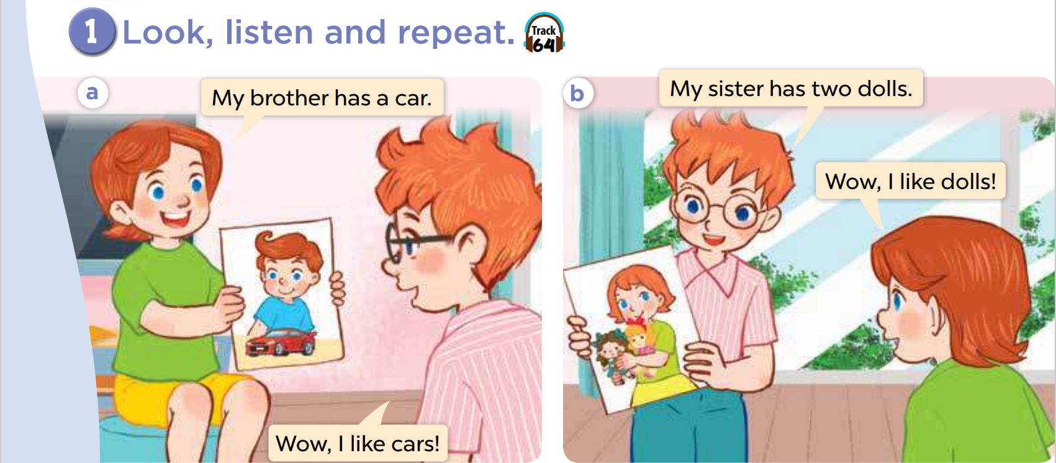
Notes:
Step 1: Have pupils look at Pictures a and b and identify the characters in the pictures.
Step 2: Ask pupils to look at Picture a. Play the recording for them to listen.
Step 3: Play the recording again for pupils to listen and repeat individually and in chorus. Correct their pronunciation where necessary. Repeat the same procedure with Picture b.
Step 4: Invite a few pairs to the front of the classroom to listen to and repeat the sentences in the recording.
Step 5: Draw pupils’ attention to the sentences My brother has a car. / My sister has two dolls. Tell pupils that they are used to identify someone’s toys.

Slide 18
3
Listen, point and say
3
18

Slide 19
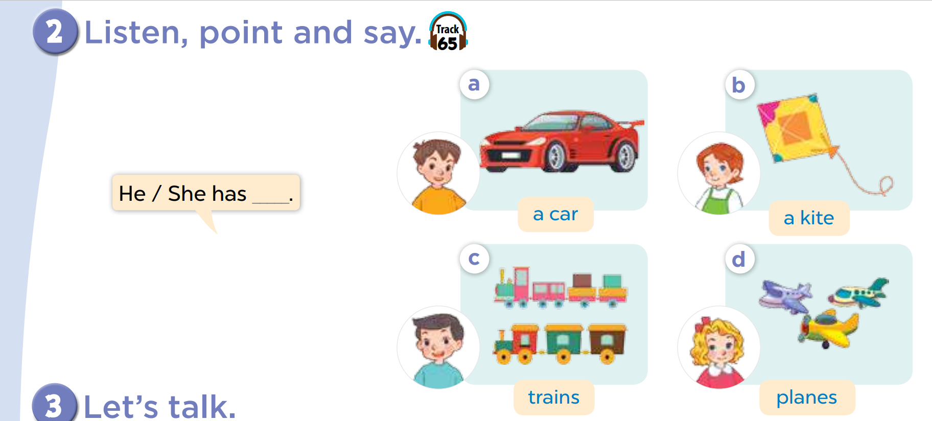
Notes:
Step 1: Draw pupils’ attention to Pictures a to d. Elicit the character and the quantity of toys in each picture. Draw pupils’ attention to the plural form of toys in Pictures c (trains) and d (planes). Check comprehension. Ask pupils to listen to the recording and repeat the words for the toys several times until they feel confident.
Step 2: Put pupils into pairs. Tell them to point at the pictures and say the names for the toys in the pictures.
Step 3: Draw pupils’ attention to the speech bubble. Remind them that He / She has ___. is used to identify someone’s toys. Ask pupils to look at the bubble and Picture a. Play the recording for them to listen to and repeat the sentence several times. Repeat the same procedure with the other three pictures.
Step 4: Get them to talk about someone’s toys using the speech bubble and picture cues. Go around the classroom to offer support.
Step 5: Invite a few pupils to come to the front of the classroom and talk about someone’s toys. If they perform well, praise them.

Slide 20


Slide 21
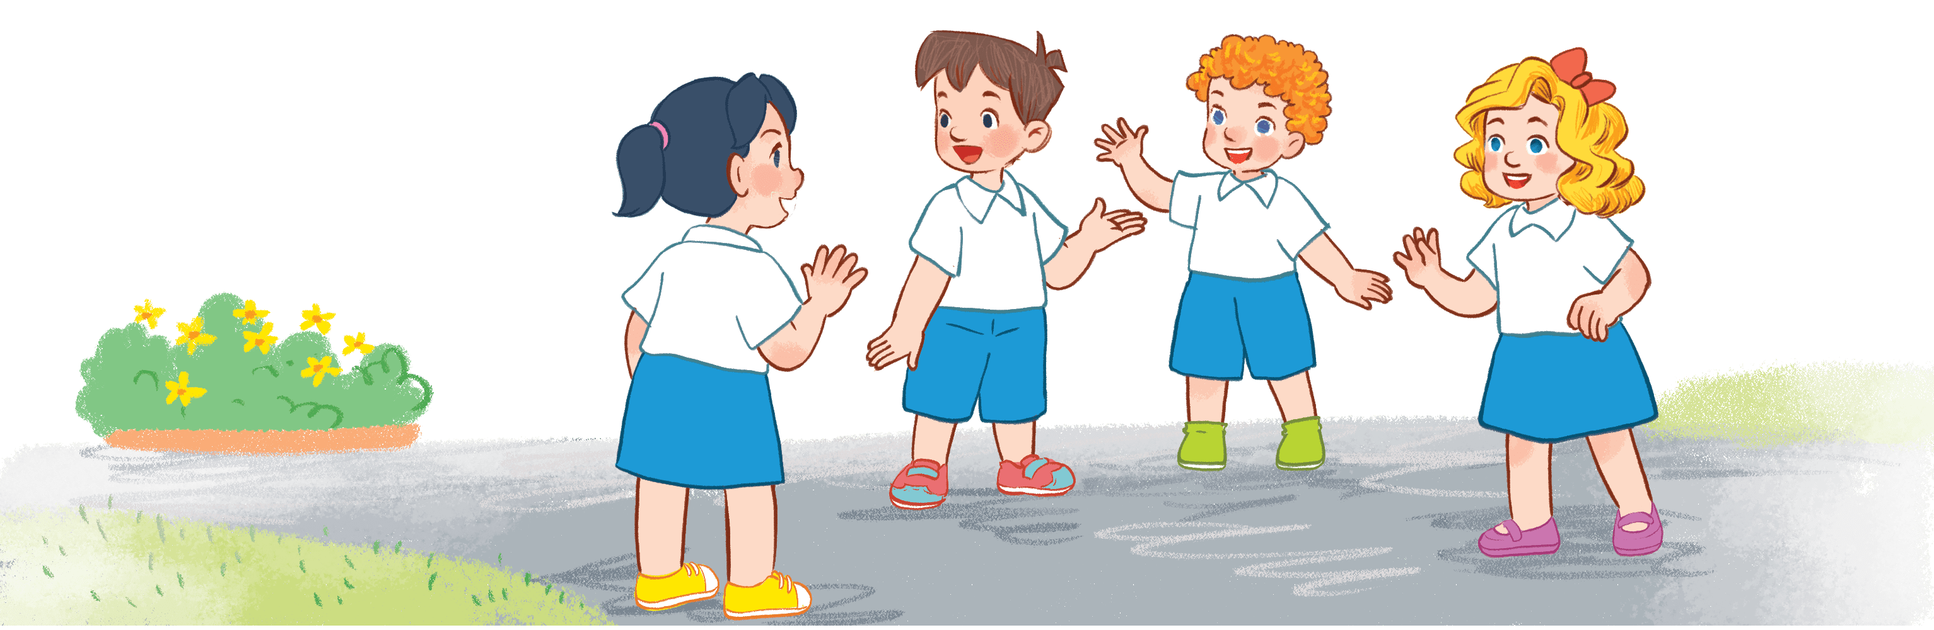
Game time!!!
Listen and choose
Notes:
Step 1: Divide the class into four teams.
Step 2: Invite each pupil from each team go to the board and touch into the monitor. The fastest and have correct answer has one point for team.
Step 3: Encourage pupils take part in the game.
Step 4: Give point for pupils.

Slide 22
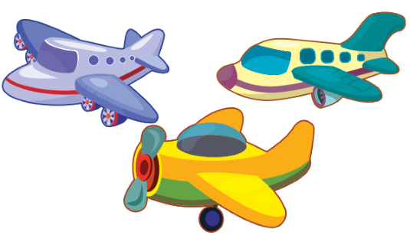

Listen and choose
A
B

Slide 23

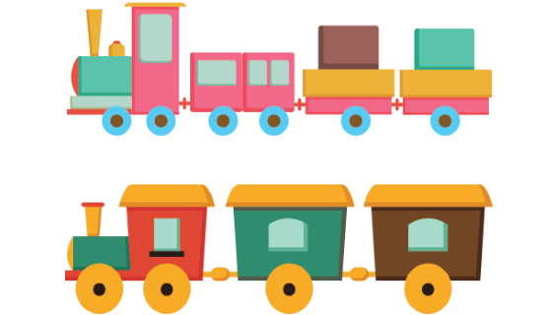
Listen and choose
A
B

Slide 24
Listen and choose
B
A

Slide 25
Listen and choose
A
B

Slide 26
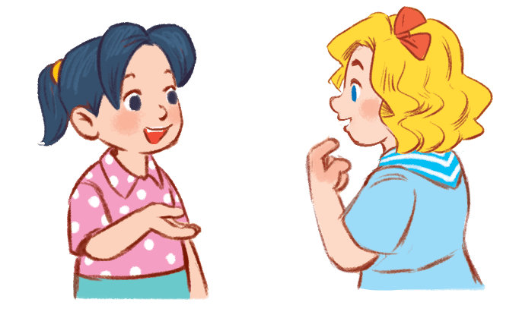
4
Let’s talk
4
26

Slide 27
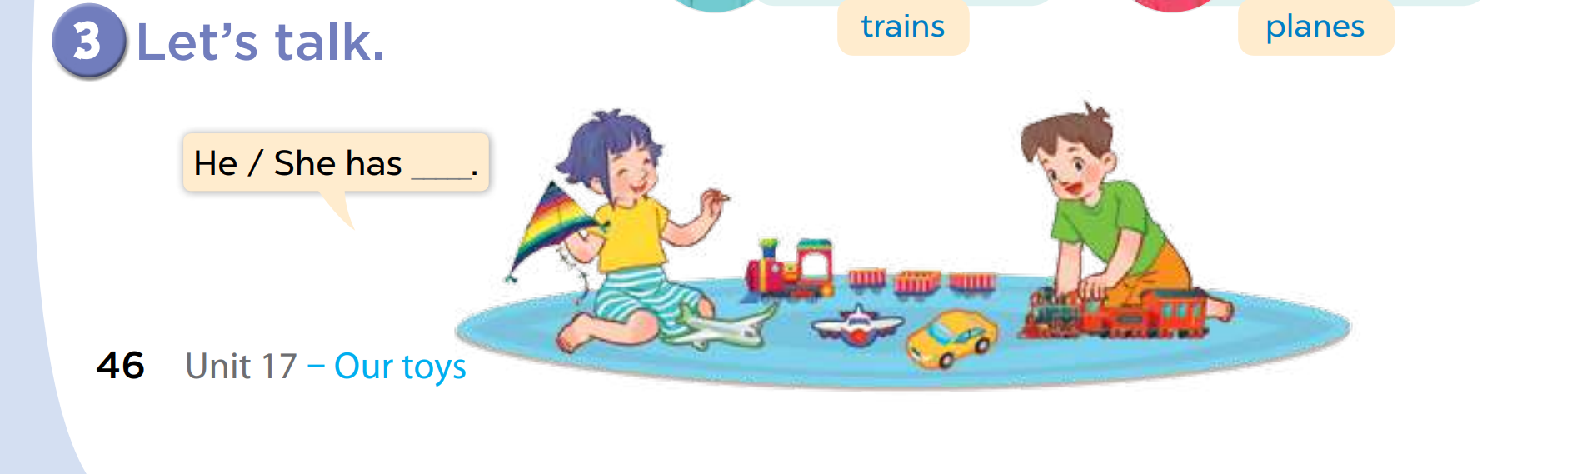
Notes:
Step 1: Draw pupils’ attention to the picture. Ask questions to help them identify the context (see Input). Have pupils look at the bubble to understand how the sentence pattern is used.
Step 2: Have pupils practise identifying someone’s toys in pairs. Make sure pupils understand the structure and say them with the right pronunciation and intonation. Go around the classroom to observe and provide help if necessary.
Step 3: Invite some pupils to practise identifying someone’s toys in front of the class. Praise them if they perform well.

Slide 28

Game: Who says fast?

Slide 29

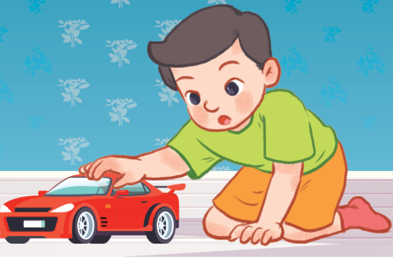



He has a _______.
A. car
B. plane
C. train
D. kite
Notes:
Key: A

Slide 30
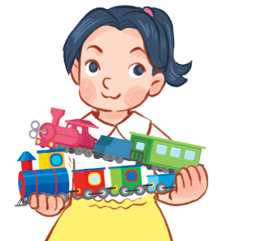
She has two ____.
A. cars
B. planes
C. trains
D. dolls
Notes:
Key: C

Slide 31
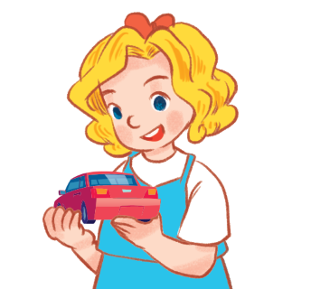
She has a ____.
A. car
B. kite
C. train
D. plane
Notes:
Key: A

Slide 32

She has a ____.
A. doll
B. kite
C. plane
D. train
Notes:
Key: B

Slide 33
5
Fun corner and wrap up
5
Game: Guessing game
Notes:
Step 1: Divide class into 4 teams.
Step 2: Set rule: invite 1 pupil from each team touch into the monitor and say aloud 3 times. If correct, one point for your team.
Step 3: Encourage pupils practice speaking English.
Step 4: Give points for pupils.

Slide 34
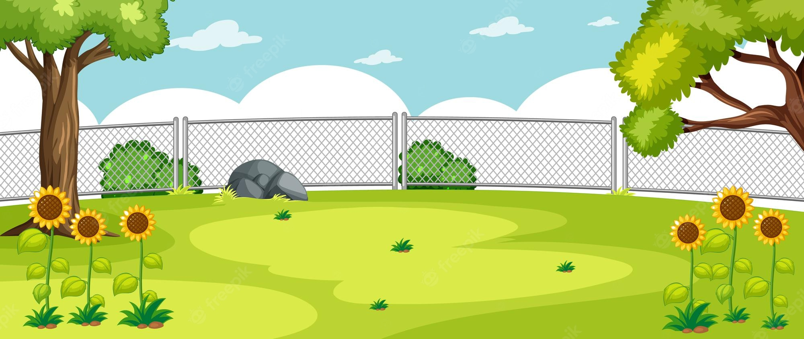
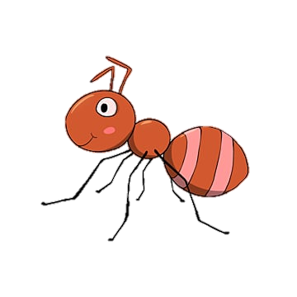

a car
a kite

Slide 35
a train
a plane

Slide 36
a kite
a plane

Slide 37
kites
planes

Slide 38
trains
planes

Slide 39
a train
a car

Slide 40
a car
a kite

Slide 41
cars
planes

Slide 42
a doll
a car

Slide 43
Homework
Workbook, page …

