Slide 2
REVIEW 1
PERIOD 1

Slide 3
CONTENTS
1. Warm-up and review
3. Listen and number.
2. Listen and tick.
4. Let’s talk.
5.Fun corner and wrap-up

Slide 4
1. Warm-up and review

Slide 5
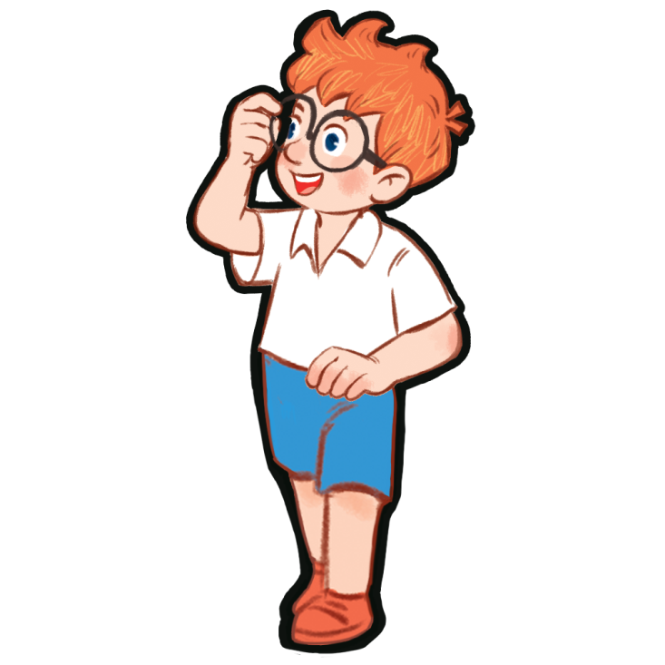

Slide 6
2. Listen and
tick.

Slide 7
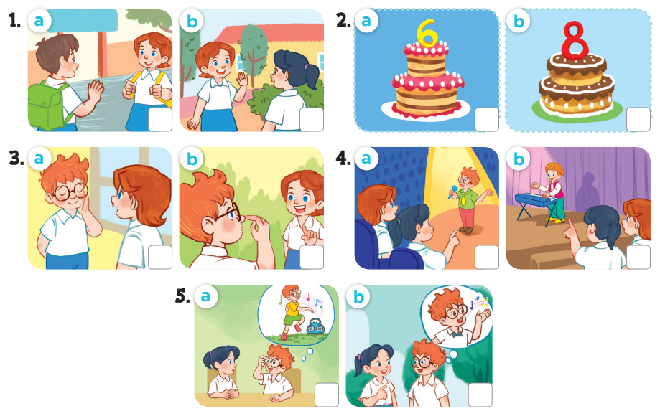
Notes:
Key: 1. b 2. b 3. a 4. b 5. b

Slide 8
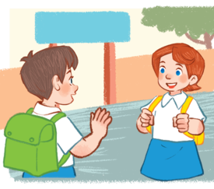
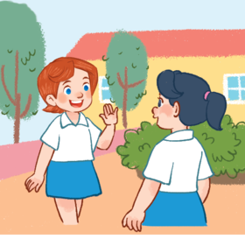
1
a
b

Slide 9
2
a
b

Slide 10
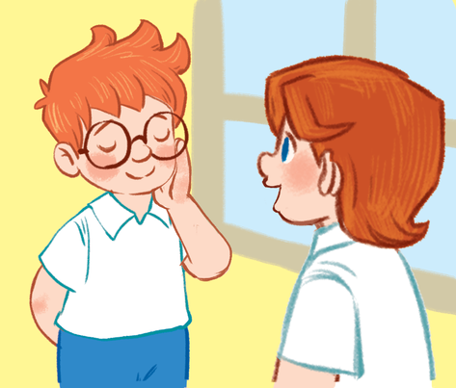
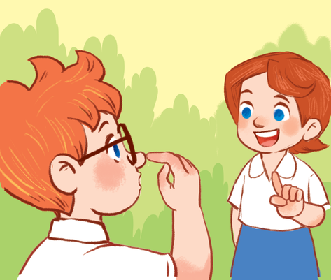
3
a
b

Slide 11
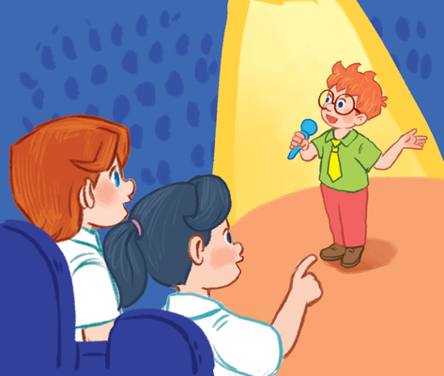
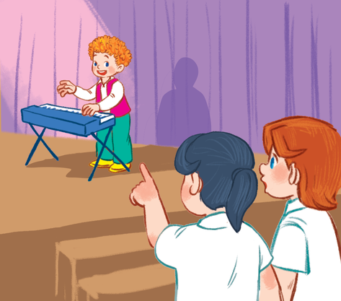
4
a
b

Slide 12
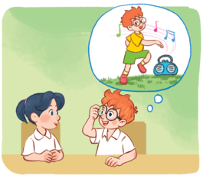
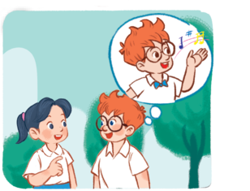
5
a
b

Slide 13
3.Listen and
number.

Slide 14
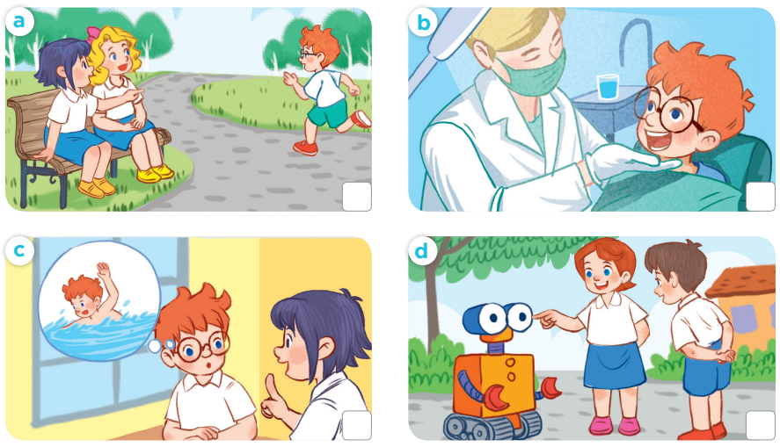
4
1
2
3
Notes:
Key:
1. b
2. c
3. d
4. a

Slide 15
4. Let’s talk.

Slide 17
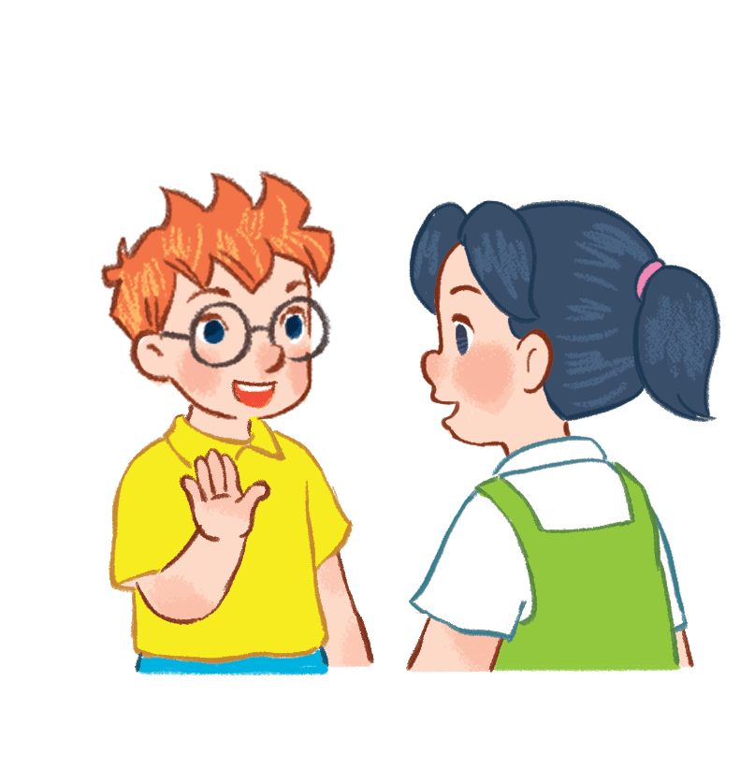
Let’s talk
What...?
How old...?

Slide 18
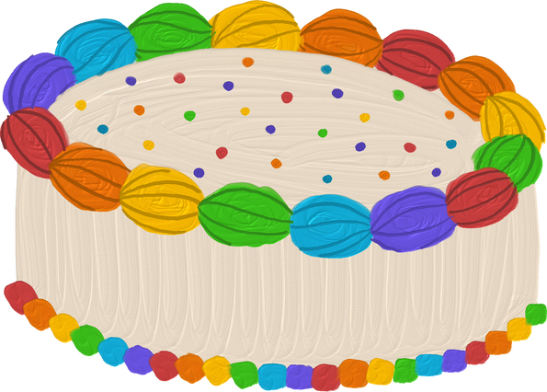
5. Fun corner and wrap-up
Notes:
A survey
- Pupils use the questions to interview their friends.
+ What's your name? − My name's ...
+ How old are you? – I’m _____ years old.
+ What's your hobby? − It's ...
- Afterwards, pupils can tell the class what they found out about their friends.

Slide 19
Name | Age | Hobby
1.
2.
3.
4.
5.
6.
7.
Notes:
A survey
− Pupils use the questions to interview their friends.
+ What's your name? − My name's...
+ How old are you? – I’m _____ years old.
+ What's your hobby? − It's ____.
- Afterwards, pupils can tell the class what they found out about their friends.

Slide 20
Name | Age | Hobby
1. Minh | 8 | drawing
2.
3.
4.
5.
6.
7.
Notes:
Example

