Slide 2
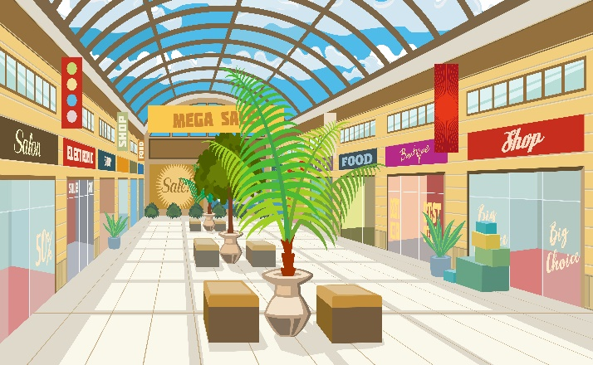
Friday, April 26th 2024
At the
shopping centre
Unit 18
Lesson 3 (1+2+3)

Slide 3
Warm-up

Slide 4
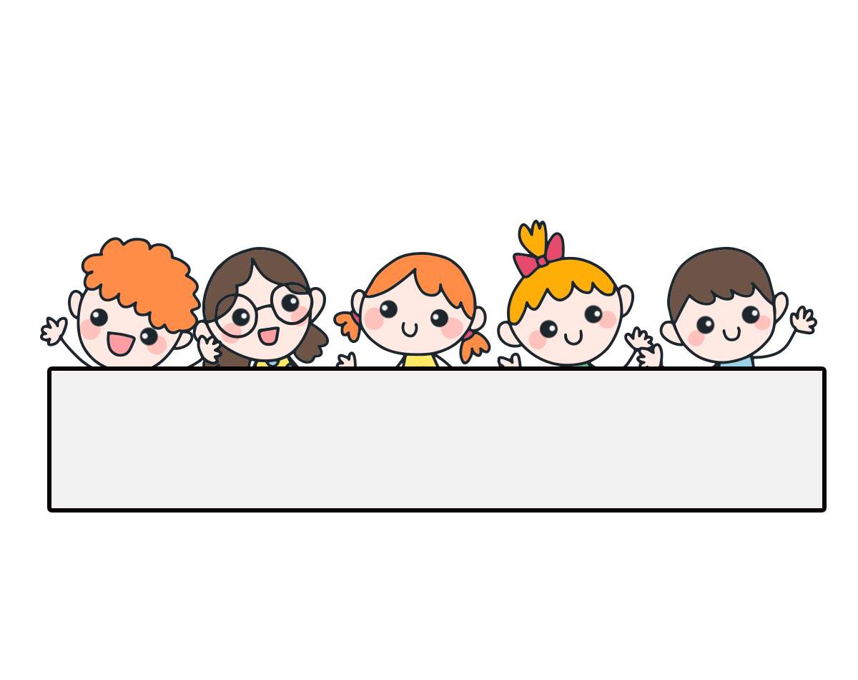
Let’s play!

Slide 5
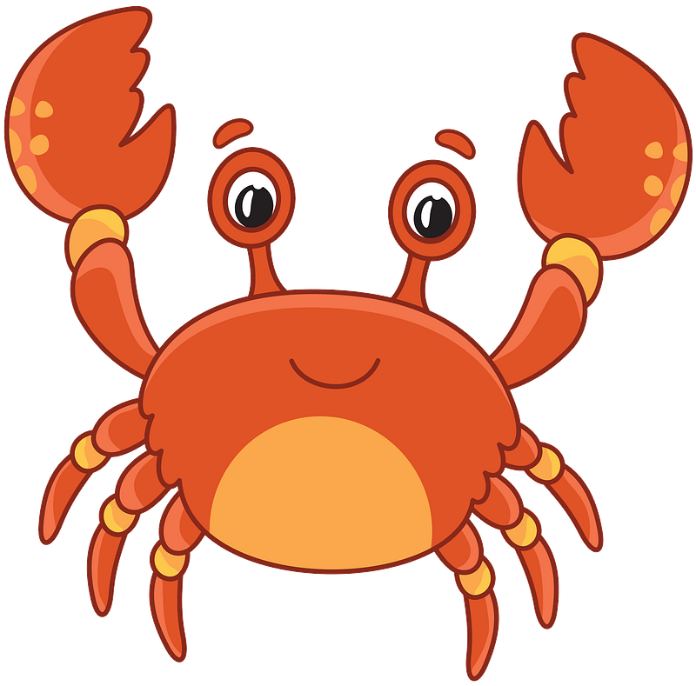
THE FUNNY CRAB
START

Slide 6
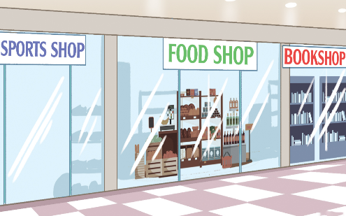
between
A: Where’s the food shop?
B: It’s _____ the sports shop
and the bookshop.
Next
Check

Slide 7
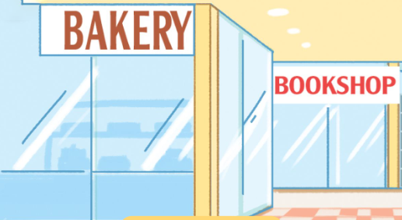
behind
A: Where’s the bookshop?
B: It’s _____ bakery.
Next
Check

Slide 8
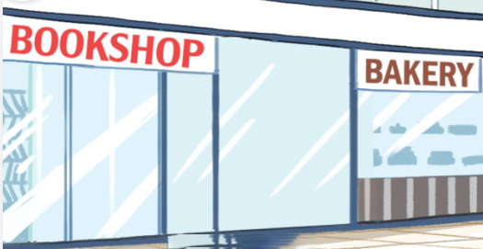
near
A: Where’s the bookshop?
B: It’s _____ bakery.
Next
Check

Slide 9
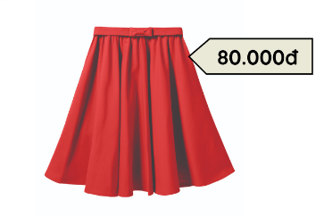
skirt
A: How much is the _____?
B: It’s eighty thousand dong.
Next
Check

Slide 10
thousand dong
A: How much is the hat?
B: It’s twenty ___________.
Next
Check

Slide 11
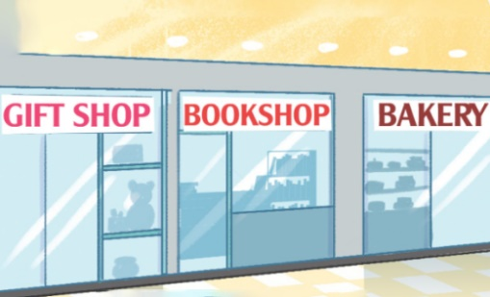
Where
A: _______’s the bookshop?
B: It’s between the gift shop and the bakery.
Next
Check

Slide 12
Where’s the bakery?
A: __________
B: It’s near the bookshop.
Next
Check

Slide 13
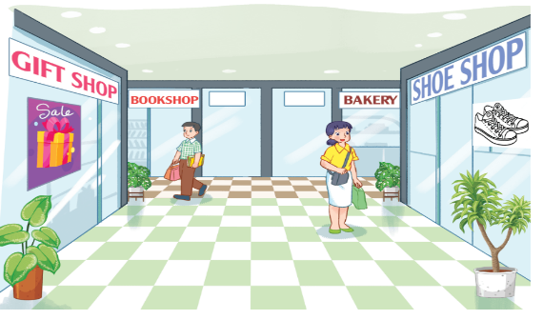
gift shop
A: Where’s the shoe shop?
B: It’s opposite the ______.
Next
Check

Slide 14
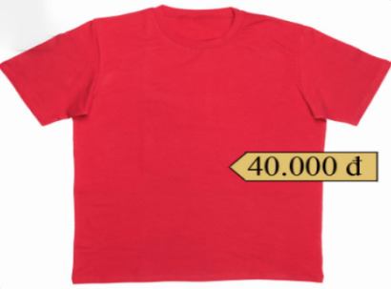
T-shirt
How much is the _____? It’s forty thousand dong.
Next
Check

Slide 15
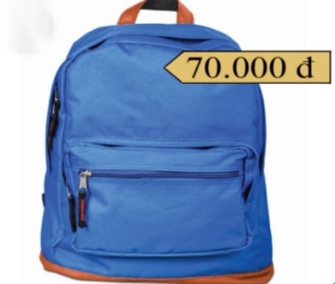
How much is the school bag?
A: _______________________
B: It’s seventy thousand ____ .
Next
Check

Slide 16
Goodjob!
Exit

Slide 17
Contents
Listen and repeat.
Listen and circle.
Let’s chant.

Slide 18
1. Listen and repeat.
be‘hind
The bakery is be‘hind the bookshop.
be‘tween
The bakery is be‘tween the bookshop and the sports shop.
Click on the letters / words / sentences to listen again.

Slide 19
2. Listen and circle.
1. The gift shop is ____ the bookshop and the bakery.
a. behind
b. between
c. opposite
2. The gift shop is ____ the bookshop and the bakery.
a. between
b. opposite
c. behind

Slide 20
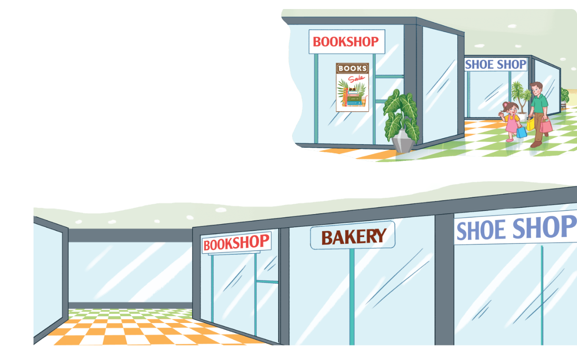
3. Let’s chant.
Where’s the shoe shop?
Behind,
behind,
behind.
It’s behind the bookshop.
Where’s the bakery?
Between,
between,
between.
It’s between the bookshop and the shoe shop.

Slide 21
3. Let’s chant.

Slide 22
3. Let’s chant.
Where’s the shoe shop?
Behind,
behind,
behind.
It’s behind the bookshop.
Where’s the bakery?
Between,
between,
between.
It’s between the bookshop and the shoe shop.

Slide 23
Wrap up

Slide 24
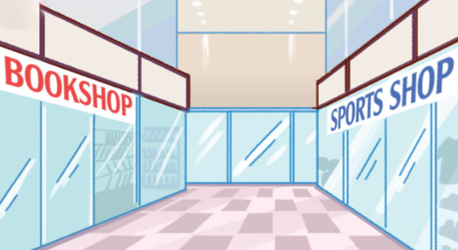
Unit 18 Lesson 1
Where’s the bookshop?
It’s ________.
near
between
opposite
behind

Slide 25
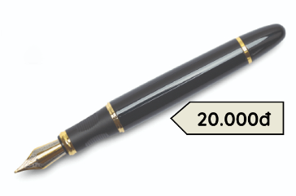
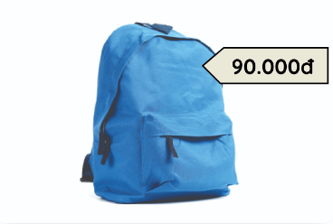
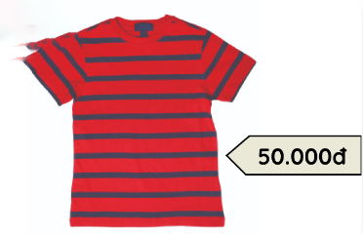
Unit 18 Lesson 2
How much is the _______?
It’s_______.
pen / twenty thousand dong
school bag / ninety thousand dong
skirt / eighty thousand dong
T-shirt / fifty thousand dong

Slide 26
Homework
……………………………………....
……………………………………….

Slide 27
Thank you!

