Slide 2
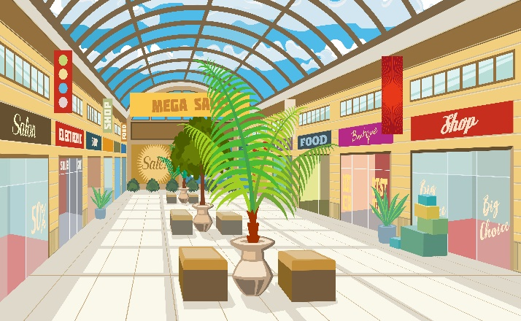
Thursday, April 25th 2024
At the
shopping centre
Unit 18
Lesson 2 – 4.5.6

Slide 3
Warm-up

Slide 4
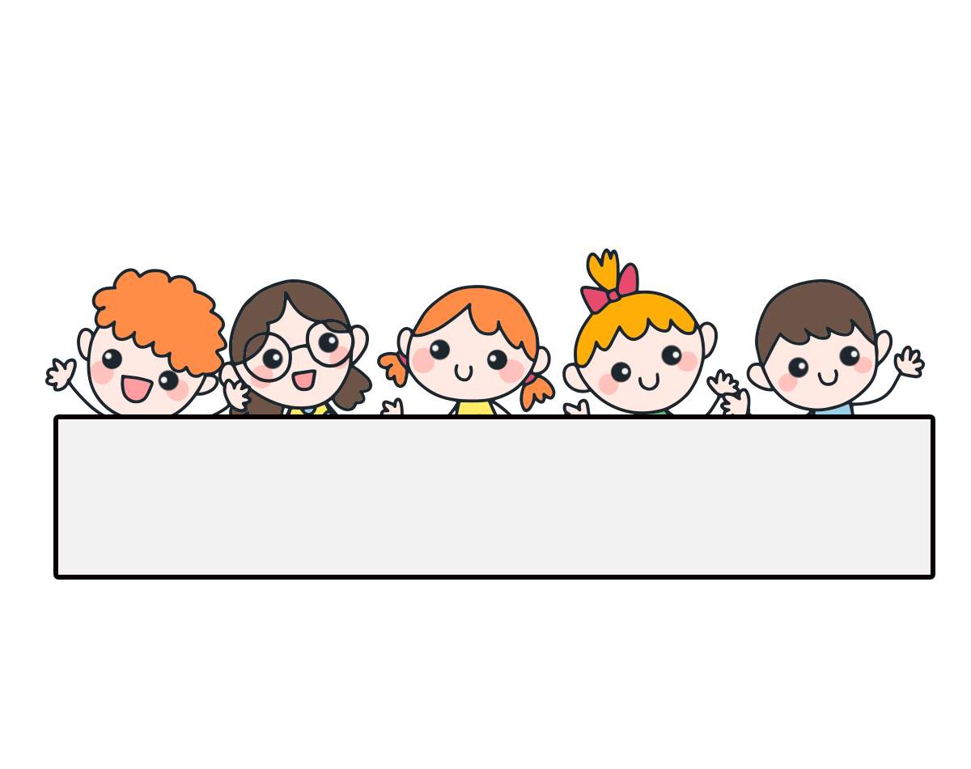
Let’s play!

Slide 5
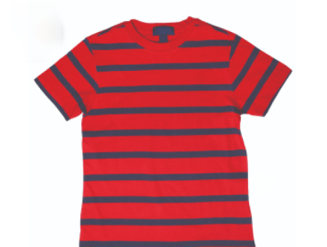
Choose the correct answer.
A. skirt
B. hat
C. pen
D. T-shirt

Slide 6
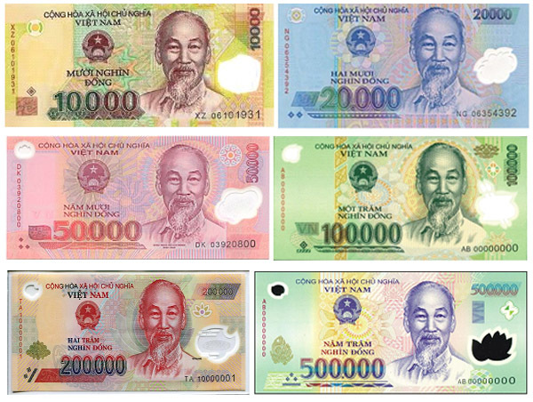
A. dong
B. T-shirt
C. skirt
D. hat

Slide 7
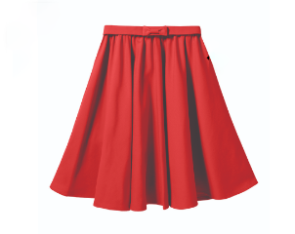
A. skirt
B. T-shirt
C. toy
D. hat

Slide 8
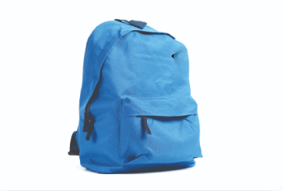
Lucy: How much is the _____?
Nam: It’s forty thousand dong.
A. T-shirt
B. skirt
C. school bag
D. pen

Slide 9
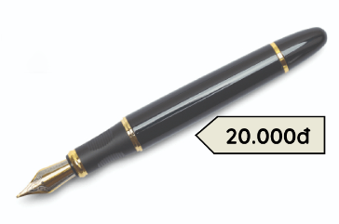
Linh: How much is the _____?
Bill: It’s ______ thousand dong.
A. pencil / twenty
B. pen / twenty
C. pen / twelve
D. skirt / eighty

Slide 10
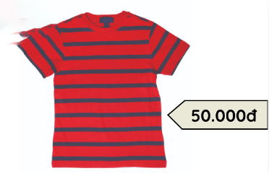
Lucy: How much is the T-shirt?
Mai: It’s fifty thousand _______.
A. T-shirt
B. dong

Slide 11
Lucy: _______ is the school bag?
Mai: It’s fifty thousand dong.
A. What
B. Where
C. How can
D. How much

Slide 12
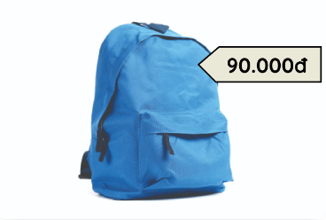
Linh: How much is the school bag?
Bill: _____________.
A. It’s fifty thousand dong.
B. It’s ninety thousand dong.
C. It’s nineteen thousand dong.
D. It’s eighty thousand dong.

Slide 13
Bill: _______________?
Ben: It’s eighty thousand dong.
A. What does she do?
B. Where’s the bakery?
C. What’s your hobby?
D. How much is the skirt?

Slide 14
Choose the odd one out.
A. behind
B. opposite
C. T-shirt
D. near

Slide 15
Well done!

Slide 16
Contents
Listen and number.
Look, complete and read.
Let’s play.

Slide 17
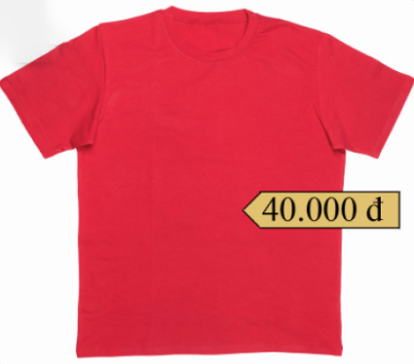
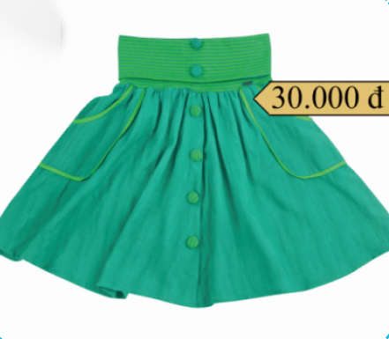
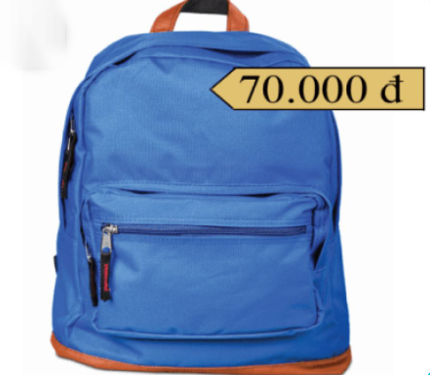
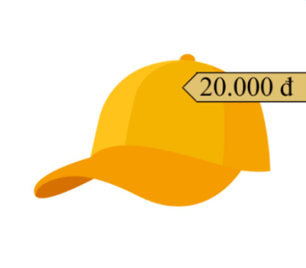
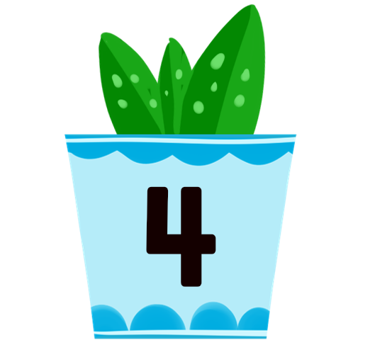
4. Listen and number.
a
b
c
d
2
4
1
3
Click on the speaker to listen.

Slide 18
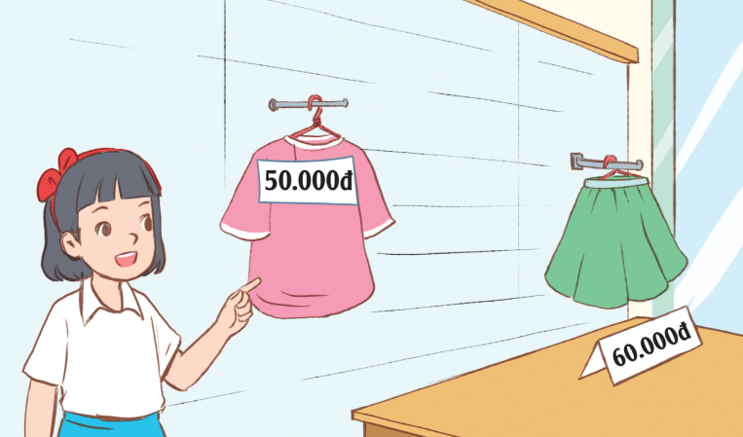
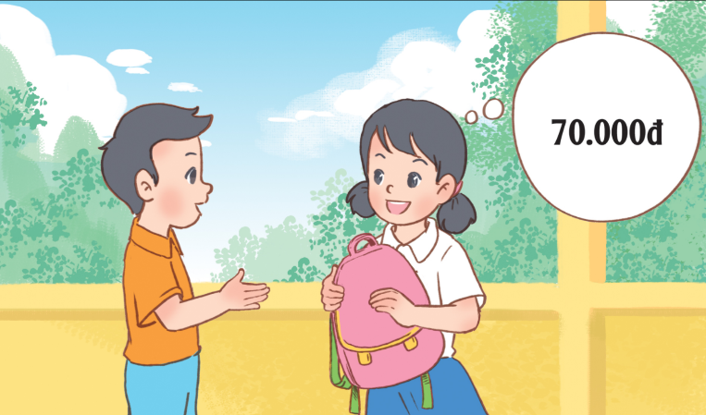
5. Look, complete and read.
1.
A: Excuse me. How much is this T-shirt?
B: It’s _______ thousand dong.
A: And how much is that skirt?
B: It’s sixty ______________.
fifty
thousand dong
2.
A: Your school bag is so nice.
B: Thank you. I like it very much.
A: ___________ is it?
B: It’s __________ thousand dong.
How much
seventy

Slide 19
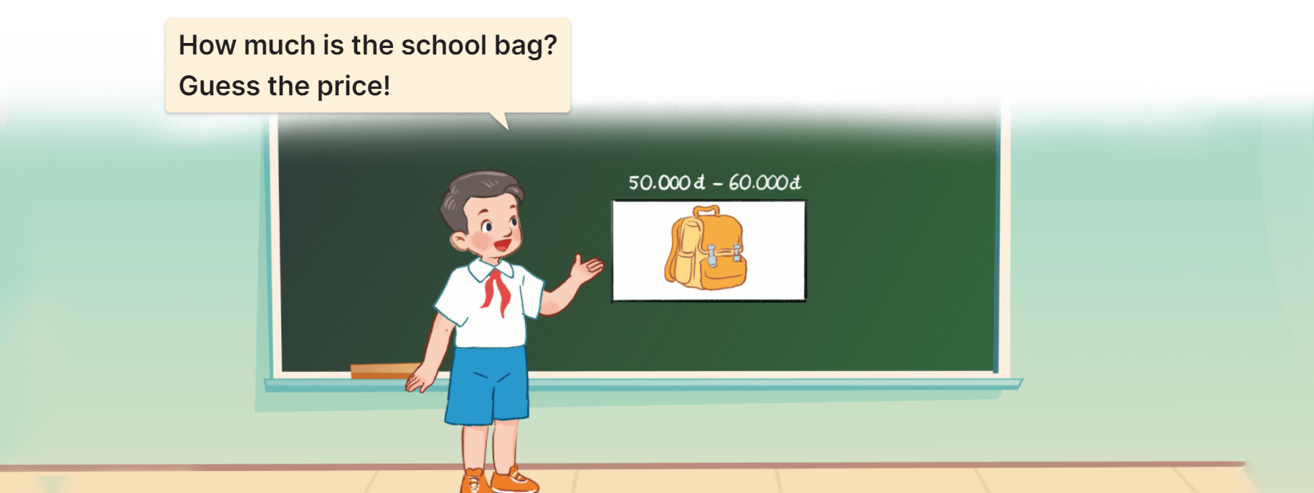
6. Let’s play.
Guess the price!

Slide 20
Let’s play!

Slide 21
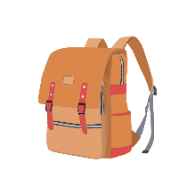
Guess the answer.
How much is the school bag?
__________________
90.000
It’s ninety thousand dong.
Answer

Slide 22
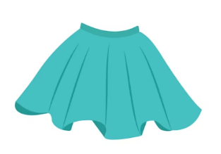
Guess the answer.
How much is the skirt?
__________________
70.000
It’s seventy thousand dong.
Answer

Slide 23
Guess the answer.
How much is the hat?
__________________
30.000
It’s thirty thousand dong.
Answer

Slide 24
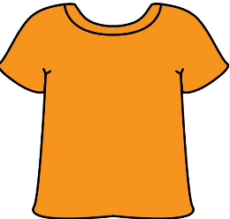
Guess the answer.
How much is the T-shirt?
__________________
80.000
It’s eighty thousand dong.
Answer

Slide 25
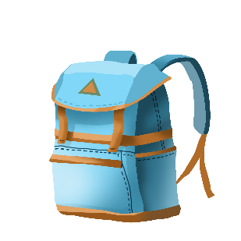
Guess the answer.
How much is the school bag?
__________________
90.000
It’s ninety thousand dong.
Answer

Slide 26
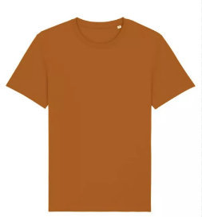
Guess the answer.
How much is the T-shirt?
__________________
60.000
It’s sixty thousand dong.
Answer

Slide 27
Great!

Slide 28
Wrap up

Slide 29
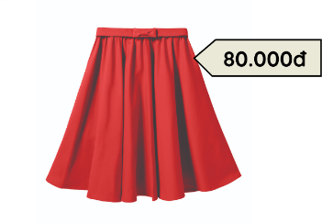
Review
How much is the _______?
It’s_______.
pen / twenty thousand dong
school bag / ninety thousand dong
skirt / eighty thousand dong
T-shirt / fifty thousand dong

Slide 30
Homework
………………………………………..
………………………………………..

Slide 31
Thank you!

