Slide 1
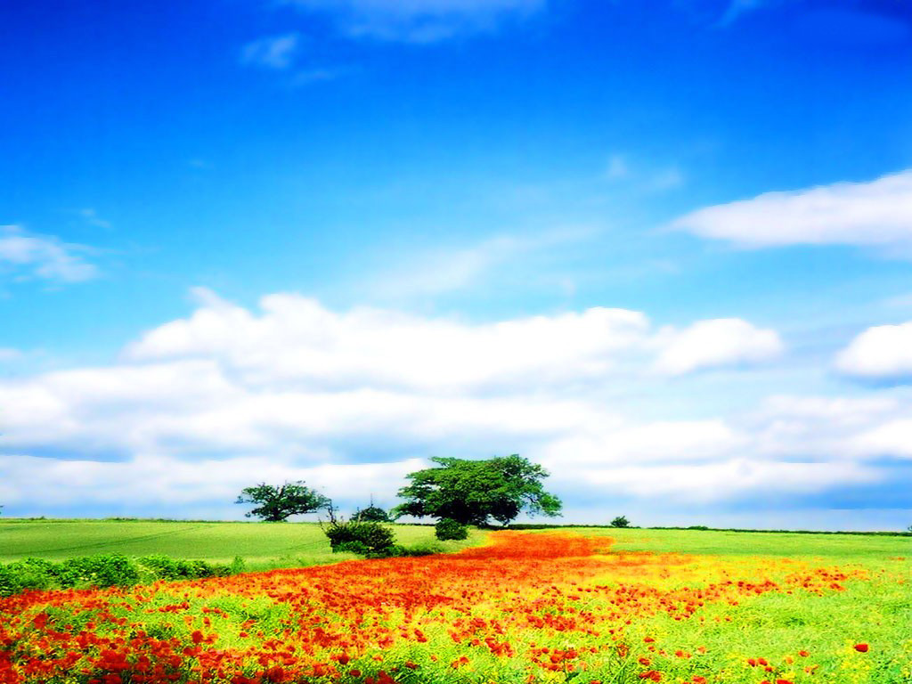
TO OUR CLASS!

Slide 2
PERIOD 69: Unit 9 Cities of the world
Lesson 1: Getting started

Slide 3
WARM UP https://wordwall.net/vi/resource/86902437/warm-up-unit-9-getting-started

Slide 4
I. VOCABULARY

Slide 5
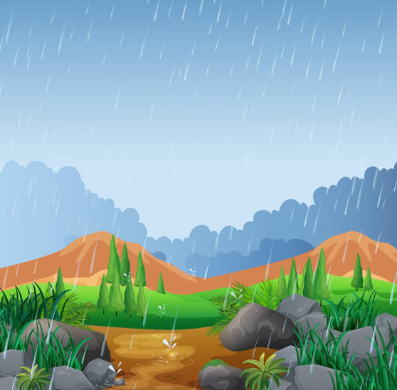
I. VOCABULARY
/ˈreɪni/

Slide 6
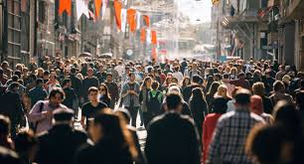
VOCABULARY
/ˈkraʊdɪd/

Slide 7
VOCABULARY
/ɪkˈsaɪtɪŋ/

Slide 8
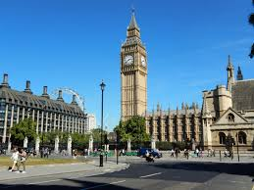
VOCABULARY
/ˈlændmɑːk/

Slide 9
I. VOCABULARY
New words | Pronunciation | Meaning
1. rainy (adj) | /ˈreɪni/ | có mưa
2. crowded (adj) | /ˈkraʊdɪd/ | đông đúc
3. exciting (adj) | /ɪkˈsaɪtɪŋ/ | hào hứng
4. landmark (adj) | /ˈlændmɑːk/ | Địa điểm thu hút du khách

Slide 10
What a nice photo!
What do you think Mai and Tom are talking about?
Mai
Tom
Listen and check

Slide 11
II. PRACTICE
1
Listen and read.
Mai: Tom, are these photos from your holiday?
Tom: Yes, they are. This is Sydney, a city in Australia.
Mai: What’s it like?
Tom: It’s exciting with a lot of beaches.
Mai: What a beautiful place!
Tom: Yes, its beaches are very clean.
Mai: Wonderful. Oh, this is London. Isn’t it raining? What bad weather!
Tom: Yes, it rains all the time. Can you see Big Ben?
Mai: Yeah ... on the River Thames. It’s a landmark of London.
Tom: It is. And this is Times Square in New York, crowded but interesting.
Mai: You’re lucky to visit many places.
Tom: I am. What about your holiday?
Mai: Here are some photos of mine. This is ...

Slide 12
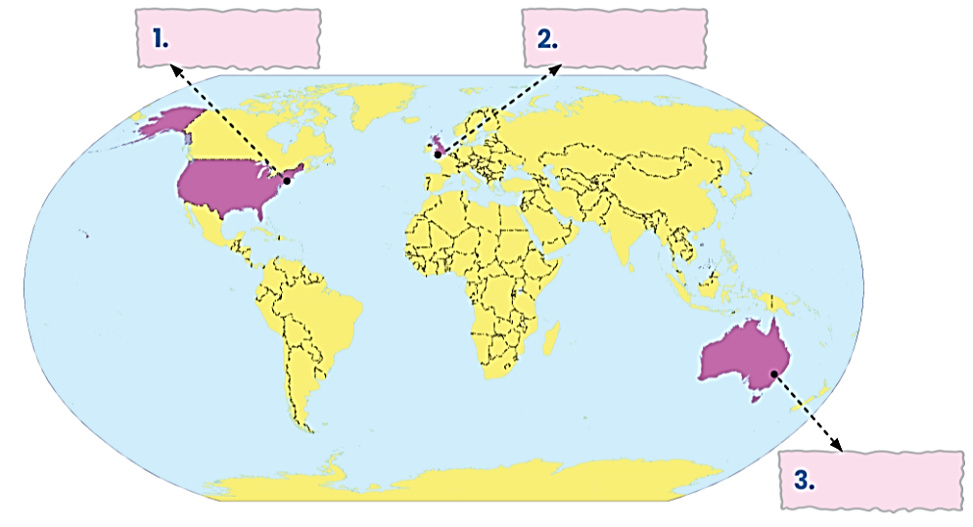
2. (p.27) Write the names of the cities in the correct place.
New York
London
London
New York
Sydney
Sydney
https://www.thinglink.com/scene/1950876693551907493

Slide 13
3. (p.27) Read the conversation again and match the cities with the adjectives describing them.
Mai: Tom, are these photos from your holidays?
Tom: Yes, they are. This is Sydney, a city in Australia. Mai: What's it like?
Tom: It's exciting with a lot of beaches.
Mai: What a beautiful place!
Tom: Yes, its beaches are very clean.
Mai: Wonderful. Oh, this is London. Isn't it raining? What bad weather!
Tom: Yes, it rains all the time. Can you see Big Ben?
Mai: Yeah... on the River Thames. It's a landmark of London.
Tom: It is. And this is Times Square in New York, crowded but interesting.
Mai: You're lucky to visit many places.
Tom: I am. What about your holiday?
Mai: Here are some photos of mine. This is...
1. Sydney
a. rainy
2. London
b. crowded
c. exciting
3. New York
d. beautiful
e. interesting

Slide 14
3. (p.27) Read the conversation again and match the cities with the adjectives describing them.
Mai: Tom, are these photos from your holidays?
Tom: Yes, they are. This is Sydney, a city in Australia. Mai: What's it like?
Tom: It's exciting with a lot of beaches.
Mai: What a beautiful place!
Tom: Yes, its beaches are very clean.
Mai: Wonderful. Oh, this is London. Isn't it raining? What bad weather!
Tom: Yes, it rains all the time. Can you see Big Ben?
Mai: Yeah... on the River Thames. It's a landmark of London.
Tom: It is. And this is Times Square in New York, crowded but interesting.
Mai: You're lucky to visit many places.
Tom: I am. What about your holiday?
Mai: Here are some photos of mine. This is...
Mai: Tom, are these photos from your holidays?
Tom: Yes, they are. This is Sydney, a city in Australia. Mai: What's it like?
Tom: It's exciting with a lot of beaches.
Mai: What a beautiful place!
Tom: Yes, its beaches are very clean.
Mai: Wonderful. Oh, this is London. Isn't it raining? What bad weather!
Tom: Yes, it rains all the time. Can you see Big Ben?
Mai: Yeah... on the River Thames. It's a landmark of London.
Tom: It is. And this is Times Square in New York, crowded but interesting.
Mai: You're lucky to visit many places.
Tom: I am. What about your holiday?
Mai: Here are some photos of mine. This is...
1. Sydney
a. rainy
2. London
b. crowded
c. exciting
3. New York
d. beautiful
e. interesting

Slide 15
3. (p.27) Read the conversation again and match the cities with the adjectives describing them.
Mai: Tom, are these photos from your holidays?
Tom: Yes, they are. This is Sydney, a city in Australia. Mai: What's it like?
Tom: It's exciting with a lot of beaches.
Mai: What a beautiful place!
Tom: Yes, its beaches are very clean.
Mai: Wonderful. Oh, this is London. Isn't it raining? What bad weather!
Tom: Yes, it rains all the time. Can you see Big Ben?
Mai: Yeah... on the River Thames. It's a landmark of London.
Tom: It is. And this is Times Square in New York, crowded but interesting.
Mai: You're lucky to visit many places.
Tom: I am. What about your holiday?
Mai: Here are some photos of mine. This is...
Mai: Tom, are these photos from your holidays?
Tom: Yes, they are. This is Sydney, a city in Australia. Mai: What's it like?
Tom: It's exciting with a lot of beaches.
Mai: What a beautiful place!
Tom: Yes, its beaches are very clean.
Mai: Wonderful. Oh, this is London. Isn't it raining? What bad weather!
Tom: Yes, it rains all the time. Can you see Big Ben?
Mai: Yeah... on the River Thames. It's a landmark of London.
Tom: It is. And this is Times Square in New York, crowded but interesting.
Mai: You're lucky to visit many places.
Tom: I am. What about your holiday?
Mai: Here are some photos of mine. This is...
1. Sydney
a. rainy
2. London
b. crowded
c. exciting
3. New York
d. beautiful
e. interesting

Slide 16
3. (p.27) Read the conversation again and match the cities with the adjectives describing them.
Mai: Tom, are these photos from your holidays?
Tom: Yes, they are. This is Sydney, a city in Australia.
Mai: What's it like?
Tom: It's exciting with a lot of beaches.
Mai: What a beautiful place!
Tom: Yes, its beaches are very clean.
Mai: Wonderful. Oh, this is London. Isn't it raining? What bad weather!
Tom: Yes, it rains all the time. Can you see Big Ben?
Mai: Yeah... on the River Thames. It's a landmark of London.
Tom: It is. And this is Times Square in New York, crowded but interesting.
Mai: You're lucky to visit many places.
Tom: I am. What about your holiday?
Mai: Here are some photos of mine. This is...
Mai: Tom, are these photos from your holidays?
Tom: Yes, they are. This is Sydney, a city in Australia. Mai: What's it like?
Tom: It's exciting with a lot of beaches.
Mai: What a beautiful place!
Tom: Yes, its beaches are very clean.
Mai: Wonderful. Oh, this is London. Isn't it raining? What bad weather!
Tom: Yes, it rains all the time. Can you see Big Ben?
Mai: Yeah... on the River Thames. It's a landmark of London.
Tom: It is. And this is Times Square in New York, crowded but interesting.
Mai: You're lucky to visit many places.
Tom: I am. What about your holiday?
Mai: Here are some photos of mine. This is...
1. Sydney
a. rainy
2. London
b. crowded
c. exciting
3. New York
d. beautiful
e. interesting

Slide 17
4. (p.27) Match the cities with their landmarks. https://quizizz.com/admin/activity/classic/67c8d781a3871eca34deaa3a
a
b

Slide 18
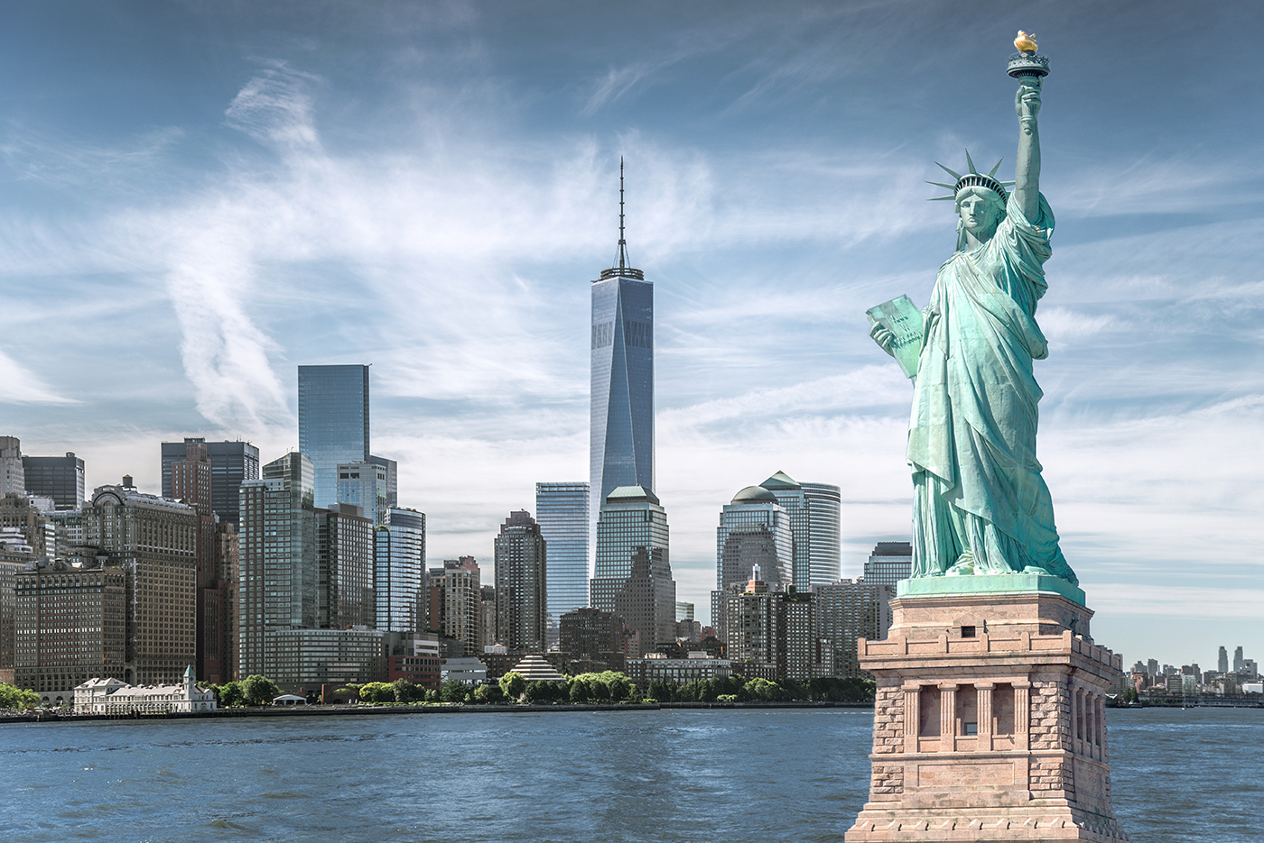
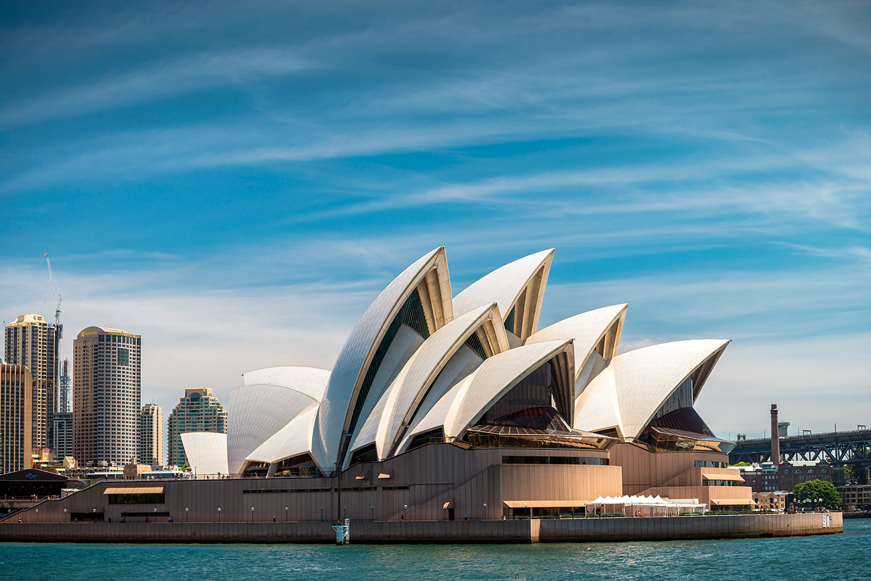
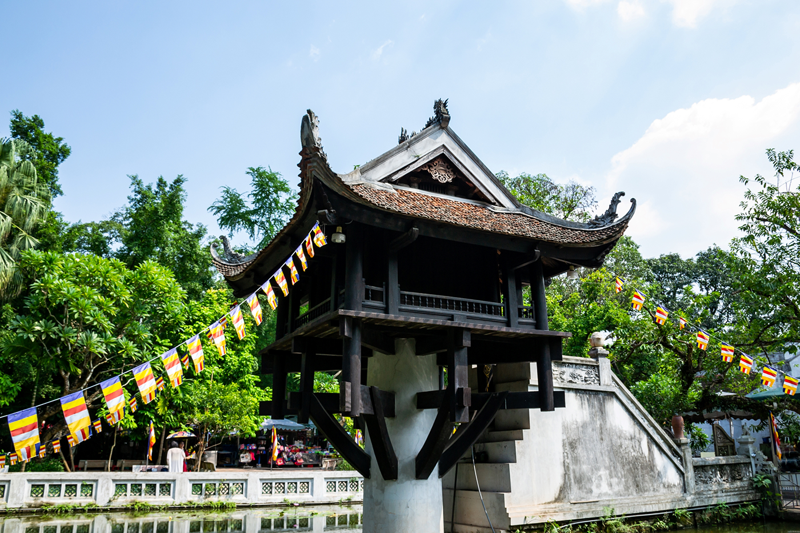
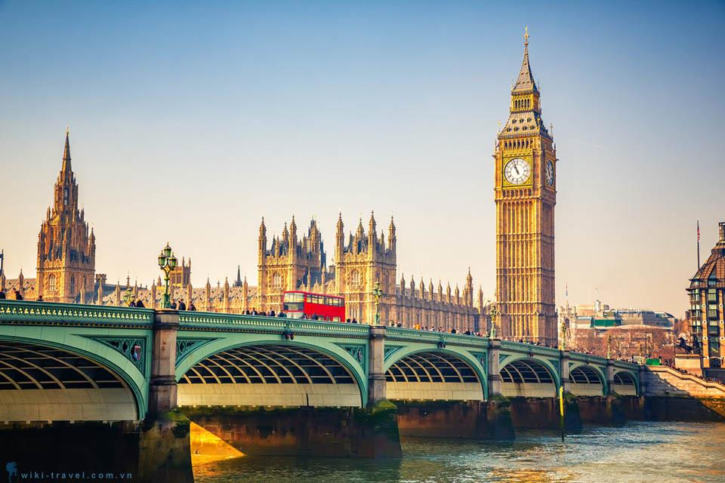
4. (p.27) Match the cities with their landmarks.
a
b
1. Ha Noi
2. London
3. New York
3. New York
4. Sydney
c
d
4. Sydney
1. Ha Noi
2. London

Slide 19
STRUCTURES
What is Sydney like?
Mai: What a beautiful place!
What is London like?
Mai: Wonderful. Oh, this is London. Isn't it raining? What bad weather!
What + (a/an) + adj + noun!

Slide 20
WRAP UP
1. What is our topic about?
A. Our world B. Cities of the world
C. Worldwide problems D. Man-made wonders
2. Big Ben is a _________ of London.
A. landmark B. city C. village

Slide 21
homework
Learn by heart all the new words.
Practice reading conversation.
- Go to the Internet and search for the information on your favourite cities in the world (food, people, weather, etc.)
- Prepare lesson 2 ( Unit 9: A closer look 1).

Slide 22
Thanks!
Does anyone have any questions?

