Slide 2




PHÒNG GIÁO DỤC THÀNH PHỐ LÀO CAI
TRƯỜNG TIỂU HỌC BẮC LỆNH
BÀI GIẢNG ĐIỆN TỬ
MÔN : TIẾNG ANH 3
UNIT 10: BREAK TIME ACTIVITIES
LESSON 1(1,2,3)

Slide 3



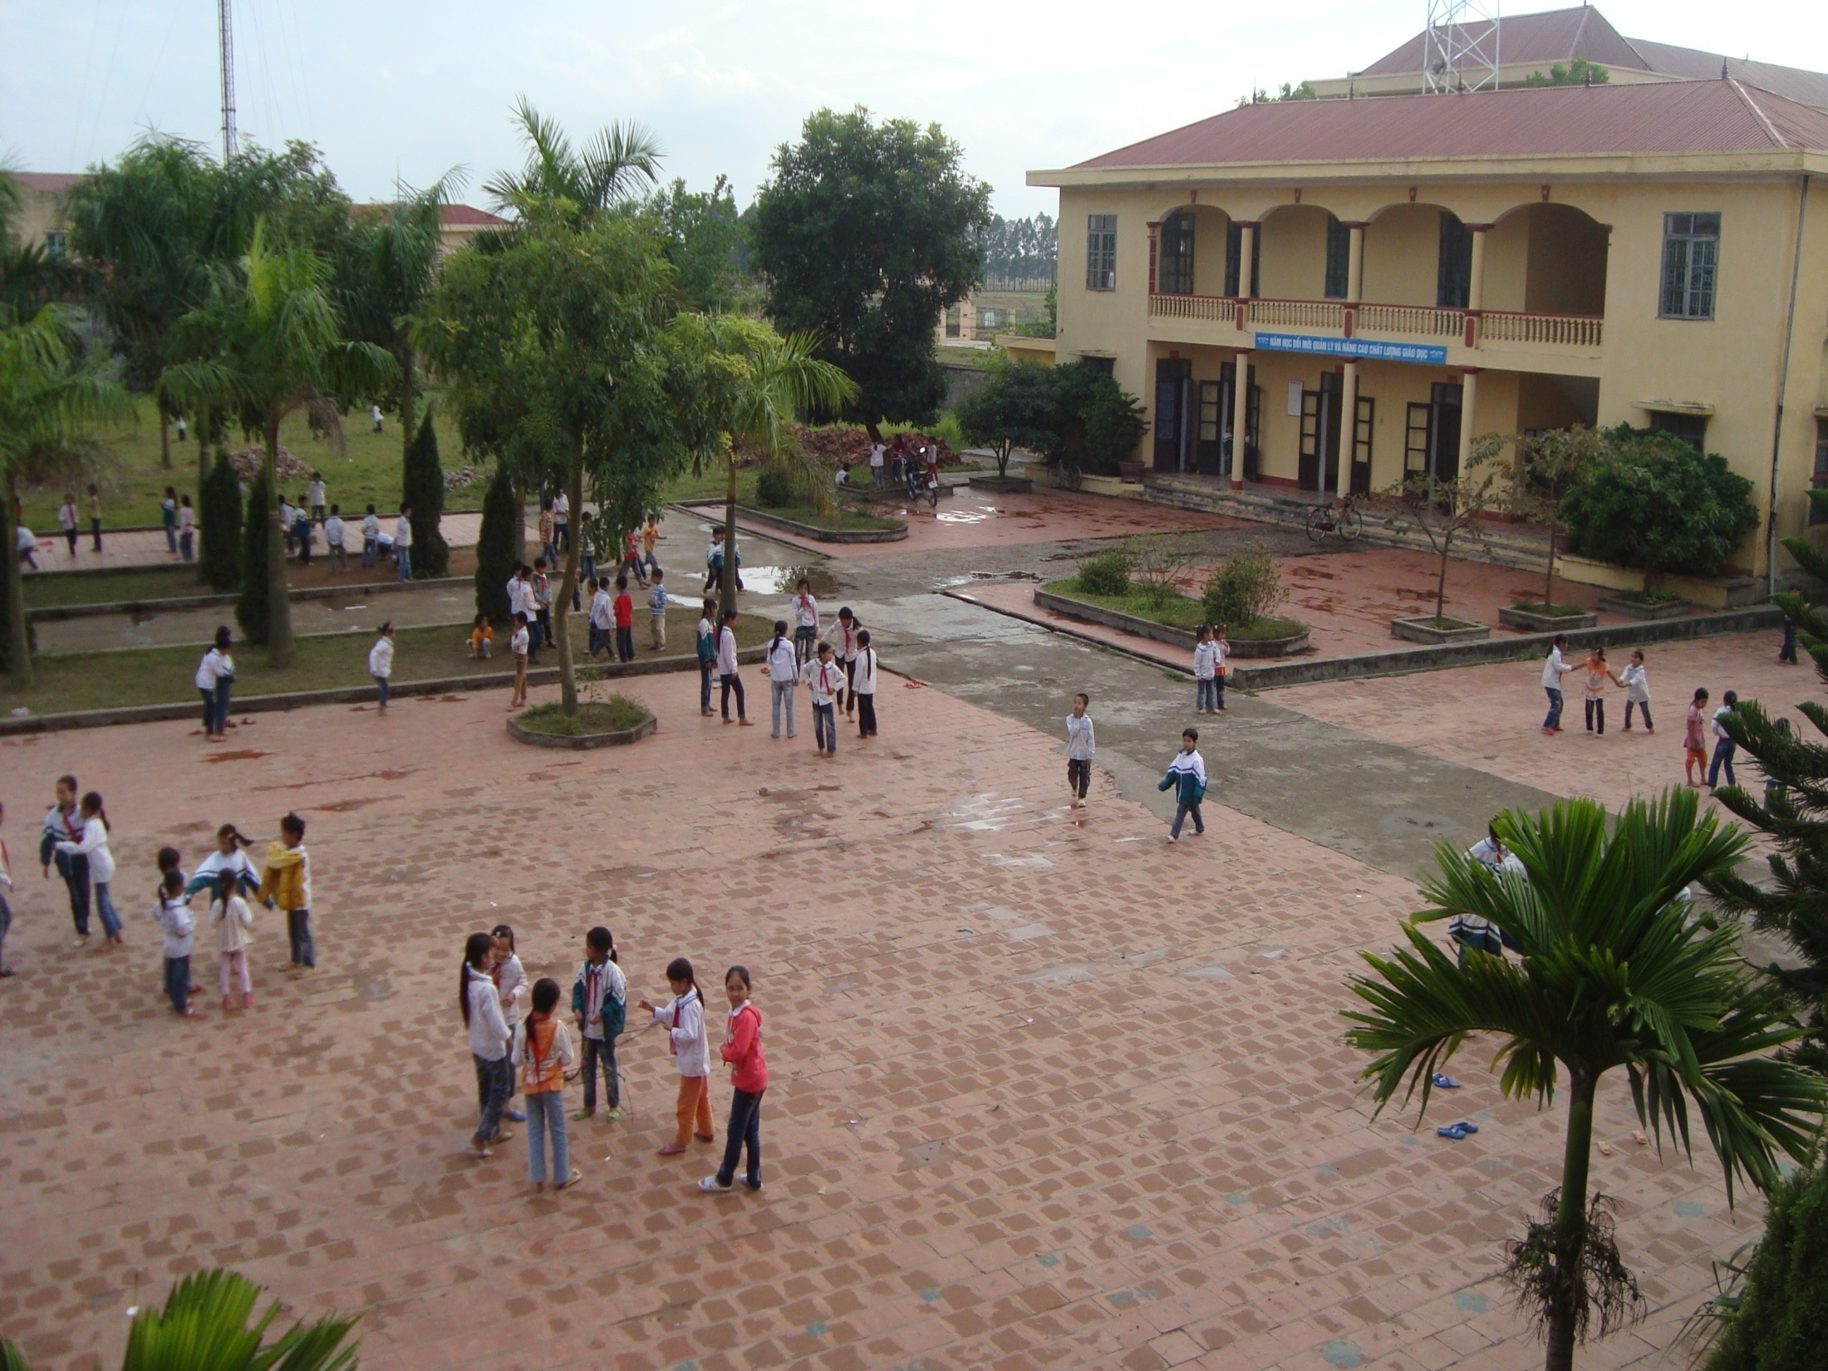



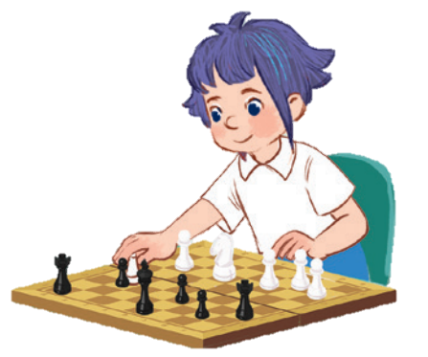
Monday, December 9th 2024
10
Period 1

Slide 4
Contents
1
5
Warm-up and review
Fun corner and wrap-up
4
2
3
Let’s talk.
Look, listen and repeat.
Listen, point and say.

Slide 5
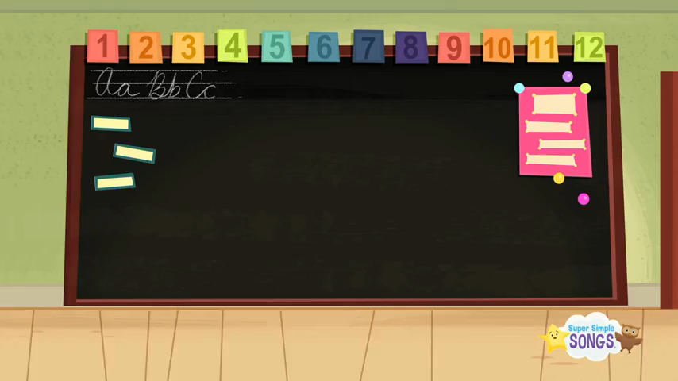

Warm- up: Hello song
Notes:
Game: Look and Guess
- Teacher shows 4 pictures numbered 1 to 4 on the board.
- Teacher lets the pupils choose 1 square on the screen and open it.
- Teacher lets the pupils guess the corresponding number of the picture.

Slide 6
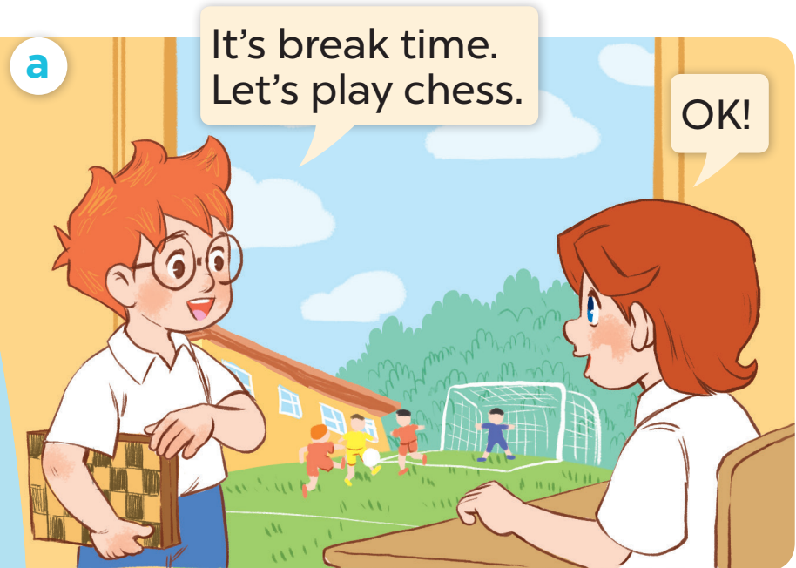
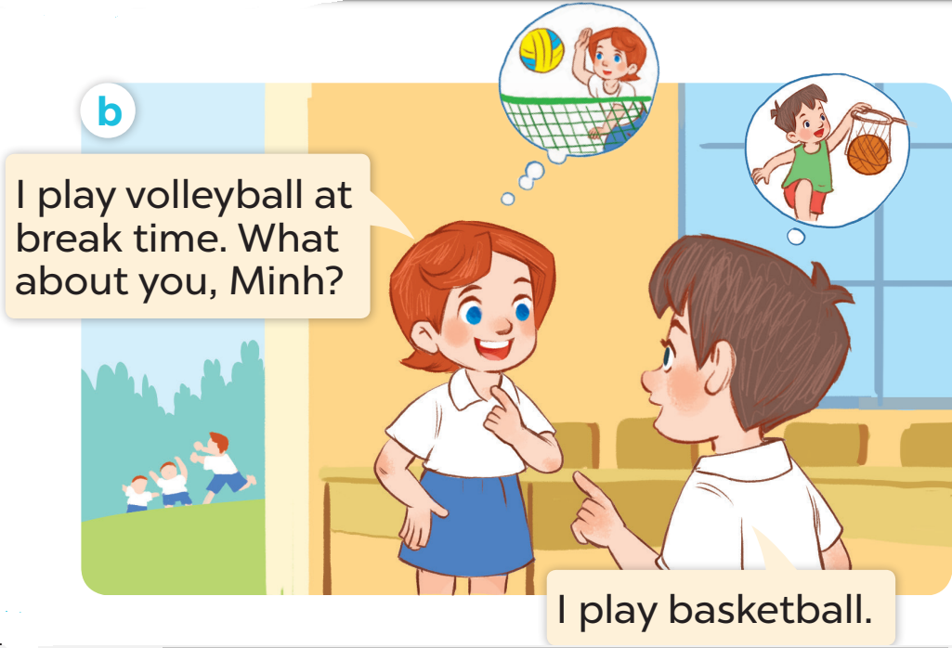
1.Look, listen and repeat

Slide 7
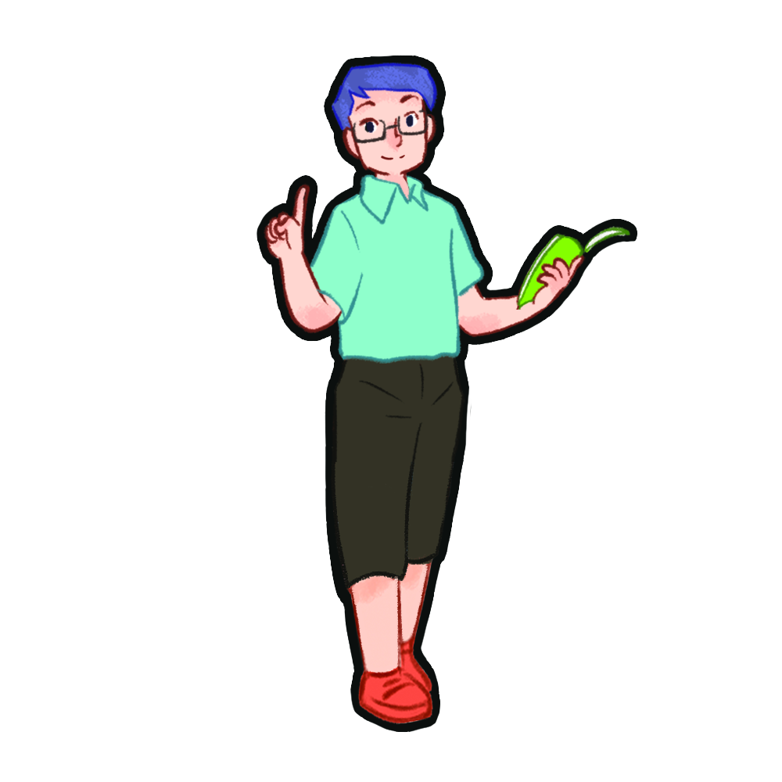
2.Listen, point and say.
* New words

Slide 8
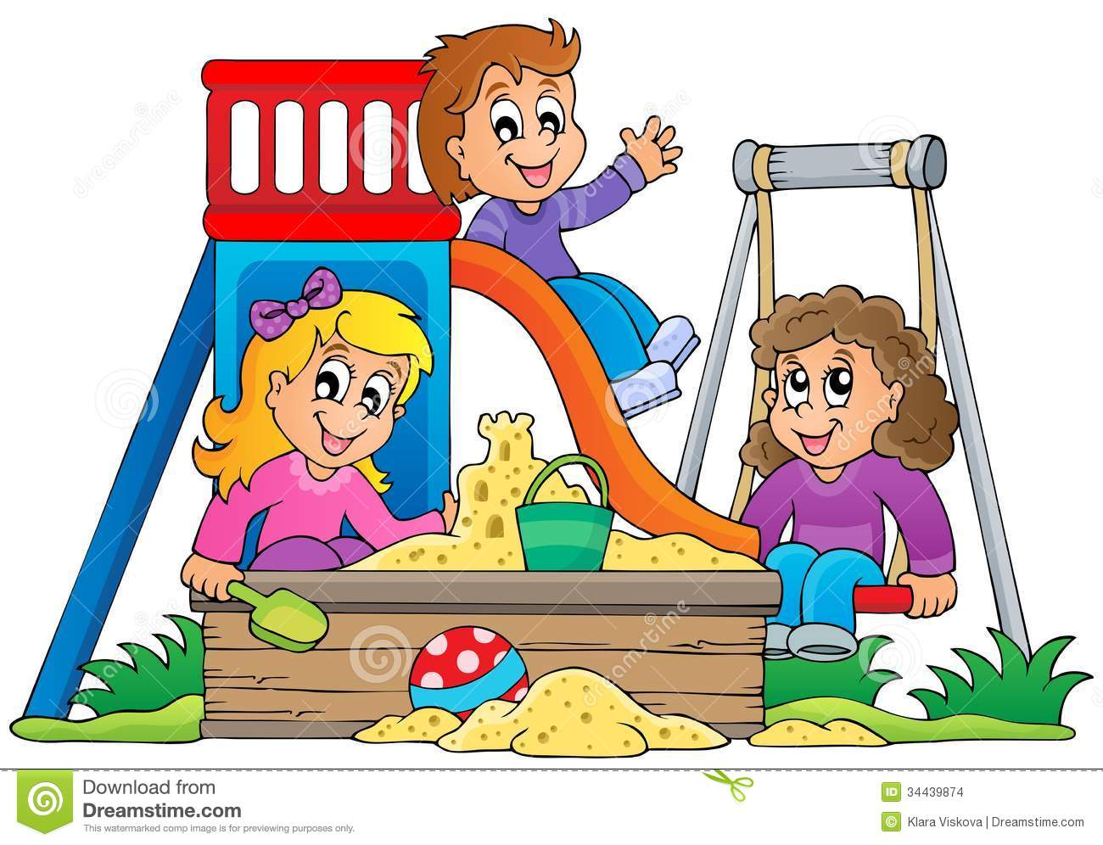
Play

Slide 9
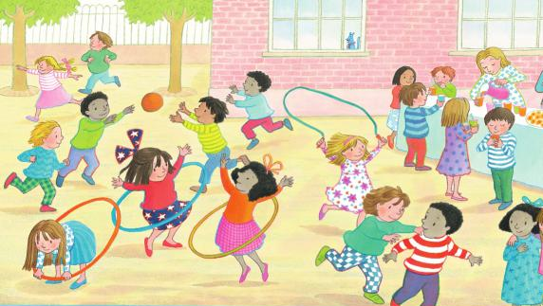
Break time

Slide 10

Chess

Slide 11

Volleyball

Slide 12

Basketball

Slide 13

Badminton

Slide 14

Quiz
Multiple choise questions

Slide 15
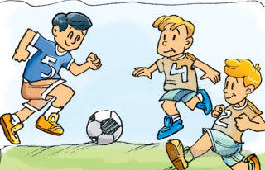
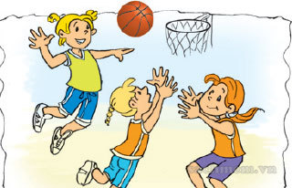

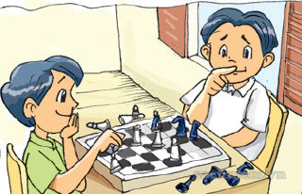
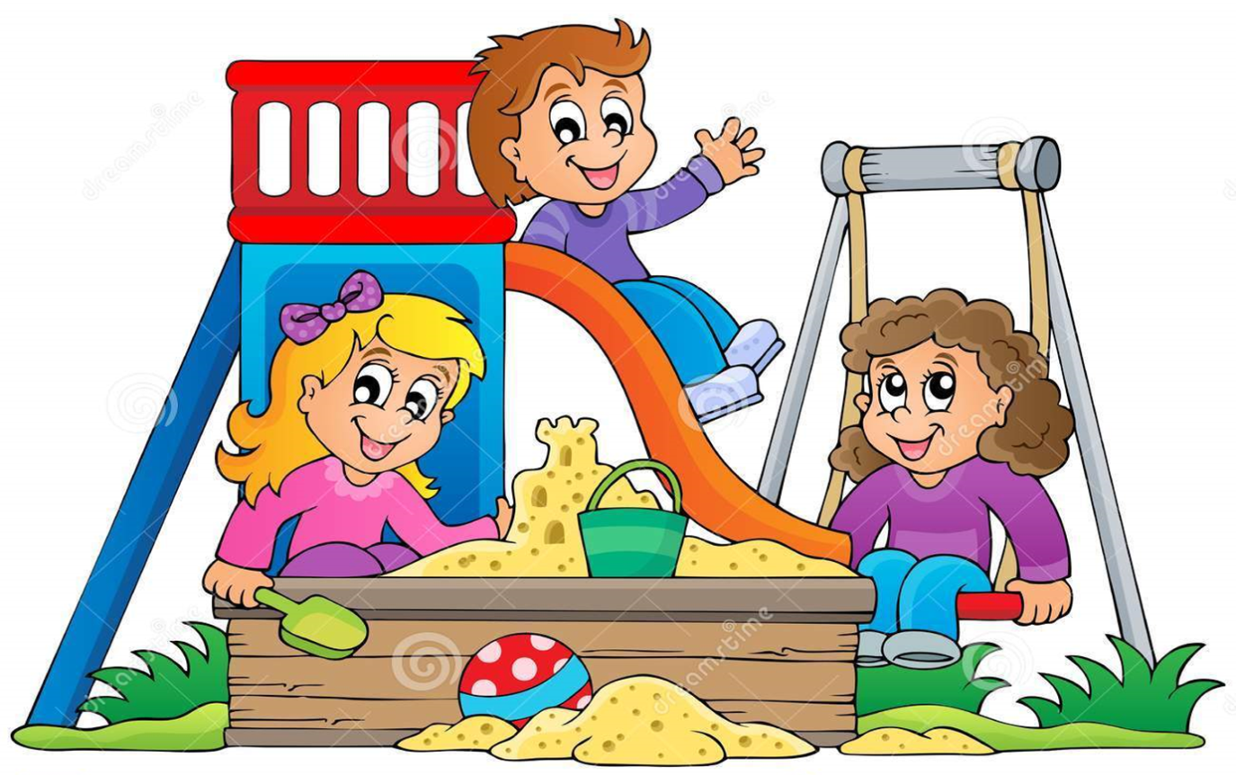

*Vocabulary:
- Badminton:
Môn cầu lông
Môn bóng đá
- Football:
- Basketball:
Môn bóng rổ
- Chess :
Môn cờ vua
- Play: chơi
- Break time:
Giờ ra chơi

Slide 16
* Sentence pattern
I play volleyball at break time.

Slide 17

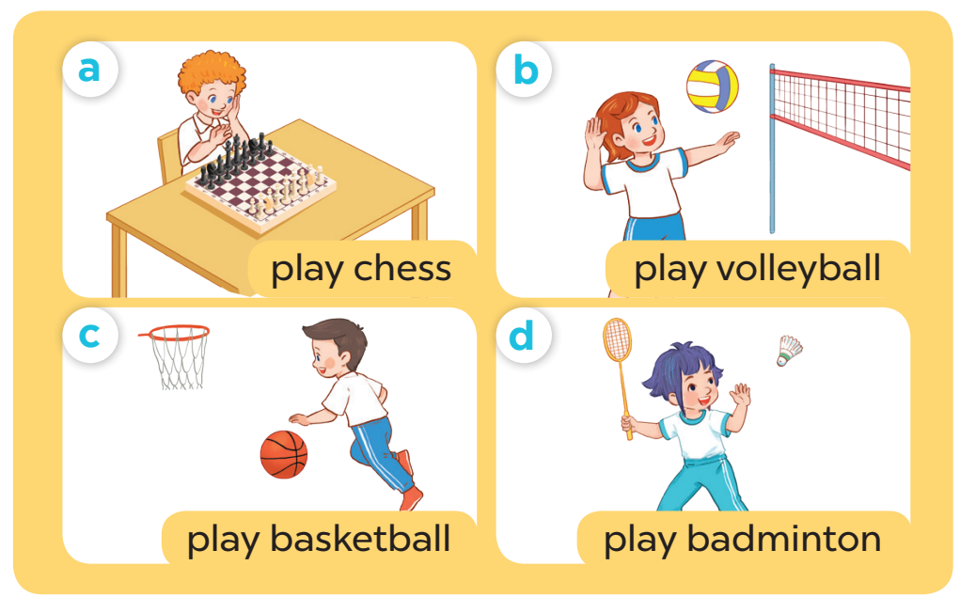

Slide 18
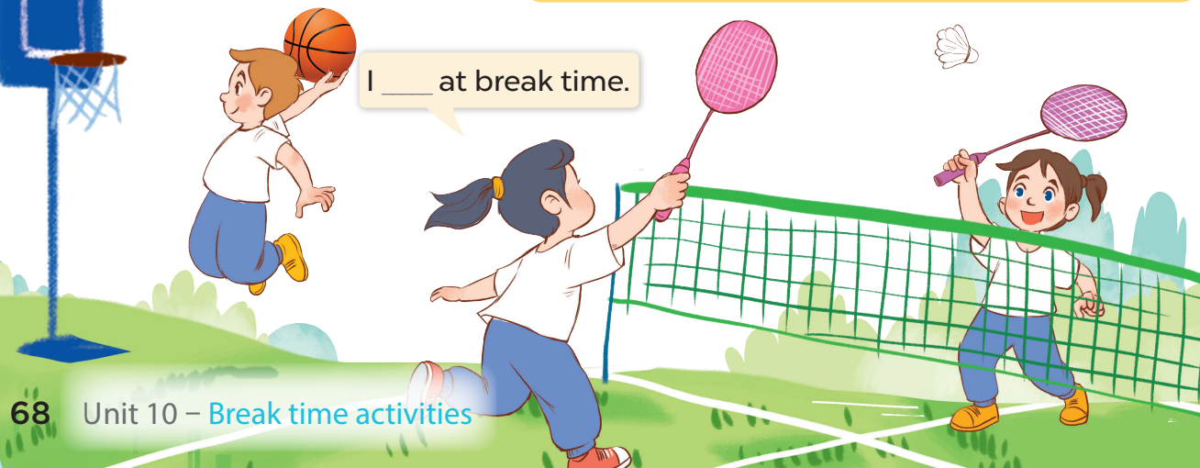
3. Let’s talk

Slide 19


I ……….. at break time
Notes:
-T asks pupils to practise in pairs asking and answering.
-T asks some pairs to present in front of the class.

Slide 20

let's play

Slide 21








Lucky number:
Peter
Mai
3
1
2
4
5
6
Notes:
Kính chao

Slide 22


Look at the picture and answer the question
A: What do you do at break time?
B: I ………………………..
play badminton
Notes:
Kính chao

Slide 23
Summary
*Vocabulary:
Play, badminton, chess, volleyball, football, break time.
*Sentence pattern:
I play volleyball at break time.

Slide 24



HOMEWORK:
-
Learn vocabulary and model sentence by heart.
- Prepare for the next lesson( Lesson 1: 4,5,6)

Slide 25

THANK YOU FOR YOUR ATTENTION

