Slide 1
Class: 3A3
Teacher:

Slide 2
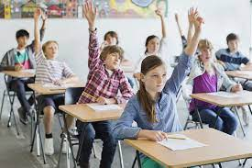
What’s in the box?
It’s an eraser..

Slide 3
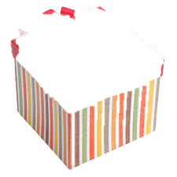

Slide 4
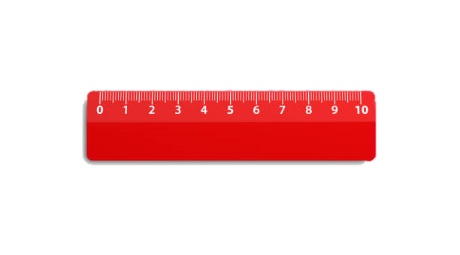

Slide 6
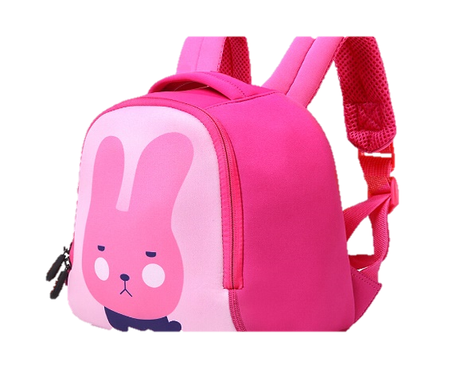

Slide 7
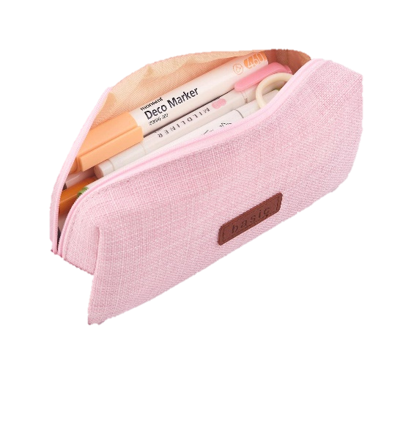

Slide 9
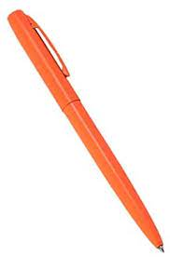
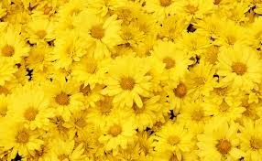
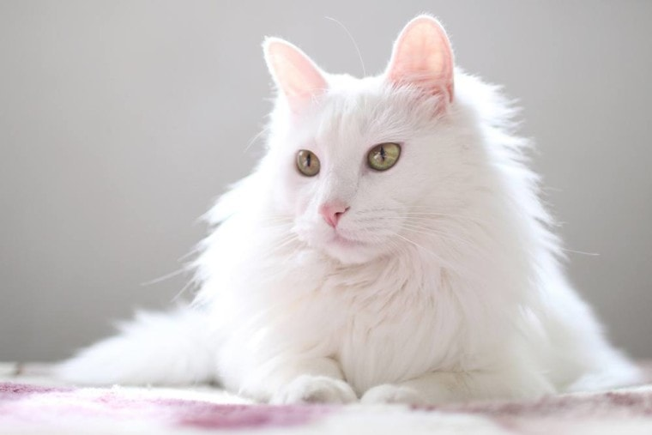
9
colours
LESSON 1
1, 2, 3

Slide 11
1. Look, listen and repeat

Slide 12
2. Listen, point and say

Slide 13
* New words:
colour: màu sắc
blue:
brown:
red:
yellow:

Slide 14
* Sentence parttern:
- What colour is it?
It’s blue.
- What colour is your pen?
It’s orange.
- What colour is this ruler?
It’s brown.

Slide 16
Sing a song together
https://www.youtube.com/watch?v=YyFLBTTAbSE

Slide 17
3. Let’s talk
What colour is it?
It’s yellow.

Slide 18
Summary
Matching game
1. colour
2. blue
3. brown
4. red
5. yellow
màu sắc
What colour is it?
It’s yellow.

Slide 19
Connection
It’s ______
It’s ______
It’s ______
What colour is __________?

Slide 20
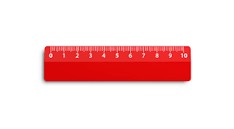
What colour is it?
It’s red.

Slide 21
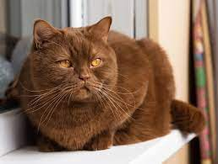
What colour is the cat?
It’s brown.

Slide 22
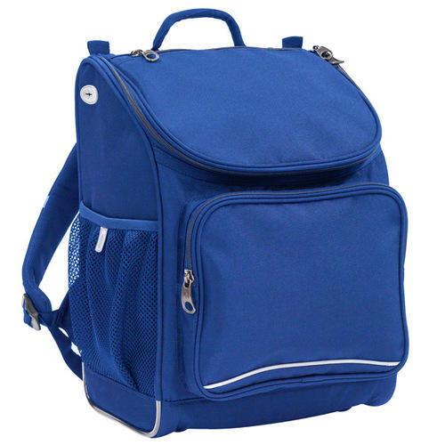
What colour is the school bag?
It’s blue.

Slide 23
What colour is this pencil?
It’s yellow.

Slide 24
Tài liệu tham khảo:
- Hình ảnh sưu tầm trên Internet
- Bài hát “what colour is it” lấy từ kênh youtube “Dream English Kids”
https://www.youtube.com/watch?v=YyFLBTTAbSE
- Các bài nghe được ghi âm từ nguồn “sachmem.vn”

