Slide 1
REVIEW 2

Slide 2
Table of Contents
1
2
3
4
Warm-up and review
Listen and tick.
Listen and number.
Fun corner and wrap-up

Slide 3
1
Warm-up and review

Slide 4
Colours
School things
Instructions
Activities
100
100
100
100
200
200
200
200
300
300
300
300
400
400
400
400
500
500
500
500
Notes:
Game:
Gv chia lớp thành 2 đội.
Gv cho hs từ mỗi đội chọn 1 chủ đề kèm với số điểm muốn nhận.
Gv click chuột vào số điểm tương ứng, hs trả lời câu hỏi.
Hs trả lời đúng thì đội sẽ được cộng điểm, trả lời sai không được điểm.
Đội nào nhiều điểm hơn khi trò chơi kết thúc sẽ là đội thắng cuộc.

Slide 5
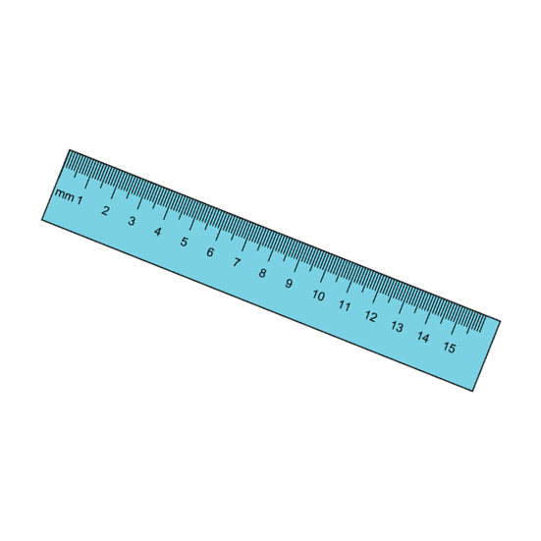
What colour is it?
It’s blue.

Slide 6
What colour is it?
It’s yellow.

Slide 7
What colour is it?
It’s pink.

Slide 8
What colour are they?
They’re green.

Slide 9
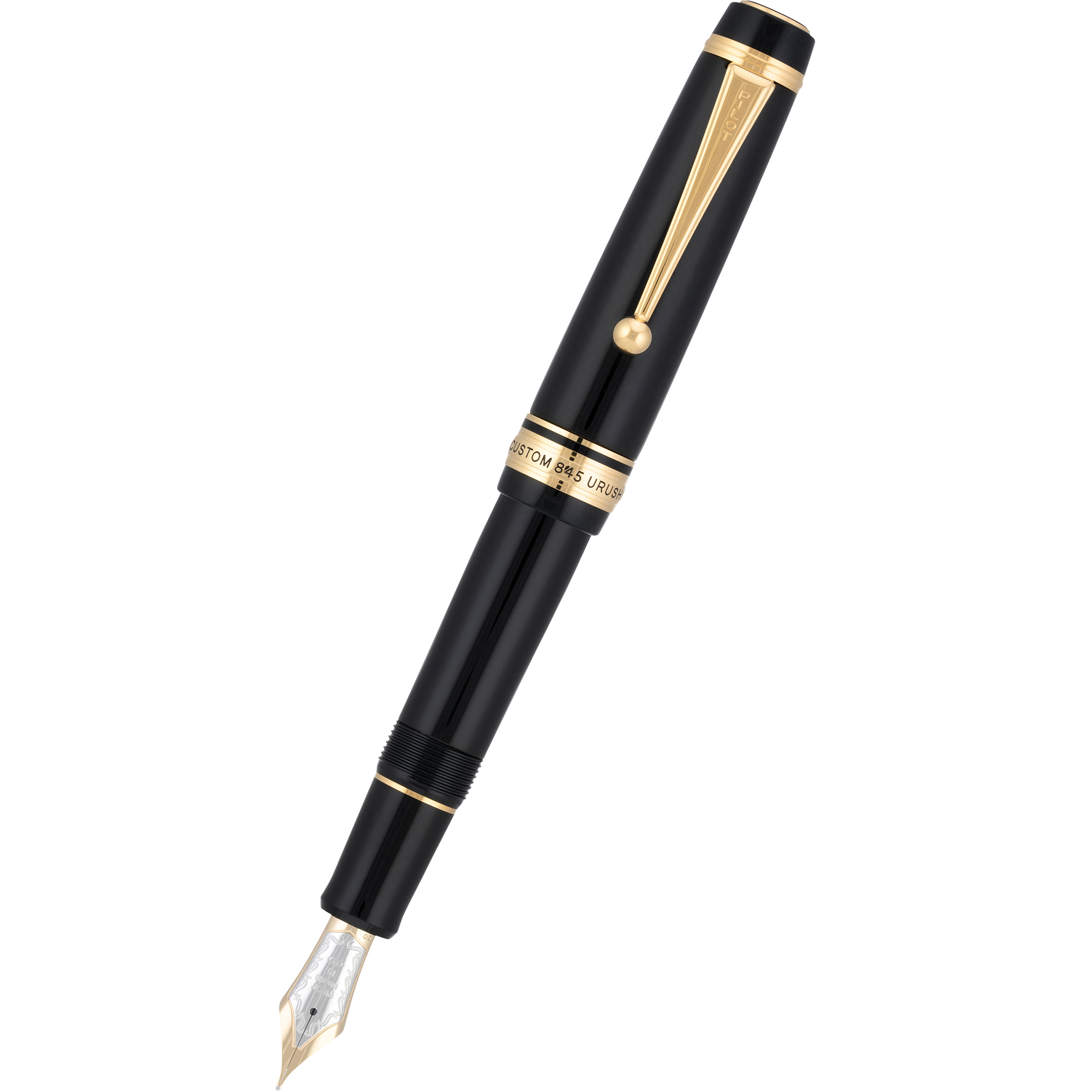
What colour are they?
They’re black.

Slide 10
Do you have ......................?
Yes, I do.

Slide 11
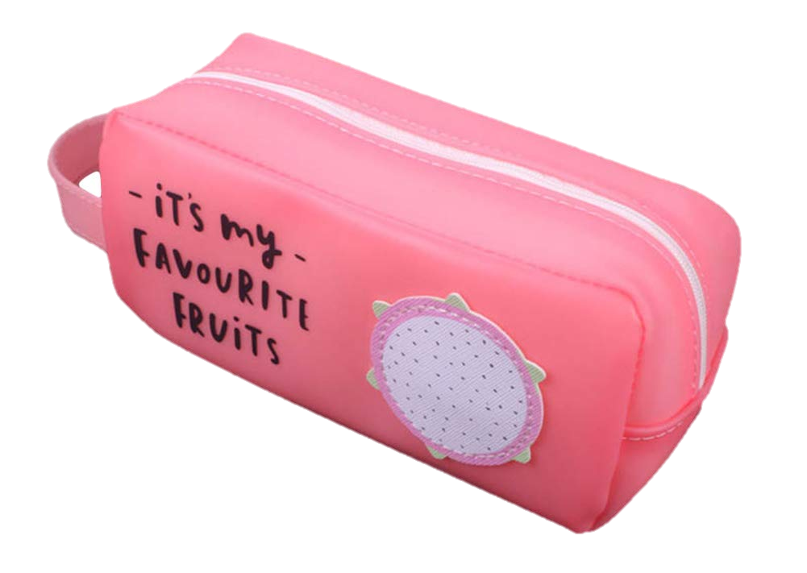
What colour is it?
It’s pink.

Slide 12
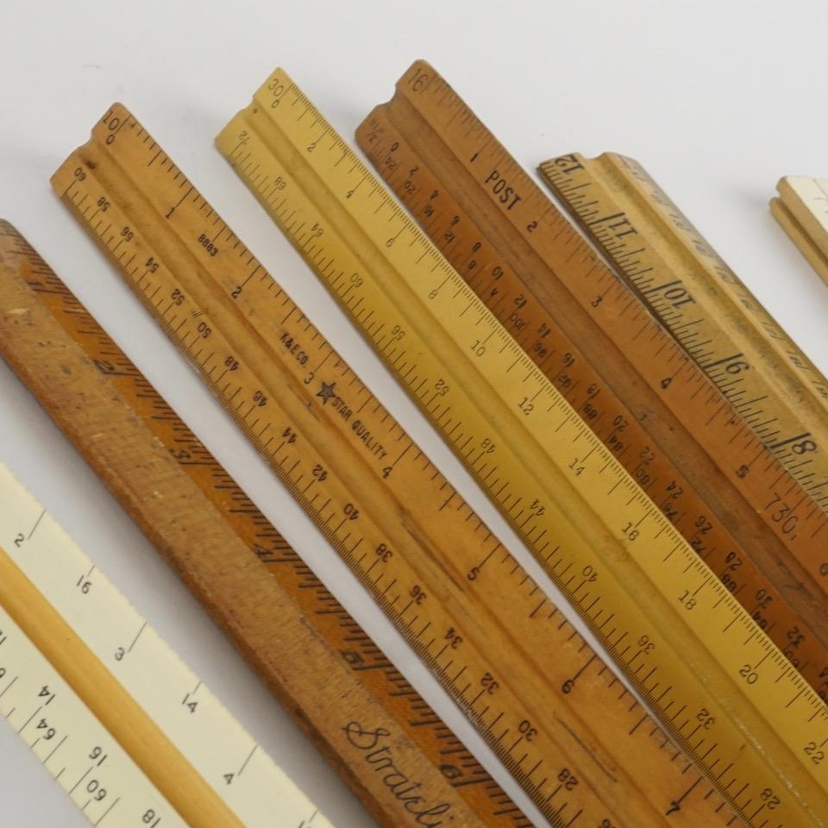
Do you have erasers?
No, I don’t. I have rulers.

Slide 13
Do you have books?
Yes, I do.

Slide 14
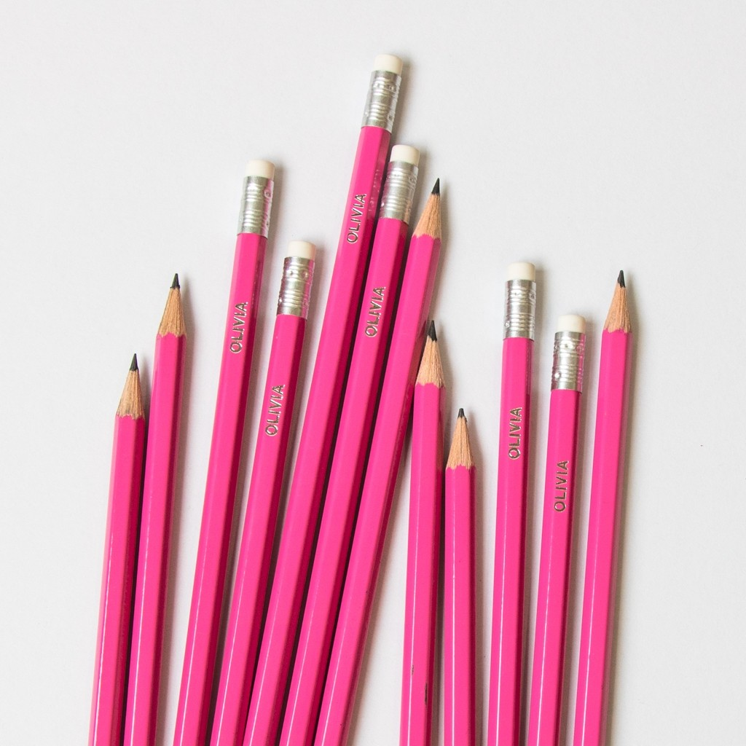
Do you have bags?
No, I don’t. I have pencils.

Slide 15
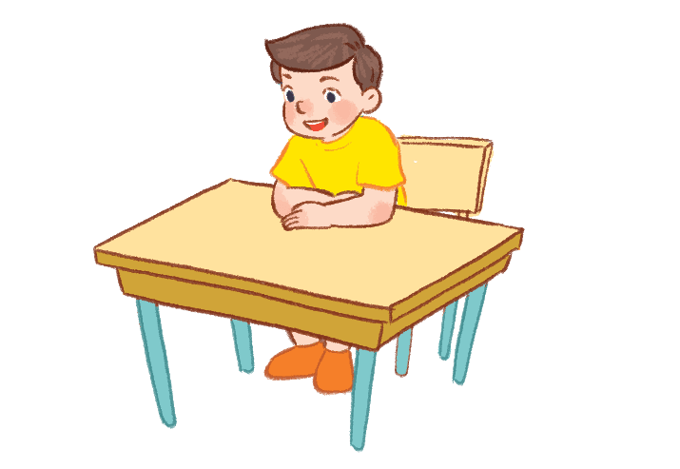
Sit down, please!

Slide 16
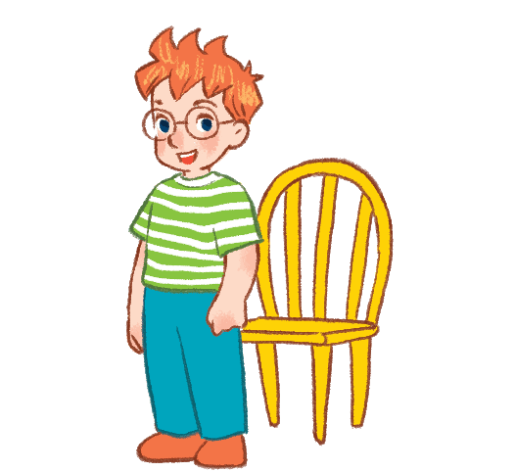
Stand up, please!

Slide 17
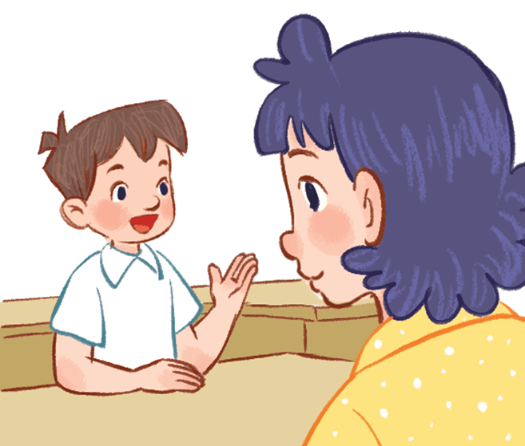
Vietnamese?
May I speak Vietnamese?

Slide 18
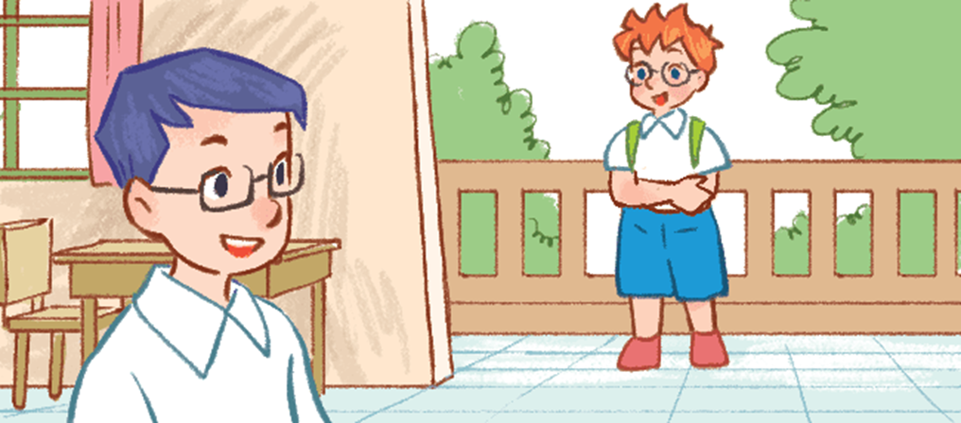
May I come in?

Slide 19
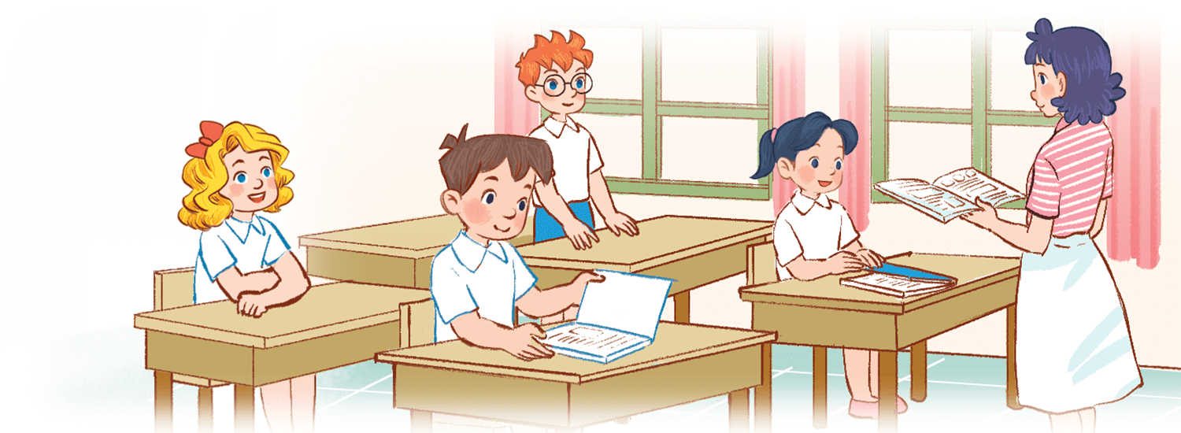
May I close the book?

Slide 20
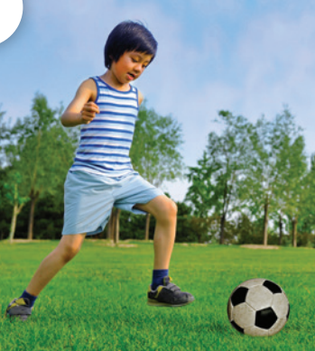
What do you do at break time?
I play football.

Slide 21
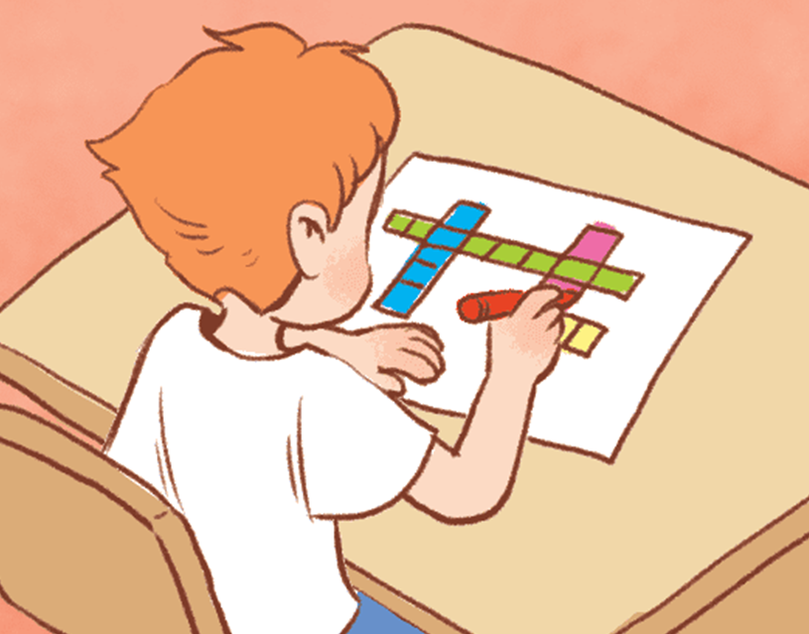
What do you do at break time?
I do word puzzles.

Slide 22
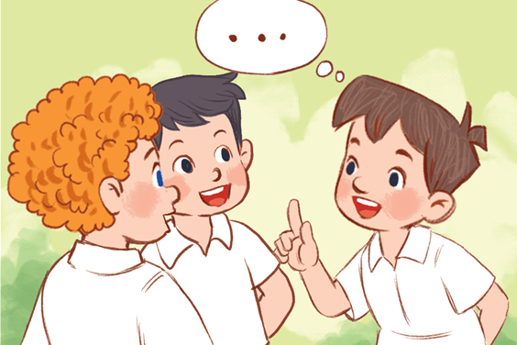
What do you do at break time?
I chat with my friends.

Slide 23
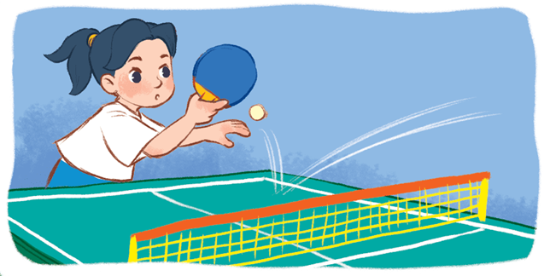
What do you do at break time?
I play table tennis.

Slide 24
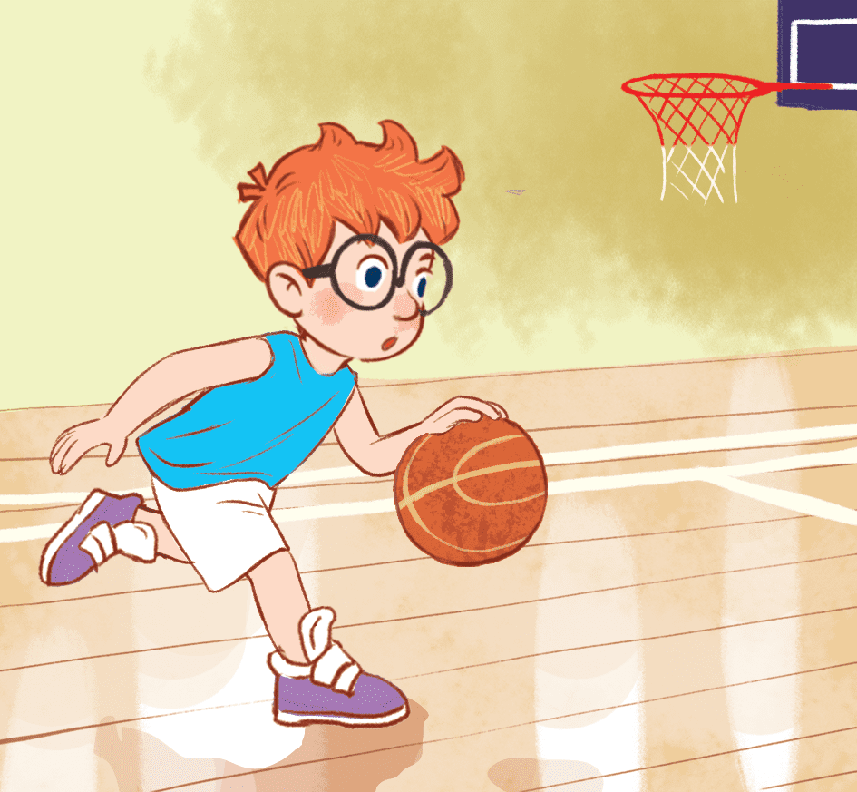
What do you do at break time?
I play basketball.

Slide 25
2
Listen and tick.

Slide 26
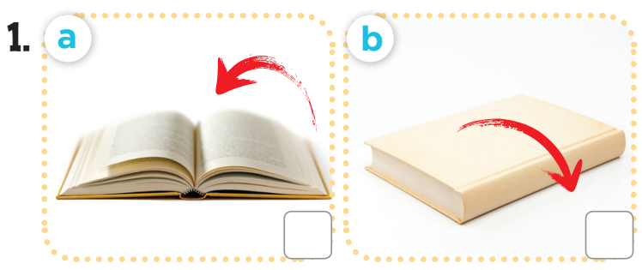
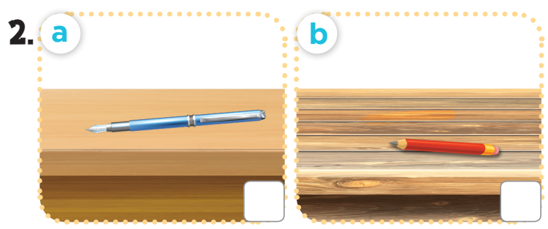
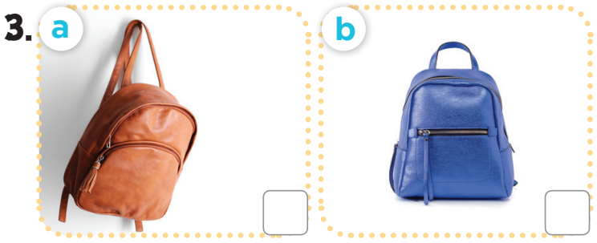
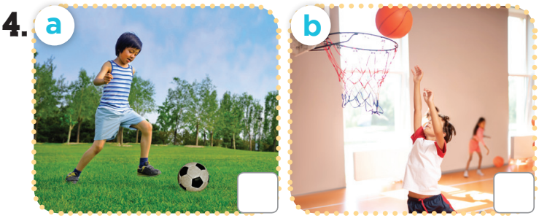
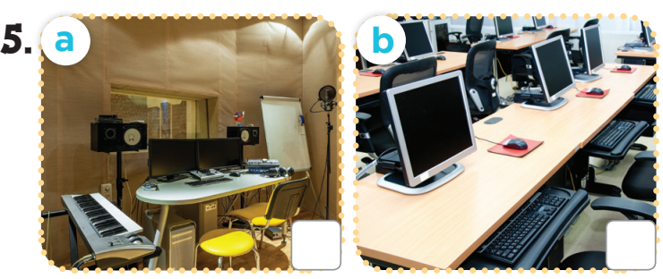

Slide 27
3
Listen and number.

Slide 28
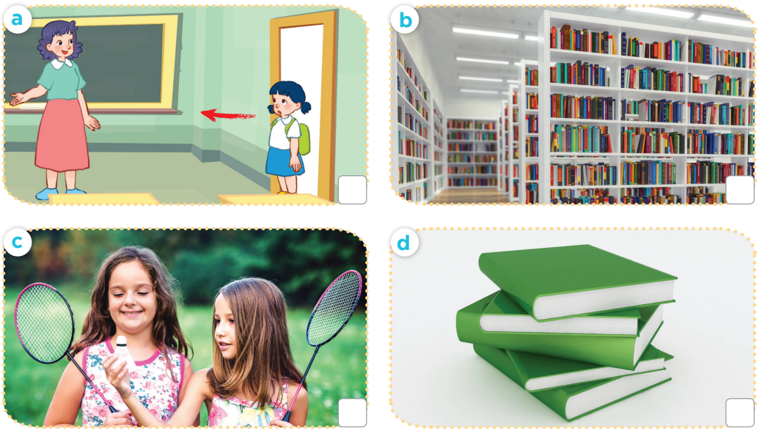

Slide 29
3
1
4
2

Slide 30
4
Fun corner and wrap-up

Slide 31
Notes:
Pupils work in groups. Each group has a set of questions related to the topics from unit 6 - 10.
Pupils ask and answer the questions in groups.
The fastest group to finish all the questions is the winner.

