Slide 2
Warm up
Play a game: apple picking

Slide 3
APPLE PICKING

Slide 4
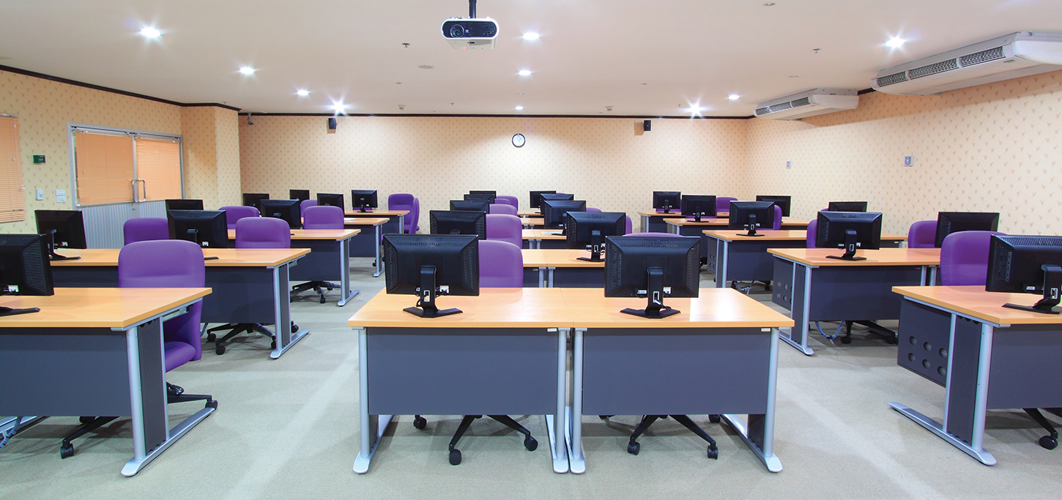
Question 1
What’s room?
Computer room

Slide 5
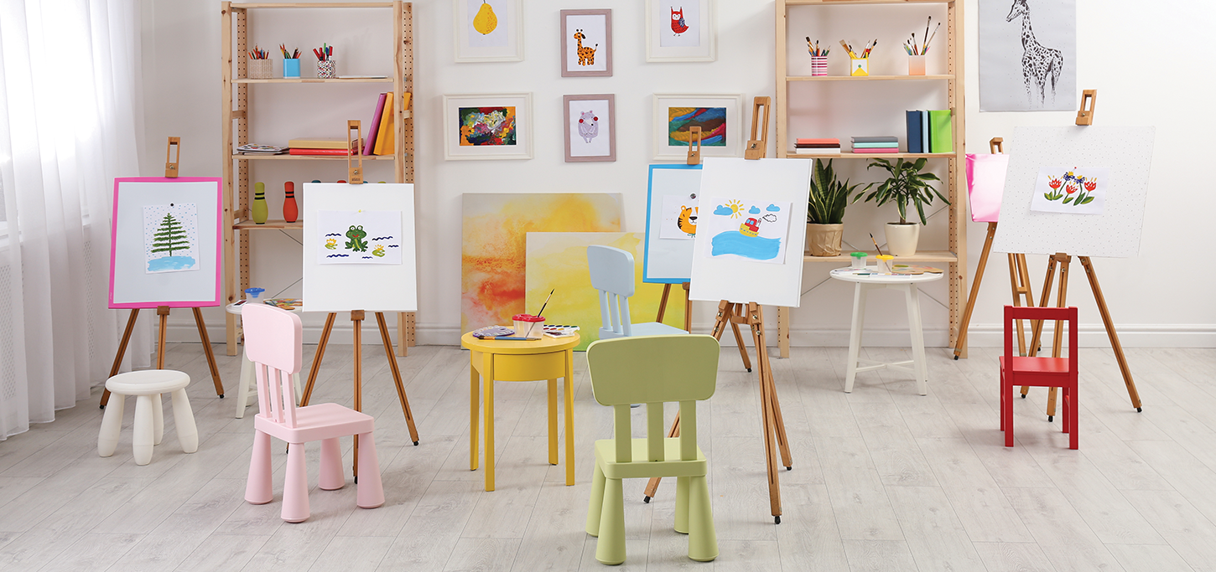
Question 2
What’s room?
Art room

Slide 6
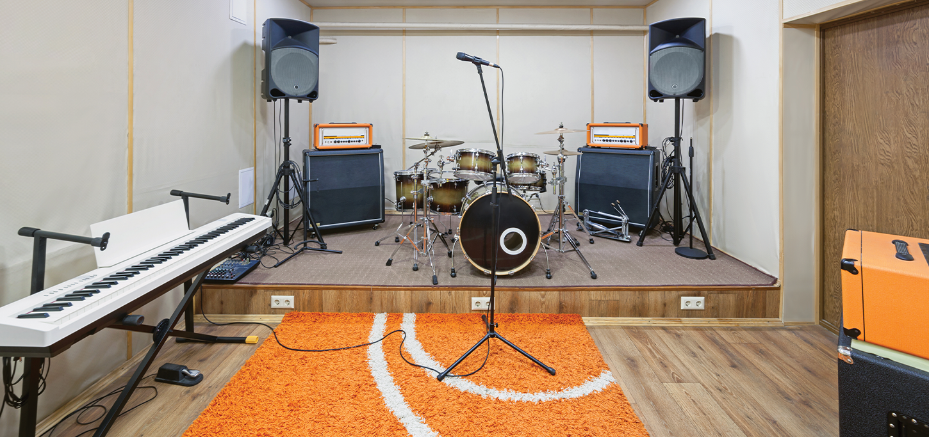
Question 3
What’s room?
Music room

Slide 7
Question 4
What’s room?
gym

Slide 8
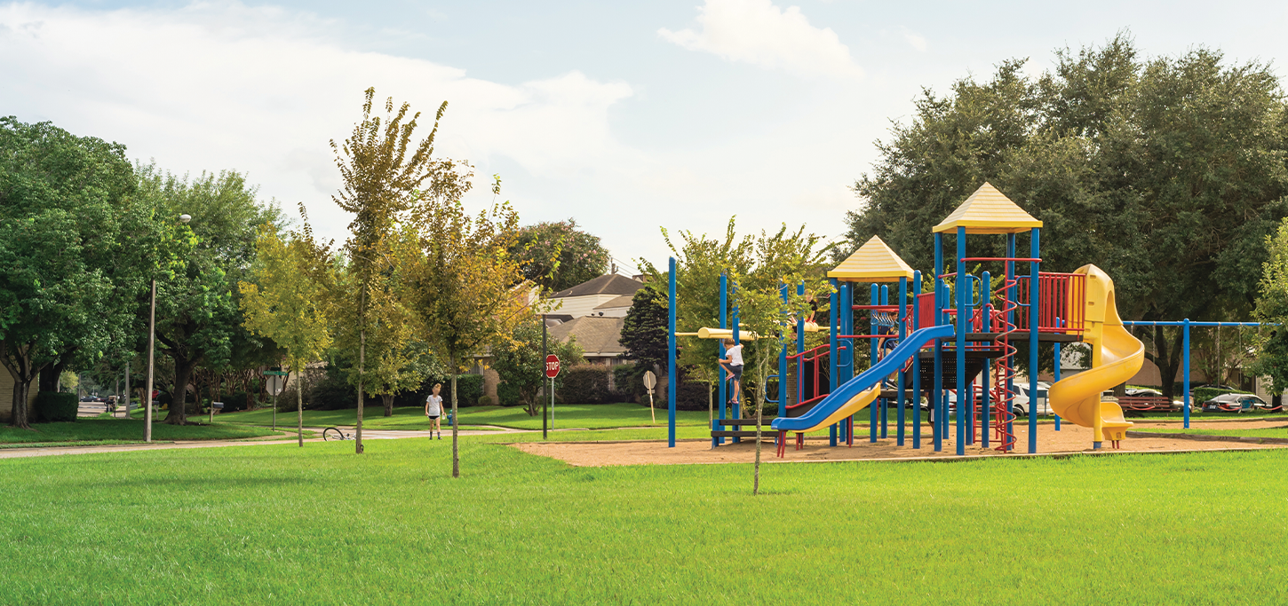
Question 5
What’s room?
playground

Slide 9
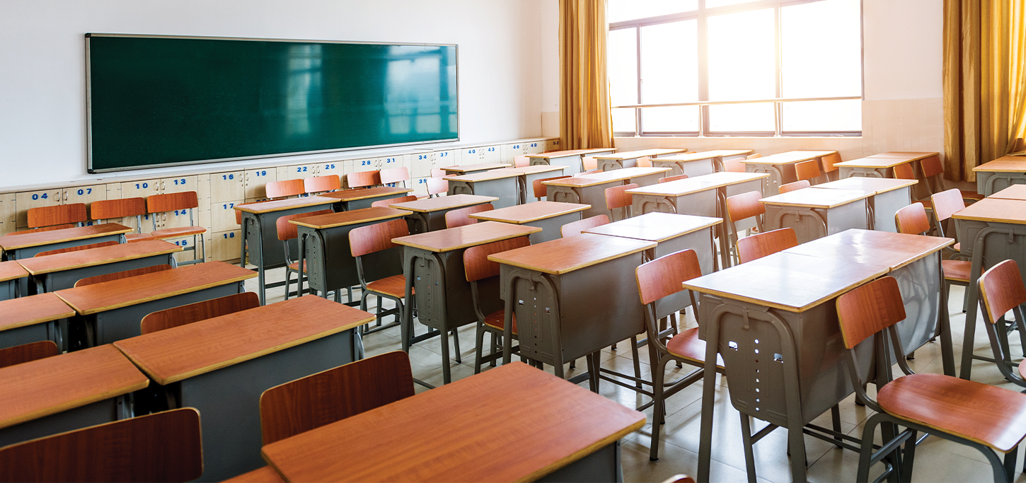
Question 6
What’s room?
classroom

Slide 10
6
Our school
LESSON 2 - PERIOD 4

Slide 11
Listen and number.

Slide 12
Activity 5:
Read and match.

Slide 16
FUN CORNER

Slide 17
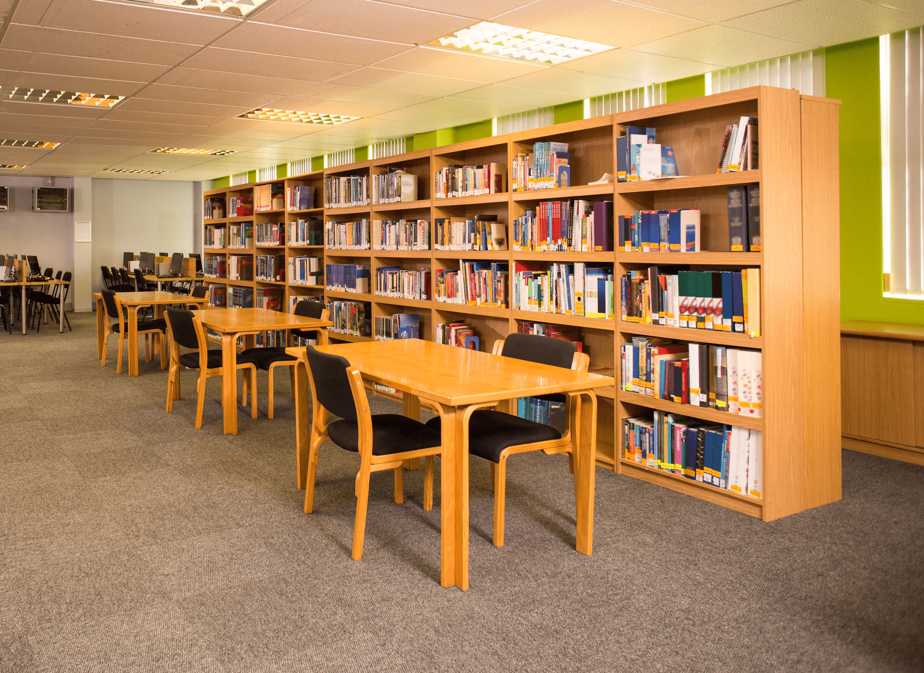
Read and say the correct answer.
We like reading.
Let’s go to the library.

Slide 18
1 point
5 points
SPIN
3 points
2 points
10 points
tekhnologic
Notes:
5 Segments

Slide 19
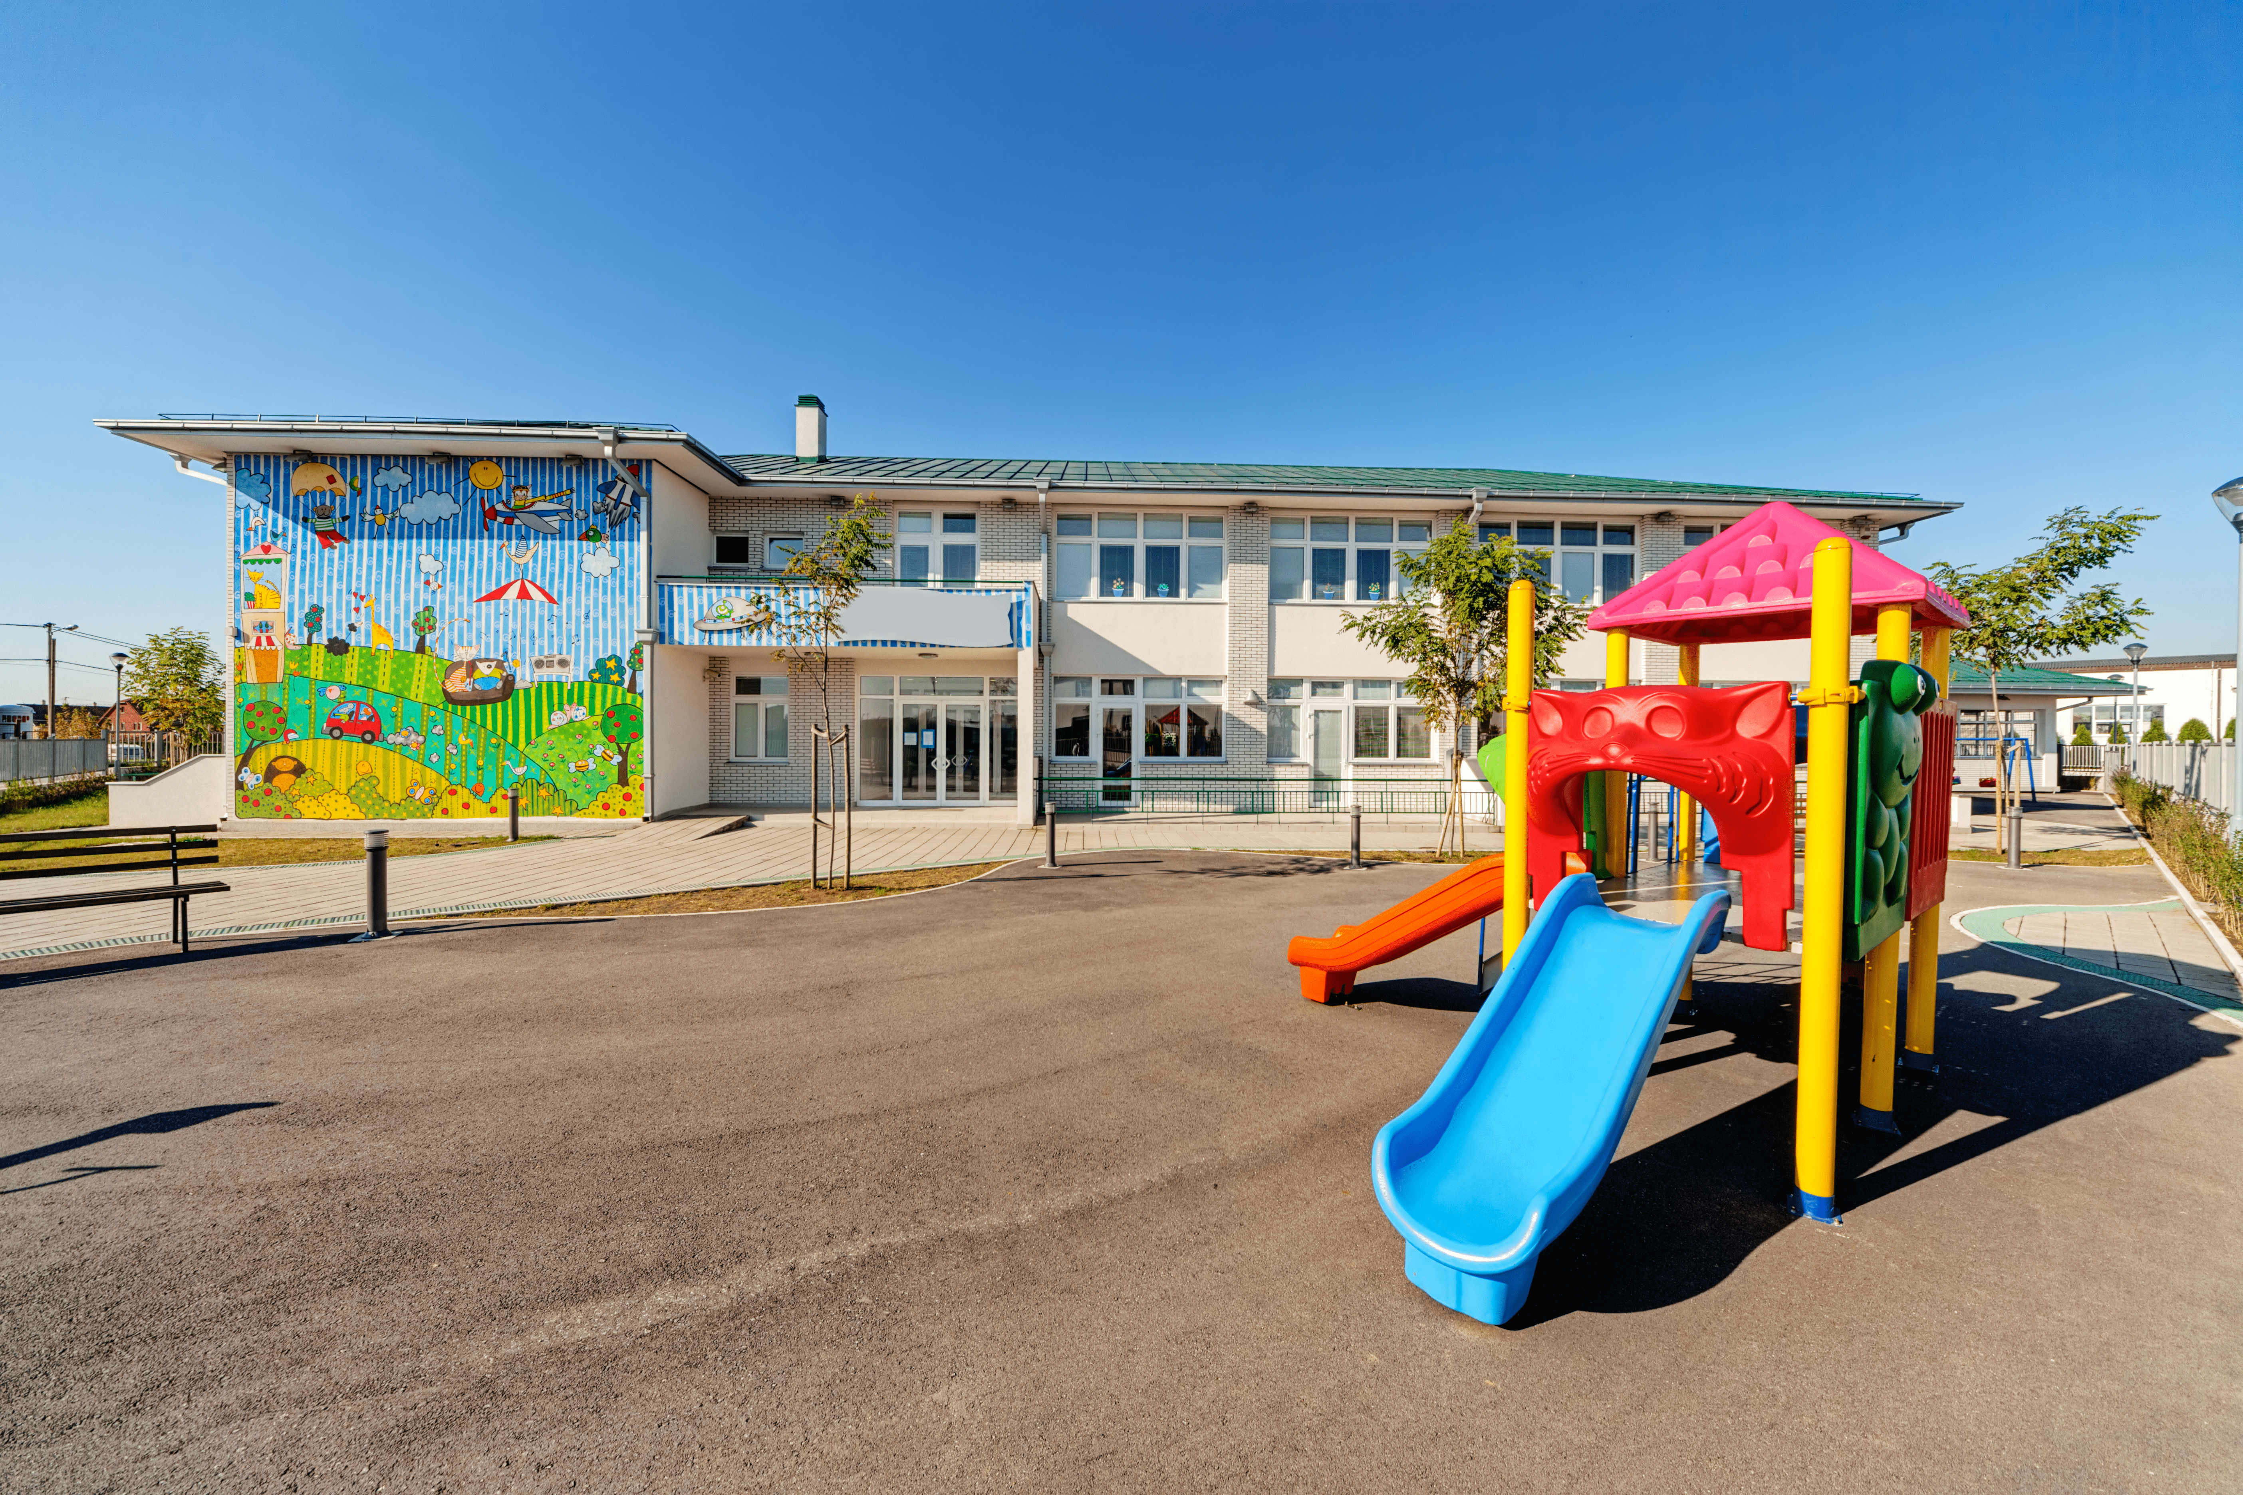
Read and say the correct answer.
I like running and playing.
Let’s go to the playground.

Slide 20
1 point
5 points
SPIN
3 points
2 points
10 points
tekhnologic
Notes:
5 Segments

Slide 21
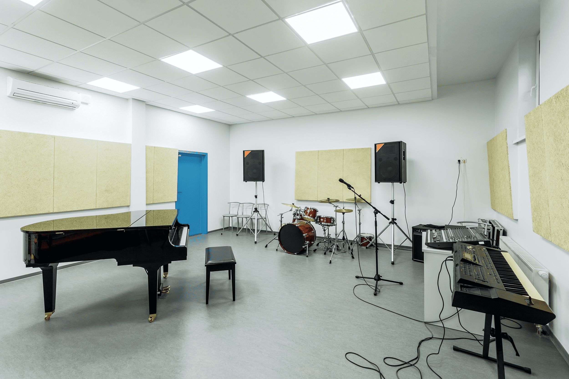
Read and say the correct answer.
We like singing songs.
Let’s go to the music room.

Slide 22
1 point
5 points
SPIN
3 points
2 points
10 points
tekhnologic
Notes:
5 Segments

Slide 23
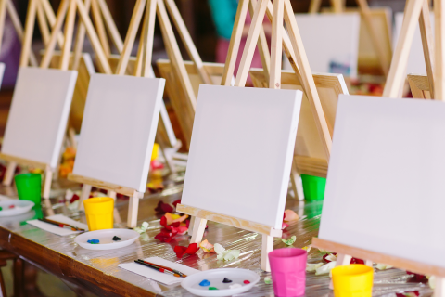
Read and say the correct answer.
I like drawing.
Let’s go to the art room.

Slide 24
1 point
5 points
SPIN
- 3 points
2 points
10 points
tekhnologic
Notes:
5 Segments

Slide 25
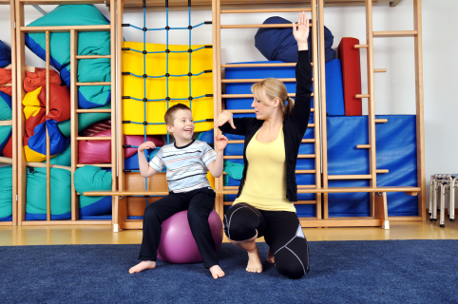
Read and say the correct answer.
We like playing sports.
Let’s go to the gym.

Slide 26
10 point
5 points
SPIN
3 points
2 points
10 points
tekhnologic
Notes:
5 Segments

Slide 27
Read and say the correct answer.
I like playing computer games.
Let’s go to the computer room.

Slide 28
10 point
5 points
SPIN
3 points
2 points
10 points
tekhnologic
Notes:
5 Segments

