Slide 1



Slide 2



13
My house
LESSON 3 - PERIOD 6

Slide 3
TABLE OF CONTENTS
Warm-up and review
Read and complete.
1
2
3
Let’s write.
4
Project
5
Fun corner and wrap-up

Slide 4
1
Warm-up and review

Slide 5










TEAM 1
TEAM 2
TEAM 3
Notes:
- Divide the class into 3 teams.
- Each team takes turn choosing a number.

Slide 6




= 10 points
= - 20 points
= 50 points

Slide 7
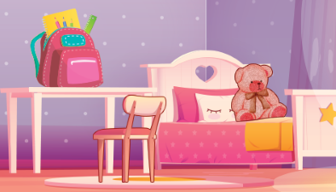
Where is the teddy bear?
It’s on the bed.

Slide 8
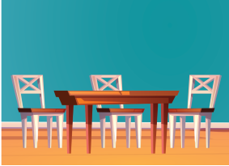
Where are the chairs?
They’re next to the table.

Slide 9
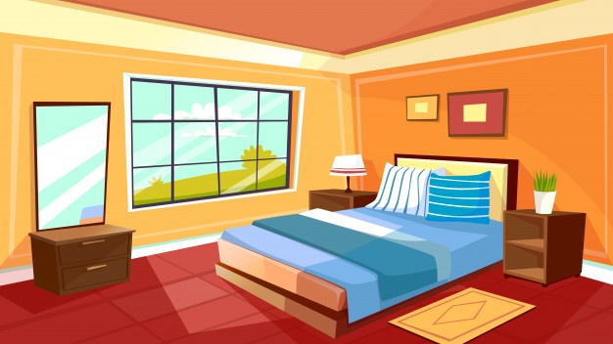
Where is the bed?
It’s in the bedroom.

Slide 10

Where is the bedroom?
It’s here.

Slide 11
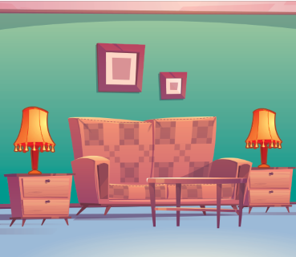
Where is the sofa?
It’s between the lamps.

Slide 12
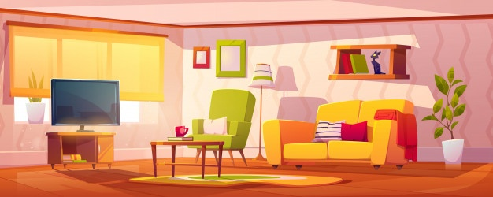
Where is the TV?
It’s in the living room.

Slide 13
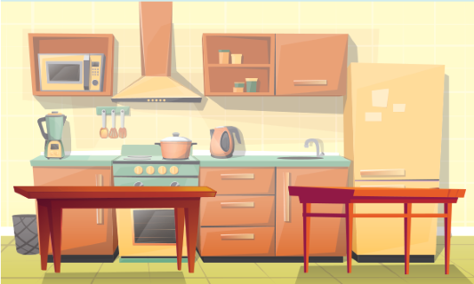
Where are the tables?
They are in the kitchen.

Slide 14
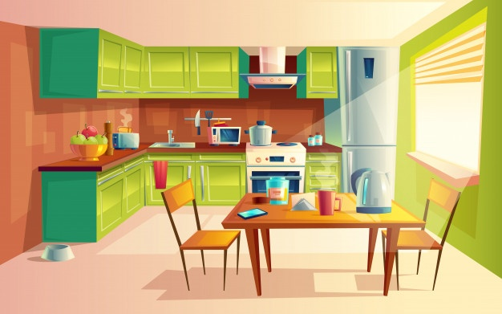
Where is the kitchen?
It’s there.

Slide 15
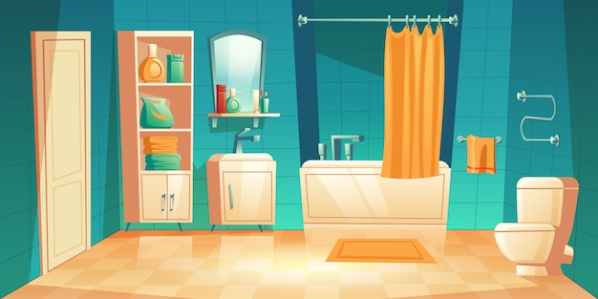
Where is the bathroom?
It’s here.

Slide 16
2
Read and complete.

Slide 17
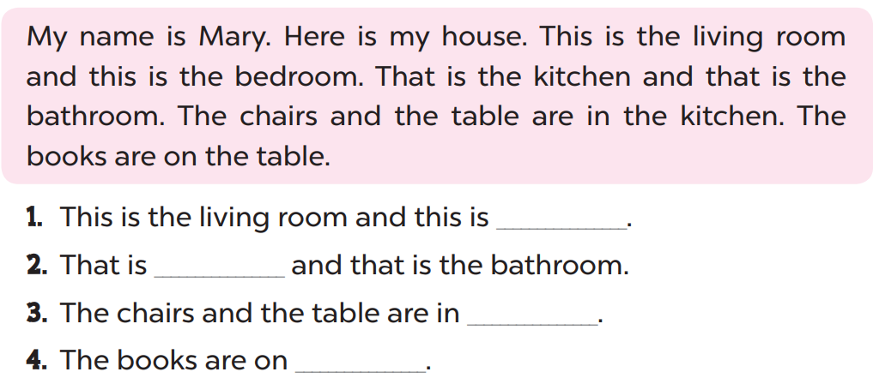
the bedroom
the kitchen
the kitchen
the table

Slide 18
3
Let’s write.

Slide 19
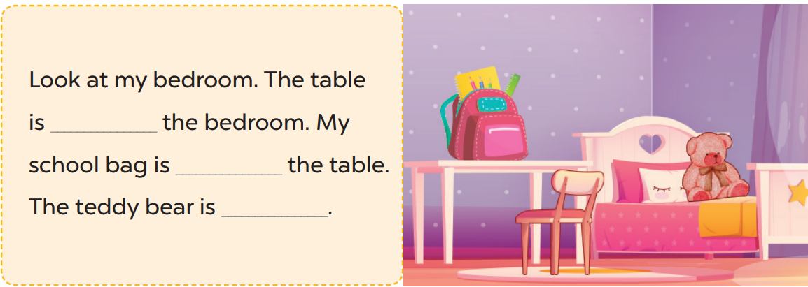
next to
on
on the bed

Slide 20
4
Project

Slide 21
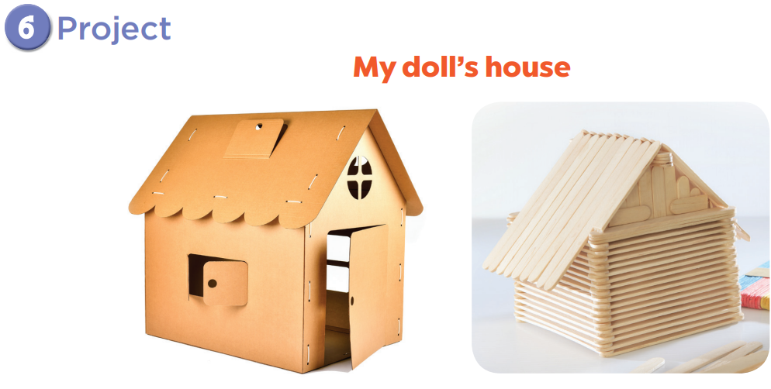

Slide 22

Notes:
Create a class display of doll’s houses and have pupils vote for the best decorated one.

Slide 23
5
Fun corner and wrap-up

Slide 24


1
2
3
4
5
a
+1
+2
+3
+2
b
+5
+2
+4
c
+3
+1
+5
+3
+5
d
+1
+5
+4
+3
e
+2
+4
+1
+4
Notes:
Giáo viên chuẩn bị các câu hỏi liên quan đến bài học.
Chia lớp thành 2 nhóm.
Nếu học sinh trả lời đúng sẽ được chọn 1 ô.

Slide 25

Website: hoclieu.vn
Fanpage: facebook.com/www.tienganhglobalsuccess.vn

