Slide 1



Slide 2



13
My house
LESSON 3 - PERIOD 5

Slide 3
TABLE OF CONTENTS
Warm-up and review
Listen and repeat.
1
2
3
4
Let’s chant.
Listen and circle.
5
Fun corner and wrap-up

Slide 4
1
Warm-up and review

Slide 5

2
5
7
4
1
8
3
6
Notes:
Review the previous lesson by having the class play the game Lucky number, using the model sentences.
Click the number to go to the question.

Slide 6




=
-
=
Notes:
There’s a bomb and an egg. The number with the egg is the lucky number.

Slide 7

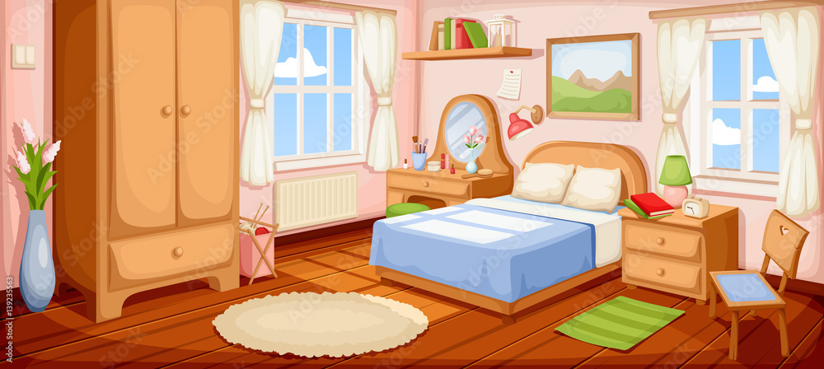



Where is the bedroom?
It’s here.
Notes:
Teacher asks the question. Students reply using the model sentences in the previous lesson. Click the rabbit to go back to the question slide.

Slide 8
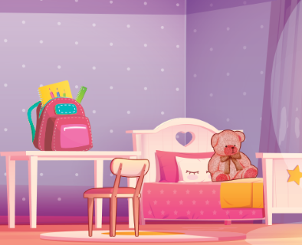

Where is the bed?
You have an egg!
It’s there.

Slide 9
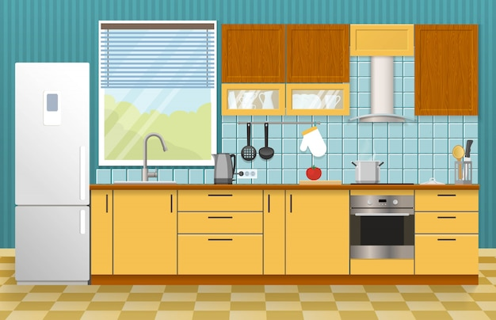
Where is the kitchen?
It’s here.
It’s here!

Slide 10

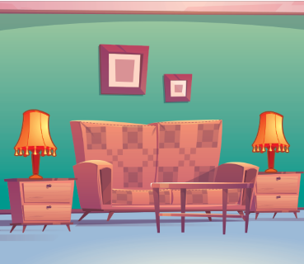
Where are the lamps?
Good luck next time!
They are in the living room.

Slide 11
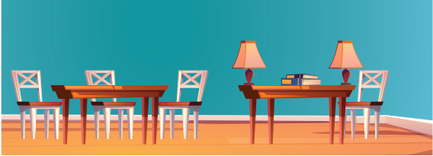
Where are the books?
They are on the table.

Slide 12
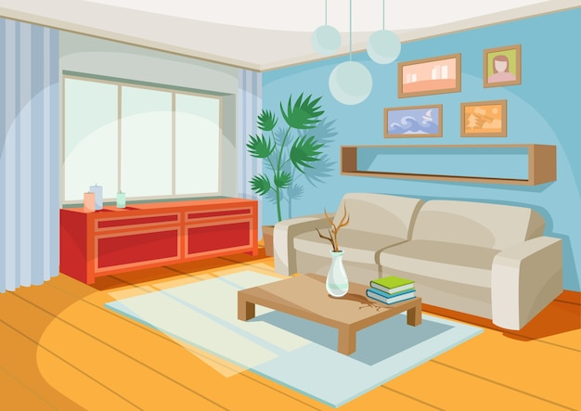
Where is the living room?
It’s here.

Slide 13
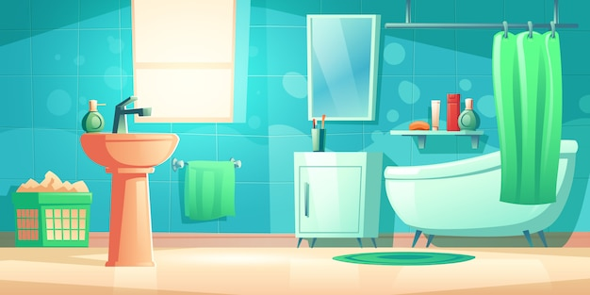
Where is the bathroom?
It’s there.

Slide 14
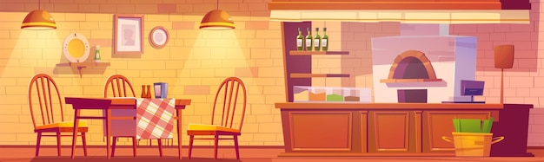
Where are the table?
It’s in the kitchen.

Slide 15
2
Listen and repeat.

Slide 16

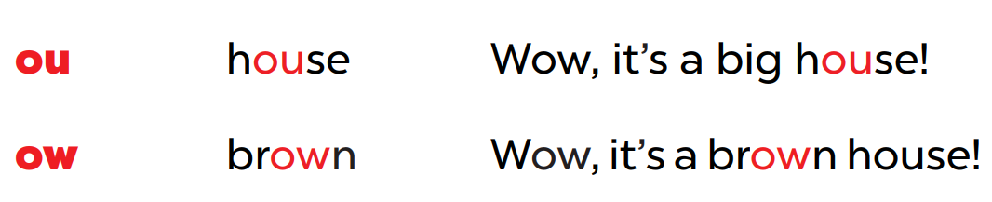

Slide 17
/aʊ/
ou
h
se
Wow, it’s a big house!

Slide 18
/aʊ/
ow
br
n
Wow, it’s a brown house!

Slide 19
3
Listen and circle.

Slide 20
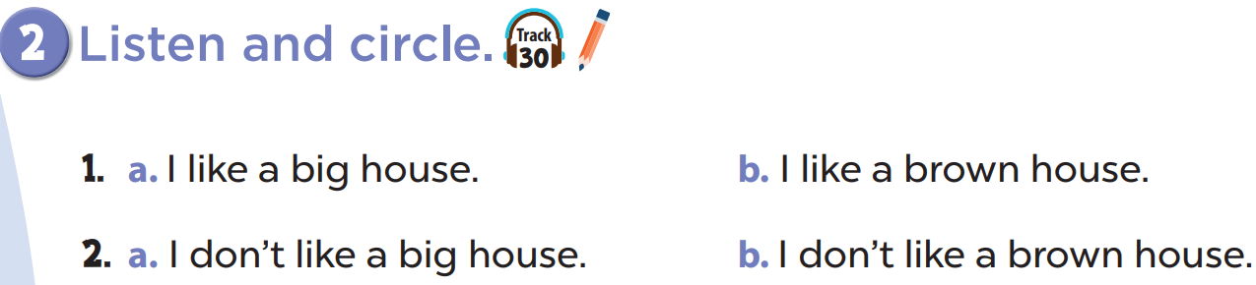

Slide 21
4
Let’s chant.

Slide 22
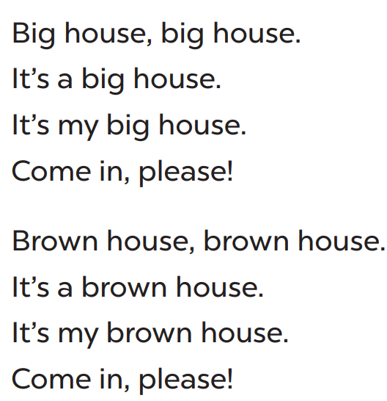
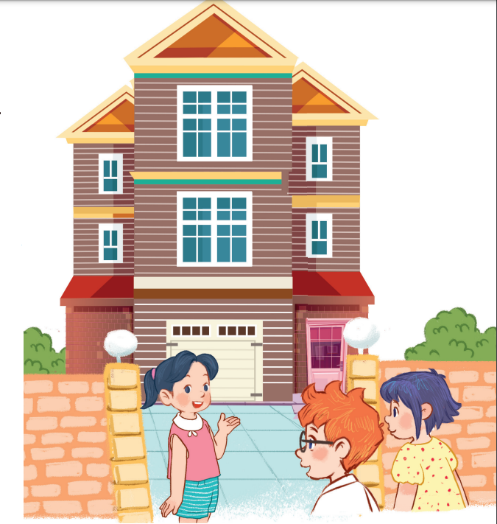

Slide 23
5
Fun corner and wrap-up

Slide 24
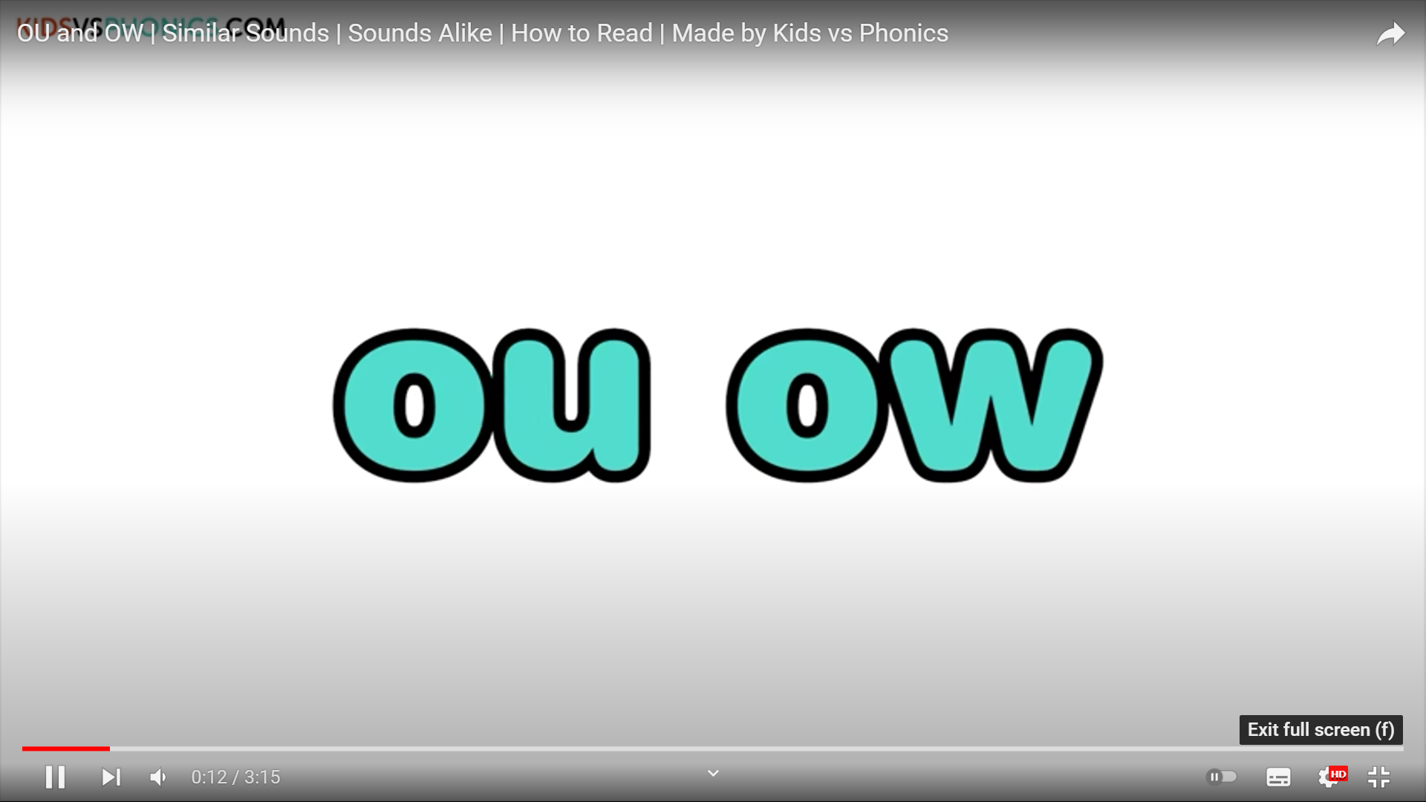
Notes:
https://www.youtube.com/watch?v=ySRd-Amrd28

Slide 25

Website: hoclieu.vn
Fanpage: facebook.com/www.tienganhglobalsuccess.vn

