Slide 1



Slide 2



13
My house
LESSON 1 - PERIOD 2

Slide 3
TABLE OF CONTENTS
Warm-up and review
Listen and circle.
01.
02.
Let’s sing.
03.
04.
Look, complete and read.
05.
Fun corner and wrap-up

Slide 4
01.
Warm-up and review

Slide 5
0
0
0
O
O
O
X
X
X
1
2
3
X
X
X
0
0
0
O
O
O
X
X
X
4
5
6
X
X
X
0
0
0
O
O
O
X
X
X
7
8
9
X
X
X
Notes:
Divide the class into 2 teams.
The teams take turns to choose numbers. Teacher asks and has pupils answer the questions.
For each correct answer, have the team add O or X to the board. The first team to line up three of their symbols in a row wins.

Slide 6
02.
Listen and circle.

Slide 7
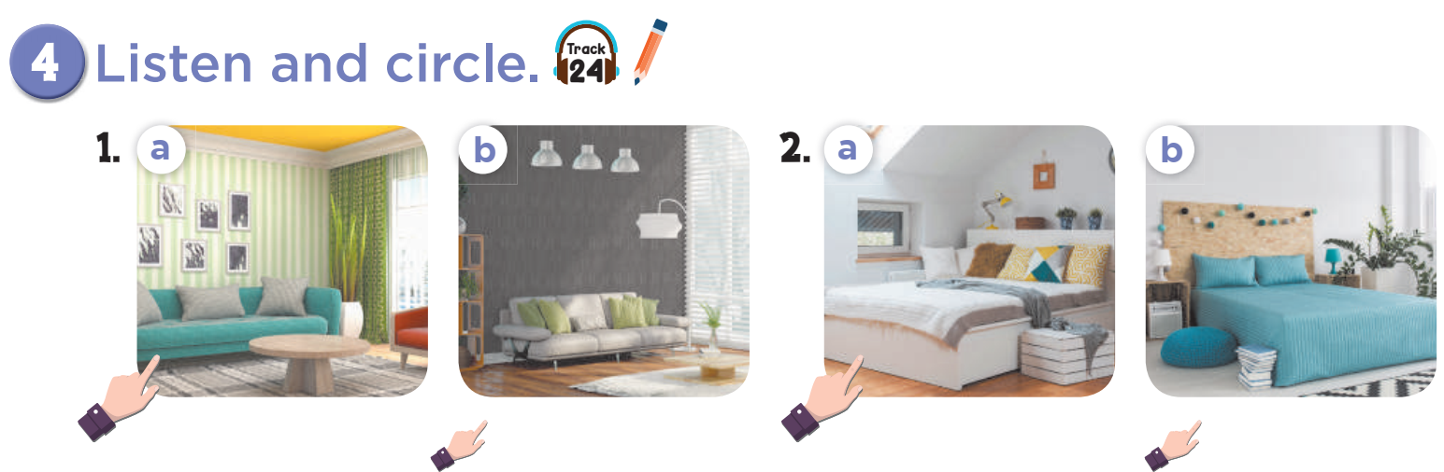


Slide 8
03.
Look, complete and read.

Slide 9
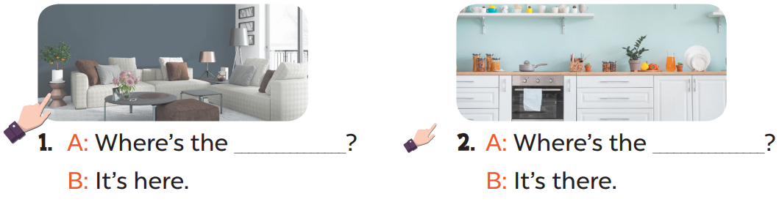
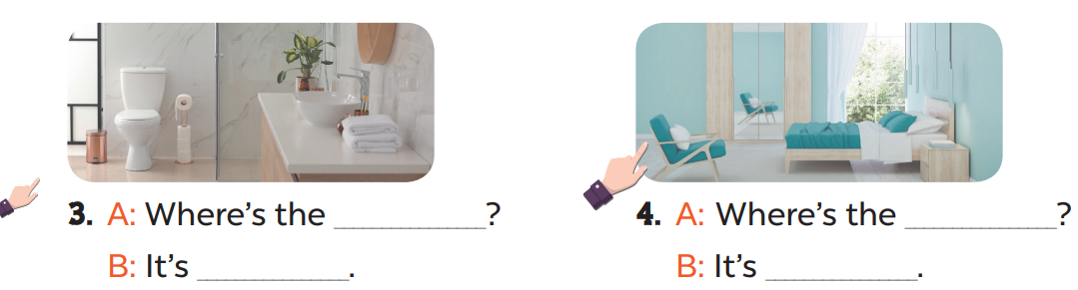
living room
kitchen
bathroom
bedroom
there
here

Slide 10
04.
Let’s sing.

Slide 11
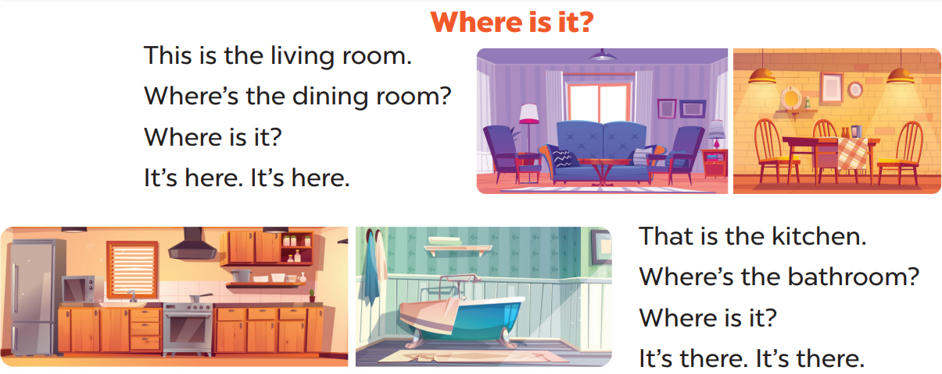

Slide 12
05
Fun corner and wrap-up

Slide 13
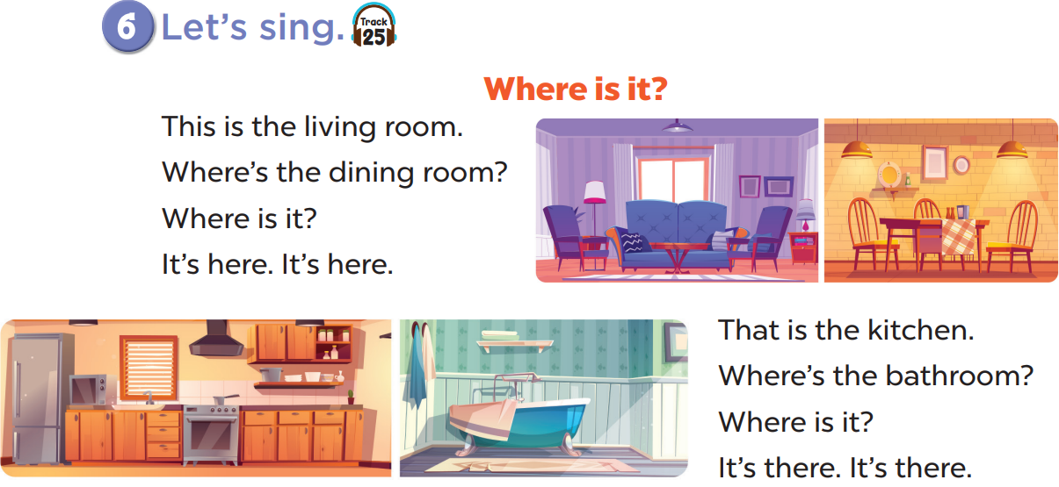
Sing the song quietly.

Slide 14
Sing the song loudly.

Slide 15

Website: hoclieu.vn
Fanpage: facebook.com/www.tienganhglobalsuccess.vn

