Slide 1



Slide 2




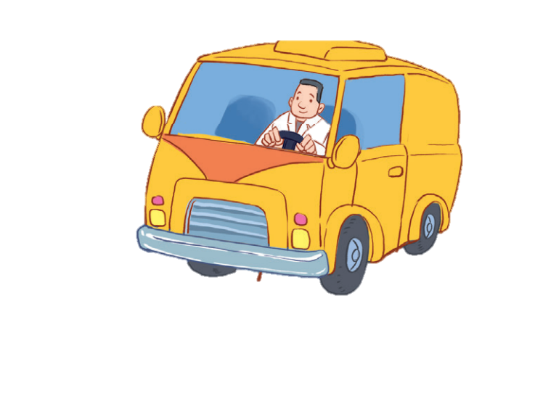

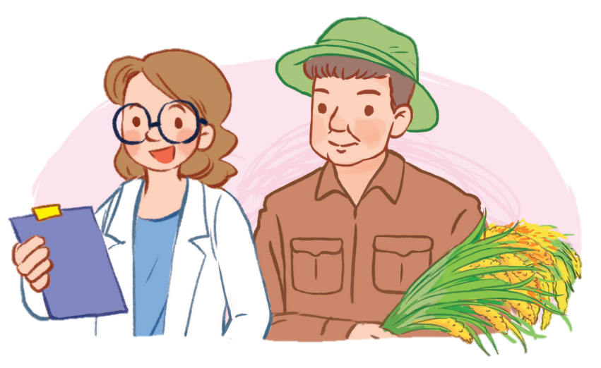
12
LESSON 3 – Period 5

Slide 3
Contents
Warm-up and review
Listen and repeat.
Listen and circle.
Let’s chant.
1
2
3
4
5
Fun corner and wrap-up

Slide 4
1
Warm-up and review

Slide 5


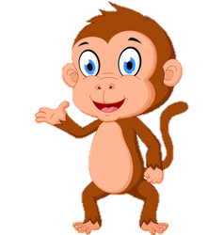

Picking coconut
Notes:
Step 1: Divide the class into 4 teams.
Step 2: Invite one pupil from each team to the front, listen to the recording and choose the right answer.
Step 3: Encourage pupils to join in the game.
Step 4: Give points to pupils.

Slide 6





Look and click on the right coconut!
farmer
driver
doctor
We did it!
driver

Slide 7



Look and click the right coconut!
nurse
worker
driver
We did it!
nurse

Slide 8

Look and click on the right coconut!
teacher
doctor
cook
We did it!
cook

Slide 9

Look and click the right coconut!
singer
teacher
doctor
We did it!
teacher

Slide 10

Look and click the right coconut!
nurse
farmer
teacher
We did it!
farmer

Slide 11
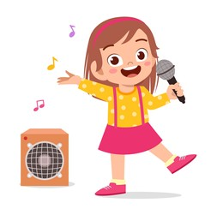
Look and click the right coconut!
worker
doctor
singer
We did it!
singer

Slide 12

Look and click the right coconut!
worker
cook
driver
We did it!
worker

Slide 13

Look and click the right coconut!
singer
doctor
worker
We did it!
doctor

Slide 14
2
Listen and repeat.

Slide 15
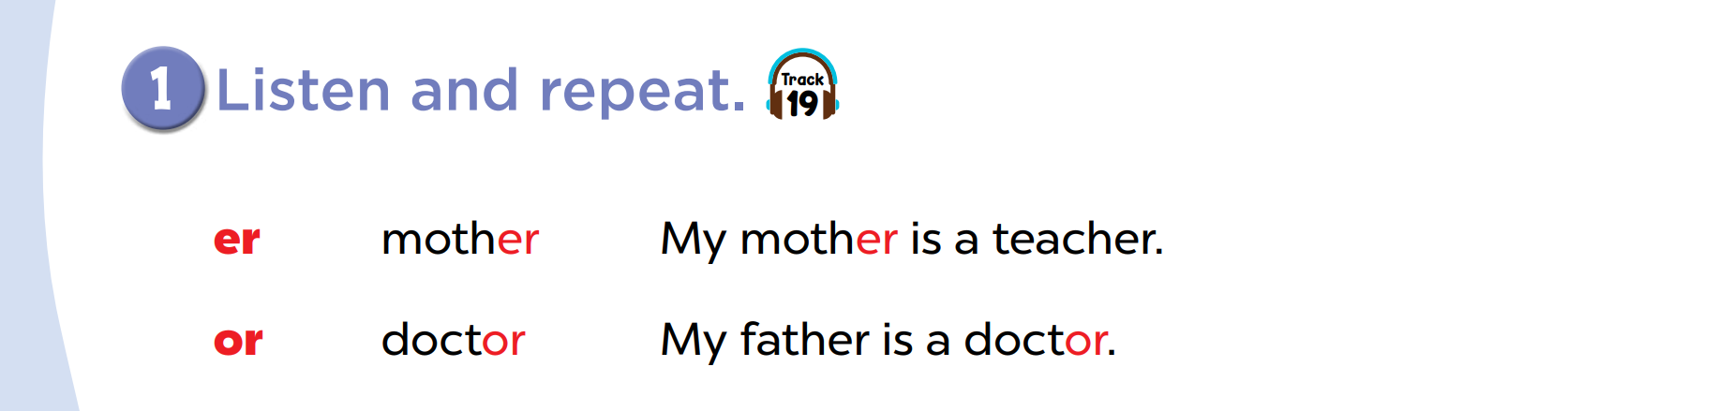

Slide 16


Slide 17
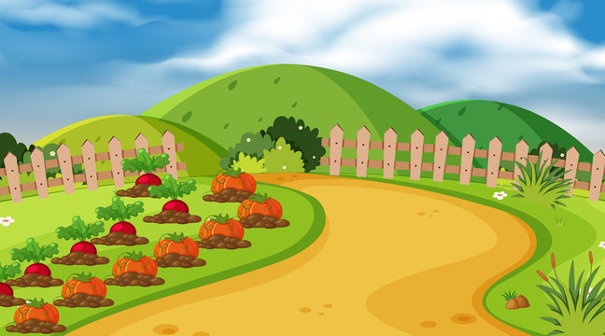
Listen and choose.
mother
or
er
doctor
Notes:
Game: Listen and choose.
Divide the class into 2 groups. Let the pupils listen to the recording, then choose the correct word.

Slide 18
Listen and choose.
or
mother
doctor
ch

Slide 19
Listen and choose.
th
or
mother
doctor

Slide 20
Listen and choose.
er
m
doctor
mother

Slide 21
3
Listen and circle.

Slide 22
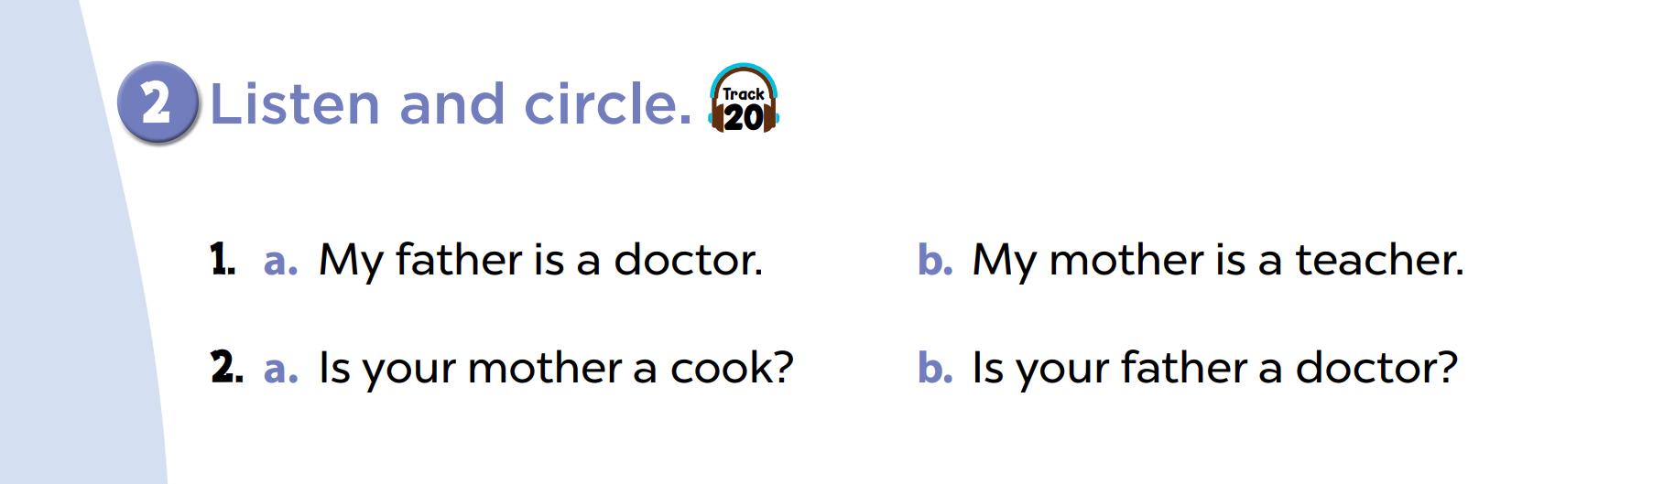

Slide 24

Chinese whisper
Notes:
Step 1: Divide the class into four teams.
Step 2: Invite 5 pupils from each team to line up. The first pupil gets a card/ listens to the teacher’s whisper. Pupils whisper sentences to the next friends in their lines. The last pupils say the sentence aloud.
Step 3: Encourage pupils to join in the game.
Step 4: Give points to teams.

Slide 25

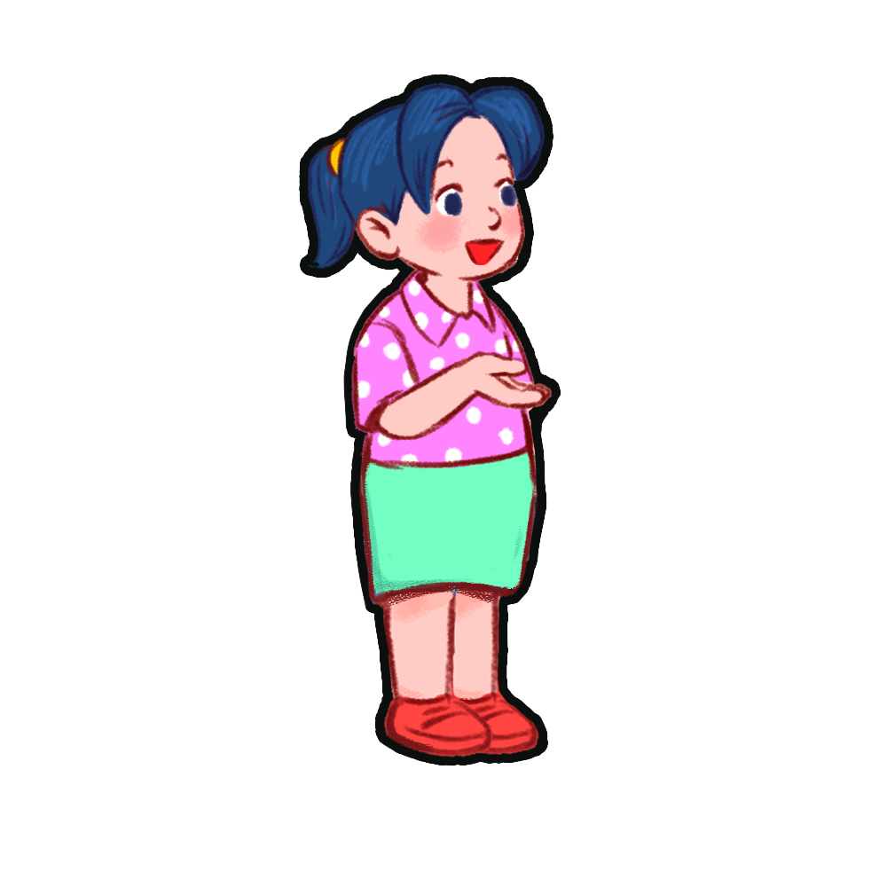



My mother is a teacher.
My mother is a teacher.
My mother is a teacher.
My mother is a teacher.
My mother is a teacher.

Slide 26
My father is a singer.
My father is a singer.
My father is a singer.
My father is a singer.
My father is a singer.

Slide 27
My aunt is a doctor.
My aunt is a doctor.
My aunt is a doctor.
My aunt is a doctor.
My aunt is a doctor.

Slide 28
My grandma is a farmer.
My grandma is a farmer.
My grandma is a farmer.
My grandma is a farmer.
My grandma is a farmer.

Slide 29
My uncle is a cook.
My uncle is a cook.
My uncle is a cook.
My uncle is a cook.
My uncle is a cook.

Slide 30
My cousin is a driver.
My cousin is a driver.
My cousin is a driver.
My cousin is a driver.
My cousin is a driver.

Slide 31
My grandpa is a teacher.
My grandpa is a teacher.
My grandpa is a teacher.
My grandpa is a teacher.
My grandpa is a teacher.

Slide 32
My brother is a nurse.
My brother is a nurse.
My brother is a nurse.
My brother is a nurse.
My brother is a nurse.

Slide 33
4
Let’s chant.

Slide 34
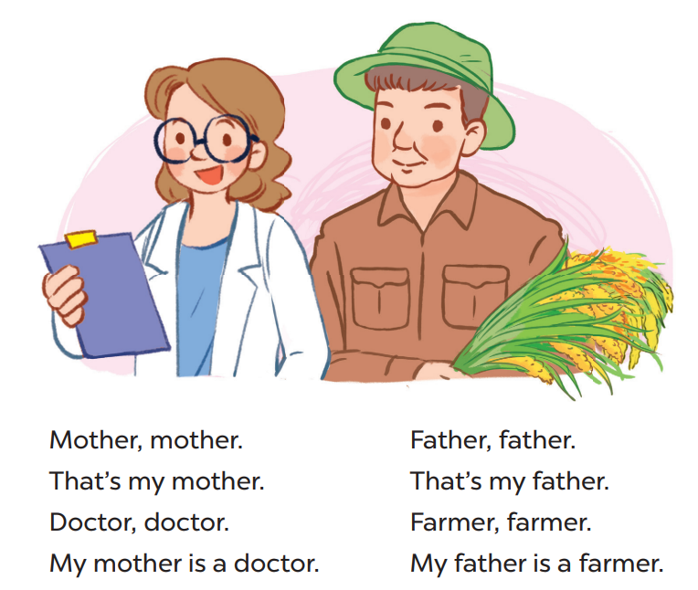

Slide 35
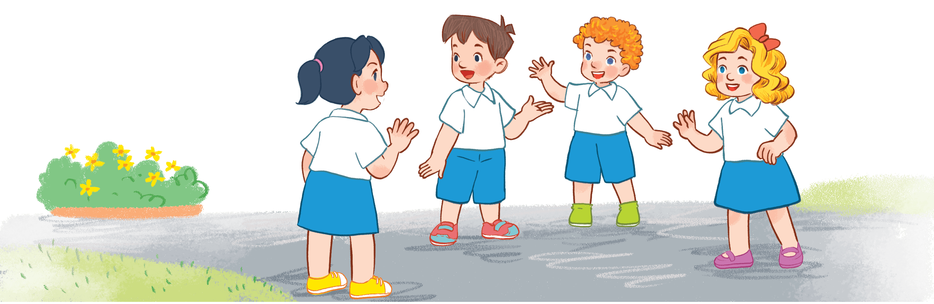
Game time
Doctor, doctor.
My mother is a doctor.
Father, father.
That’s my father.
Mother, mother.
That’s my mother.
Farmer, farmer.
My father is a farmer.
Notes:
Step 1: Divide the class into 4 teams.
Step 2: Set rules: invite one pupil from each team to stand up and say 1 sentence aloud, the next one continues. Then take turns reading the chant. Who can make it correctly will get points for the team.
Step 3: Encourage pupils to join in the game.
Step 4: Give points to pupils.

Slide 36
5
Fun corner and wrap-up

Slide 37



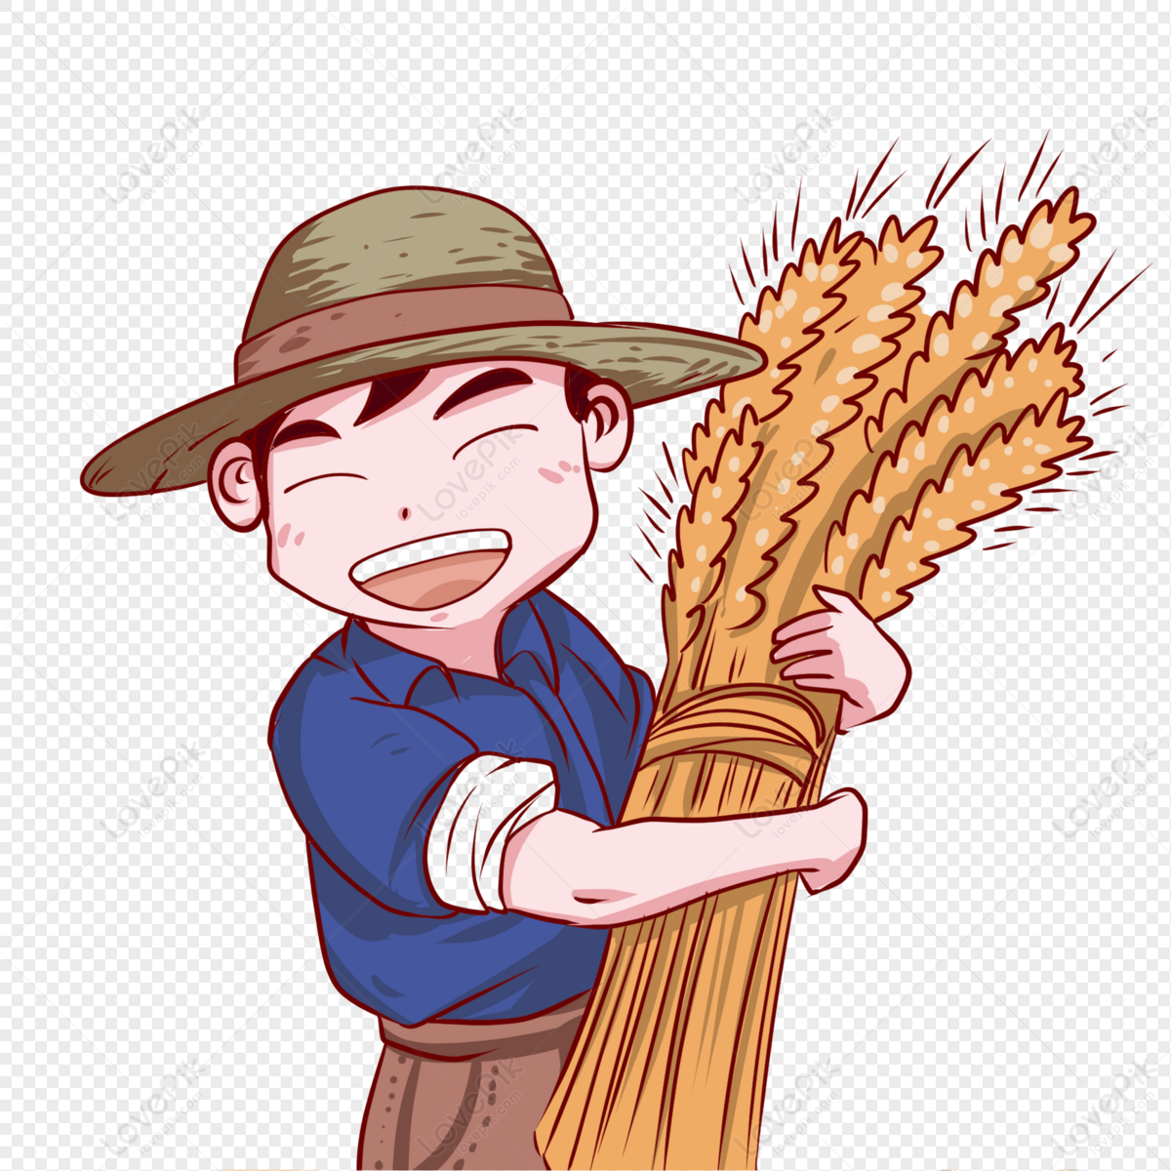


Game time: guessing
1
2
3
4
5
6
7
8
points
Notes:
Step 1: Divide the class into 4 teams.
Step 2: Look at the cards (1-8), there are pictures behind them. Let pupils guess the jobs in the pictures. (Spin the lucky wheel to get points.)
Step 3: Encourage pupils to take part in the game and practice speaking English.
Step 4: Give points to pupils.

Slide 38




LUCKY WHEEL
5
20
15
10
Team 1
SPIN
Team 2
5
15
Team 3
20
10
Team 4
Pictures
Next activity

Slide 39

Website: hoclieu.vn
Fanpage: facebook.com/www.tienganhglobalsuccess.vn

