Slide 1



Slide 2




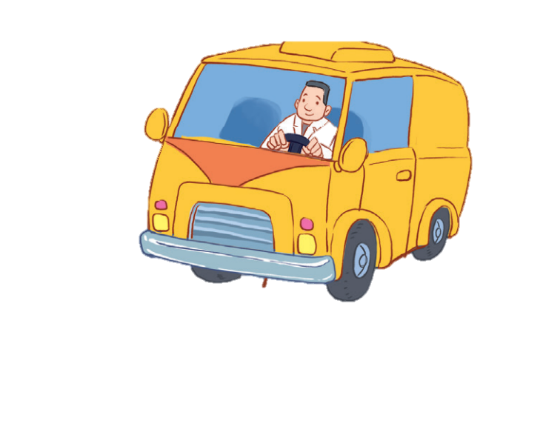


12
LESSON 1 – Period 2

Slide 3
Contents
Warm up
Look, complete and read.
01
Warm-up and review
03
Listen and tick.
Let’s sing.
02
04
05
Fun corner and wrap-up

Slide 4
1
Warm-up and review
Game: Spelling Bee
Notes:
Step 1: Divide the class into 4 teams.
Step 2: Each pupil from each team goes to the front to choose one letter.
Step 3: Encourage pupils to join in the game.
Step 4: Give points for pupils.

Slide 5











JOBS
JOBS
PLAY
JOBS
JOBS

Slide 6



F
A
E
What's her job?
L
B
D
G
K
C
M
H
J
I
YOU'RE GREAT!
S
N
R
T
O
Q
Z
P
U
Y
D
O
C
T
O
R
V
X
W
CLICK
HERE

Slide 7

F
A
P
What’s his job?
L
B
W
G
A
R
M
H
J
I
YOU'RE GREAT!
S
N
R
K
O
Q
Z
E
U
Y
W
O
R
K
E
R
V
X
G
CLICK
HERE

Slide 8

F
A
E
What's her job?
L
B
D
G
K
C
M
H
J
I
YOU'RE GREAT!
S
N
E
T
O
Q
R
P
U
Y
T
E
A
C
H
E
R
V
X
W
CLICK
HERE

Slide 9

F
I
R
What's her job?
L
B
H
G
K
V
M
E
J
A
YOU'RE GREAT!
S
N
R
D
O
Q
Z
P
U
Y
D
R
I
V
E
R
A
X
W
CLICK
HERE

Slide 10
2
Listen and tick.

Slide 11




Slide 12


Listen and choose A or B.
A
B

Slide 13


Listen and choose A or B.
A
B

Slide 14

Listen and choose A or B.
A
B

Slide 15

Listen and choose A or B.
A
B

Slide 16
3
Look, complete and read.

Slide 17
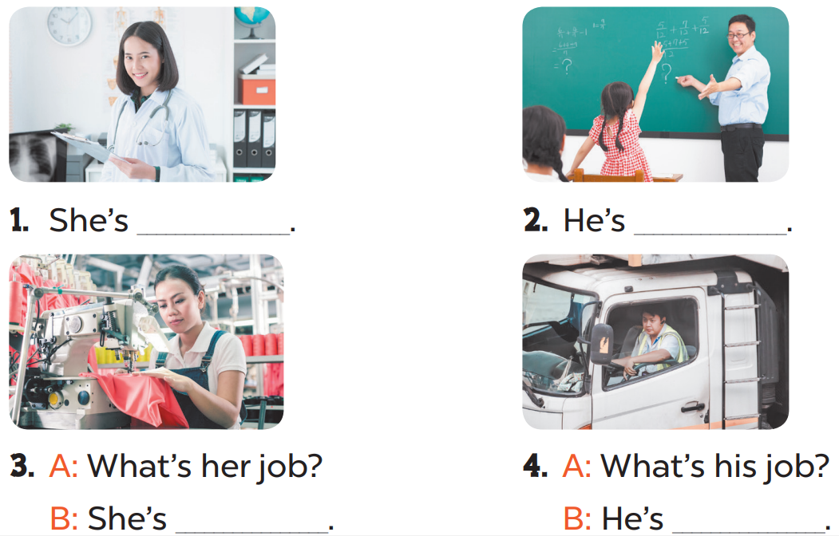

Slide 18
a doctor
a teacher
a worker
a driver

Slide 19


Game time!!!
Role play
- What’s her/ his job?
- She’s/ He’s _______.

Slide 20
- What’s her/ his job?
- She’s/ He’s _______.

Slide 21
- What’s her/ his job?
- She’s/ He’s _______.

Slide 22
- What’s her/ his job?
- She’s/ He’s _______.

Slide 23
- What’s her/ his job?
- She’s/ He’s _______.

Slide 24
4
Let’s sing.

Slide 25
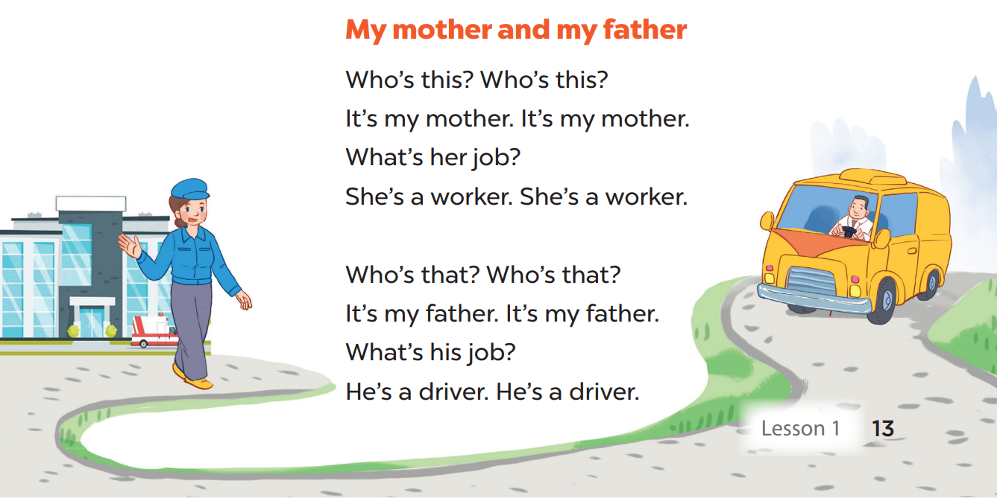

Slide 26

Sing and dance
Game time!!!
Notes:
Game: Sing and dance
Step 1: Divide the class into 4 teams.
Step 2: Play the music for pupils to sing and do the actions. When the music stops, students stop their actions. Anyone who can not stop in time will be eliminated.
Step 3: Encourage pupils to sing and dance.
Step 4: Give points to pupils.

Slide 27
5
Fun corner and wrap-up

Slide 28
Game time!!!
Sentence Puzzle
Notes:
Step 1: Divide the class into groups of four.
Step 2: Give each group a sentence that is cut into pieces. Ask them to arrange the words to make a complete sentence, then read it aloud.
Step 3: The faster group will be the winner.
Step 4: Encourage pupils to join in the game.
Step 5: Give points to pupils.

Slide 29



She’s
a
doctor
+3
____ __ _____.
She’s a doctor

Slide 30
driver
He’s
a
+4
____ __ _____.
He’s a driver

Slide 31
worker
a
He’s
+4
___ __ _____.
He’s a worker

Slide 32
He’s
a
teacher
+2
___ __ ______.
He’s a teacher

Slide 33

Website: hoclieu.vn
Fanpage: facebook.com/www.tienganhglobalsuccess.vn

