Slide 1
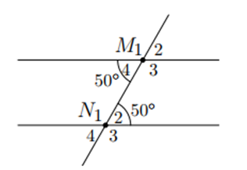
a
b

Slide 2
a
b

