Slide 1
Welcome to our class!

Slide 2
Warm-up

Slide 3
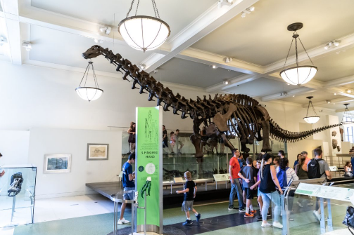
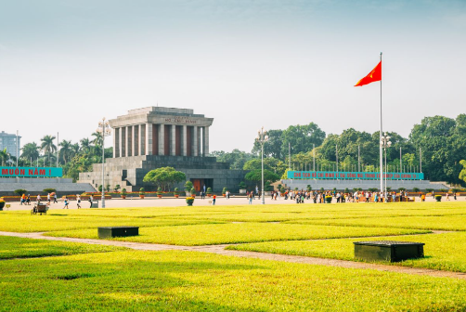
Let’s sing.
Where do you want to visit?
I want to visit somewhere.
Where do you want to visit?
I want to visit the museum.
Let’s go!
That’s a great idea!
I want to visit somewhere.
Where do you want to visit?
I want to visit the square.
That’s a great idea!
Let’s go!
Click on the mic symbol.

Slide 4
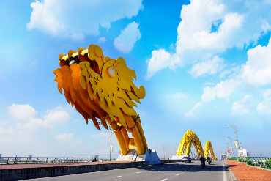
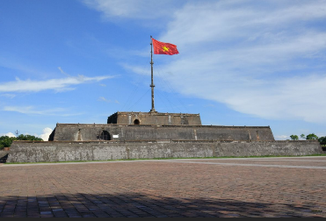
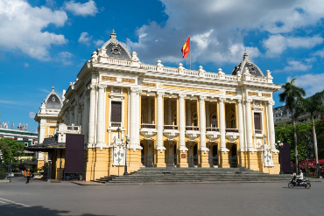
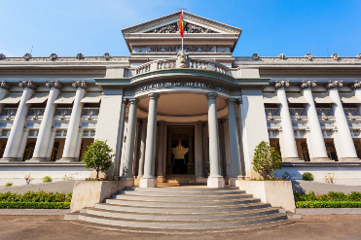
Review
Where do you want to visit?
I want to visit _____.
Dragon Bridge
Ngo Mon Square
Ha Noi Opera House
Ho Chi Minh City Museum

Slide 5
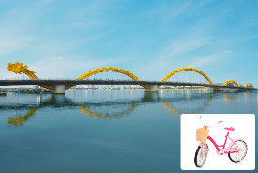
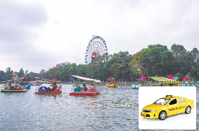
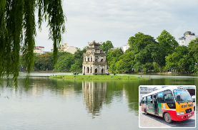
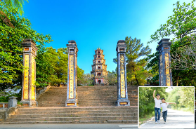
Monday, November 1st 2024
Unit 18
Means of transport
Lesson 2 (1+2+3)

Slide 6
Contents
Look, listen and repeat.
Listen, point and say.
Let’s talk.

Slide 7
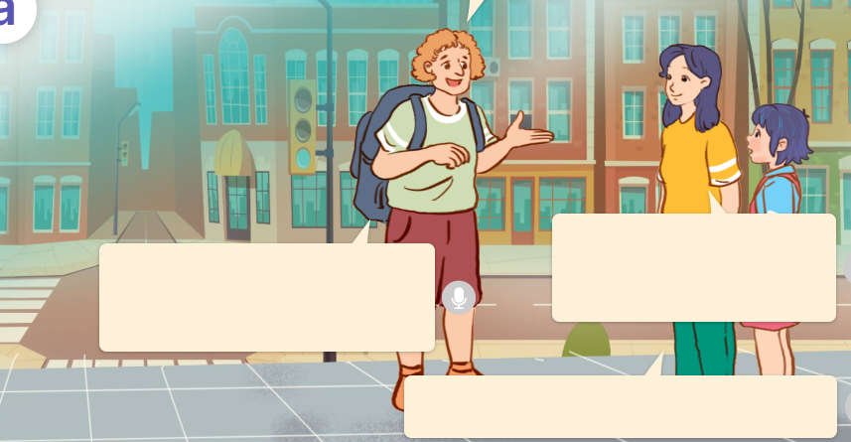
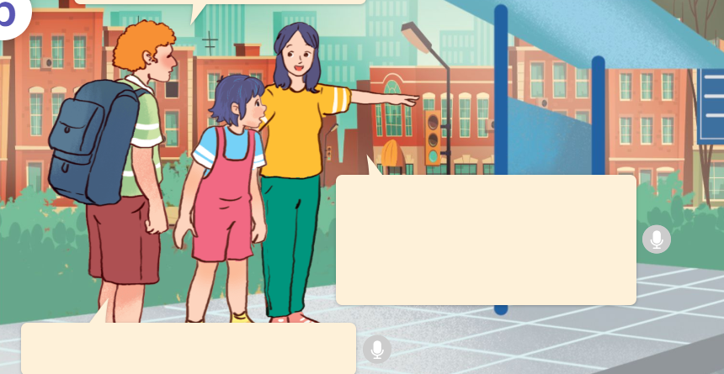
1. Look, listen and repeat.
How can I get to Hoan Kiem Lake?
Excuse me!
I’m lost.
a
b
Where do you want to go?
You can get there by bus.
I want to get to Hoan Kiem Lake.
The bus stop is over
there.
Well, it’s far from here.
Thank you so much!
Who are they?
What are they talking about?
Where are they?
They’re at a street corner.
They are Linh, her mother and a tourist.
Linh’s mother telling the tourist how to get to
Hoan Kiem Lake.
Click on the speaker / sentences to listen.

Slide 8
Vocabulary

Slide 9
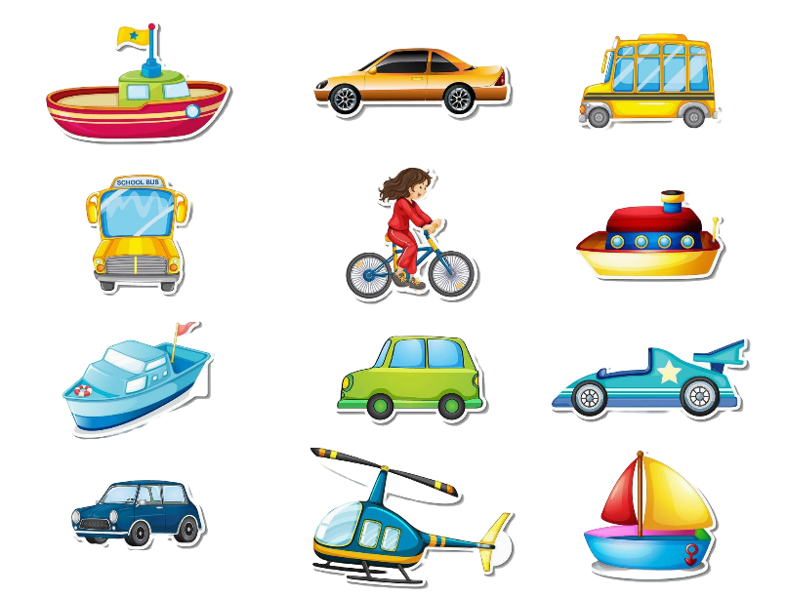
Vocabulary
means of transport
/mɪnz əv 'trænspɔ:t/
phương tiện giao thông
Click on the English word / phrase to listen.

Slide 10
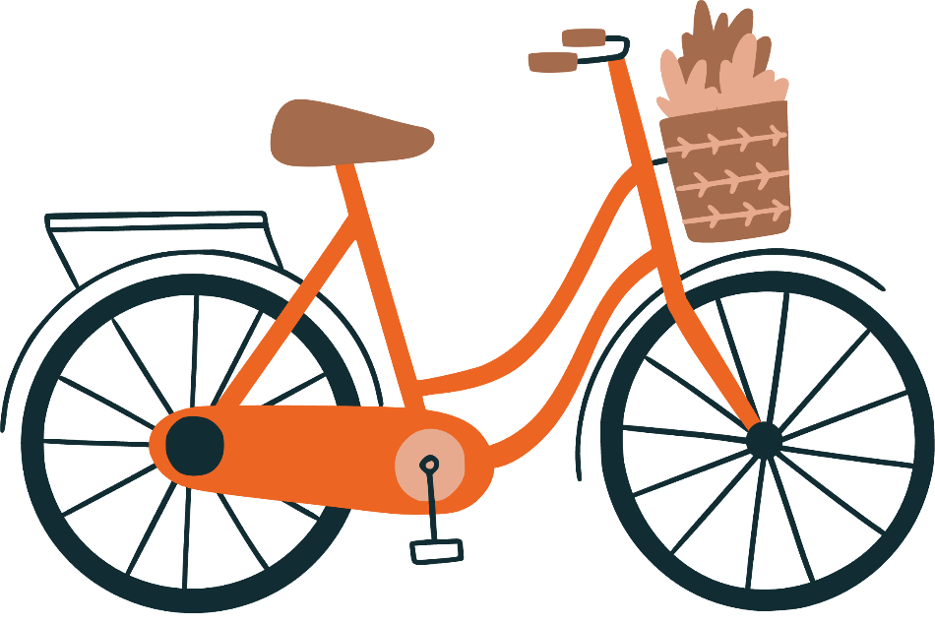
by bicycle
/baɪ ˈbaɪsɪkl/
bằng xe đạp

Slide 11
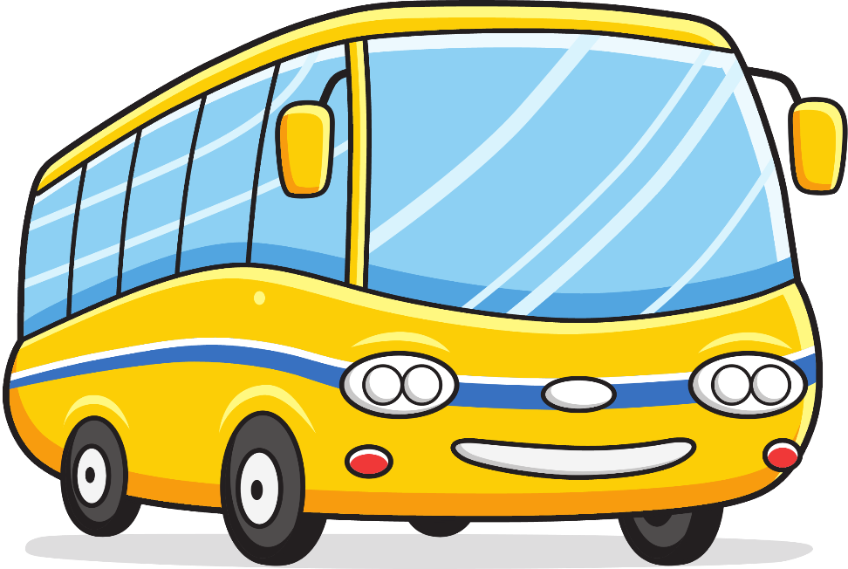
by bus
/baɪ bʌs/
bằng xe buýt

Slide 12
by taxi
/baɪ ˈtæksɪ/
bằng xe tắc xi

Slide 13
on foot
/ɒn fʊt/
đi bộ

Slide 14
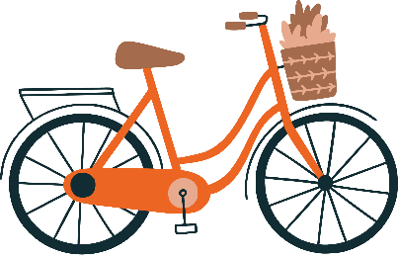
Review
means of transport
by bicycle
by bus
by taxi
on foot
Click on the English words to listen again.

Slide 15
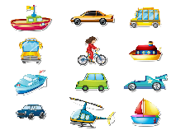
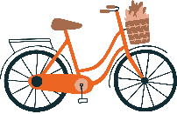
Vocabulary
1. means of transport
: phương tiện giao thông
2. by bicycle
: bằng xe đạp
3. by bus
: bằng xe buýt
4. by taxi
: bằng xe tắc xi
5. on foot
: đi bộ
Click on the English words to listen again.

Slide 16
Checking vocabulary!

Slide 17
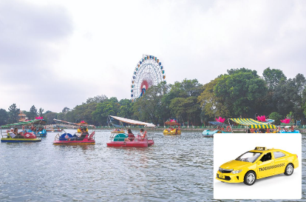
Tick the right picture.
by bus
a
b

Slide 18
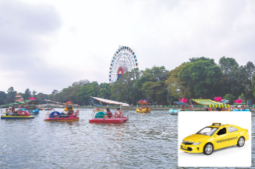
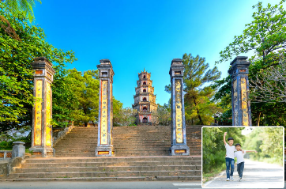
Tick the right picture.
by taxi
a
b

Slide 19
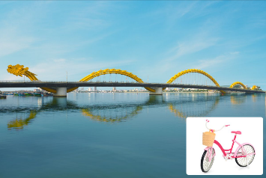
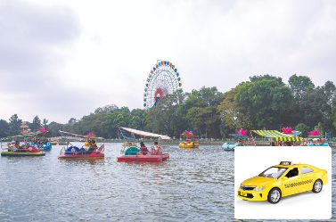
Tick the right picture.
by bicycle
a
b

Slide 20
Tick the right picture.
on foot
a
b

Slide 21
Good job!

Slide 22
Structures

Slide 23
Hỏi và trả lời về cách di chuyển đến một địa điểm nào đó:
How can I get to _____?
(Làm thế nào tôi đến được _____?)
You can get there ______.
(Bạn có thể đến đó ______.)
Example:
How can I get to Hoan Kiem Lake?
You can get there by bus.

Slide 24
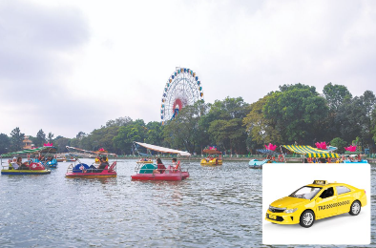
Unit 18 lesson 2 (1+2+3)
How can I get to ______?
You can get there ______.
Thien Mu Pagoda / on foot
Dam Sen Water Park / by taxi
Dragon Bridge / by bicycle
Hoan Kiem Lake / by bus

Slide 25
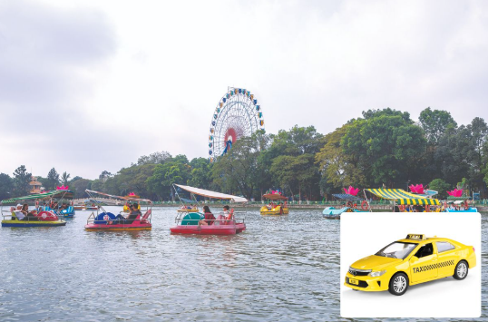
2. Listen, point and say.
a
b
How can I get to ______?
Hoan Kiem Lake / by bus
Dragon Bridge / by bicycle
c
d
You can get there ________.
Dam Sen Water Park / by taxi
Thien Mu Pagoda / on foot
Click on the words / phrases to listen again.

Slide 26
2. Listen, point and say.
a
Hoan Kiem Lake / by bus
How can I get to Hoan Kiem Lake?
You can get there by bus.
Click on the sentences to listen.

Slide 27
2. Listen, point and say.
b
Dragon Bridge / by bicycle
How can I get to Dragon Bridge?
You can get there by bicycle.

Slide 28
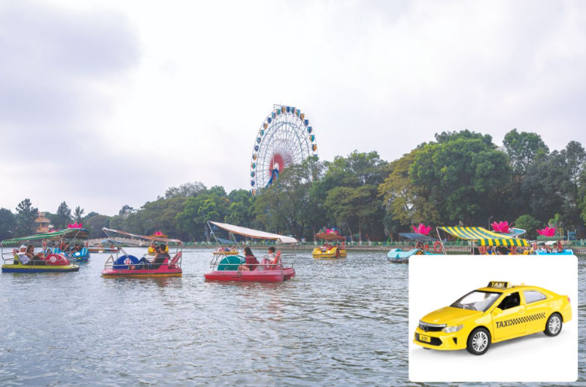
2. Listen, point and say.
c
Dam Sen Water Park / by taxi
How can I get to Dam Sen Water Park?
You can get there by taxi.

Slide 29
2. Listen, point and say.
d
Thien Mu Pagoda / on foot
How can I get to Thien Mu Pagoda?
You can get there on foot.

Slide 30
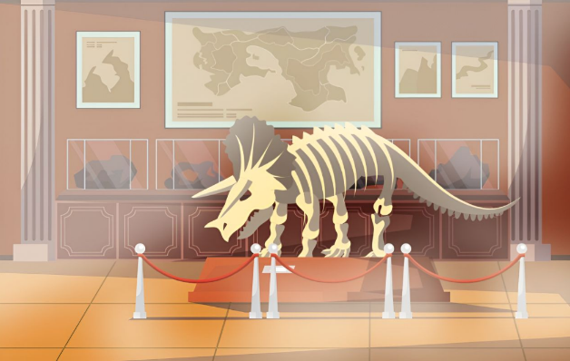
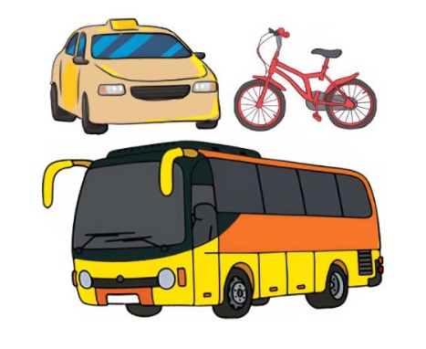
3. Let’s talk.
Where do you want to visit?
___________.
How can I / you get to ______?
___________.

Slide 31
3. Let’s talk.
Where do you want to visit?
I want to visit Vietnam National Museum of Nature
______________________________________________.
How can I / you get to ___________?
the museum
You can get there by bus
____________________.
Vietnam National Museum of Nature: Bảo tàng Thiên nhiên Việt Nam.

Slide 32
3. Let’s talk.
Where do you want to visit?
I want to visit Thien Mu Pagoda
_________________________.
How can I / you get to ______________?
Thien Mu Pagoda
You can get there by taxi
____________________.
Thien Mu Pagoda

Slide 33
Fun corner
& wrap - up

Slide 34
PLAY

Slide 35
B. When – I
1/8
C. How - I
A. How - you
A: ____ can ___ get to Hoan Kiem Lake?
B: You can get there by bus.

Slide 36
B. Dam Sen Water Park / by taxi
2/8
C. Dam Sen Water Park
/ by bus
A. Dragon Bridge
/ by taxi
A: How can I get to ____?
B: You can get there ____.

Slide 37
B. Dragon Bridge
/ on foot
3/8
C. Dragon Bridge
/ by bicycle
A. Hoan Kiem Lake
/ by bus
A: How can I get to ____?
B: You can get there ____.

Slide 38
B. Thien Mu Pagoda
/ on foot
4/8
A. Dragon Bridge / by bicycle
C. Thien Mu Pagoda
/ by bus
A: How can I get to ____?
B: You can get there ____.

Slide 39
B. Thien Mu Pagoda
/ by bus
5/8
A. Hoan Kiem Lake
/ by bus
C. Hoan Kiem Lake
/ by taxi
A: How can I get to _____?
B: You can get there _____.

Slide 40
B. How I can get to Dragon Bridge?
6/8
C. How get I to can Dragon Bridge?
A. How can I get
to Dragon Bridge?
A: ___________________
B: You can get there by bicycle.

Slide 41
B. You can get
there on foot.
7/8
A. You can get
there by bicycle.
C. You can get there by car.
A: How can I get to Dam Sen
Water Park?
B: __________________

Slide 42
B. You can get
there by bus.
8/8
A. You can get
there by bicycle.
C. You can get
there on foot.
A: How can I get to
Thien Mu Pagoda?
B: _________________

Slide 43
Great!

Slide 44
Review
How can I get to ______?
You can get there ______.
Thien Mu Pagoda / on foot
Dam Sen Water Park / by taxi
Dragon Bridge / by bicycle
Hoan Kiem Lake / by bus

Slide 45
Homework
Learn by heart all the new words and the model sentences.
Read again the dialogue in part 1. Prepare for lesson 2 (4+5+6).

Slide 46
Goodbye!

