Slide 1
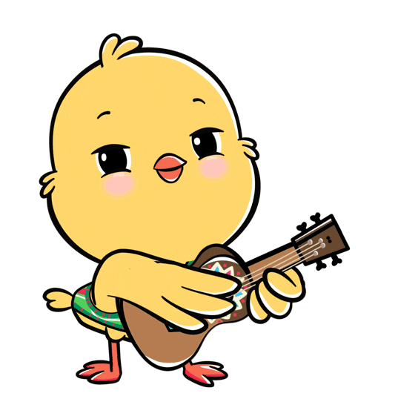
Welcome to our class!

Slide 2
Warm-up

Slide 3
Let’s play!
PLAY

Slide 4
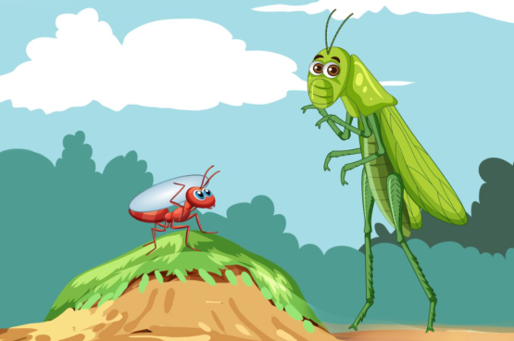
1/8
A: _____ are the main characters in the story? B: ____ are the ant and the grasshopper.
Who - They
Answer
Next

Slide 5
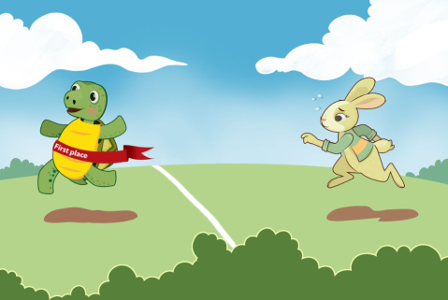
2/8
A: Who are the main characters in the story?
B: They’re the tortoise and the hare.
True
Answer
Next

Slide 6
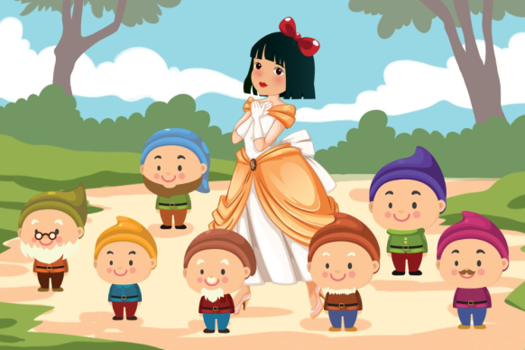
3/8
A: Who are the main characters in the story?
B: ___________________.
They’re Snow White and the seven dwarfs
Answer
Next

Slide 7
4/8
A: Who are the main characters in the story?
B: __________________.
They’re the tortoise
and the hare
Answer
Next

Slide 8
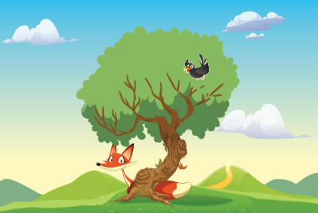
5/8
A: Who are the main characters in the story?
B: ____________________.
They’re the fox
and the crow
Answer
Next

Slide 9
6/8
A: ___________________________?
B: They’re the tortoise and the hare.
Who are the main characters in the story
Next
Answer

Slide 10
7/8
A: _________________
B: _________________
Who are the main characters
in the story?
They’re Snow White and
the seven dwarfs.
Answer
Next

Slide 11
8/8
A: _________________
B: _________________
- Who are the main characters
in the story?
- They’re the fox and the crow.
Answer
End

Slide 12
Great job!
s
EXIT

Slide 13
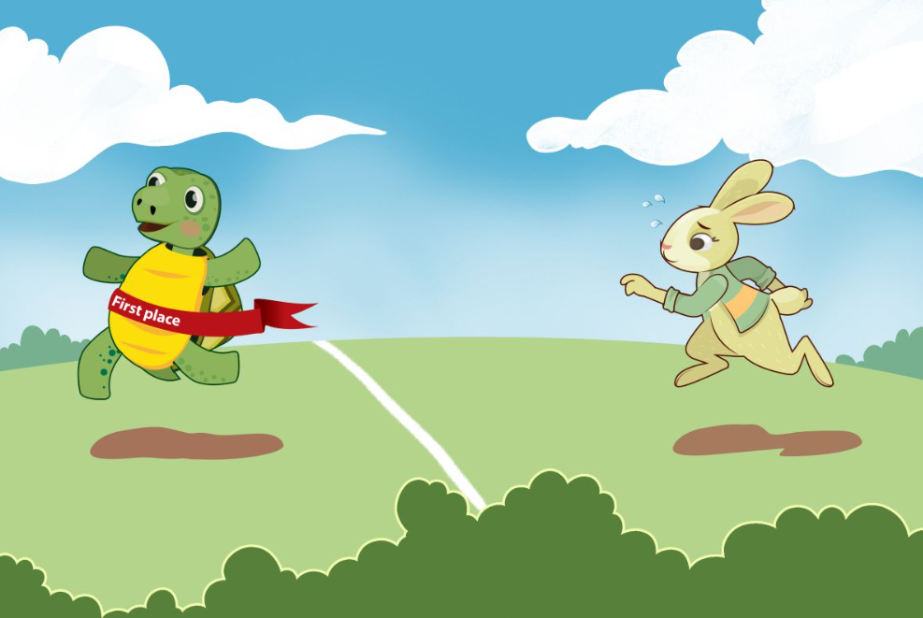
Monday, November 1st 2024
Unit 17
Stories for children
Lesson 1 (4+5+6)

Slide 14
Contents
Listen and circle.
Read and complete.
Let’s play.

Slide 15
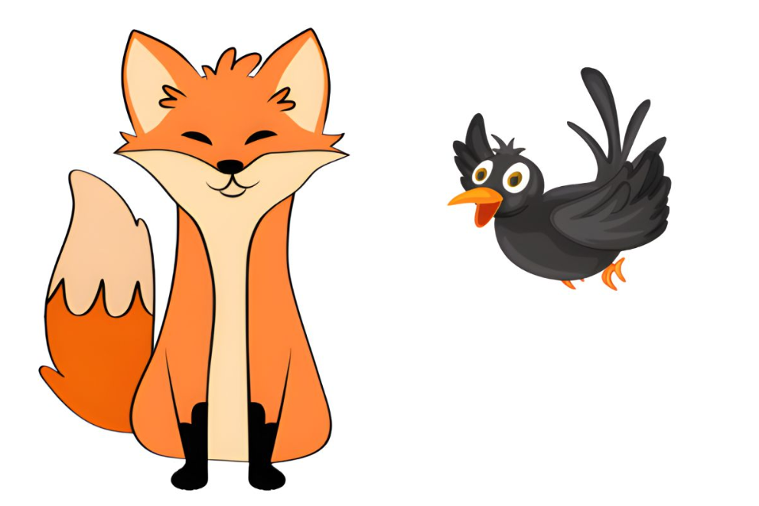
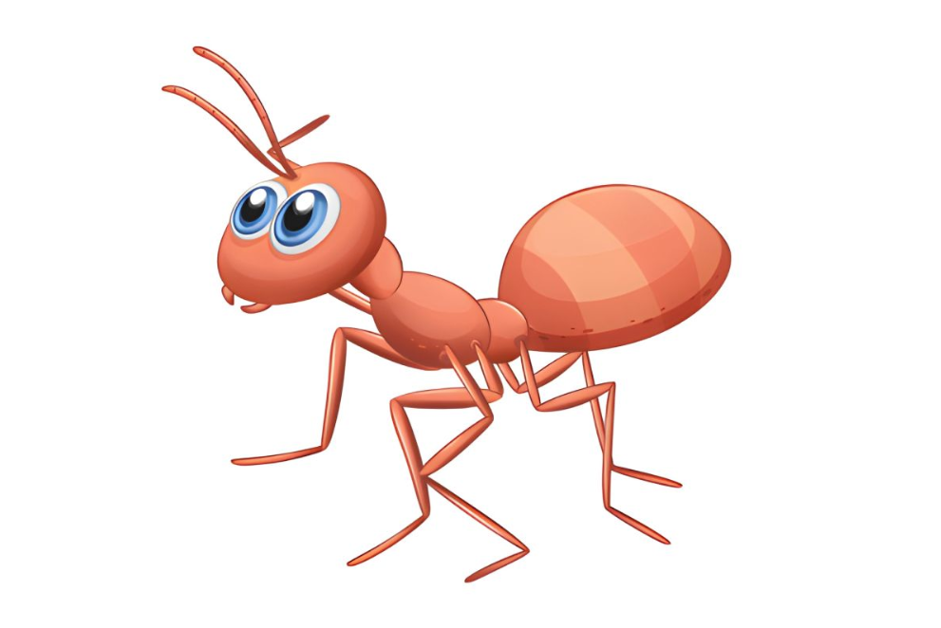
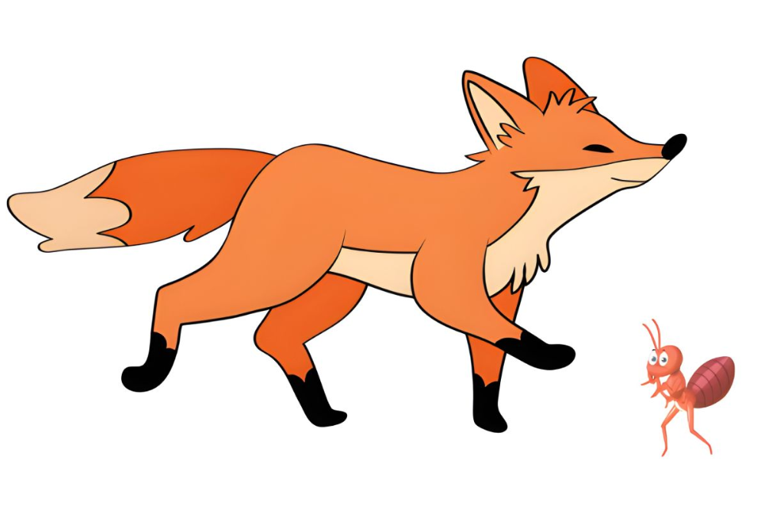
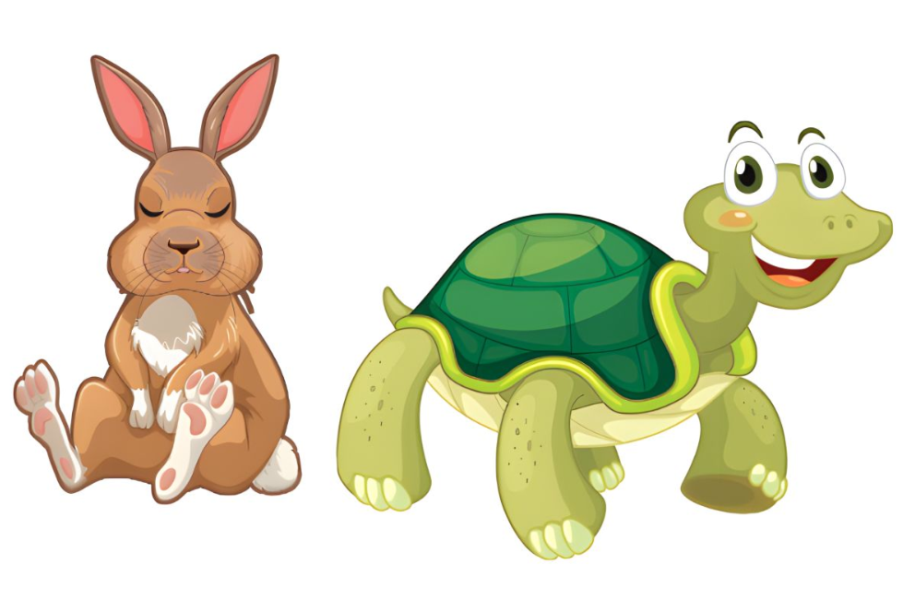
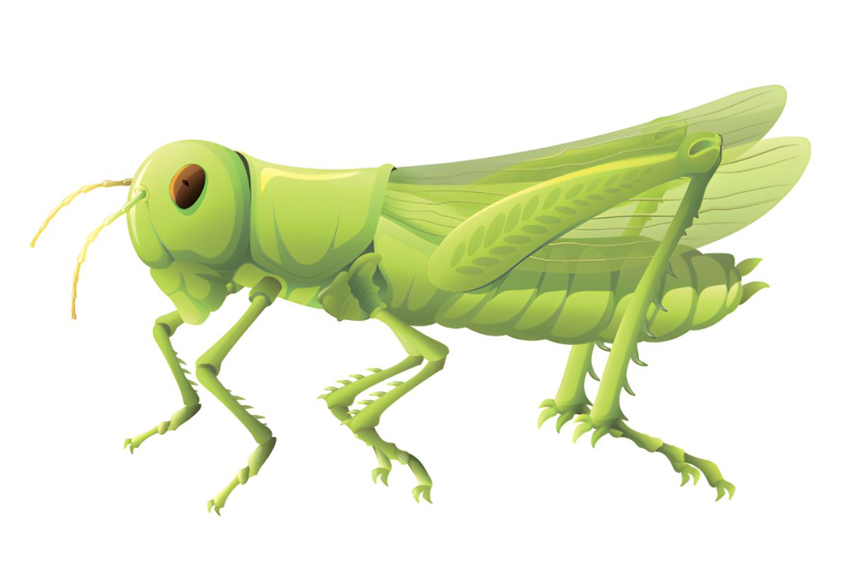
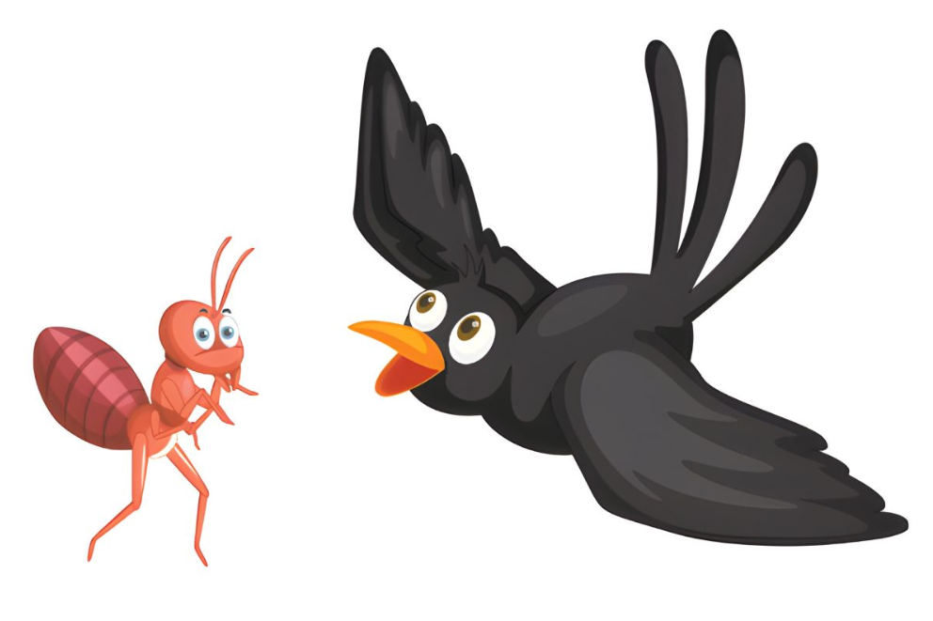
4. Listen and circle.
1. The main characters in the story are ______.
2. Ben likes the __________.
3. The main characters in the story are ______.
a
a
a
b
b
b
Click on the speaker / pots to listen.

Slide 16
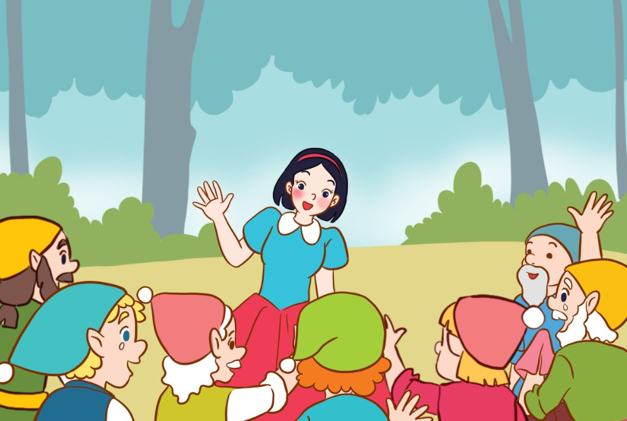
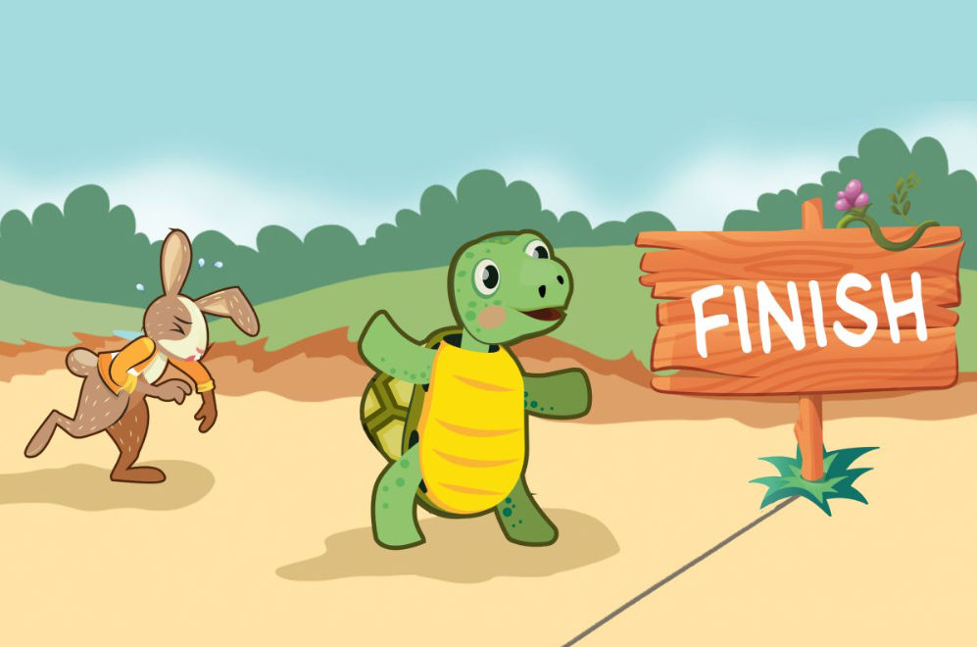
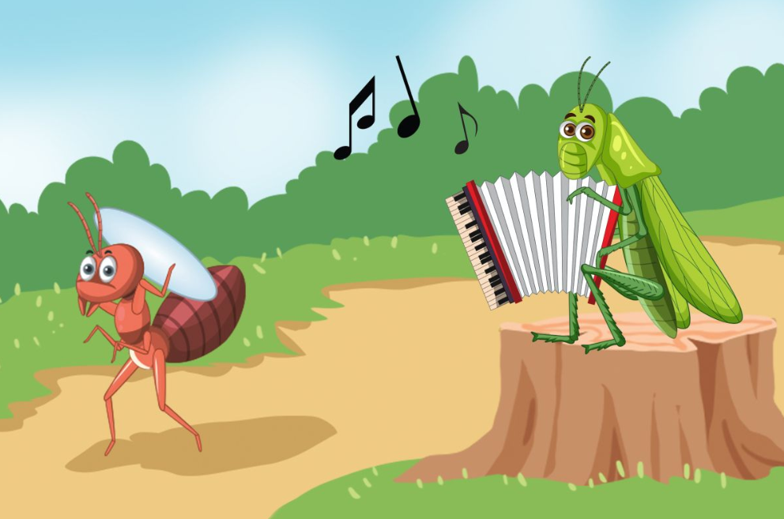
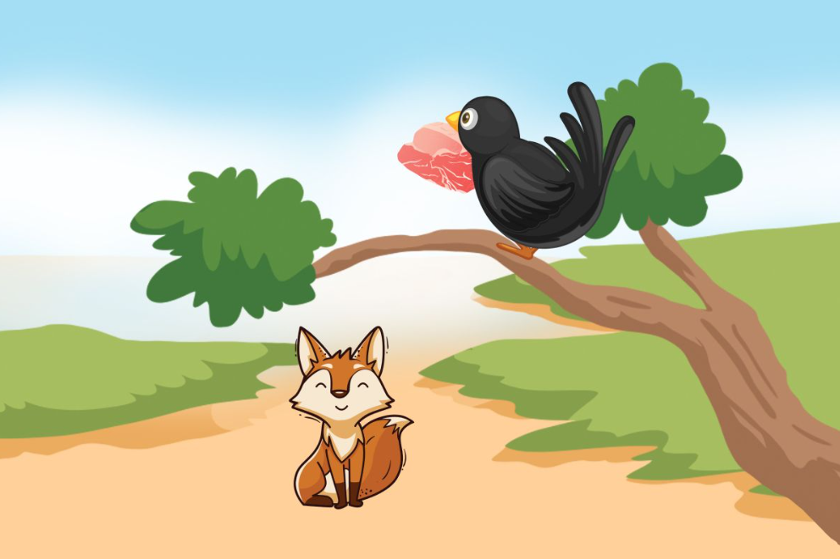
5. Read and complete.
1.
A: Look at this story. Who are the main characters?
B: They’re __________ and the seven dwarfs.
Snow White
2.
A: Are the hare and the _______ the main characters in this story?
B: Yes, they are.
tortoise
3.
A: Are the ______ and the grasshopper the main characters in this story?
B: Yes, they are.
A: Which ______________ do you prefer?
B: I prefer the ant.
ant
characters
4.
reading
A: What story are you ___________?
B: I’m reading The Fox and the Crow.
A: Do you like the ________ or the crow?
B: I like the fox.
fox

Slide 17
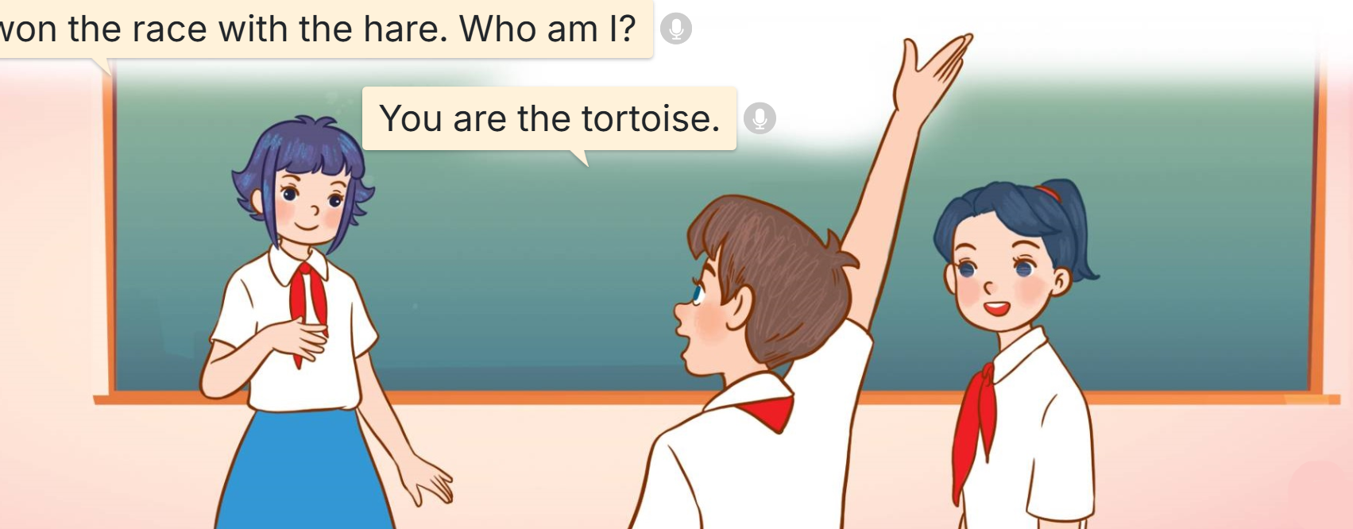
6. Let’s play.
Who am I?
I won the race with the hare. Who am I?
You are the tortoise.
Notes:
I am a good cook. I cook food for seven short men. Who am I? – You are Snow White. I am clever. I took the meat from the crow. Who am I? – You are the fox. I didn’t win the race with the tortoise. Who am I? – You are the hare.

Slide 18
Fun corner
& wrap - up

Slide 19
Let’s play!

Slide 20
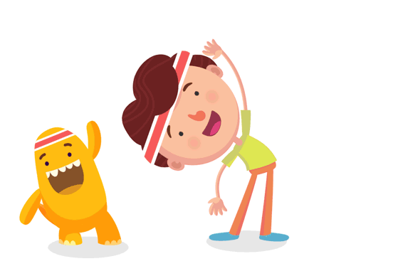
Look, say and choose.
1/8
A: Who are the main characters in the story?
B: They’re the tortoise and the hare.
A B C

Slide 21
Look, say and choose.
2/8
A: Who are the main characters in the story?
B: They’re the Snow White and the seven dwarfs.
A B C

Slide 22
Look, say and choose.
3/8
A: Who are the main characters in the story?
B: They’re the ant and the grasshopper.
A B C

Slide 23
Look, say and choose.
4/8
A: Who are the main characters in the story?
B: They’re the fox and the crow.
A B C

Slide 24
5/8
Listen and choose.
A B C

Slide 25
6/8
Listen and choose.
A B C

Slide 26
7/8
Listen and choose.
A B C

Slide 27
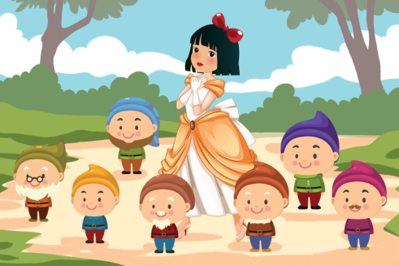
8/8
Listen and choose.
A B C

Slide 28
Well done!

Slide 29
Review
Who are the main characters in the story?
They’re _____.
the ant, the grasshopper
Snow White, the seven dwarfs
the fox, the crow
the tortoise, the hare

Slide 30
Homework
………………………………….. Prepare for lesson 2 (1+2+3).

Slide 31
Goodbye!

