Slide 1


Slide 2
Monday, November 3rd 2024
Unit 15
At the dining table
Lesson 3 (4+5+6)

Slide 3
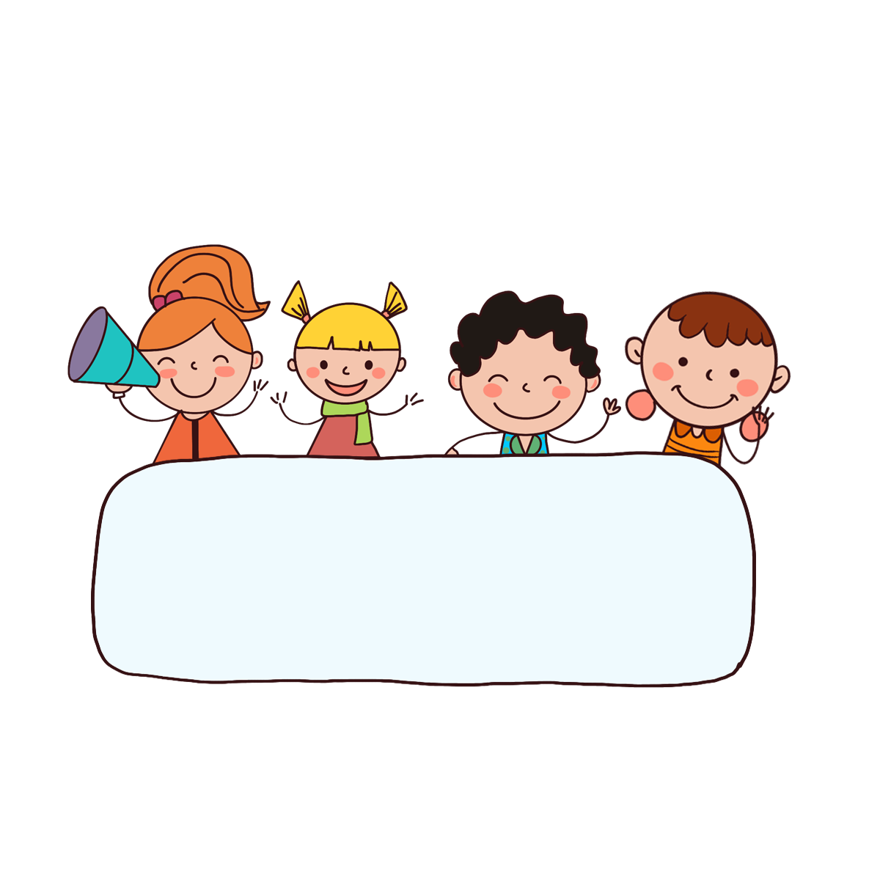
Warm up

Slide 4

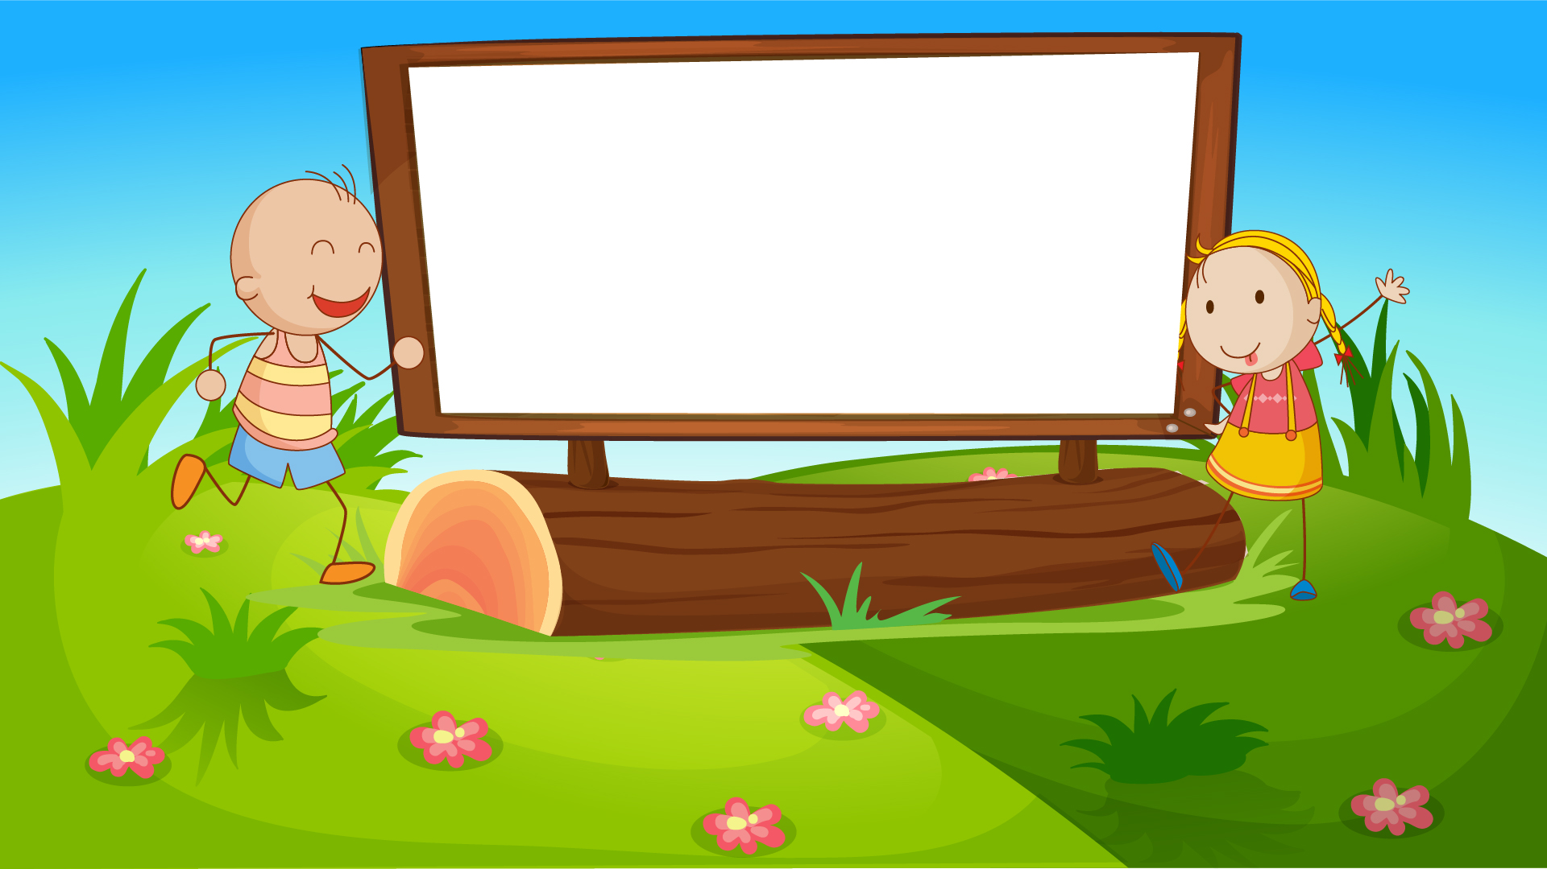
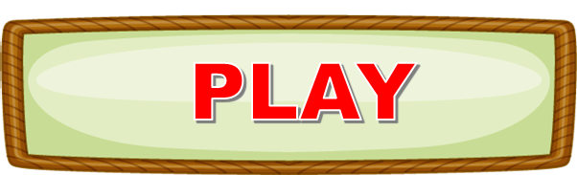

Let’s play!

Slide 5
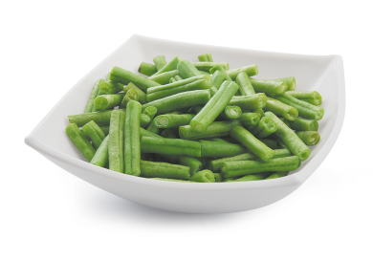

beans
Answer

Slide 6
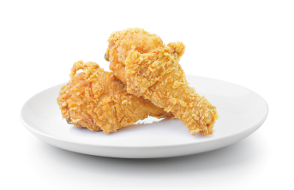
chicken
Answer

Slide 7
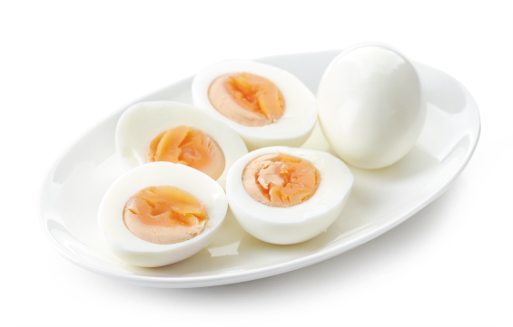
eggs
Answer

Slide 8
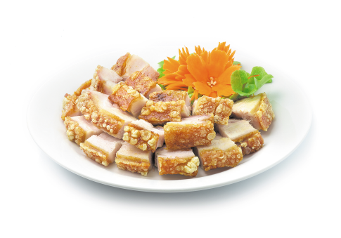
meat
Answer

Slide 9
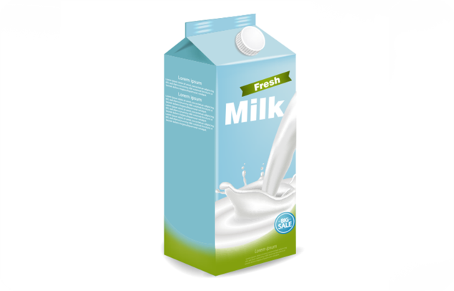
milk
Answer

Slide 10
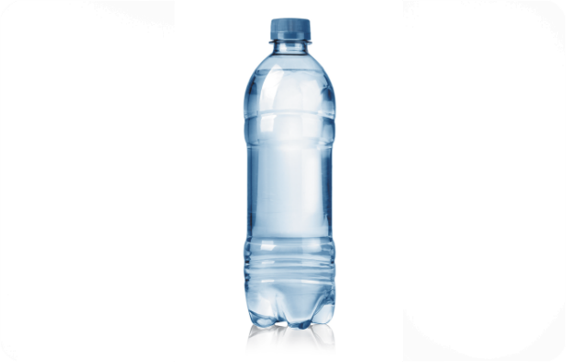
What would you like to drink?
I’d like some____, please.
water
Answer

Slide 11

What would you like to eat?
_________________.
I’d like some rice, please.
Answer

Slide 12
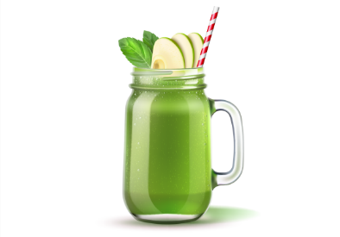
____________________? I’d like some juice, please.
What would you like
to drink?
Answer

Slide 13


Would you like some beans?
No, thanks.
Answer

Slide 14
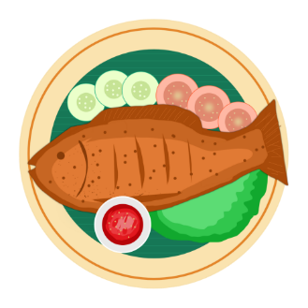
_______________?
Yes, please.
Would you like some fish
Answer

Slide 15
Great!

Slide 16



Contents
Read and complete.
Let’s write.
Project.

Slide 17

4. Read and complete
dining | drinks | like | rice | some
Nam and his family are at the (1) __________ table. There is a lot of food and (2) __________ on the table. His father and mother would (3) _______ some rice, beans and some water. His sister would like (4) ____________ bread, meat and some milk. Nam would like some (5) __________, fish and some juice.
dining
drinks
like
some
rice

Slide 18
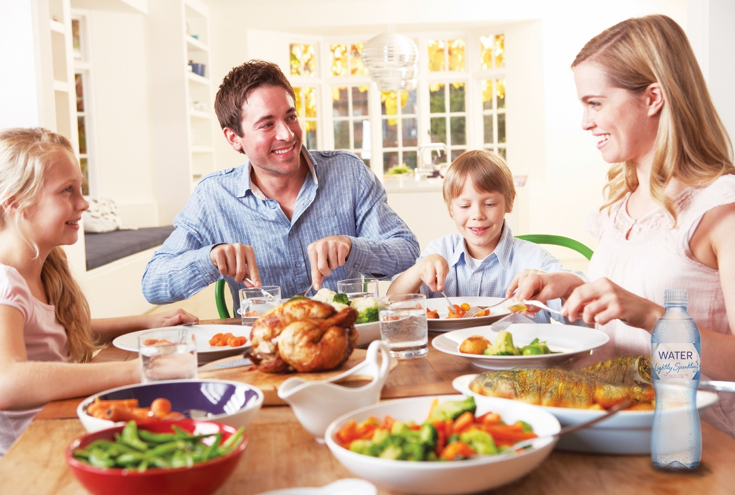
5. Let’s write.
My father and my mother would like some __________.
My sister / brother would like ______________.
I would like ______________ and _______________.
eggs
some chicken
some chicken
some water

Slide 19
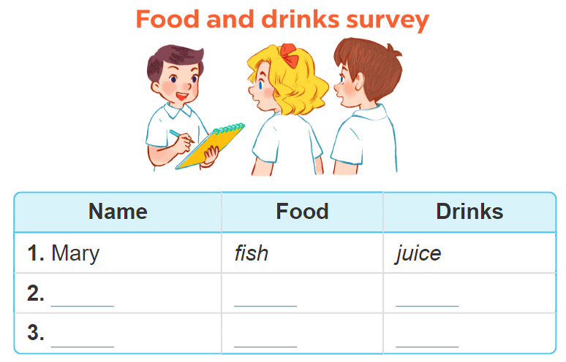
6. Project.

Slide 20
Wrap up

Slide 21


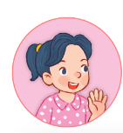

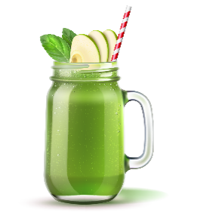


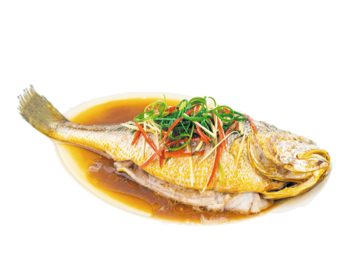
Unit 15 Lesson 1
Would you like some _____?
Yes, please.
No, thanks.
beans / yes
juice / no
fish / no
meat / yes

Slide 22
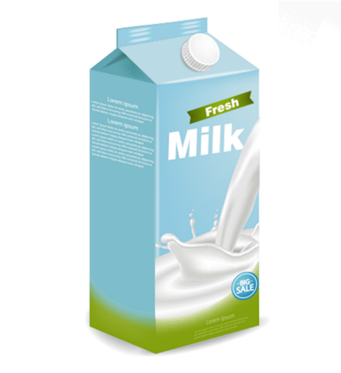
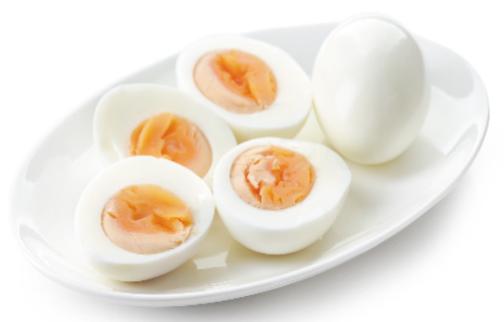
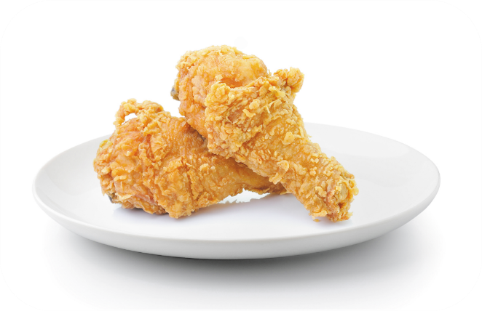
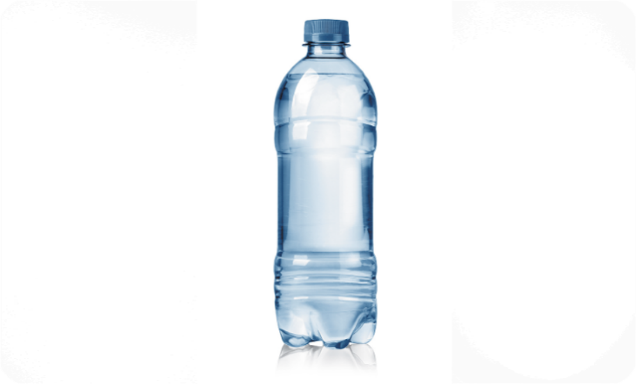
Unit 15 Lesson 2
I’d = I would
What would you like to eat / drink?
I’d like some _______, please.
eggs
milk
chicken
water

Slide 23
Homework
………………………………………..
………………………………………..

Slide 24
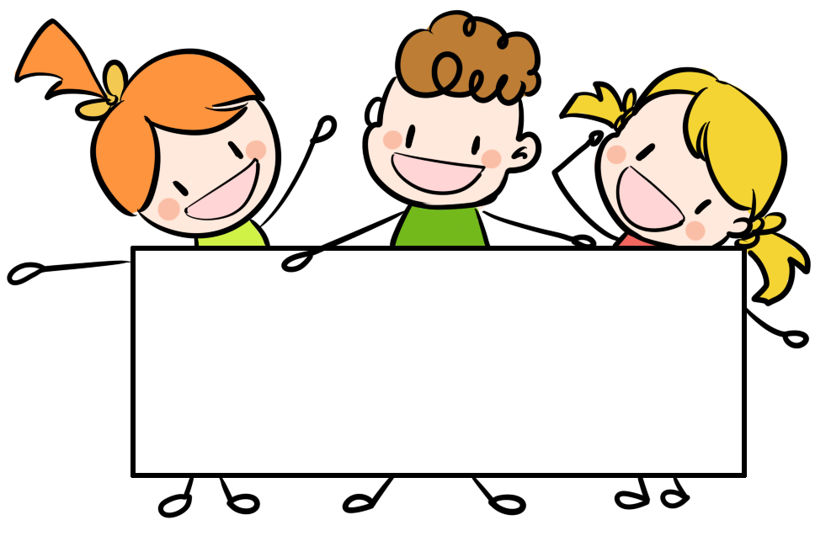
Thank you!

