Slide 1
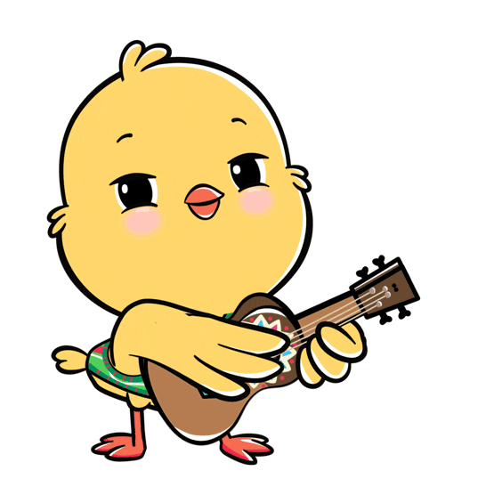
Welcome to our class!

Slide 2
Warm-up

Slide 3
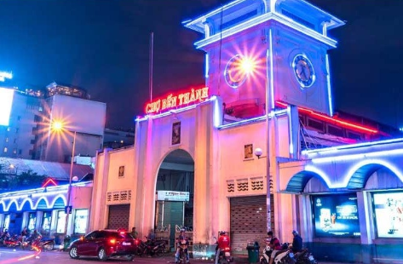
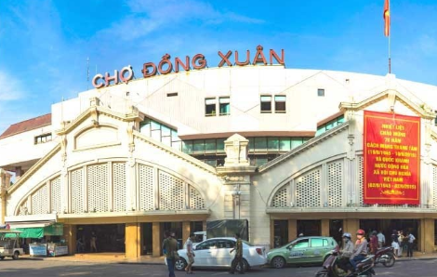
Let’s chant.
November, December.
November, December.
Where did you go last November?
We went to Ben Thanh Market last November.
November, December.
November, December.
Where did they go last December?
They went to Dong Xuan Market last December.
Click on the mic to listen.

Slide 4
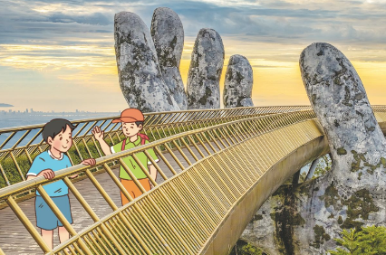
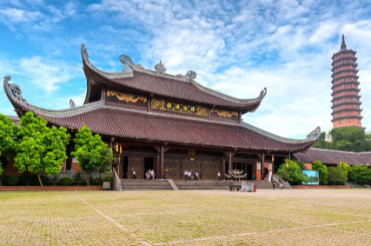
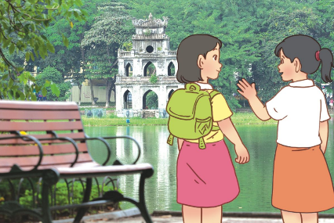
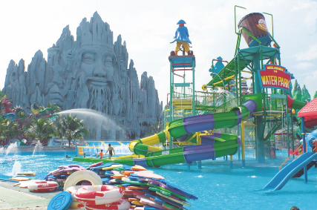
Unit 10 lesson 1
Did they go to _______?
Yes, they did.
didn’t = did not
No, they didn’t.
Ba Na Hills
Bai Dinh Pagoda
Hoan Kiem Lake
Suoi Tien Theme Park

Slide 5
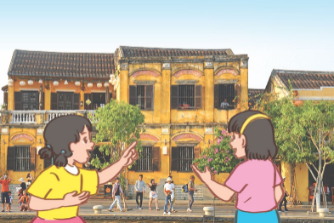
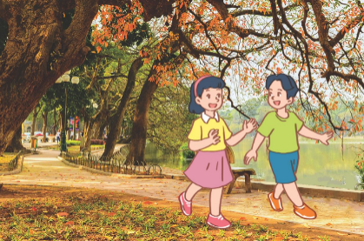
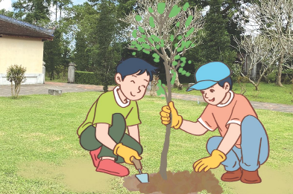
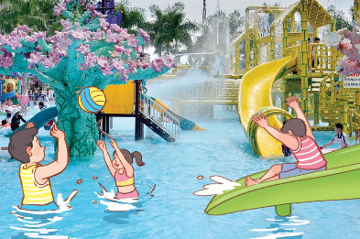
Unit 10 lesson 2
What did they do there?
They + động từ quá khứ.
visit the old buildings
walk around the lake
plant trees
play games

Slide 6
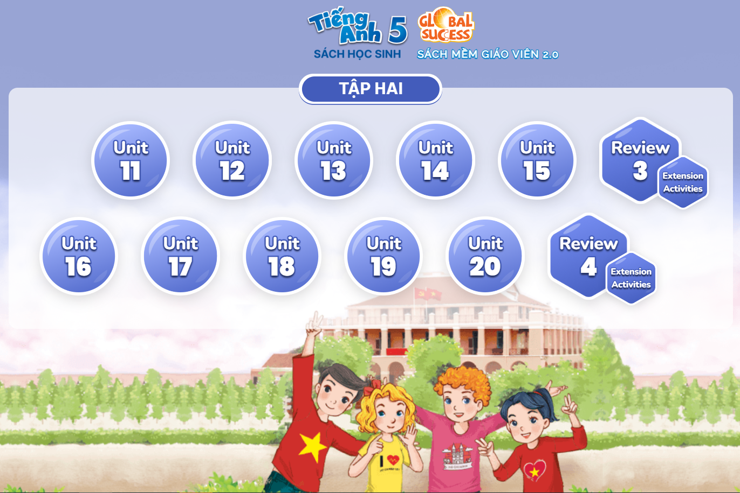
BOOK MAP
Bùi Liễu
0968142780

Slide 7
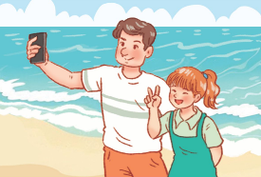
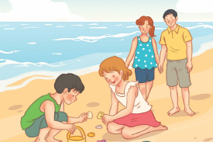
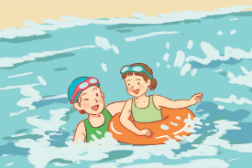
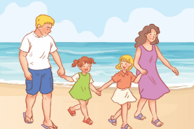
Monday, November 1st 2024
Unit 11
Family time
Lesson 1 (1+2+3)

Slide 8
Contents
Look, listen and repeat.
Listen, point and say.
Let’s talk.

Slide 9
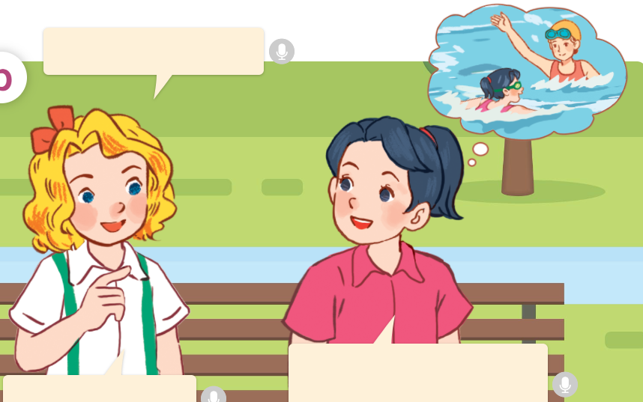
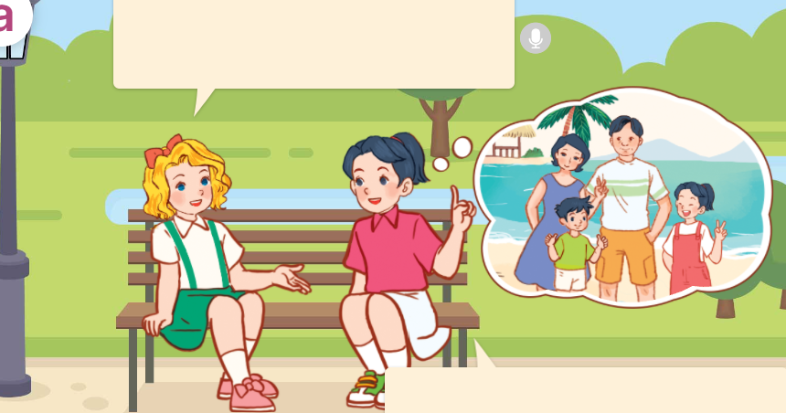
1. Look, listen and repeat.
a
Hi Mai, where did your family go last Sunday?
Did you swim?
b
Yes, I did.
We went to the beach.
I swam
with my mother.
That’s great!
They’re talking about Mai’s trip last Sunday.
They are Lucy and Linh.
They’re in the playground.
Where are they?
Who are they?
What are they talking about?
Click on the speaker / sentences to listen.

Slide 10
Vocabulary

Slide 11
Vocabulary
collect seashells
/kəˈlekt ˈsɪːʃelz/
thu lượm, đi nhặt vỏ sò
Click on the English words to listen.

Slide 12
walk on the beach
/ wɔːk ɒn ðə bɪːtʃ/
đi bộ trên bãi biển

Slide 13
Review
collect seashells
walk on the beach
Click on the English word to listen again.

Slide 14
Vocabulary
1. collect seashells
: thu lượm, nhặt vỏ sò
2. walk on the beach
: đi bộ trên bãi biển
Click on the English word to listen again.

Slide 15
Checking vocabulary!

Slide 16
LOOK AND CHOOSE!

Slide 17
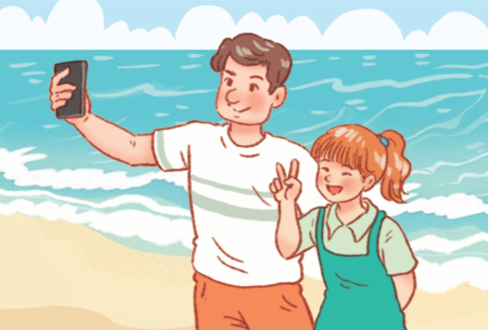
Look and choose.
Facebook: Bùi Liễu
Zalo: 0968142780
a
b
collect seashells

Slide 18
Look and choose.
Facebook: Bùi Liễu
Zalo: 0968142780
a
b
take photos

Slide 19
Look and choose.
Facebook: Bùi Liễu
Zalo: 0968142780
a
b
swim

Slide 20
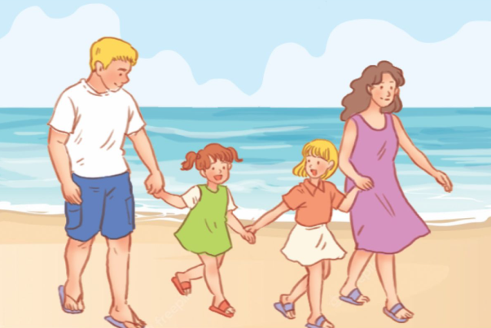
Look and choose.
Facebook: Bùi Liễu
Zalo: 0968142780
a
b
walk on the beach

Slide 21
Well done!

Slide 22
Structures

Slide 23
Dạng quá khứ của động từ
Động từ ở hiện tai | Động từ ở quá khứ
Động từ ở hiện tai | Động từ ở quá khứ
collect
/kəˈlekt/
collected
/kəˈlek.tɪd/
am
/æm/
was
/wəz/
walk
/wɔːk/
walked
/wɔːkt/
is
/ɪz/
was
/wəz/
bought
/bɔːt/
are
/ɑːr/
were
/wɜːr/
buy /baɪ/
do
/du/
did
/dɪd/
take
/teɪk/
took
/tʊk/
go
/ɡəʊ/
went
/went/
swim
/swɪm/
swam
/swæm/
Click on the words to listen again.

Slide 24
Cách hỏi và đáp về việc đã làm gì trong quá khứ.
Did you + động từ hiện tại?
( Bạn đã ____________?)
Yes, I ___. I + động từ quá khứ + with _____.
( Vâng, tôi đã. Tôi _____ với _____.)
Example:
Did you take photos?
Yes, I did. I took photos with my father.

Slide 25
Unit 11 lesson 1 (1+2+3)
Did you + động từ hiện tại?
Yes, I ___. I + động từ quá khứ + with ____.
swim / with my mother
walk on the beach with my family
take photos / with my father
collect seashells / with my brother

Slide 26
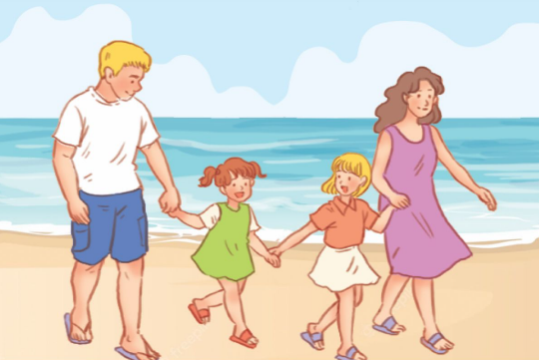
2. Listen, point and say.
a
b
Did you _________?
swim / with my mother
take photos / with my father
Yes, I ___. I _______.
c
d
collect seashells / with my brother
walk on the beach / with my family
Click on the words / phrases to listen again.

Slide 27
2. Listen, point and say.
a
swim / with my mother
Did you swim?
Yes, I did. I swam with my mother.
Click on the sentences to listen.

Slide 28
2. Listen, point and say.
b
take photos / with my father
Did you take photos?
Yes, I did. I took photos with my father.

Slide 29
2. Listen, point and say.
c
collect seashells / with my brother
Did you collect seashells?
Yes, I did. I collected seashells with my brother.

Slide 30
2. Listen, point and say.
d
walk on the beach / with my family
Did you walk on the beach?
Yes, I did. I walked on the beach with my family.

Slide 31
3. Let’s talk.
Did you ________?
_____________.

Slide 32
3. Let’s talk.
Did you ___________?
take photos
_______________________________.
Yes, I did. I took photos with my mother

Slide 33
3. Let’s talk.
Did you ________________?
collect seashells
Yes, I did. I collected seashells with my brother
______________________________________.

Slide 34
3. Let’s talk.
Did you ________________?
walk on the beach
______________________________________.
Yes, I did. I walked on the beach with my family

Slide 35
3. Let’s talk.
Did you ___________?
swim
___________________________.
Yes, I did. I swam with my father

Slide 36
Fun corner
& wrap - up

Slide 37
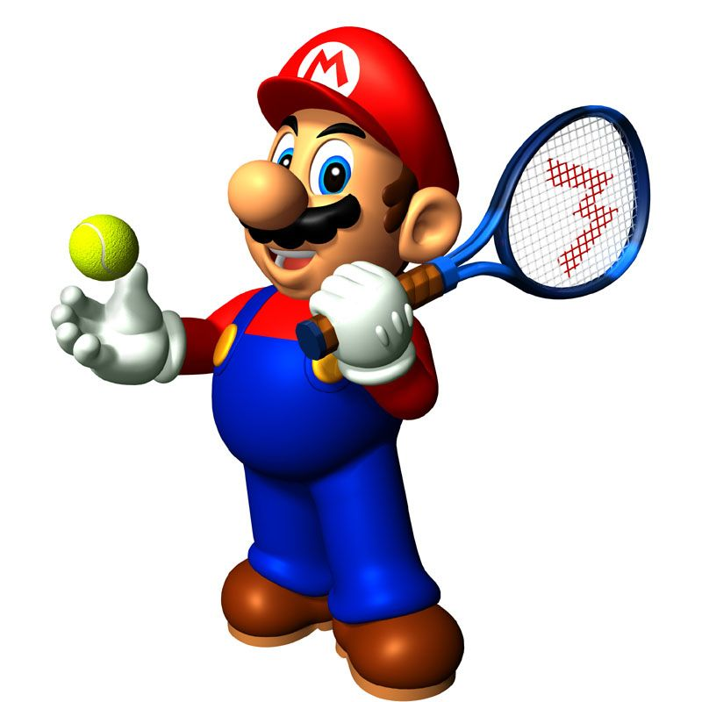

Slide 38
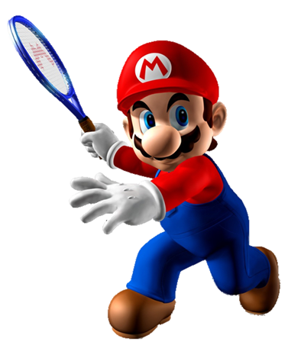
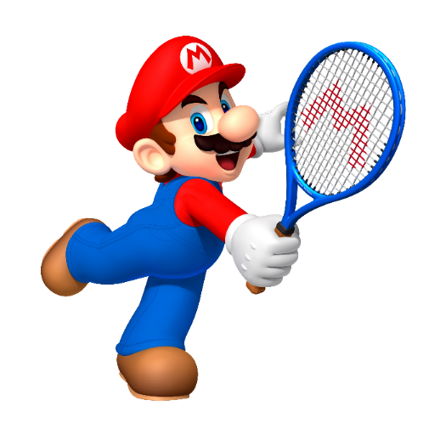
1/8
A. took photos with my father
A: Did you swim?
B: Yes, I did . I ______.
B. swam with my mother
C. collect seashells with my brother

Slide 39
2/8
A. collected seashells with my brother
A: Did you collects seashells?
B: Yes, I did . I ______.
B. walked on the beach with my family
C. swam with my mother

Slide 40
3/8
A. took photos with my father
B. collected seashells with my brother
A: Did you take photos?
B: Yes, I did . I ______.
C. swam with my mother

Slide 41
4/8
A. swam with my mother
A: Did you walk on the beach?
B: Yes, I did . I ______.
B. took photos with my father
C. walked on the beach with my family

Slide 42
5/8
A. swim
A: Did you _____?
B: Yes, I did . I swam with my mother.
B. swam

Slide 43
6/8
A. collect seashells
A: Did you ______ ?
B: Yes, I did . I collected seashells with my brother.
B. collected seashells

Slide 44
7/8
A: ___ you walk on the beach?
B: Yes, I did . I walked on the beach with my family.
A. Do
B. Did

Slide 45
8/8
A: Did you take photos?
B: Yes, I ____ . I took photos with my father.
A. do
B. did

Slide 46
Good job!

Slide 47
Unit 11 lesson 1 (1+2+3)
Did you + động từ hiện tại?
Yes, I ___. I + động từ quá khứ + with ____.
swim / with my mother
walk on the beach with my family
take photos / with my father
collect seashells / with my brother

Slide 48
Homework
Learn by heart all the new words and the model sentences.
Read again the dialogue in part 1. Prepare for the lesson 1 (4+5+6).

Slide 49
Goodbye!

