Slide 2
Monday, November 3rd 2024
Colours
Unit 9
Lesson 3 (4+5+6)

Slide 3
Warm up

Slide 4
Let’s play!

Slide 5
START

Slide 6
Click vào nút đỏ để xuất hiện bức ảnh, hs đoán từ vựng.
Sau đó gv ấn check để hiển thị kết quả.
What colour is it?
It’s blue.
Check
Next

Slide 7
What colour is it?
It’s yellow.
Check
Next

Slide 8
What colour is it?
It’s brown.
Check
Next

Slide 9
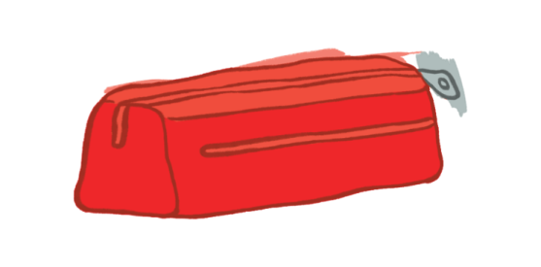
What colour is it?
It’s red.
Check
Next

Slide 10
What colour are they?
They’re orange.
Check
Next

Slide 11
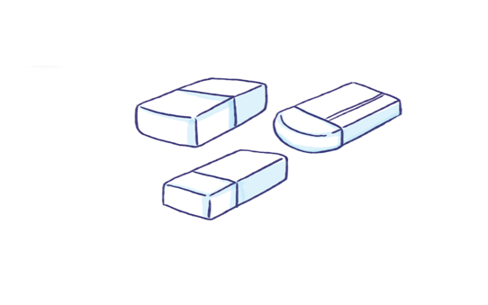
What colour are they?
They’re white.
Check
Next

Slide 12
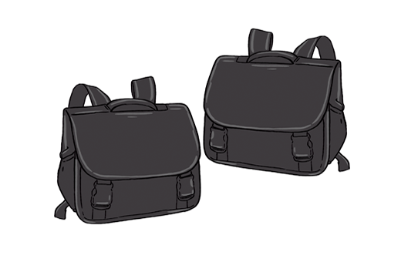
What colour are they?
They’re black.
Check
Next

Slide 13
What colour are they?
They’re green.
Check
Next

Slide 14
Good job!
End

Slide 15
Contents
Read and tick.
Let’s write.
Project.

Slide 16
4. Read and tick.
Look at my school things. I have a school bag. It’s brown. My books
and notebooks are blue. My pencil case and eraser are orange. My
pen and pencil are black. I like my school things very much.
1
2
3
4
My school things | black | blue | brown | orange
1. school bag
2. books and notebooks
3. pencil case and eraser
4. pen and pencil

Slide 17
5. Let’s write
I have a school bag. It is brown. I have a pen. It is ____.
I have two _______. They are ____.
red
erasers
blue

Slide 18
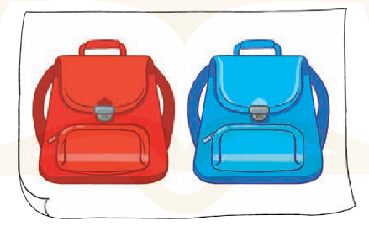
6. Project
Colours of my school things.

Slide 19
Wrap up

Slide 20
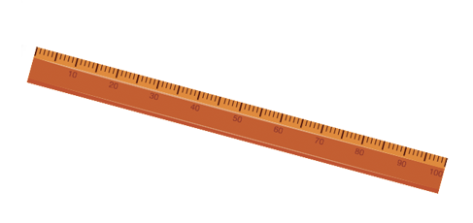
Unit 9 lesson 1
What colour is it?
It’s = it is
It’s _______.
blue
yellow
brown
red

Slide 21
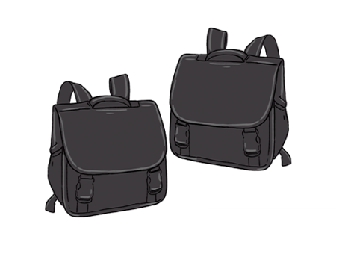
Unit 9 lesson 2
What colour are they?
They’re _____.
they’re = they are
orange
black
green
white

Slide 22
Homework
..................................................
..................................................

Slide 23
Thank you!

