Slide 1
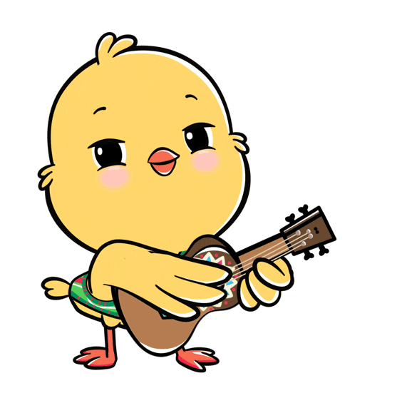
Welcome to
our class!

Slide 2
Warm-up

Slide 3
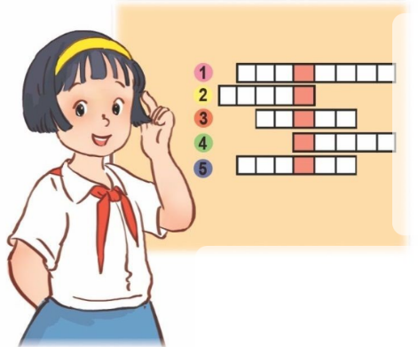
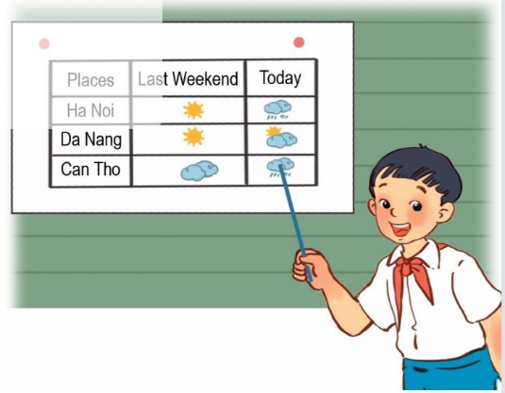
Let’s sing.
What school activities does she like?
What school activities does she like?
She likes playing word puzzles.
She likes playing the violin.
She likes reading stories.
What school activities does he like?
He likes playing football.
He likes playing the guitar.
He likes doing projects.
Nhấn vào loa để chạy chữ và nghe toàn bài.

Slide 4
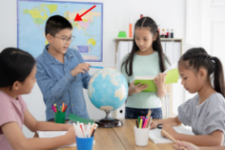
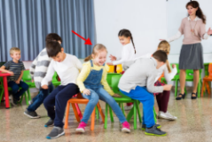
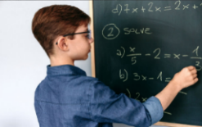
Monday, July 15th 2024
Unit 7
Our favourite
school activities
Lesson 2 (1+2+3)
Notes:
Bùi Liễu Powerpoint
0968142780

Slide 5
Contents
Look, listen and repeat.
Listen, point and say.
Let’s talk.

Slide 6
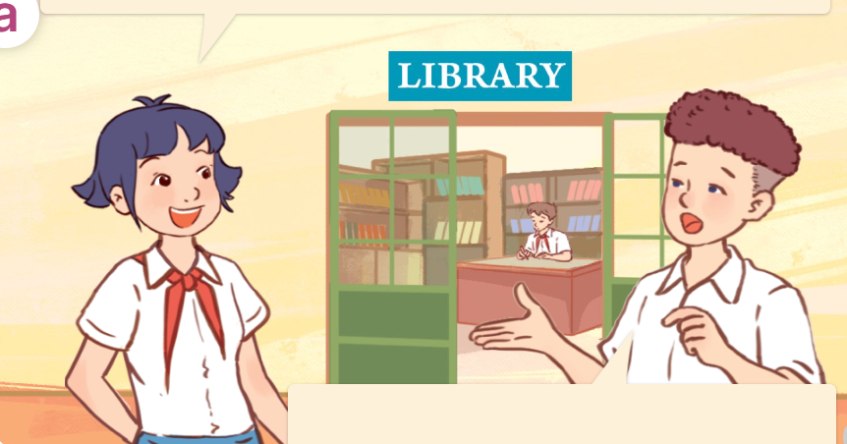
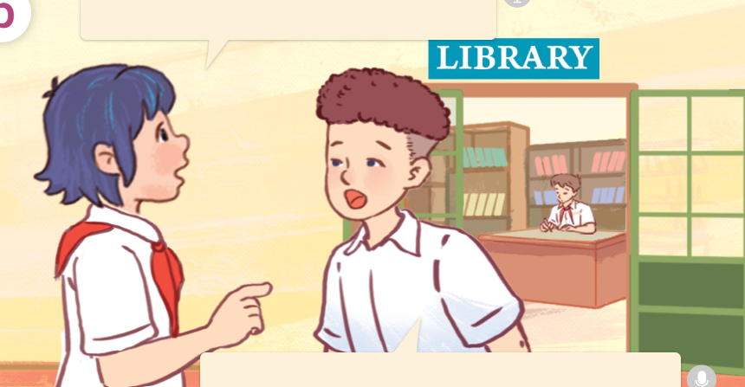
1. Look, listen and repeat.
Hi, Tom.
I can’t see Minh.
Why does he like solving maths problems?
What’s he doing?
a
b
He’s solving maths problems in the library.
He likes maths.
Because he thinks it’s useful.
They are Linh and Tom.
Where are they?
What are they talking about?
They’re talking about Minh.
They’re at school.
Who are they?
Click on the speaker / sentences to listen.

Slide 7
Vocabulary

Slide 8
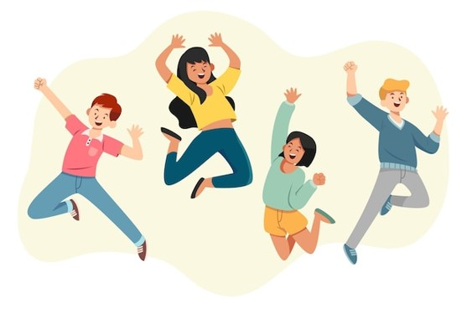
Vocabulary
fun
/fʌn/
sự vui thích
Click on the English words to listen.

Slide 9
good for group work
/ɡʊd fɔː ˈɡruːp wɜːk/
tốt, giúp ích cho hoạt động

Slide 10
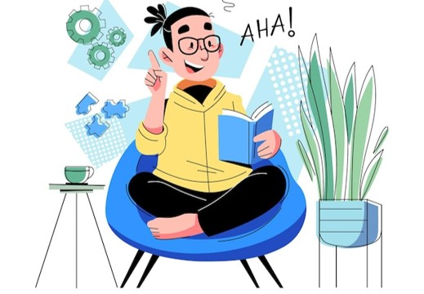
interesting
/ˈɪntrəstɪŋ/
thú vị

Slide 11
useful
/ˈjuːsfl/
có ích, hữu ích

Slide 12
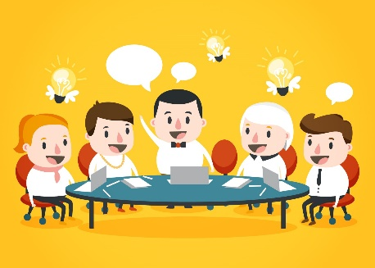
Review
fun
useful
interesting
good for group work
Click on the English word to listen again.

Slide 13
Vocabulary
1. fun
: sự vui thích
2. good for
group work
: tốt, giúp ích
cho hoạt động
3. interesting
: thú vị
4. useful
: có ích, hữu ích
Click on the English word to listen again.

Slide 14
Checking vocabulary
Look and match.
1
2
3
4
a
b
c
d
interesting
useful
fun
good for group work

Slide 15
Structures

Slide 16
Cách hỏi lí do ai đó thích làm hoạt động nào đó.
Why does he / she like ______?
( Tại sao anh ấy / cô ấy thích ______?)
Because he / she thinks it’s _______.
( Bởi vì anh ấy / cô ấy nghĩ rằng _______.)
Example:
Why does she like reading books?
Because she thinks it’s interesting.

Slide 17
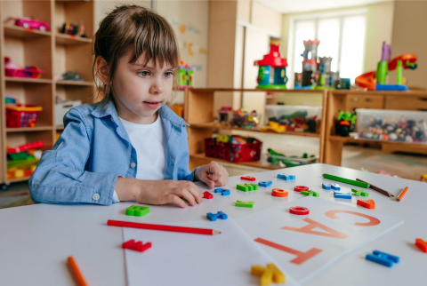
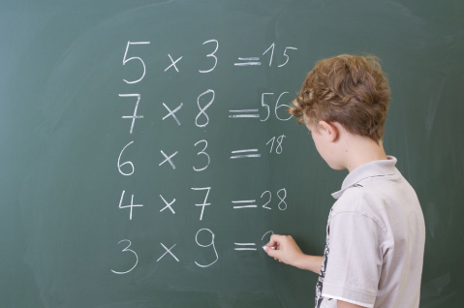
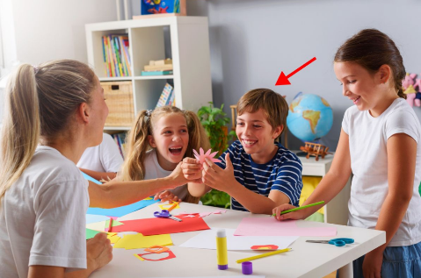
Unit 7 lesson 2 (1+2+3)
Why does he / she like _____?
Because he / she thinks it’s _____.
play games / fun
solve maths problems / useful
do projects / good for group work
read books / interesting

Slide 18
2. Listen, point and say.
a
b
Why does he / she like ____?
do projects / good for group work
play games / fun
Because he / she thinks it’s ______.
c
d
read books / interesting
solve maths problems / useful
Click on the words / phrases to listen again.

Slide 19
2. Listen, point and say.
a
play games / fun
Why does she like playing games?
Because she thinks it’s fun.
Click on the sentences to listen.

Slide 20
2. Listen, point and say.
b
do projects / good for group work
Why does he like doing projects?
Because he thinks it’s good for group work.

Slide 21
2. Listen, point and say.
c
read books / interesting
Why does she like reading books?
Because she thinks it’s interesting.

Slide 22
2. Listen, point and say.
d
solve maths problems / useful
Why does he like solving maths problems?
Because he thinks it’s useful.

Slide 23
3. Let’s talk.
What school activity does he / she like?
_____________.
Why does he / she like _______?
______________.

Slide 24
3. Let’s talk.
What school activity does ___ like?
he
doing crossword puzzles
he
Why does ___ like ____________________?
He likes doing crossword puzzles
______________________.
___________________________.
Because he thinks it’s fun

Slide 25
3. Let’s talk.
What school activity does ____ like?
she
reading books
she
Why does ____ like _____________?
____________________________.
She likes reading books
Because she thinks it’s interesting
____________________.

Slide 26
3. Let’s talk.
What school activity does ___ like?
Why does ___ like ____________________?
he
solving maths problems
he
________________________.
He likes solving maths problems
Because he thinks it’s useful
___________________________.

Slide 27
3. Let’s talk.
What school activity does ____ like?
she
doing projects
she
Why does ____ like _____________?
___________________.
She likes doing projects
___________________________________.
Because she thinks it’s good for group work

Slide 28
Fun corner
& wrap - up

Slide 29
Sun flower

Slide 30
1/10
A: Why does he like solving maths problems?
B: Because he thinks
it’s ________.
Click on the flowers to choose.
A
B
C
D
interesting
useful
fun
good for group work

Slide 31
2/10
A: Why does she like reading books?
B: Because she thinks
it’s ________.
Click on the flowers to choose.
A
B
C
D
good for group work
useful
interesting
fun

Slide 32
3/10
A: Why does she like playing games?
B: Because she
thinks it’s _____.
Click on the flowers to choose.
A
B
C
D
useful
fun
good for group work
interesting

Slide 33
4/10
A: Why does he like doing projects?
B: : Because he
thinks it’s ______.
A
B
C
D
useful
interesting
good for group work
fun

Slide 34
5/10
A: Why does she like playing games?
B: Because she thinks it’s fun.
A
B
C
D

Slide 35
6/10
A: Why does she like reading books?
B: Because she thinks it’s interesting.
A
B
C
D

Slide 36
7/10
A: Why does he like solving maths problems?
B: Because he thinks it’s useful.
A
B
C
D
Sai
Sai

Slide 37
8/10
A: Why does he like doing projects?
B: Because he thinks it’s good for group work.
A
B
C
D

Slide 38
9/10
A: ________________
B: Because she thinks it’s interesting.
A
B
C
D
Why does he likes reading books?
What school activity does she like?
Why does she likes reading books?
Why would you like to be a doctor?

Slide 39
A: ________________
B: Because he thinks it’s good for group work.
10/10
A
B
C
D
Why does she likes doing projects?
Why does he likes doing projects?
What school activity does he like?
Why does he likes reading books?

Slide 41
Review
Why does he / she like _____?
Because he / she thinks it’s _____.
play games / fun
solve maths problems / useful
do projects / good for group work
read books / interesting

Slide 42
Homework
Learn by heart all the new words and the model sentences.
Read again the dialogue in part 1. Prepare for lesson 2 (4+5+6)

Slide 43
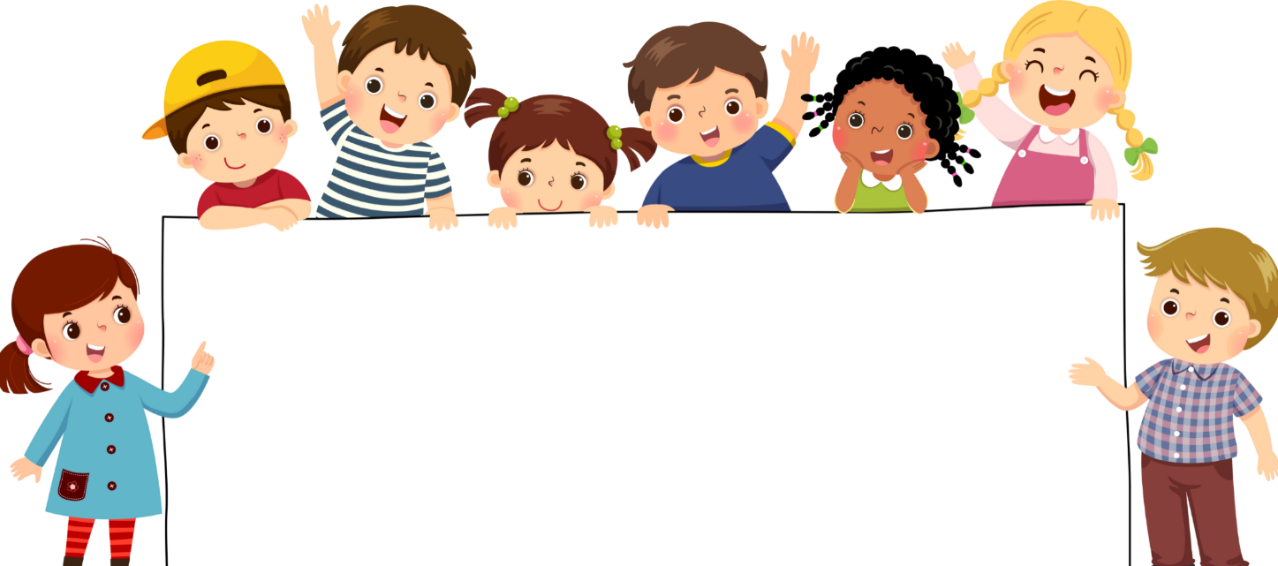
Goodbye!

