Slide 2
Warm-up

Slide 3
Let’s guess!

Slide 4
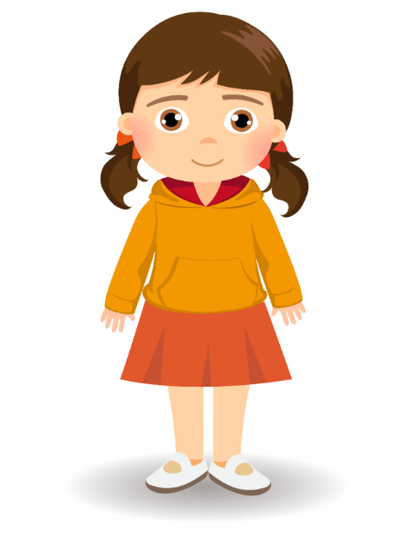

Slide 5
A. It’s an eye.
B. It’s an ear.
C. It’s a hand.
D. It’s a face.
It’s an ear.

Slide 6
A. It’s an ear.
B. It’s an eye.
C. It’s a face.
D. It’s a hand.
It’s a hand.

Slide 7
A. It’s an eye.
B. It’s a hand.
C. It’s a face.
D. It’s a nose.
It’s a face.

Slide 8
A. It’s a hand.
B. It’s an eye.
C. It’s an ear.
D. It’s a face.
It’s an eye.

Slide 9
A. It’s a face
B. It’s a nose.
C. It’s a hand.
D. It’s an eye.
It’s a nose.

Slide 10
Facebook : Bùi Liễu
0968142780
Good job!

Slide 11
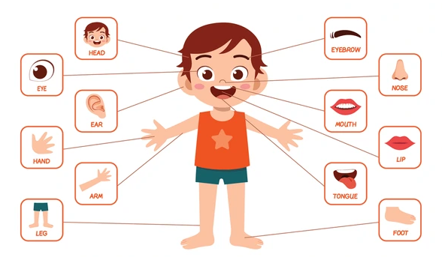
Monday, May 25th 2024
Our bodies
Unit 4
Lesson 1 (4+5+6)

Slide 12
Contents
Listen and tick.
Look, complete and read.
Let’s sing.

Slide 13
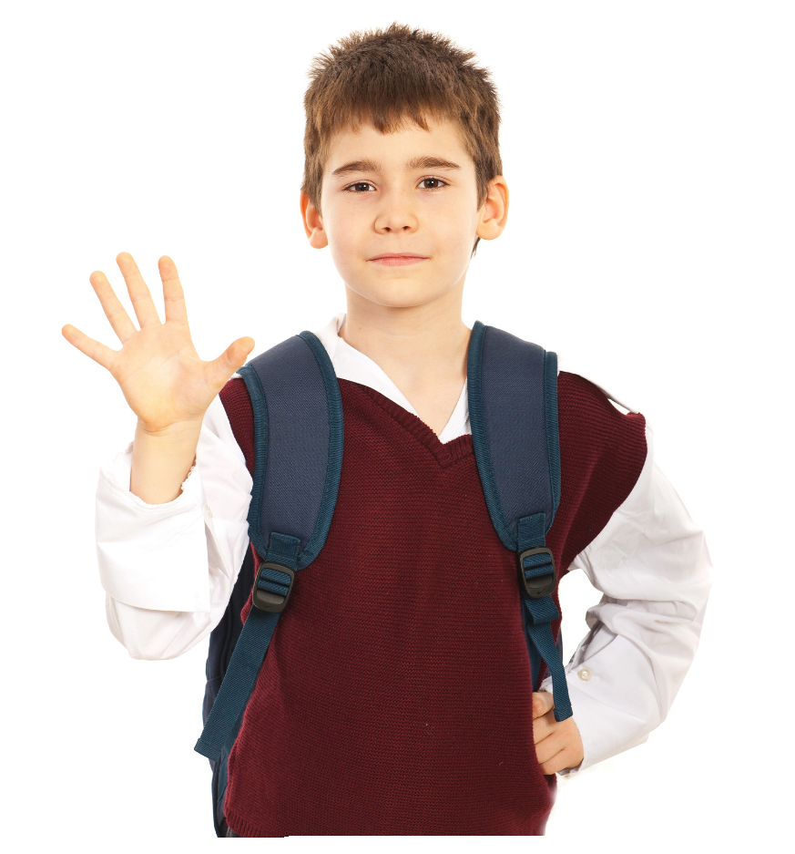
3. Let’s talk.
1
What’s this?
1
5
5
2
2
4
4
It’s an ear
3
_________.
3
It’s a nose
It’s an eye
It’s a face
It’s a hand

Slide 14
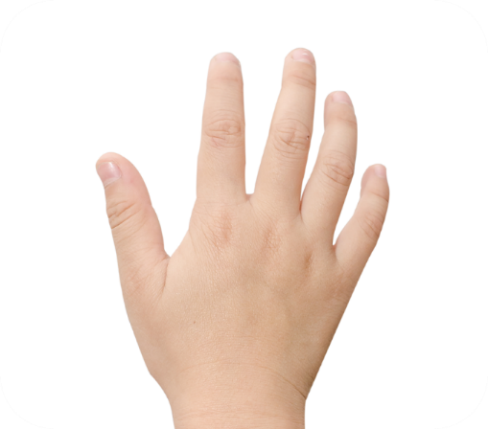
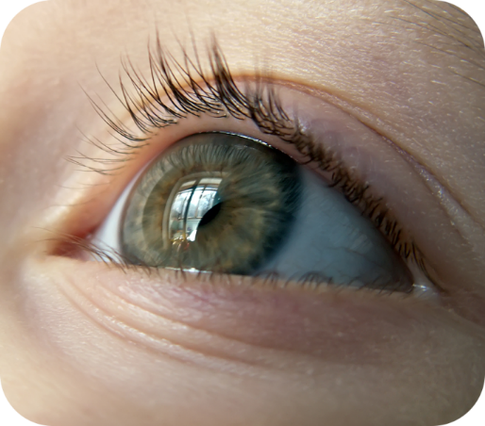
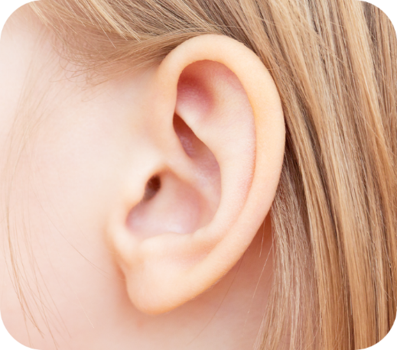
4. Listen and tick.
1.
a
b
2.
a
b

Slide 15
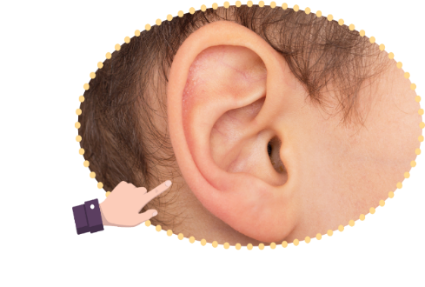
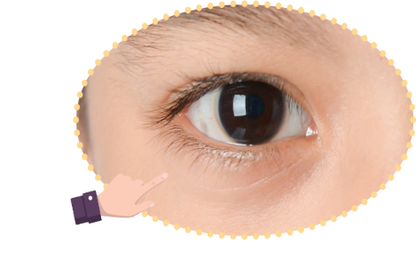
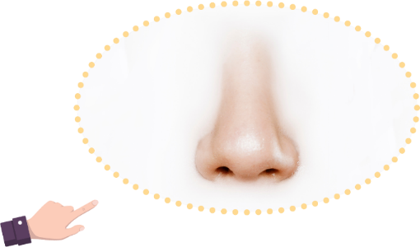
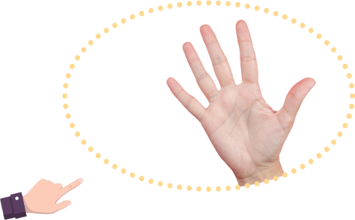
5. Look, complete and read.
1. A: What’s this?
B: It’s ________.
2. A: What’s this?
B: It’s ________.
an eye
an ear
3. A: What’s that?
B: It’s ________.
4. A: What’s that?
B: It’s ________.
a nose
a hand

Slide 16
6. Let’s sing.
Parts of the body
What’s this? It’s an eye.
What’s this? It’s an ear.
An eye and an ear.
What’s that? It’s a face.
What’s that? It’s a hand.
A face and a hand.

Slide 17
6. Let’s sing.

Slide 18
6. Let’s sing.
Parts of the body
Facebook : Bùi Liễu
0968142780
What’s this? It’s an eye.
What’s this? It’s an ear.
An eye and an ear.
What’s that? It’s a face.
What’s that? It’s a hand.
A face and a hand.

Slide 19
Wrap up

Slide 20
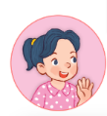
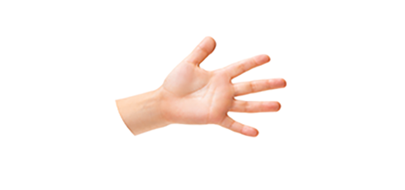
Unit 4 lesson 1
What’s this?
what’s = what is
it’s = it is
It’s _____.
a face
a nose
a hand
an ear
an eye

Slide 21
Homework
………………………………………………
……………………………………………...

Slide 22
Thank you!

