Slide 1
Monday, ........2024
Our friends
Unit
3
Lesson 2 (1+2+3)

Slide 2
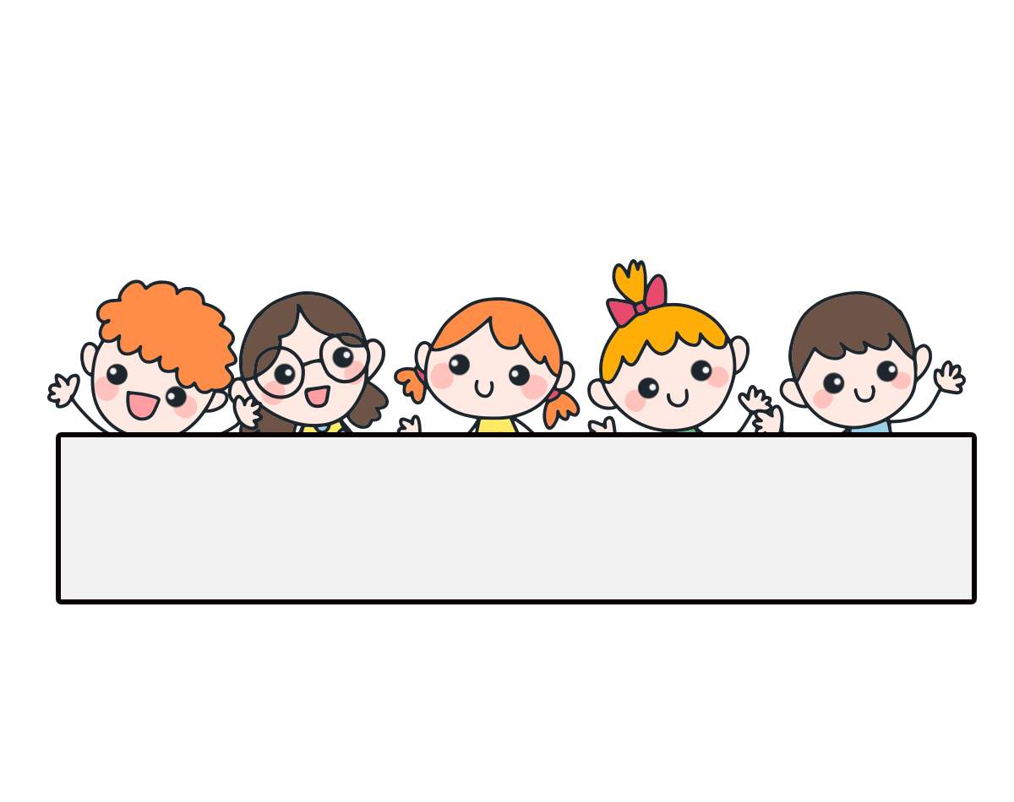
Warm-up

Slide 3
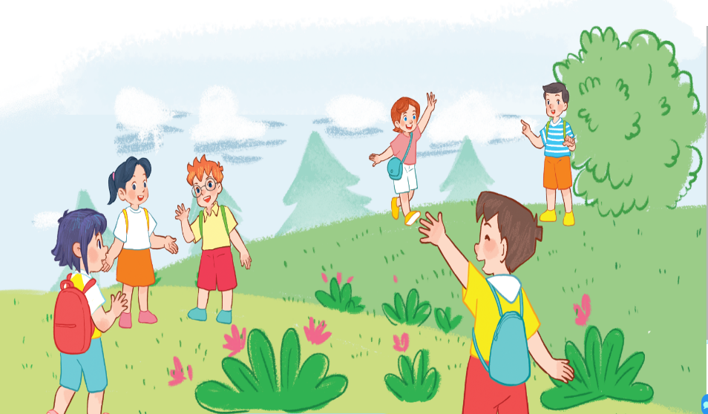
Let’s sing.
This is Linh
This is Linh.
This is Ben.
Hello, Linh.
That’s Minh.
Hello, Ben
That’s Lucy.
Hi, Minh.
Hi, Lucy.

Slide 4
Contents
Look, listen and repeat.
Listen, point and say.
Let’s talk.

Slide 5
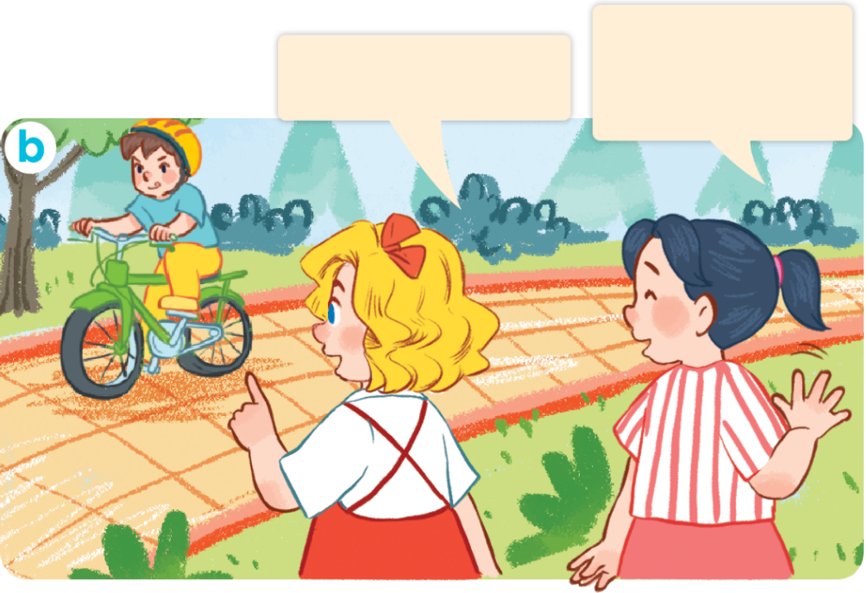
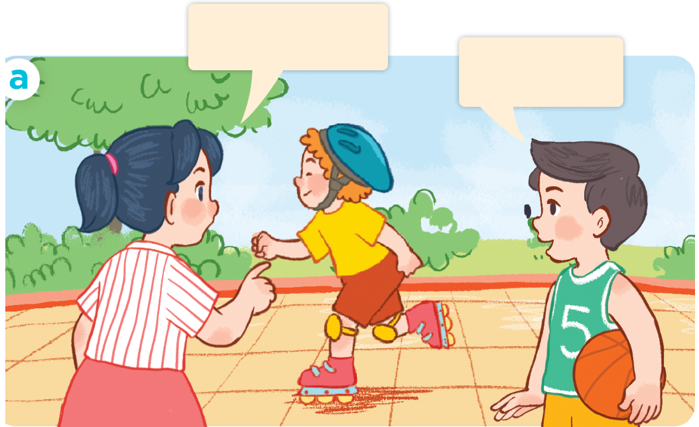
1. Look, listen and repeat.
No, it isn’t.
It’s Minh.
Is this Bill?
Is that Nam?
Yes, it is.
What are they doing?
Where are they?
Who are they?
Click on the speaker / sentences to listen.

Slide 6
Vocabulary

Slide 7
Facebook : Bùi Liễu
0968142780
Vocabulary
yes
/jes/
vâng, ừ
Click on the words to listen again.

Slide 8
Vocabulary
no
/nəʊ/
không

Slide 9
Review
yes
no

Slide 10
Vocabulary
1. yes
: vâng, ừ
2. no
: không

Slide 11
Structures

Slide 12
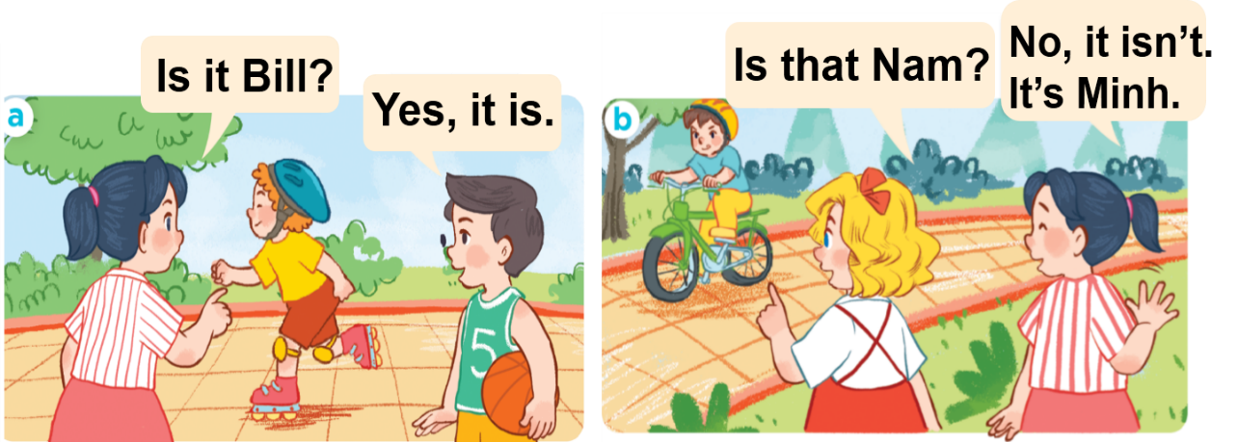
* Hỏi đây/kia là ai đó phải không.
Yes, it is.
Is this / that + ______?
(Vâng, đúng vậy.)
(Đây/kia là ___ có phải không?)
No, it isn’t.
It’s _____.
(Không, không phải).
Đó là _____.
isn’t = is not
It’s = it is

Slide 13
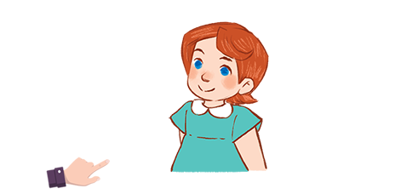
Unit 3 lesson 2 period 1
Yes, it is.
Is this / that ______?
No, it isn’t.
It’s ____.
isn’t = is not
It’s = it is
Linh / yes
Minh / no / Nam
Lucy / yes
Bill / no / Ben

Slide 14
2. Listen, point and say.
a
b
Is this / that ____?
Linh / yes
Lucy / yes
Yes, it is.
c
d
No, it isn’t. It’s ____.
isn’t = is not
It’s = it is
Bill / no / Ben
Minh / no / Nam

Slide 15
2. Listen, point and say.
Is this / that ____?
a
Yes, it is.
No, it isn’t. It’s ____.
Linh / yes
Is this Linh?
Yes, it is.
Click on the sentences to listen again.

Slide 16
2. Listen, point and say.
Is this / that ____?
b
Yes, it is.
No, it isn’t. It’s ____.
Lucy / yes
Is this Lucy?
Yes, it is.

Slide 17
2. Listen, point and say.
c
Is this / that ____?
Yes, it is.
No, it isn’t. It’s ____.
Bill / no / Ben
Is that Bill?
No, it isn’t. It’s Ben.

Slide 18
2. Listen, point and say.
Is this / that ____?
d
Yes, it is.
No, it isn’t. It’s ____.
Minh / no / Nam
Is that Minh?
No, it isn’t. It’s Nam.

Slide 19
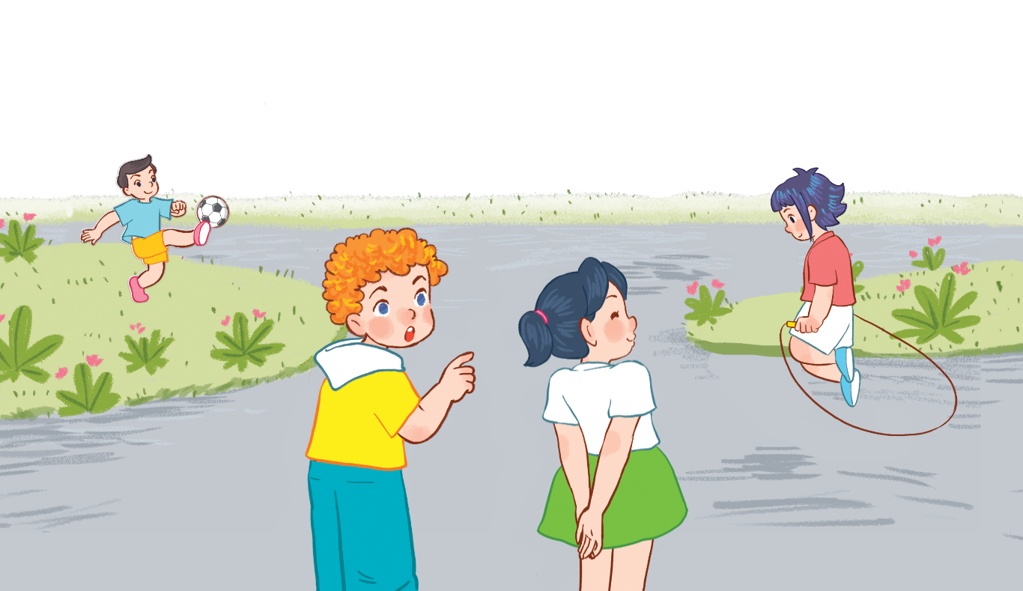
3. Let’s talk.
Is this / that ___?
Yes, / No, ____.

Slide 20
3. Let’s talk.
_______Minh?
Is that
_________________.
No, it isn’t. It’s Nam

Slide 21
3. Let’s talk.
______ Lucy?
Is this
_______.
Yes, it is

Slide 22
Facebook : Bùi Liễu
0968142780
Let’s play!

Slide 23
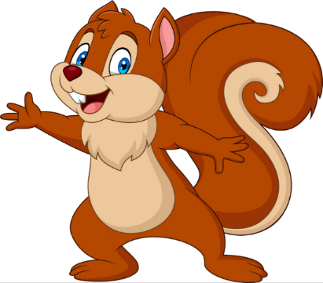
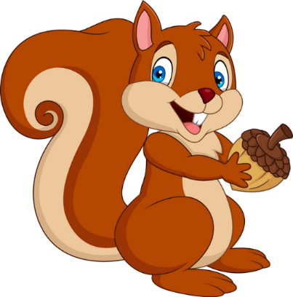
PLAY
NEXT

Slide 24
Is this Lucy?
A. Yes, it is.
B. No, it isn’t. It’s Linh.

Slide 25
Is this Bill?
A. No, it isn’t. It’s Minh.
B. No, it isn’t. It’s Ben.

Slide 26
________?
Yes, it is.
A. Is that Nam
B. Is this Nam

Slide 27
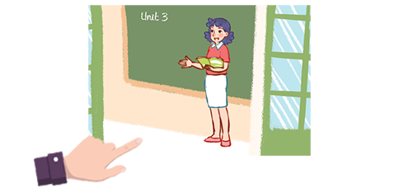
Is that Ms Loan?
A. No, it isn’t. It’s Ms Hoa.
B. No, it isn’t. It’s Ms Lieu.

Slide 28
Is this Mai?
Yes, it is.
A. True
B. False

Slide 29
Is that Minh?
________.
A. No, it isn’t. It’s Bill.
B. No, it isn’t. It’s Ben.

Slide 30
Is _____?
Yes, it is.
A. this Mai
B. this Linh

Slide 31
___ this Ben?
Yes, it is.
A. Is
B. Are

Slide 32
Good job!

Slide 33
Wrap up

Slide 34
Unit 3 lesson 2 (1+2+3)
Yes, it is.
Is this / that ______?
No, it isn’t.
It’s ____.
isn’t = is not
It’s = it is
Linh / yes
Minh / no / Nam
Lucy / yes
Bill / no / Ben

Slide 35
Homework
Learn by heart all the new words and the model sentences.
Read again the dialogues in part 1.

Slide 36
Thank you!
Facebook: Bùi Liễu Powerpoint
0968142780

