Slide 2
Warm-up

Slide 3
Let’s play!

Slide 4
Look and say.
1/8
10
A: What nationality is she?
B: _______________
Time’s up
She’s Japanese.
+1
Check
Next

Slide 5
Look and say.
2/8
10
A: What nationality is she?
B: _______________
Time’s up
She’s Malaysian.
+1
Check
Next

Slide 6
Look and say.
3/8
10
A: What nationality is she?
B: _____________
Time’s up
She’s American.
+1
Check
Next

Slide 7
Look and say.
4/8
10
A: What __________is she?
B: She is Japanese.
nationality
Time’s up
+2
Check
Next

Slide 8
Look and say.
5/8
10
A: What nationality_______?
B: She is Malaysian.
is she
Time’s up
+2
Check
Next

Slide 9
Look and say.
6/8
10
What nationality is he
A: ___________________?
B: He’s Australian.
Time’s up
+1
Check
Next

Slide 10
Look and say.
7/8
10
Listen and say “True or False?
Time’s up
False
→ She’s American.
+1
Check
End

Slide 11
Look and say.
8/8
10
Listen and say “True or False?
Time’s up
True
+1
Check
Next

Slide 12
Well done!
Exit

Slide 13
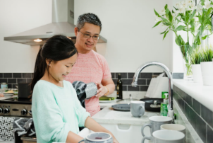
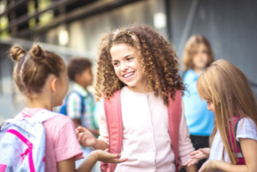
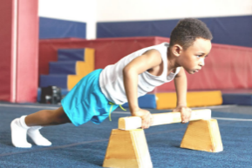
Monday, October ^{th} 2024
Unit 3
My foreign friends
Lesson 2 (1+2+3)

Slide 14
Contents
Look, listen and repeat.
Listen, point and say.
Let’s talk.

Slide 15
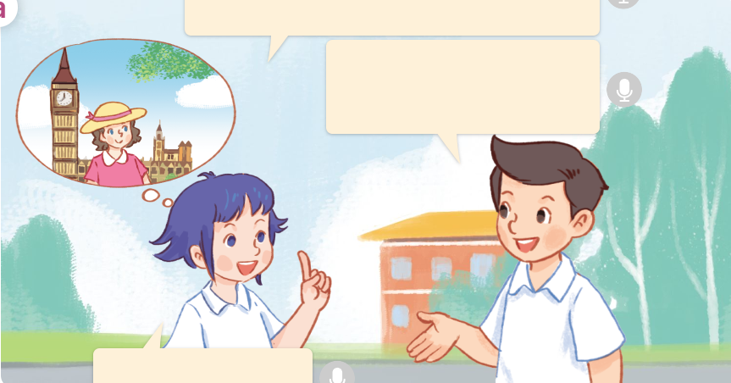
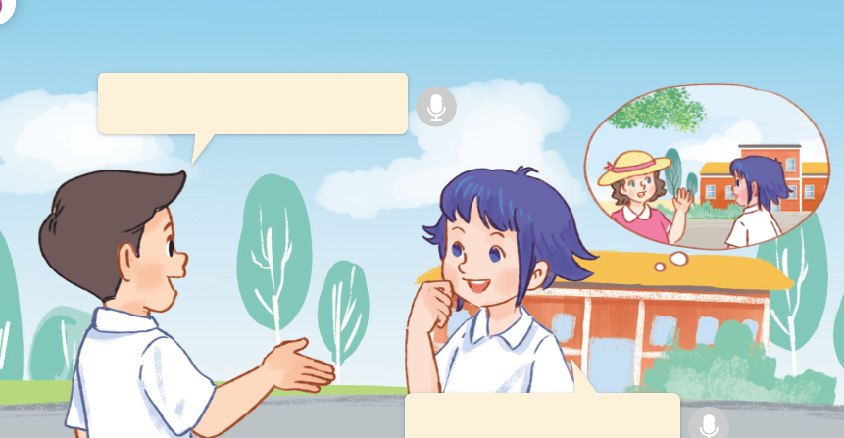
1. Look, listen and repeat.
Click on the speaker / sentences to listen.
There’s a new pupil in our class.
Her name’s Lily.
b
a
What nationality is she?
What’s she like?
She’s British.
She’s friendly.
Where are they?
They’re talking about LiLy.
She’s a new friend in their class.
They are Nam and Linh.
They’re on a road.
Who are they?
What are they talking about?

Slide 16
Vocabulary

Slide 17
helpful
/ˈhelp.fəl/
tốt bụng, hay giúp đỡ

Slide 18
Vocabulary
friendly
/ˈfrend.lɪ/
thân thiện
Click on the English words to listen.

Slide 19
active
/ˈæk.tɪv/
nhanh nhẹn, năng động

Slide 20
clever
/ˈklev.ər/
thông minh, lanh lợi

Slide 21
Review
friendly
helpful
clever
active
Click on the English word to listen again.

Slide 22
Vocabulary
1. friendly
: thân thiện
2. helpful
: tốt bụng, hay giúp đỡ
3. clever
: thông minh, lanh lợi
4. active
: nhanh nhẹn, năng động
Click on the English word to listen again.
Facebook: Bùi Liễu Powerpoint

Slide 23
Checking vocabulary!

Slide 24
Look and say.
1. friendly
2. helpful
3. clever
4. active
clever

Slide 25
Look and say.
1. clever
2. friendly
3. helpful
4. active
friendly

Slide 26
Look and say.
1. active
2. helpful
3. clever
4. friendly
active

Slide 27
Look and say.
1. friendly
2. helpful
3. clever
4. active
helpful

Slide 28
Well done!

Slide 29
Structures

Slide 30
Cách hỏi về tính cách của ai đó.
What’s he / she like?
(Cậu ấy/ Cô ấy như thế nào?)
He’s / She’s ______.
(Cậu ấy / Cô ấy _______.)
Example:
What’s she like?
She’s friendly.

Slide 31
Unit 3 lesson 2 (1+2+3)
What’s he / she like?
He’s / She’s _____.
friendly
active
helpful
clever

Slide 32
2. Listen, point and say.
a
a
b
What’s he / she like?
He’s / She’s _____.
friendly
helpful
c
d
what’s = what is
he’s = he is
she’s = she is
clever
active
Click on the words to listen again.

Slide 33
2. Listen, point and say.
a
Facebook: Bùi Liễu Powerpoint
0968142780
friendly
What’s she like?
She’s friendly.
Click on the sentences to listen.

Slide 34
2. Listen, point and say.
b
Facebook: Bùi Liễu Powerpoint
0968142780
helpful
What’s she like?
She’s helpful.

Slide 35
2. Listen, point and say.
c
Facebook: Bùi Liễu Powerpoint
0968142780
clever
What’s he like?
He’s clever.

Slide 36
2. Listen, point and say.
d
Facebook: Bùi Liễu Powerpoint
0968142780
active
What’s he like?
He’s active.

Slide 37
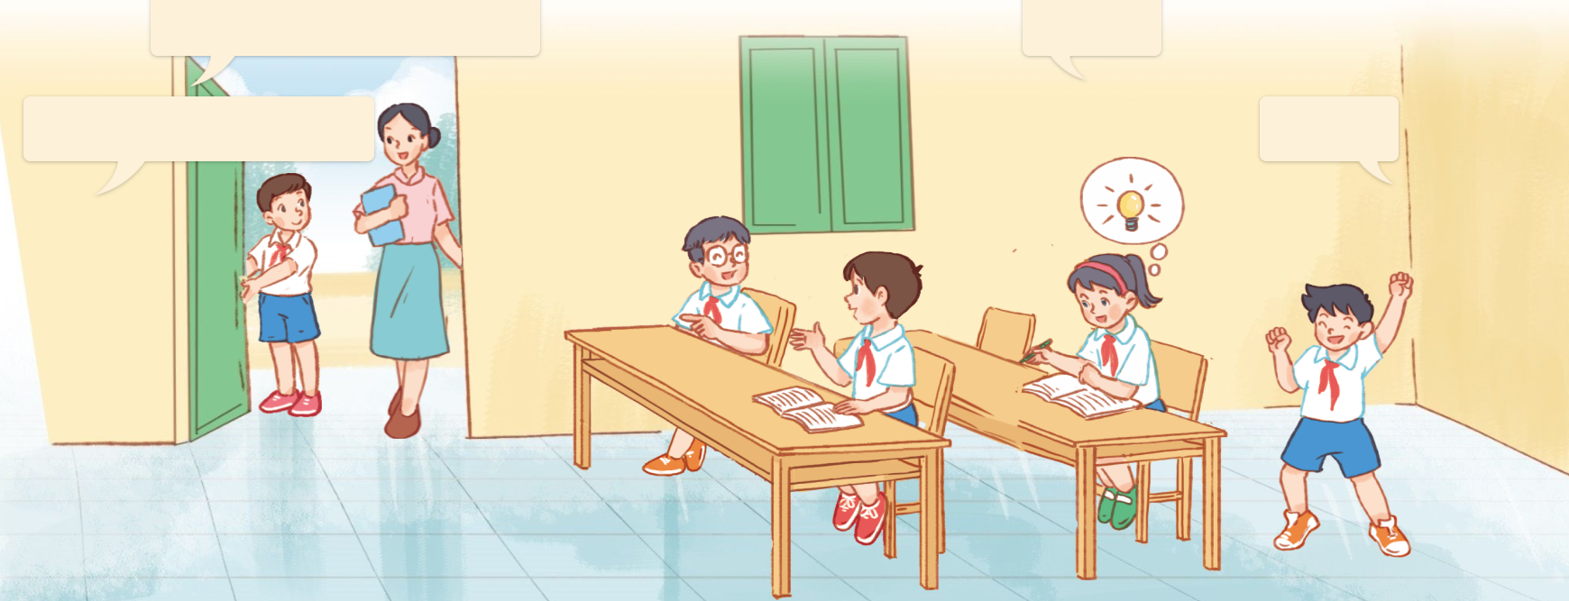
3. Let’s talk.
What’s ____ doing?
_________.
What’s ___ like?
______.

Slide 38
3. Let’s talk.
What’s ____ doing?
he
_______________.
He’s opening the door
What’s ___ like?
_________.
he
He’s helpful

Slide 39
3. Let’s talk.
What’s ____ doing?
_________.
he
He’s talking
What’s ___ like?
he
_________.
He’s friendly

Slide 40
3. Let’s talk.
What’s ____ doing?
__________.
she
She’s studying
What’s ___ like?
_________.
she
She’s clever

Slide 41
3. Let’s talk.
What’s ____ doing?
_________.
he
He’s dancing
What’s __ like?
_________.
he
He’s active

Slide 42
Fun corner
& wrap - up

Slide 43
PLAY

Slide 44
B. clever
1/10
A. helpful
C. active

Slide 45
B. helpful
2/10
A. active
C. friendly

Slide 46
B. helpful
3/10
A. clever
C. active

Slide 47
B. helpful
4/10
A. clever
C. friendly

Slide 48
B. clever – helpful – friendly - active
5/10
A. clever – active - helpful – friendly
C. helpful – clever – active - friendly

Slide 49
B. Why
6/10
A. When
C. What
A: _____’s he like?
B: He’s helpful.

Slide 50
7/10
A. He-he
B. She-she
A: What’s ____ like?
B: ____’s active.

Slide 51
B. clever
8/10
A. active
C. colour
Choose the odd one out.

Slide 52
B. She’s Japanese.
9/10
A. She’s clever.
C. He’s clever.
A: What’s he like?
B: ____________.

Slide 53
B. What your address?
10/10
C. What’s he like?
A. What’s she like?
A: ______________?
B: She’s friendly.

Slide 54
EXIT

Slide 55
Review
What’s he / she like?
He’s / She’s _____.
friendly
active
helpful
clever

Slide 56
Homework
Learn by heart all the new words and the model sentences.
Read again the dialogue in part 1. Prepare for lesson 2 (4+5+6)

Slide 57
Thank you!

