Slide 2
Monday January 15th 2025 English Unit 11: My home Period 74. Lesson 1 (4,5,6)
4. Listen and tick or cross

Slide 3
Warm-up

Slide 4
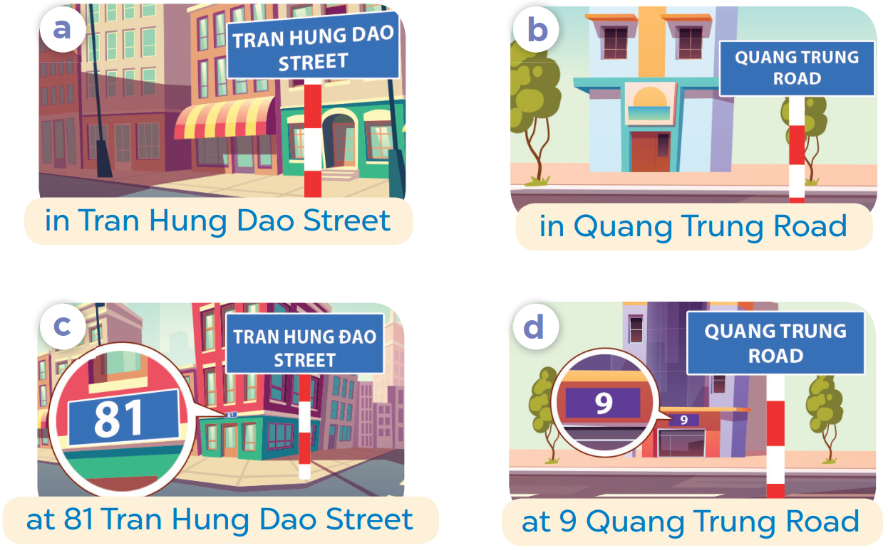
SLAP THE BOARD

Slide 5
4
Listen and tick or cross.

Slide 6
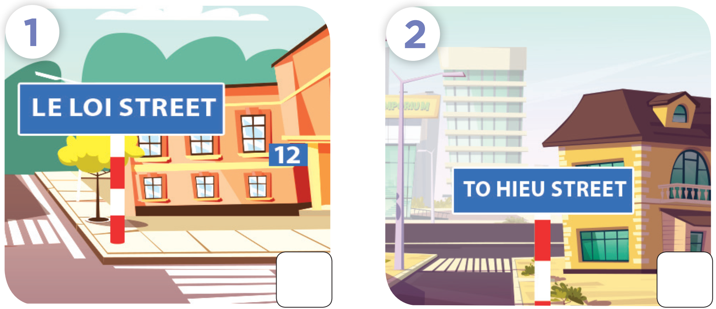

Slide 7
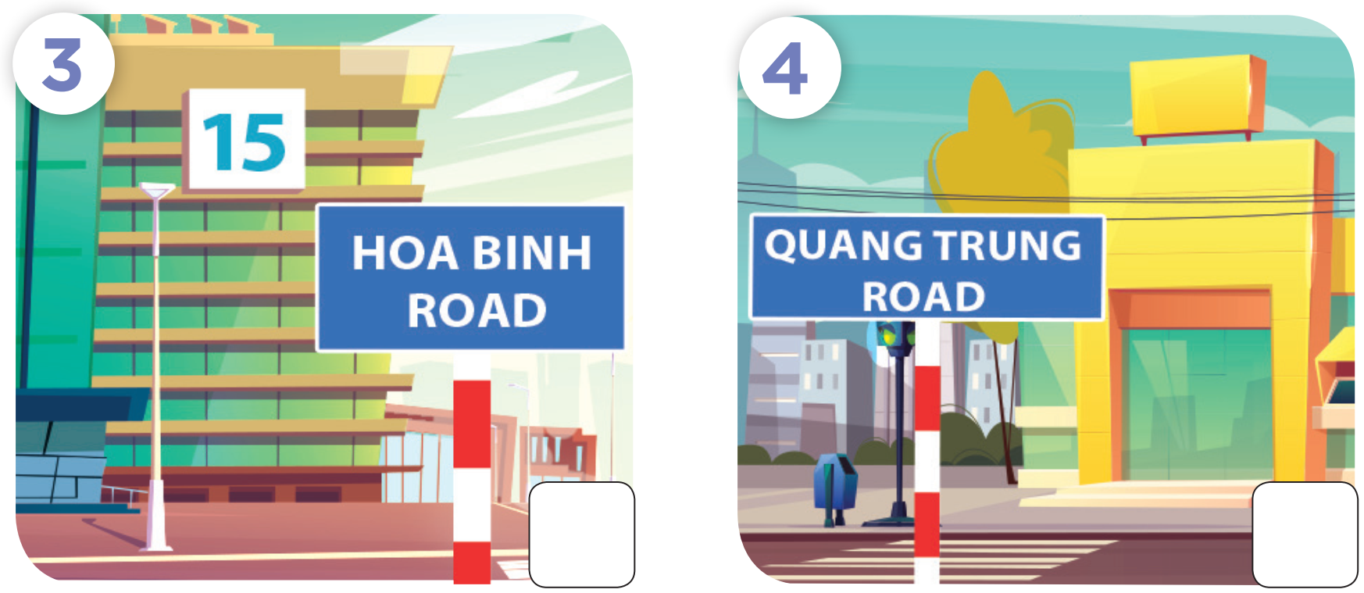

Slide 10
5
Look, complete and read.

Slide 11
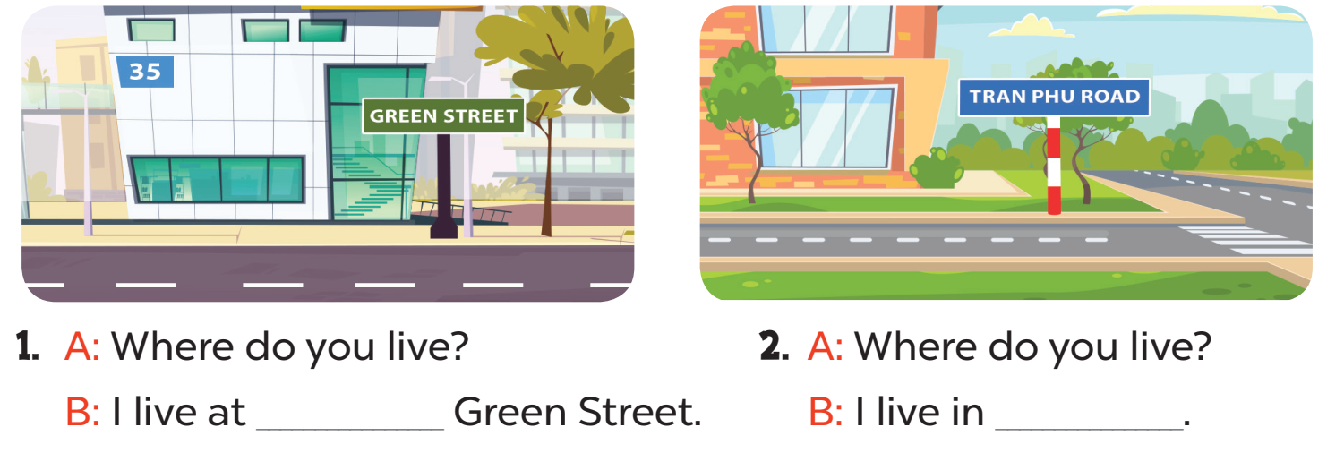
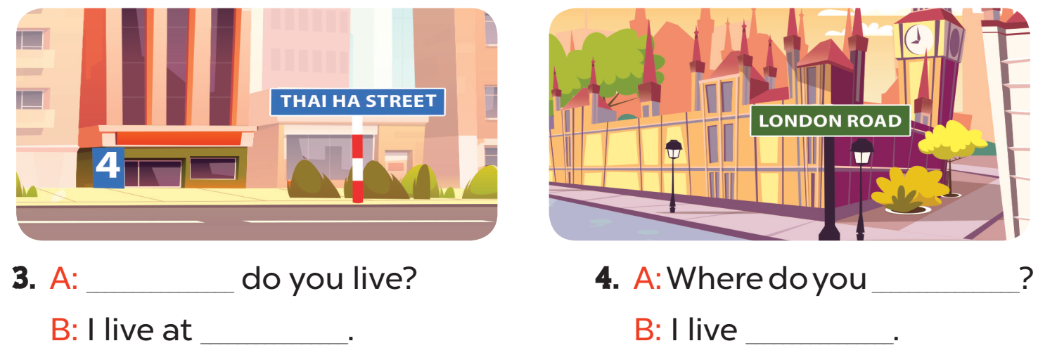

Slide 12
35
Tran Phu Road
Where
live
4 Thai Ha Street
at London Road

Slide 13
6
Let’s play.

Slide 14
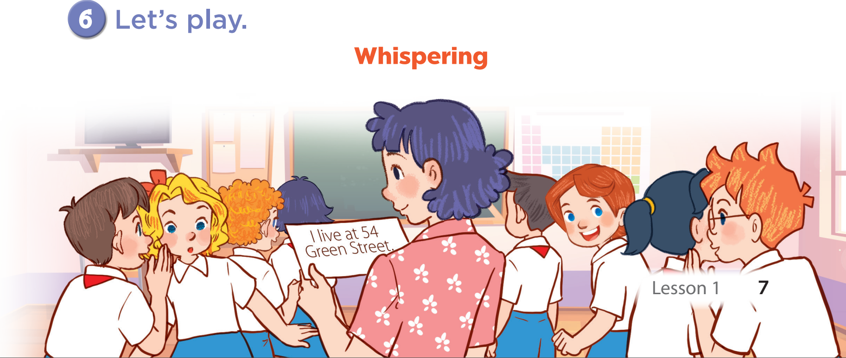

Slide 15
Fun corner & wrap-up

Slide 16
BOMBSTAR
PLAY

Slide 17
-1
-1

Slide 18
+1
Back

Slide 19
- ____________________?
- I live in Van Phuc Village.
Where do you live?
Where’s do you live?
Where you live?

Slide 20
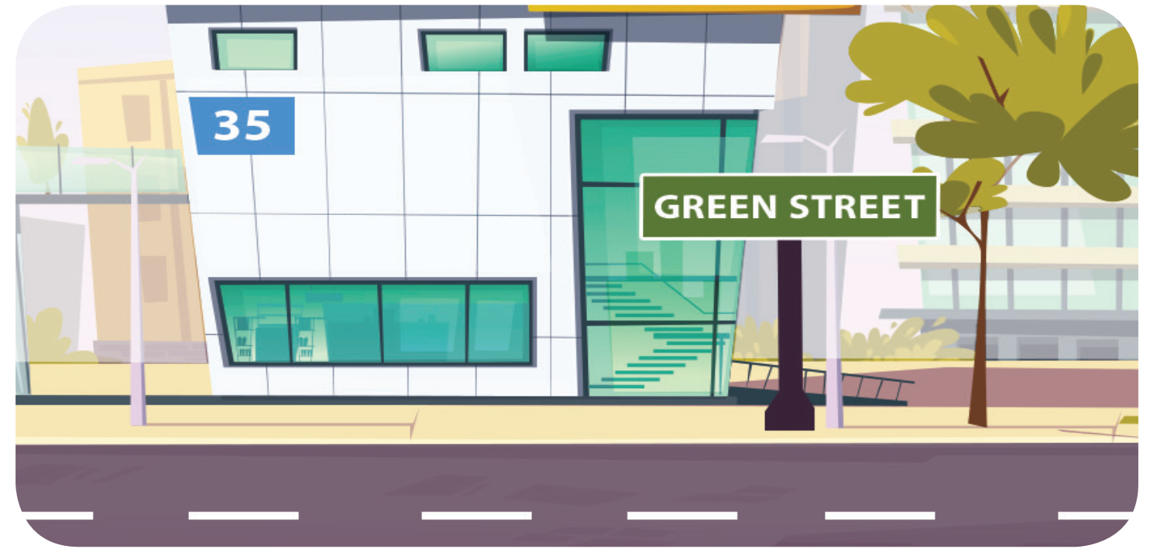
Where do you live?
_____________
I live 35 Green Street.
I live at 35 Green Street.
I live in 35 Green Street.

Slide 21
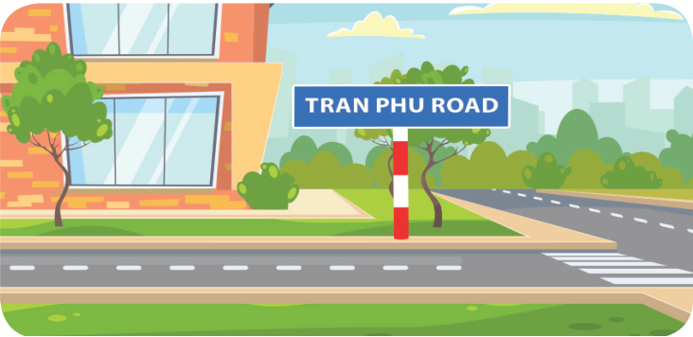
Where do you live?
She lives in Tran Phu Road.
I live in Tran Phu Street.
I live in Tran Phu Road.

Slide 22
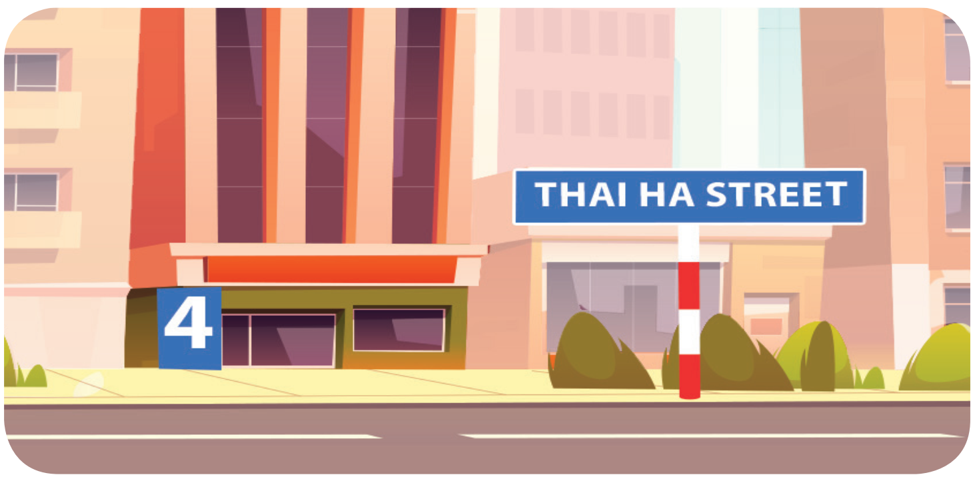
Where do you live?
I live at 4 Thai Ha Street.
I live in Thai Thinh Street.
I live at Thai Ha Street.

Slide 23
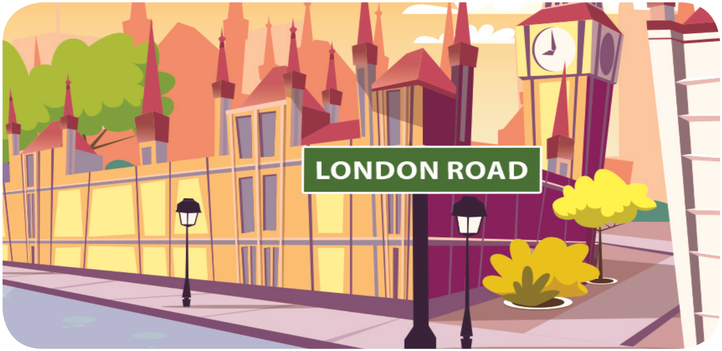
Where do you live?
I live London Road.
I live in London Road.
I live at London Road.

Slide 24
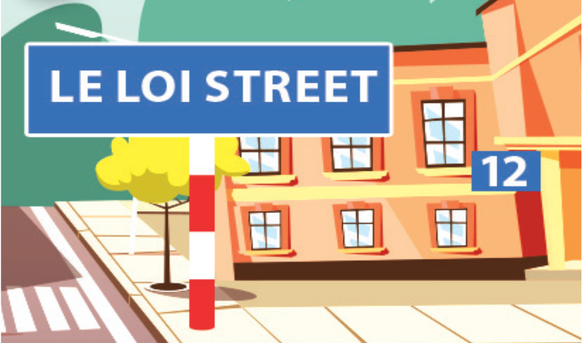
Where does he live?
He lives on Le Loi Street.
He lives in Le Loi Road.
He lives at 12 Le Loi Street.

Slide 25
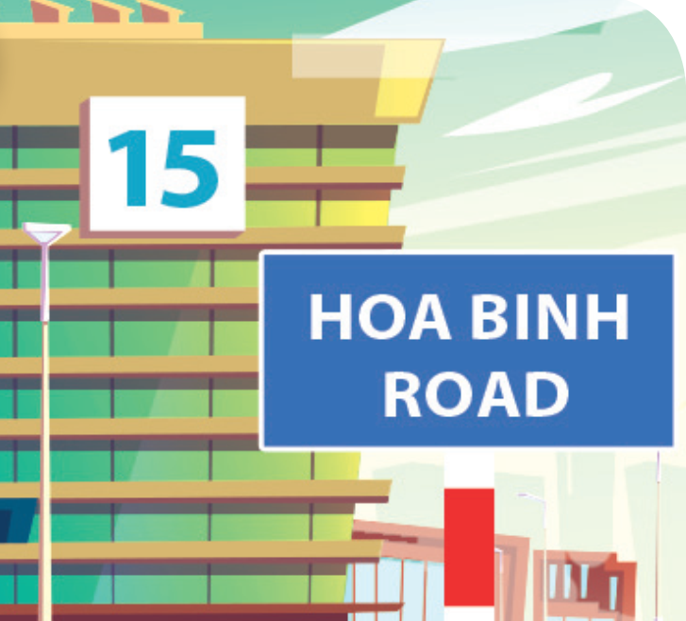
Where does she live?
She lives in 15 Hoa Binh Road.
She lives at 15 Hoa Binh Road.
She lives at 15 Hoa Binh Street.

Slide 26
What have you learnt today?

