Slide 1





Slide 2
Monday January 15th 2025
English
Unit 11: My home
Period 73. Lesson 1 (1,2,3)
1. Look, listen and repeat

Slide 3
Warm-up

Slide 4

Notes:
https://www.youtube.com/watch?v=3EDzQeh7mWE

Slide 5
1
Look, listen and repeat.

Slide 6

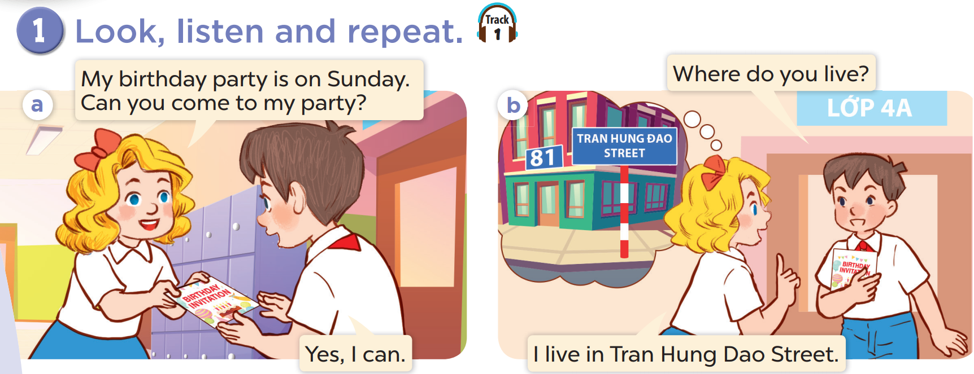

Slide 7
2
Listen, point and say.

Slide 8
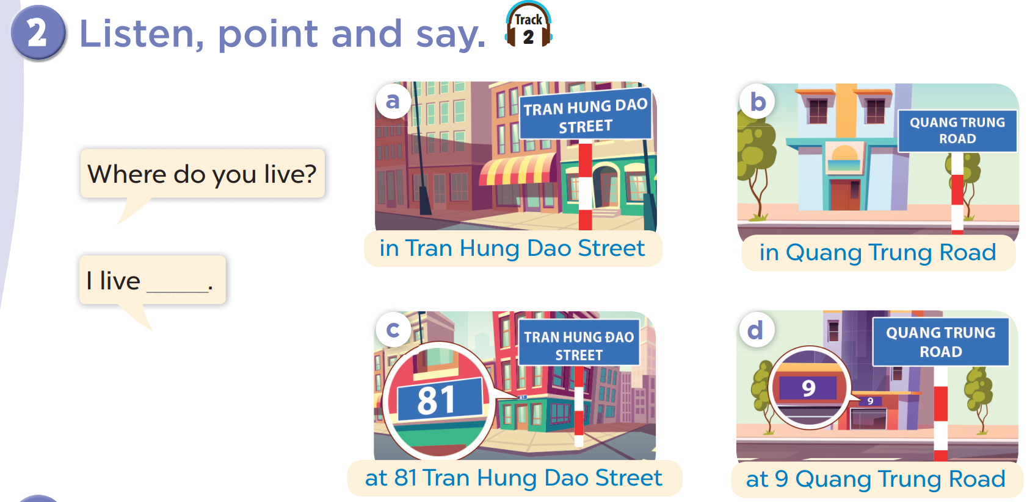

Slide 9
A. New words

Slide 10

Street
Đường phố

Slide 11

Road
Đường phố

Slide 13
B. Sentence
Asking and answering questions about where someone lives
Where do you live ?
I live ,,,,,,,,,,,,,,,,,,,,,,,,,,,,,,,,,,,,,
Ex : I live in Hong Ha street

Slide 14
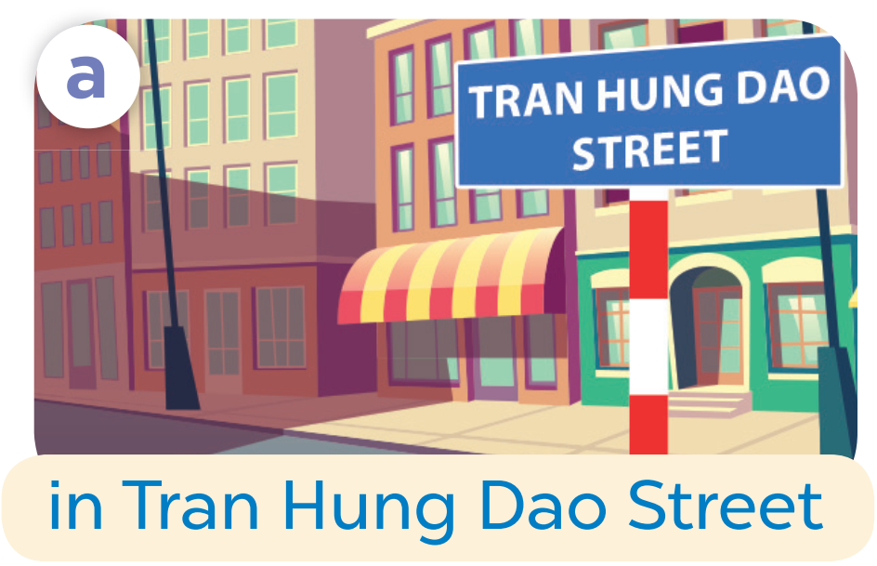
Where do you live?
I live in Tran Hung Dao Street.

Slide 15
04
Let’s talk.

Slide 16
Ward
Quận
District
Huyện

Slide 17
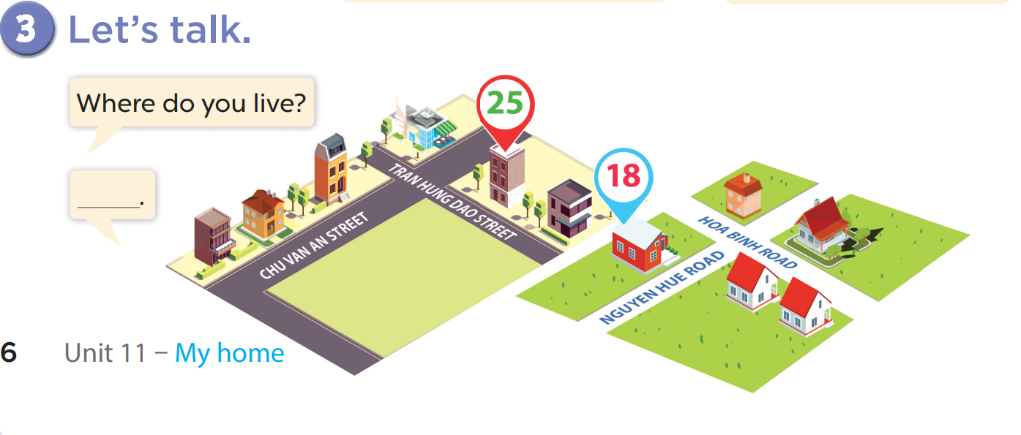

Slide 18
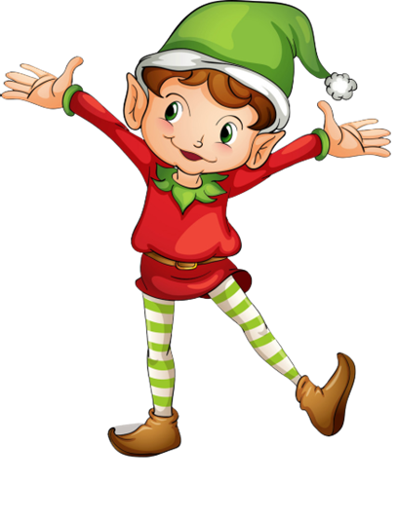
1
point
5
points
Lucky wheel!
Question
Question
Question
Question
Question
Question
SPIN
Question
3
points
2
points
10
points
End
Notes:
Click on “spin” button to spin the wheel, click again to stop

Slide 19
05
fun corner & Wrap-up

Slide 20
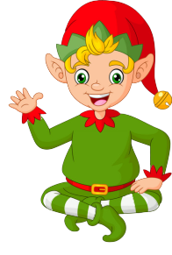
Ask and answer!
Where do you live?
I live in Tran Hung Dao Street.
Check
Back

Slide 21

Ask and answer!
Where do you live?
I live in Quang Trung Road.
Back
Check

Slide 22
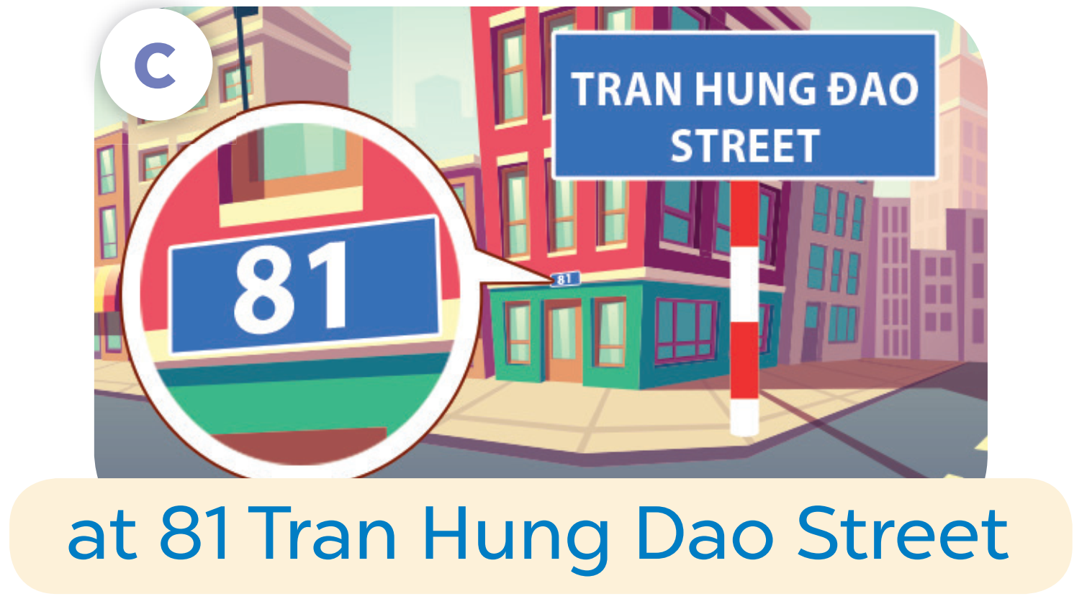
Ask and answer!
Where do you live?
I live at 81 Tran Hung Dao Street.
Back
Check

Slide 23
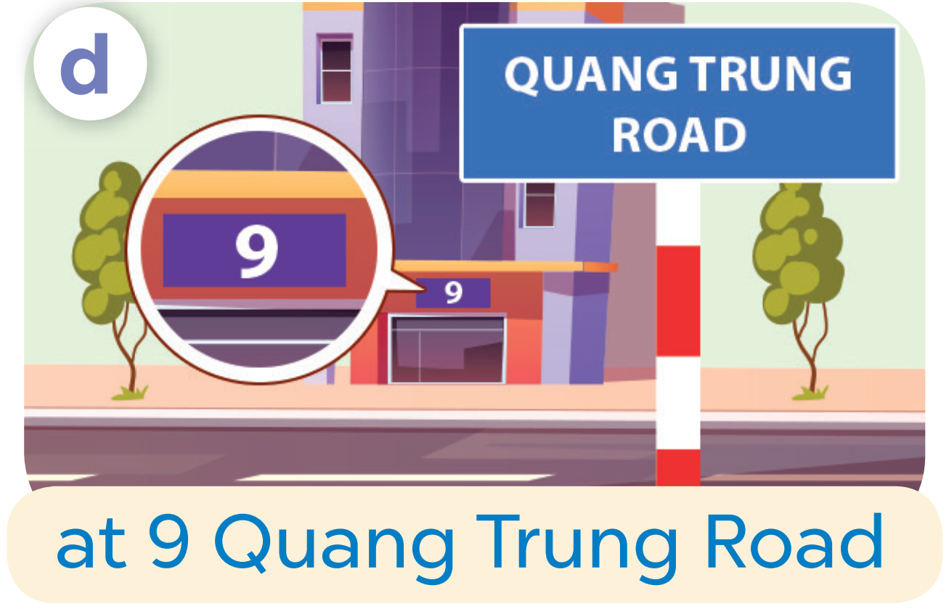
Ask and answer!
Where do you live?
I live at 9 Quang Trung Road.
Back
Check

Slide 24
Ask and answer!
Where do you live?
I live in/at…….
Back
Check

Slide 25
Ask and answer
Where do you live?
I live in/at…….
Back
Check

Slide 26

Ask and answer!
Where do you live?
I live in/at…….
Back
Check

