Slide 1
Unit 6
Artificial Intelligence
LESSON 3
READING
AI applications in education

Slide 2
LESSON 3
READING
WARM-UP
Reveal the secret word
PRE-READING
Task 1: Discuss the pictures in the article.
Task 2: Choose the correct meanings.
Task 3: Choose the correct answer.
Task 4: Complete the sentences.
WHILE-READING
POST-READING
Task 5: Discussion.
CONSOLIDATION
Wrap-up
Homework

Slide 3
WARM-UP
Reveal the secret word
- Work in groups.
- Teacher delivers a handout to each group, in which students have to fill in the blanks with suitable words.
- Teacher asks students to guess the secret key word after they have completed the task.
- The first group to do the task successfully ang get the correct key word is the winner of the game.

Slide 4
WARM-UP
Reading passage:
In the rapidly evolving world of education, technology has become a (1) _________________ behind innovation and transformation. Among the many (2) ________________ technologies making waves in the educational landscape is KEY WORD HERE. It has emerged as a powerful tool for transforming learning experiences through AI conversations. an advanced natural language processing model, is designed to understand and generate (3) ________________ text based on the input it receives. It operates on the principles of deep learning, leveraging large-scale datasets to pre-train its language comprehension abilities. By employing this (4) ____________________ AI conversational tool in education, the learning process is elevated to new heights, offering students and educators unique (5) _________________ for growth and collaboration.
driving force
cutting-edge
Chat GPT
human-like
sophisticated
opportunities

Slide 5
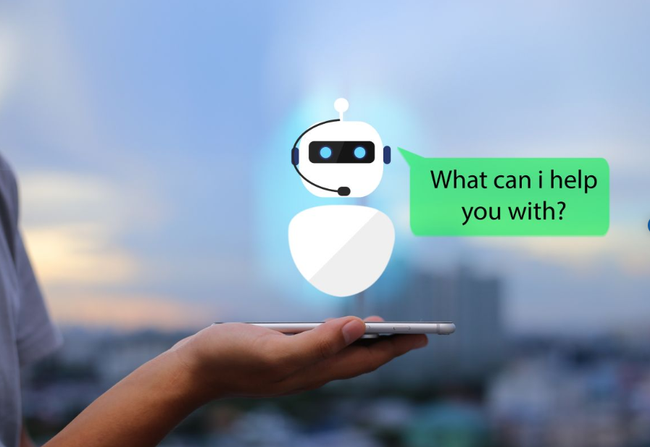
PRE-READING
1
Discuss what the pictures in the article below show and where you might see them.

Slide 6
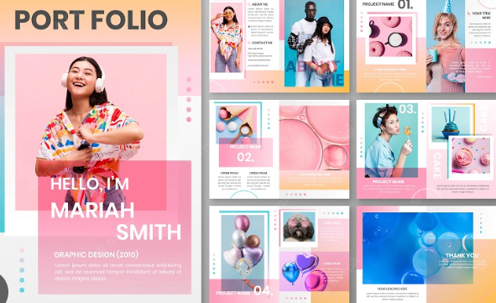
PRE-READING
portfolio (n)
/pɔːtˈfəʊliəʊ/
a collection of photographs, drawings, etc. that you use as an example of your work

Slide 7
PRE-READING
effortlessly (adv)
/ˈefətləsli/
in a way that needs little or no effort, and that seems easy

Slide 8
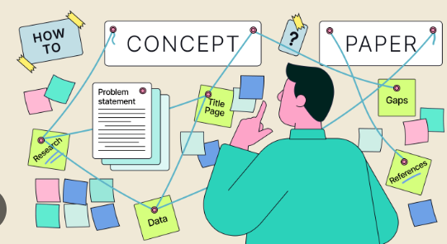
PRE-READING
concept (n)
/ˈkɒnsept/
an idea or a principle that is connected with something abstract

Slide 9
PRE-READING
personalise (v)
/ˈpɜːsənəlaɪz/
to mark something in some way to show that it belongs to a particular person

Slide 10
PRE-READING
conversational (adj)
/ˌkɒnvəˈseɪʃənl/
not formal; as used in
conversation

Slide 11
Form | Pronunciation | Meaning | Vietnamese equivalent
1. portfolio (n) | /pɔːtˈfəʊliəʊ/ | a collection of photographs, drawings, etc. that you use as an example of your work | bộ tài liệu
2. effortlessly (adv) | /ˈefətləsli/ | ​in a way that needs little or no effort, and that seems easy | không tốn sức
3. concept (n) | /ˈkɒnsept/ | an idea or a principle that is connected with something abstract | khái niệm
4. personalise (v) | /ˈpɜːsənəlaɪz/ | to mark something in some way to show that it belongs to a particular person | cá nhân hóa
5.conversational (adj) | /ˌkɒnvəˈseɪʃənl/ | not formal; as used in conversation | trong giao tiếp thông thường

Slide 12
WHILE-READING
2
Choose the correct meanings of the highlighted words.
1. portfolio
A. collection of someone’s prizes
B. collection of someone’s work such as drawings or documents
C. collection of someone’s learning and working experience
2. virtual
A. not made of natural things
B. made, done, or seen on the Internet or a computer rather than the real world
C. very similar to the real world but appearing in a different form

Slide 13
WHILE-READING
2
Choose the correct meanings of the highlighted words.
3. hands-on
A. doing something yourself rather than just talking about it
B. asking people to do something
C. doing something by hand
4. platform
A. a floor of a building
B. a kind of computer system or software
C. a working area

Slide 14
WHILE-READING
3
Read the article again and choose the correct answer.
1. What can students in Singapore upload on their digital portfolio?
A. Their curriculum vitae.
B. Their test results.
C. Their study and work experience.
D. Descriptions of their skills.

Slide 15
WHILE-READING
3
Read the article again and choose the correct answer.
2. Which of the following can AI chatbots NOT do according to Paragraph B?
A. Explain lessons.
B. Provide physical support.
C. Answer questions.
D. Comment on homework.

Slide 16
WHILE-READING
3
Read the article again and choose the correct answer.
3. Which is one benefit of using VR in Hong Kong schools?
A. Organising field trips that take place online.
B. Replacing real-life travel.
C. Reducing the costs of doing experiments.
D. Creating more ways of communication.

Slide 17
WHILE-READING
3
Read the article again and choose the correct answer.
4. Which group of students do NOT benefit from personalised learning app?
A. Physics.
B. Language.
C. Biology.
D. Chemistry.

Slide 18
WHILE-READING
3
Read the article again and choose the correct answer.
5. Which AI applications are useful for students who need additional tutoring?
A. Digital portfolio and personalised learning.
B. All the apps mentioned above.
C. Educational chatbots and virtual reality.
D. Personalised learning app and educational chatbots.

Slide 19
WHILE-READING
4
Complete each of the following sentences.
Students
1. __________ at Singaporean secondary schools can benefit from the digital portfolio.
2. Learners create project groups on __________ so that they can engage with each other.
3. Students in Hong Kong can go on virtual trips to learn about the __________ of their city.
4. The AI application in Israel has been used as the primary distance-learning __________ by advanced physics students.
chatbots
history
platform

Slide 20
POST-READING
5
Work in groups. Discuss the following question.
Which of the AI applications do you think your school can adopt?

Slide 21
CONSOLIDATION
1
Wrap-up
What have you learnt today?
Some lexical items about AI applications in education
Reading skills for general ideas and for specific information about AI applications in education.

Slide 22
CONSOLIDATION
2
Homework
Do exercises in the workbook.
Prepare for Lesson 4.

Slide 23
Website: hoclieu.vn
Fanpage: facebook.com/www.tienganhglobalsuccess.vn

