Slide 1
FUTURE CAREER CHOICES
UNIT 9
Career paths
LESSON 3
READING

Slide 2
LESSON 3
READING
WARM-UP
Game: Feed the Monkey
PRE- READING
Task 1: Discussion.
Task 2: Circle the words or phrases.
Task 3: Match each section with a heading.
Task 4: Choose the correct answer
WHILE- READING
POST- READING
Task 5: Discussion
CONSOLIDATION
Wrap-up
Homework

Slide 3
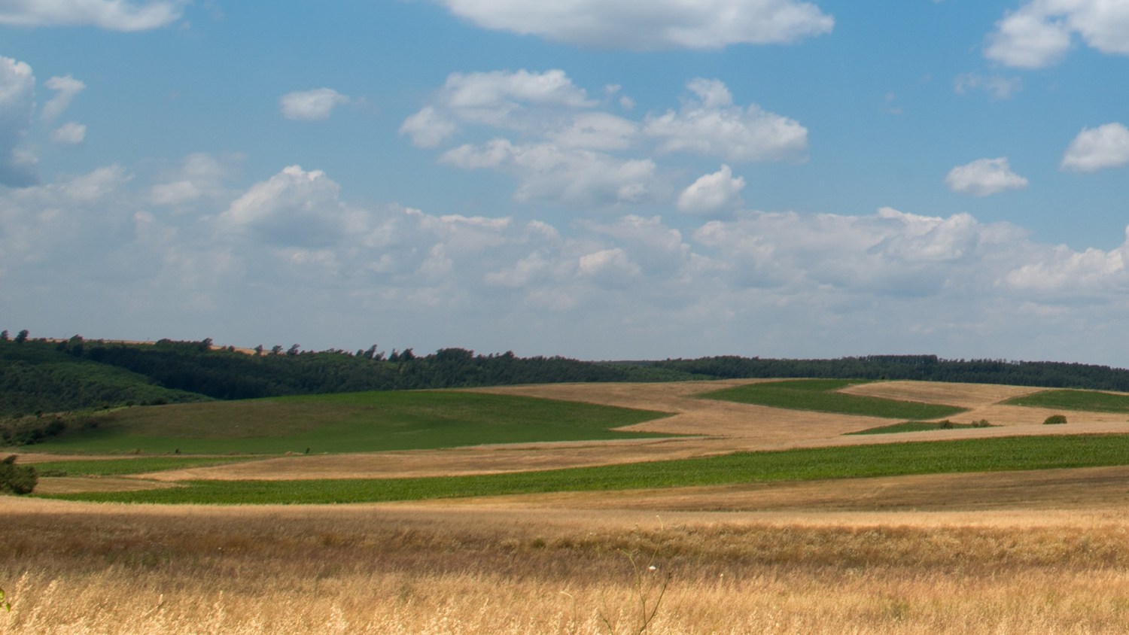


FEED THE MONKEY
WARM-UP
INSTRUCTIONS
Divide the class into 2 teams.
Each team picks an apple to choose the question.
The team look at the description and guess the job.
Each correct answer is 1 point for the team.
GOOD LUCK!
PLAY

Slide 4






FINISH

Slide 5
a person whose job is to work in a garden
Hint: g_____
gardener
GO BACK

Slide 6
a person whose job involves travelling and working in a spacecraft
Hint: a_____
astronaut
GO BACK

Slide 7
a person whose job is cutting up and selling meat in a shop or killing animals for this
Hint: b______
butcher
GO BACK

Slide 8
a person whose job is to decide how things such as clothes, furniture, tools, etc. will look or work by making drawings, plans or patterns
Hint: d_________
designer
GO BACK

Slide 9
a man who stays at home to cook, clean, take care of the children, etc. while his wife, husband or partner goes out to work
Hint: h______ h_______
house husband
GO BACK

Slide 10
a person whose job is to collect and write news stories for newspapers, magazines, radio, television or online news sites
Hint: j_________
journalist
GO BACK

Slide 11
a person who is in charge of or works in a library
Hint: l________
librarian
GO BACK

Slide 12
a person who provides voices for films, television shows, video games, etc.
Hint: v_____ a______
voice actor
GO BACK

Slide 13

PRE-READING
1
Work in pairs. Discuss the following questions.
1. What are your career plans?
2. What do you need to do to prepare your future career?

Slide 14


PRE-READING
1
Work in pairs. Discuss the following questions.
1. What are your career plans?
2. What do you need to do to prepare your future career?
I want to become a successful chef and open my own restaurant. First,…

Slide 15

WHILE- READING
2
Read the article. Circle the words or phrases with the closest meaning to the highlighted words or phrase
Career experts' advice
Our Teen Talk magazine has recently received a lot of questions from secondary school students asking about things they should consider when choosing their careers. We’ve talked to our career experts, and here is their advice.

Slide 16
WHILE- READING
A.
First, learn about yourself and discover your personality type, beliefs, soft skills, and interests. For example, if you are passionate about working with people and helping them develop, you may consider becoming a social worker or a teacher. If you are interested in learning languages, history, art, and architecture, you might look at jobs in the tourist industry. Spend time thinking about what you want to do, and list what you are good at. This can help you come up with a career path that matches your personality.
1. passionate
A. having strong feelings of enthusiasm for something
B. showing happiness and excitement about something

Slide 17
WHILE- READING
B.
Next, you should take into account any career qualifications you may need. Many jobs require formal education at a university or college. In order to work as a doctor, for example, you will need to study at medical school for some years of general medical training, followed by several years of specialty training. But there are also jobs that don't require any formal qualifications. You can be hired as a server or a barista in a coffee shop, for instance, and you will be given on-the-job training.
2. take into account
A. describe
B. consider

Slide 18
WHILE- READING
B.
Next, you should take into account any career qualifications you may need. Many jobs require formal education at a university or college. In order to work as a doctor, for example, you will need to study at medical school for some years of general medical training, followed by several years of specialty training. But there are also jobs that don't require any formal qualifications. You can be hired as a server or a barista in a coffee shop, for instance, and you will be given on-the-job training.
3. specialty
A. the subject of study that someone knows a lot about
B. the typical food that a restaurant is famous for

Slide 19
WHILE- READING
B.
Next, you should take into account any career qualifications you may need. Many jobs require formal education at a university or college. In order to work as a doctor, for example, you will need to study at medical school for some years of general medical training, followed by several years of specialty training. But there are also jobs that don't require any formal qualifications. You can be hired as a server or a barista in a coffee shop, for instance, and you will be given on-the-job training.
4. barista
A. an owner of a coffee shop
B. a person who serves in a coffee shop

Slide 20
WHILE- READING
C.
You should also consider your chances of being hired. Some fields of work may offer very few positions. With technology developing at a fast pace, some jobs such as cashiers and travel agents may become automated or obsolete. However, other jobs are on the rise. Doctors, nurses, and pharmacists, for instance, are in great demand because of ageing populations and increased life expectancy. That is why before you make a decision, you should carefully examine the opportunities that a career path may provide.
5. obsolete
A. updated
B. out of date

Slide 21
WHILE- READING
3
Match each section (A–C) with a heading (1–4).
1. Think about employment opportunities
2. Ask the career experts for advice
3. Follow your passion and interests
4. Understand education requirements

Slide 22
WHILE- READING
A.________
First, learn about yourself and discover your personality type, beliefs, soft skills, and interests. For example, if you are passionate about working with people and helping them develop, you may consider becoming a social worker or a teacher. If you are interested in learning languages, history, art, and architecture, you might look at jobs in the tourist industry. Spend time thinking about what you want to do, and list what you are good at. This can help you come up with a career path that matches your personality.
3

Slide 23
WHILE- READING
B.________
Next, you should take into account any career qualifications you may need. Many jobs require formal education at a university or college. In order to work as a doctor, for example, you will need to study at medical school for some years of general medical training, followed by several years of specialty training. But there are also jobs that don't require any formal qualifications. You can be hired as a server or a barista in a coffee shop, for instance, and you will be given on-the-job training.
4

Slide 24
WHILE- READING
C. _________
You should also consider your chances of being hired. Some fields of work may offer very few positions. With technology developing at a fast pace, some jobs such as cashiers and travel agents may become automated or obsolete. However, other jobs are on the rise. Doctors, nurses, and pharmacists, for instance, are in great demand because of ageing populations and increased life expectancy. That is why before you make a decision, you should carefully examine the opportunities that a career path may provide.
1

Slide 25
WHILE- READING
4
Read the article again and choose the correct answer A, B, or C.
1. How is the article organised?
  A. Using a ‛cause and effect’ text
  structure.
  B. Discussing similarities and differences.
  C. Sorting information into themes and
  categories.

Slide 26
WHILE- READING
4
Read the article again and choose the correct answer A, B, or C.
2. Why does the writer mention ‛a social worker or a teacher’ in Section A?
A. To illustrate jobs related to working with and helping people.
B. To prove that it will be easy to get these jobs in the future.
C. To show that more and more people want to work as social workers and teachers.

Slide 27
WHILE- READING
4
Read the article again and choose the correct answer A, B, or C.
3. Why does the writer include the server and barista jobs in Section B?
A. To compare these jobs with the jobs that need formal training.
B. To give an example of jobs that don’t require formal training.
C. To give additional examples of jobs that need formal training.

Slide 28
WHILE- READING
4
Read the article again and choose the correct answer A, B, or C.
4. The author uses ‛However’ in Section C in order to _________.
A. explain why the jobs will become obsolete
B. show the consequences of increased life expectancy
C. introduce jobs that are in demand

Slide 29

POST- READING
5
Work in pairs. Discuss the following questions.
What kind of job do you prefer: a job that requires formal education or a job that does not? Why?

Slide 30
POST- READING
5
Work in pairs. Discuss the following questions.
Suggested answers:
I prefer a job that requires formal education because I believe that formal education will provide me with not only technical knowledge, but also soft skills. Soft skills will help me prepare for the world of work better. In addition, having a formal education will improve my prospects for an interesting and rewarding career.

Slide 31

CONSOLIDATION
1
Wrap-up
What have you learnt today?
Read for main ideas and specific information in an article

Slide 32
CONSOLIDATION
2
Homework
Do exercises in the workbook.
Prepare for Lesson 4 - Unit 9.

Slide 33
Website: hoclieu.vn
Fanpage: https://www.facebook.com/tienganhglobalsuccess.vn/

