Slide 2


Unit
6
VIETNAMESE LIFESTYLE: THEN AND NOW
LESSON 1: GETTING STARTED
We didn’t do it in my day.

Slide 3

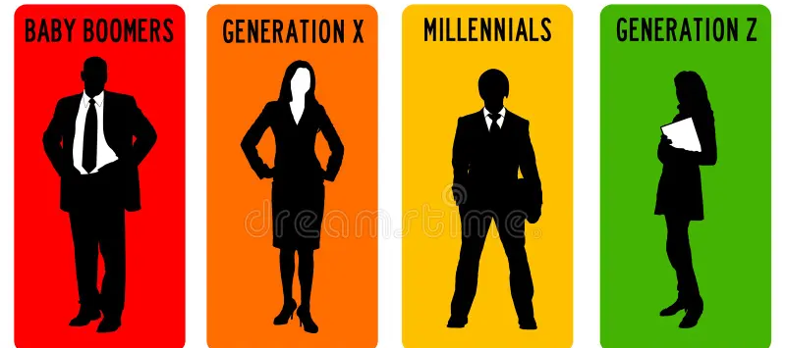

PRESENTATION
all the people of about the same age within a society
generation (n)
/ˌdʒenəˈreɪʃn/
thế hệ

Slide 4

PRESENTATION
living condition
standard of living
/ˈlɪvɪŋ kənˈdɪʃənz/
điều kiện sống

Slide 5
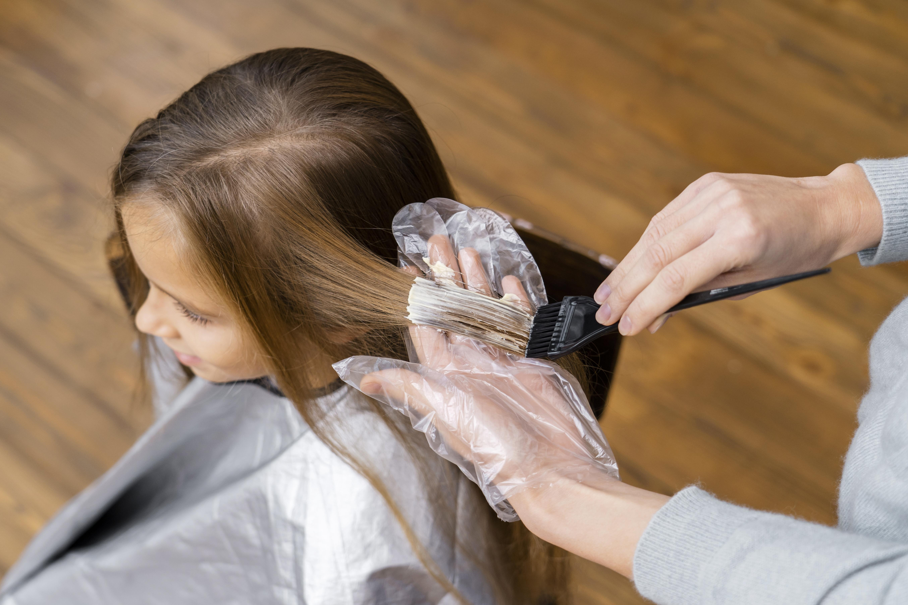
PRESENTATION
chance
opportunity (n)
/ˌɒpəˈtjuːnəti/
cơ hội
Ex: He had a golden opportunity to score in the first half but squandered it.

Slide 6
PRESENTATION
to change the colour of sth using a special liquid.
dye (v)
/daɪ/
nhuộm

Slide 7
PRESENTATION
New words | Pronunciation | Meaning
1. generation (n) | /ˌdʒenəˈreɪʃn/ | thế hệ
2. living condition | /ˈlɪvɪŋ kənˈdɪʃənz/ | điều kiện sống
3. opportunity (n) | /ˌɒpəˈtjuːnəti/ | cơ hội
4. dye (v) | /daɪ/ | nhuộm

Slide 8
PRACTICE
Look at the pictures on pages 60-61 and answer.
- What do you think the children / teens in each picture
are doing?
- Do you think the activity in each apicture is popular
in the past or present?

Slide 9
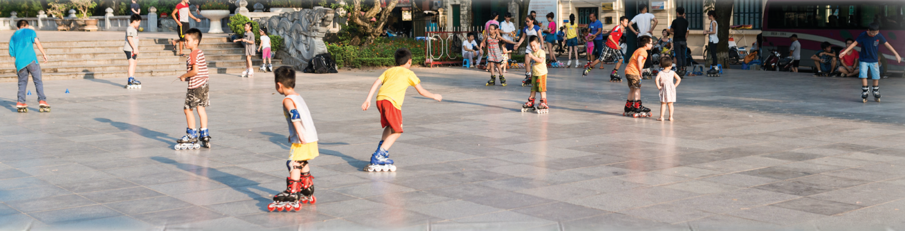
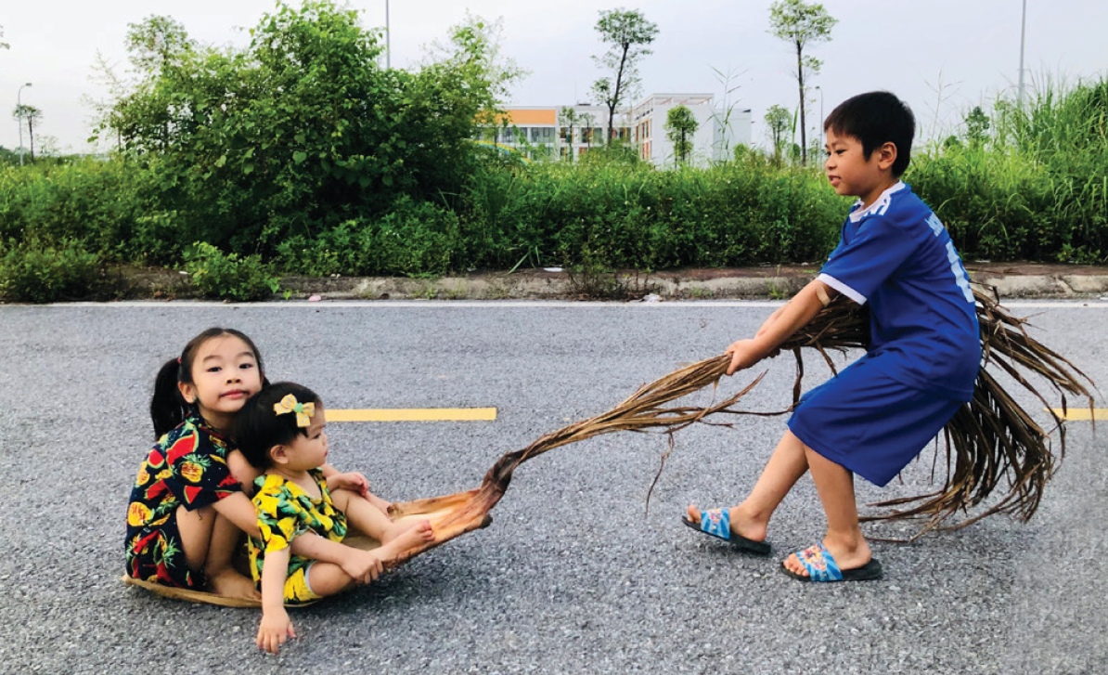
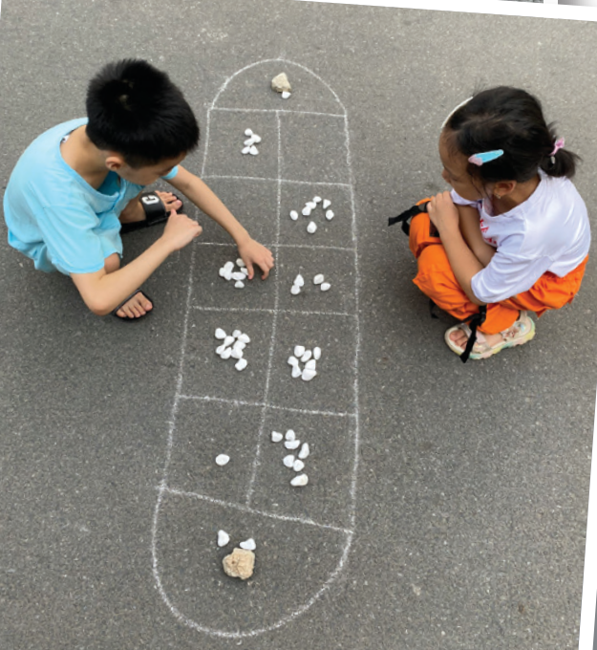
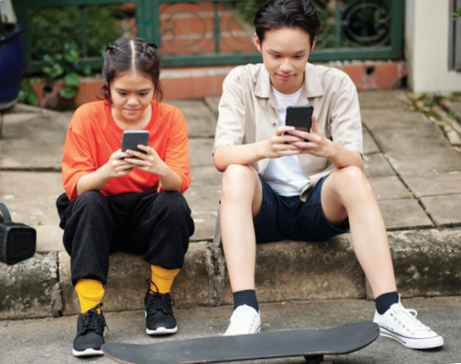
PRACTICE

Slide 10

PRACTICE
1
Listen and read.
Phong: Grandpa, do you mind telling me how our lives are different from yours in the past?
Grandpa: Well, there are many differences. In my day, we mostly played outdoors. The games were simple and cost little. We made our own toys from natural materials.
Phong: That sounds interesting. Nowadays, most leisure games depend on electronic devices.
Grandpa: Right, but that is mostly true in the city only. Many children in the countryside still play traditional games.
Phong: I know.

Slide 11
PRACTICE
1
Listen and read.
Grandpa: Another thing is that children nowadays have more freedom of choice. They wear short dresses and jeans with holes. They also dye their hair purple and green.
Phong: Ha ha … Not many, Grandpa.
Grandpa: Hm … And many children of my generation left school early to support their families. Moreover, there were not many schools then.
Phong: You mean we have more opportunities to learn now?
Grandpa: That’s right.
Phong: Do you think these changes are for the better?
Grandpa: Yes, they mostly are. They have improved our living conditions.
Phong: Thank you, Grandpa.

Slide 12
PRACTICE
2
Read the conversation again and circle the correct answers.
1. Phong and his grandpa are talking about some differences between ___________.
A. children in the city and the countryside
B. the living standards in the past and now
C. life in the past and now
D. past and present entertainment
2. Vietnamese people take great pride in their culture which has been ________________for thousands of years.
3. The foreign tourists gave a _____________performance of the Vietnamese folk songs and dances

Slide 13
a. depend on electronic devices
c. dye their hair
b. leave school early
e. make toys from natural materials
d. have more opportunities to learn
PRACTICE
2
Read the conversation again and circle the correct answers.
2. Phong’s grandpa mentions _________________differences.
A. two
C. four
B. three
D. five
3. Phong’s grandpa sees most of the changes as ______________.
A. positive
C. unnecessary
B. negative
D. necessary
THE PAST | THE PRESENT
2. Vietnamese people take great pride in their culture which has been ________________for thousands of years.
3. The foreign tourists gave a _____________performance of the Vietnamese folk songs and dances

Slide 14
opportunity
freedom
dyed
generations
materials
PRACTICE
3
Write the expressions from the conversation in the correct column.
a. depend on electronic devices
b. leave school early
c. dye their hair
d. have more opportunities to learn
e. make toys from natural materials
THE PAST | THE PRESENT

Slide 15
PRACTICE
4
Complete the sentences with the words from the box.
opportunity
freedom
dyed
generation
materials
1. A few teenagers in my village have ____________ their hair brown.
2. Young people’s lifestyle today is different from that of the previous ____________.
3. Nowadays, nearly all young people have a(n) ____________ to go to school.

Slide 16
PRACTICE
4
Complete the sentences with the words from the box.
opportunity
freedom
dyed
generation
materials
4. He wants to live green, so he uses products made from natural ____________.
5. My parents give me ____________ to pursue my own interests.

Slide 17

LESSON 1: GETTING STARTED
LESSON 1: GETTING STARTED
Option 1: Think!
Option 2: Q&A
WARM-UP
Vocabulary
PRESENTATION
Task 1: Listen and read.
Task 2: Read the conversation again and circle the correct answers.
Task 3: Write the expressions from the conversation in the correct column.
Task 4: Complete the sentences with the words from the box.
PRACTICE
PRODUCTION
Task 5: Quiz

Slide 18
PRODUCTION
5
QUIZ: Work in pairs. Decide if the statements below are TRUE or FALSE
about life in Viet Nam 40 years ago. Share your answers with the class.
40 years ago, ______
False
1. school children didn’t wear uniforms.
2. no Vietnamese student could go and study abroad.
3. most people wrote letters instead of writing emails or
texting messages.
4. bicycles were the main means of transportation.
5. people lit firecrackers at Tet and weddings.
False
True
True
True

Slide 19
PRODUCTION
KNOWLEDGE TIME
1. Many schools in Viet Nam had school uniforms since the 1950s.
2. Students in Viet Nam could go and study abroad as far back as the 1940s.
3. According to Decision no 406-TTg dated 8 August 1994, there was a complete ban on the production, trade and lighting of firecrackers in Viet Nam. (ABOUT 28 YEARS).

Slide 20
LESSON 1: GETTING STARTED
LESSON 1: GETTING STARTED
Option 1: Think!
Option 2: Q&A
WARM-UP
Vocabulary
PRESENTATION
Task 1: Listen and read.
Task 2: Read the conversation again and circle the correct answers.
Task 3: Write the expressions from the conversation in the correct column.
Task 4: Complete the sentences with the words from the box.
PRACTICE
PRODUCTION
Task 5: Quiz
CONSOLIDATION
Wrap-up
Homework

Slide 21

CONSOLIDATION
2
Homework
- Do exercises in the Workbook.

Slide 22
CONSOLIDATION
2
Homework
- prepare for the Project of the unit;
- open book p.69, look at the picture and say what the
topic of the project is;
- work individually to design a poster;
- show and present in Lesson 7 – Looking back and Project.

Slide 23
CONSOLIDATION
2
Homework
Step 1: Ask the interviewee the questions about his / her life in the past They may ask questions about different aspects of life or focus on one aspect. You can ask the questions as suggested in the project or create their own questions.
For example (with focus on one aspect):
- What school did you go to?
- Did you have to wear a uniform?
- What was learning like then?
- How do you describe the relationship between teachers and students then?
- How did you spend time after school?
Family member | Questions | Answers
 | What school did you goto?
 | Did you have to wear a uniform?
 | What was learning like then?
 | How do you describe therelationship between teachers and students then?
 | How did you spend time after school?

Slide 24
CONSOLIDATION
2
Homework
Step 2: Create a table to record their family member’s answers.
The table may look like this:
Family member | Questions | Answers
 | What school did you goto?
 | Did you have to wear a uniform?
 | What was learning like then?
 | How do you describe therelationship between teachers and students then?
 | How did you spend time after school?

Slide 25
CONSOLIDATION
2
Homework
Step 3: Make the poster.
For the text: You choose only the key information to present in your poster. They must be in short form. The findings should be grouped and presented according to the order of the questions asked.
For the pictures: You may have pictures of the family member individually or with family. Whatever they are, they must illustrate the information in the poster.

Slide 26
CONSOLIDATION
2
Homework
Step 4: How to report:
I have interviewed my ______ about his / her life in the past
when he / she was my age. Here are the findings.

Slide 27
Website: hoclieu.vn
Fanpage: facebook.com/www.tienganhglobalsuccess.vn/

