Slide 1







Unit 8
IN OUR CLASSROOM
Lesson 2 – Period 3

Slide 2





/
TABLE OF CONTENTS
Warm-up & Review
Look, listen and repeat.
Listen, point and say.
Let’s talk.
Fun corner & Wrap-up

Slide 3




01
Warm-up & Review

Slide 4



Game
SENTENCE BUILDING
Where
the
are
?
pictures

Slide 5
Game
SENTENCE BUILDING
Where
are
the
pictures
?

Slide 6
Game
SENTENCE BUILDING
are
above
bookcase
the
pictures
The
.

Slide 7
Game
SENTENCE BUILDING
The
pictures
are
above
the
bookcase
.

Slide 8
Game
SENTENCE BUILDING
.
are
in front of
The
the
books
clock

Slide 9
Game
SENTENCE BUILDING
The
books
are
in front of
.
the
clock

Slide 10
Game
SENTENCE BUILDING
behind
.
are
the
The
pencil case
erasers

Slide 11
Game
SENTENCE BUILDING
The
erasers
are
behind
pencil case
.
the
.

Slide 12
Game
SENTENCE BUILDING
under
are
chair
the
The
.
rulers

Slide 13
Game
SENTENCE BUILDING
The
rulers
are
under
the
chair
.

Slide 14




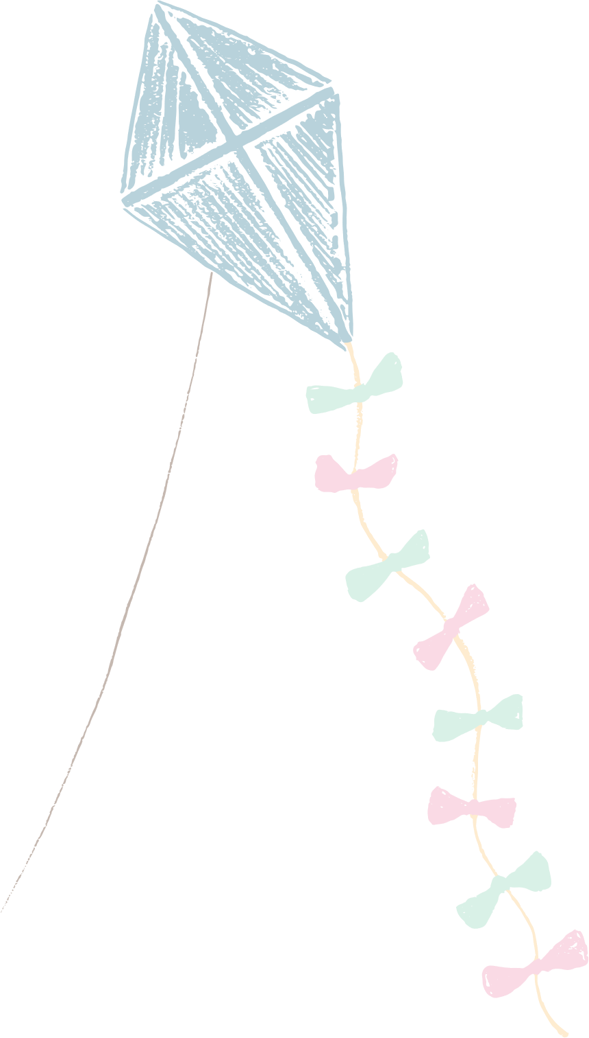






Slide 15
02
Look, listen and repeat.

Slide 16



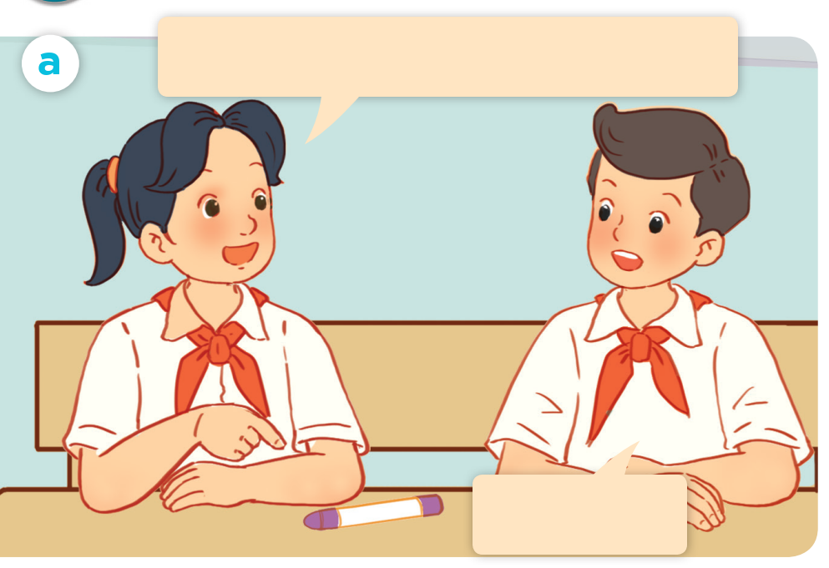


LOOK and SAY.

Slide 17
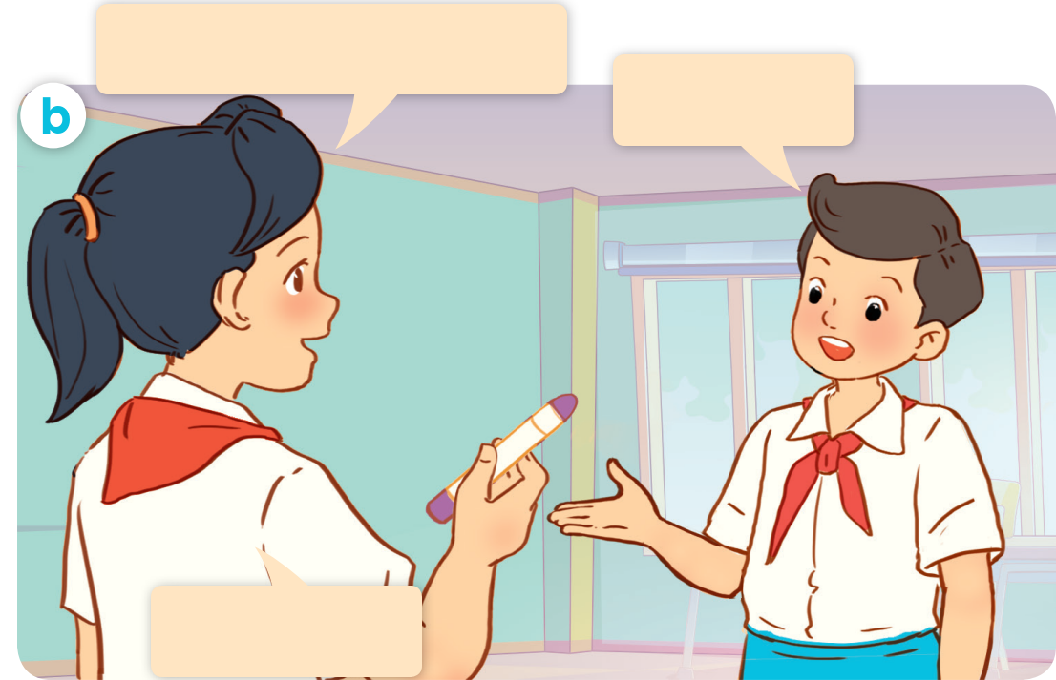
LOOK and SAY.

Slide 18

LISTEN and POINT.

Slide 19
LISTEN and REPEAT.
Excuse me, is this your crayon?
No, it isn’t.

Slide 20
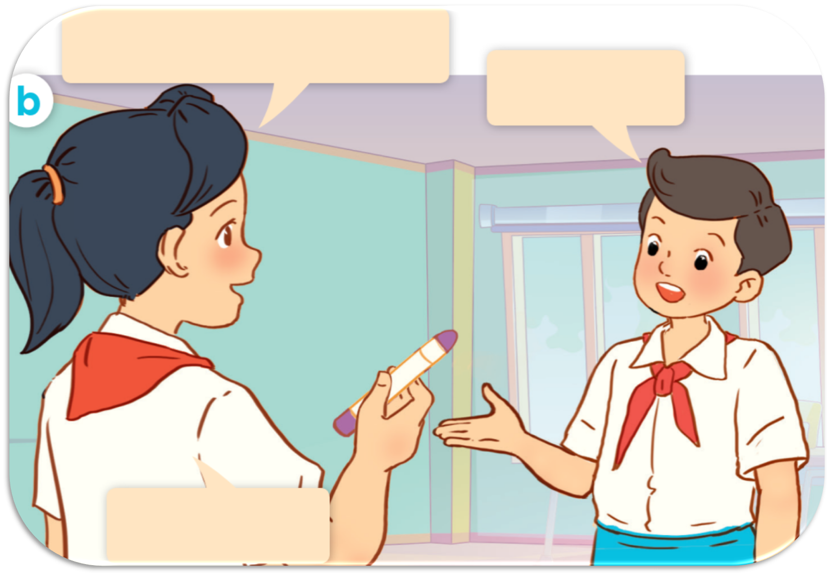
LISTEN and REPEAT.
Whose crayon
is this?
It’s Linh.
Thank you.

Slide 21
LISTEN and REPEAT.
Whose crayon is this?
Excuse me, is this your crayon?
It’s Linh.
No, it isn’t.
Thank you.

Slide 22
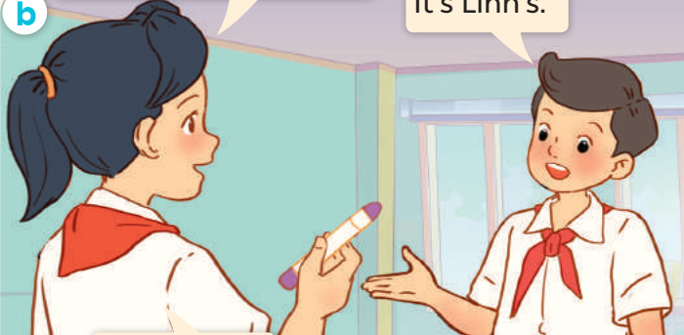
LISTEN and REPEAT.
It’s Linh’s.
Whose crayon is this?

Slide 23
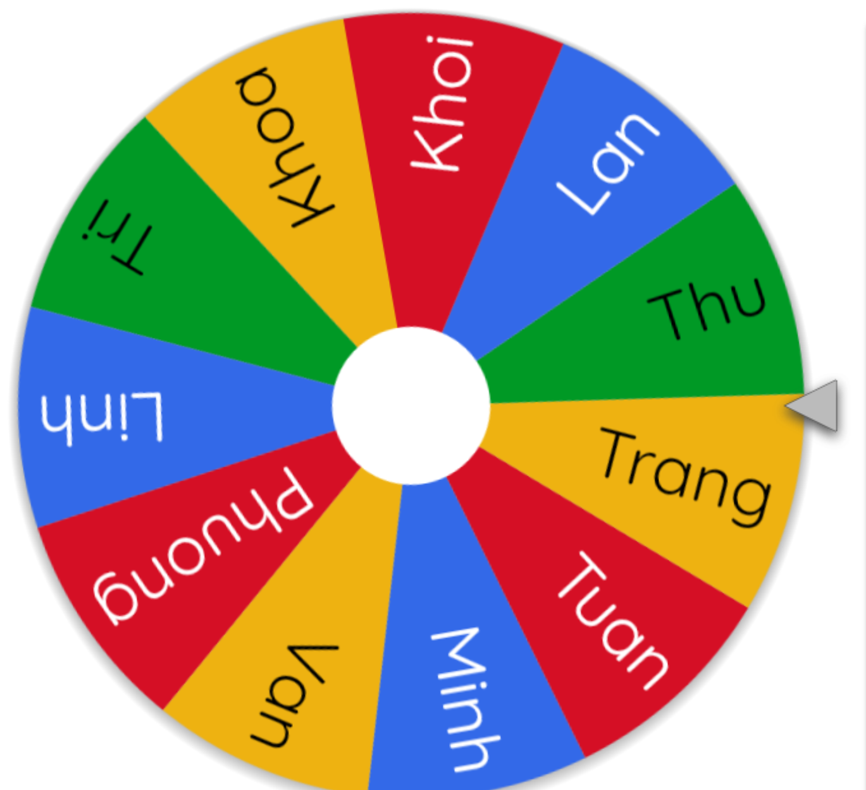
ASK and ANSWER.
Whose crayon is this?
Excuse me, is this your crayon?
It’s Linh.
No, it isn’t.
Thank you.

Slide 25
03
Listen, point and say.

Slide 26




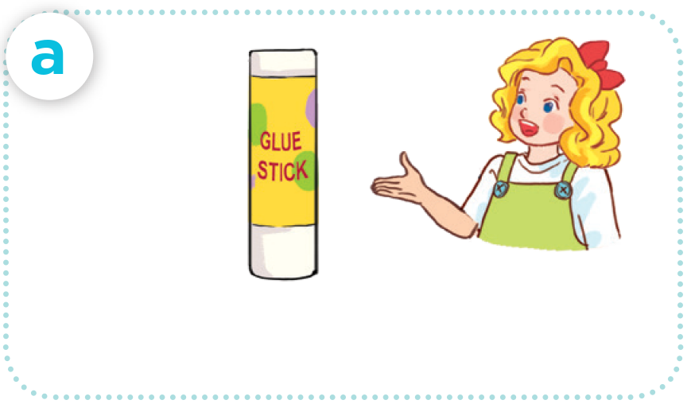

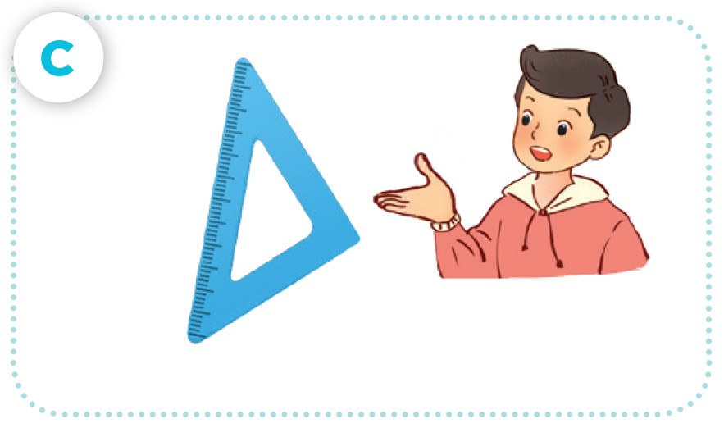
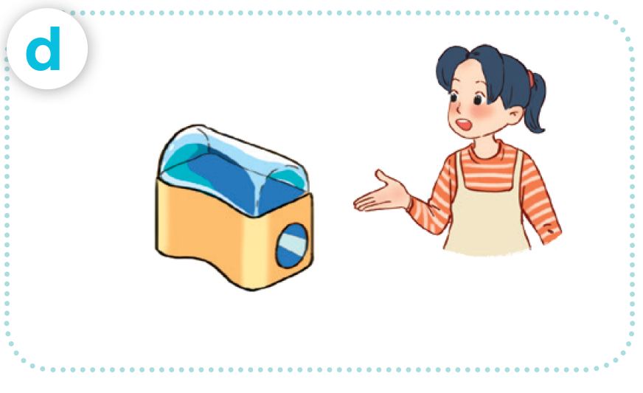
LOOK AND SAY
glue stick / Mary’s
crayon / Bill’s
set square / Nam’s
pencil sharpener / Mai’s

Slide 27




LISTEN AND REPEAT.
glue stick / Mary’s

Slide 28

LISTEN AND REPEAT.
crayon / Bill’s

Slide 29
LISTEN AND REPEAT.
set square / Nam’s

Slide 30
LISTEN AND REPEAT.
pencil sharpener / Mai’s

Slide 31



LISTEN AND REPEAT.
Whose glue stick is this?
glue stick / Mary’s
It’s Mary’s.

Slide 32
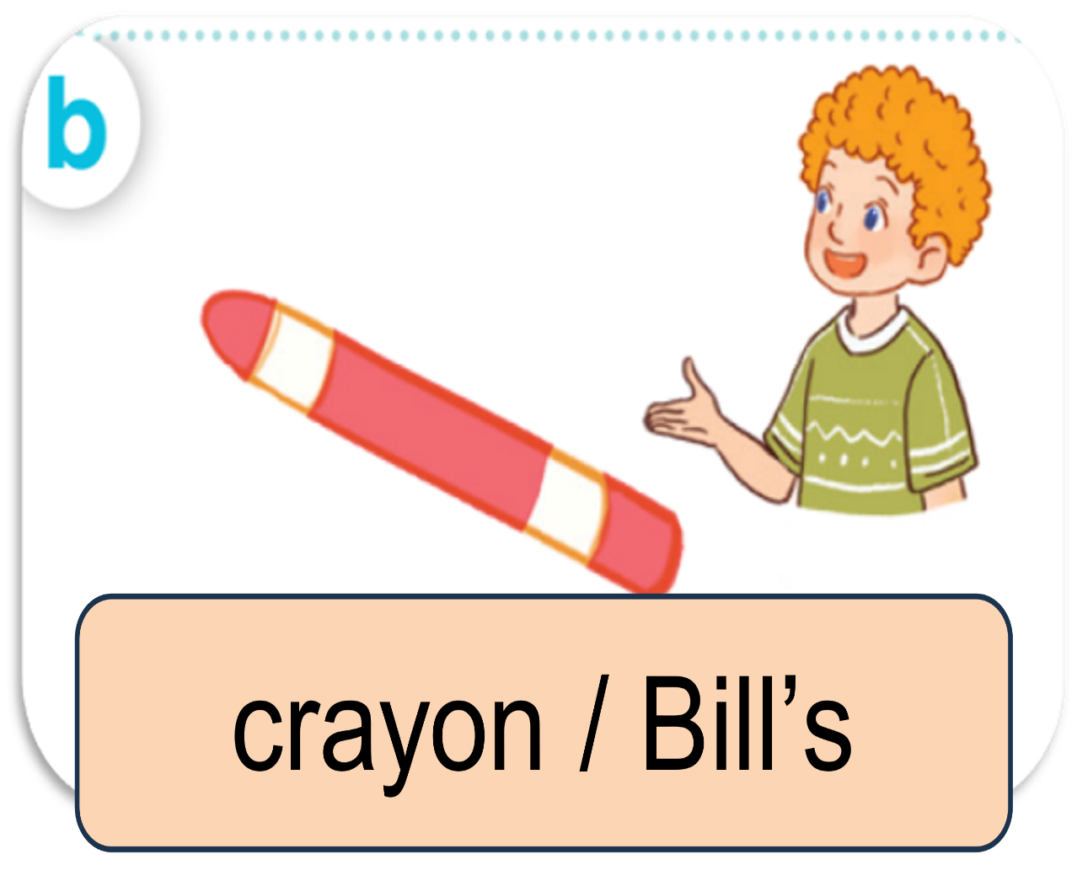

LISTEN AND REPEAT.
Whose crayon is this?
It’s Bill’s.

Slide 33
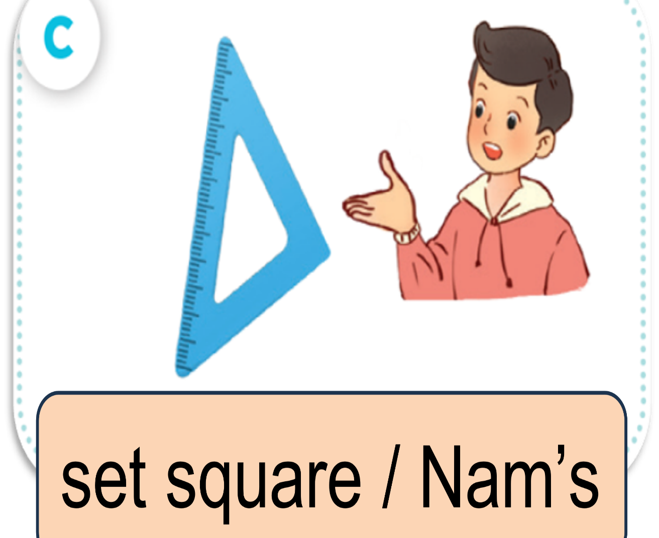
LISTEN AND REPEAT.
Whose set square is this?
It’s Nam’s.

Slide 34
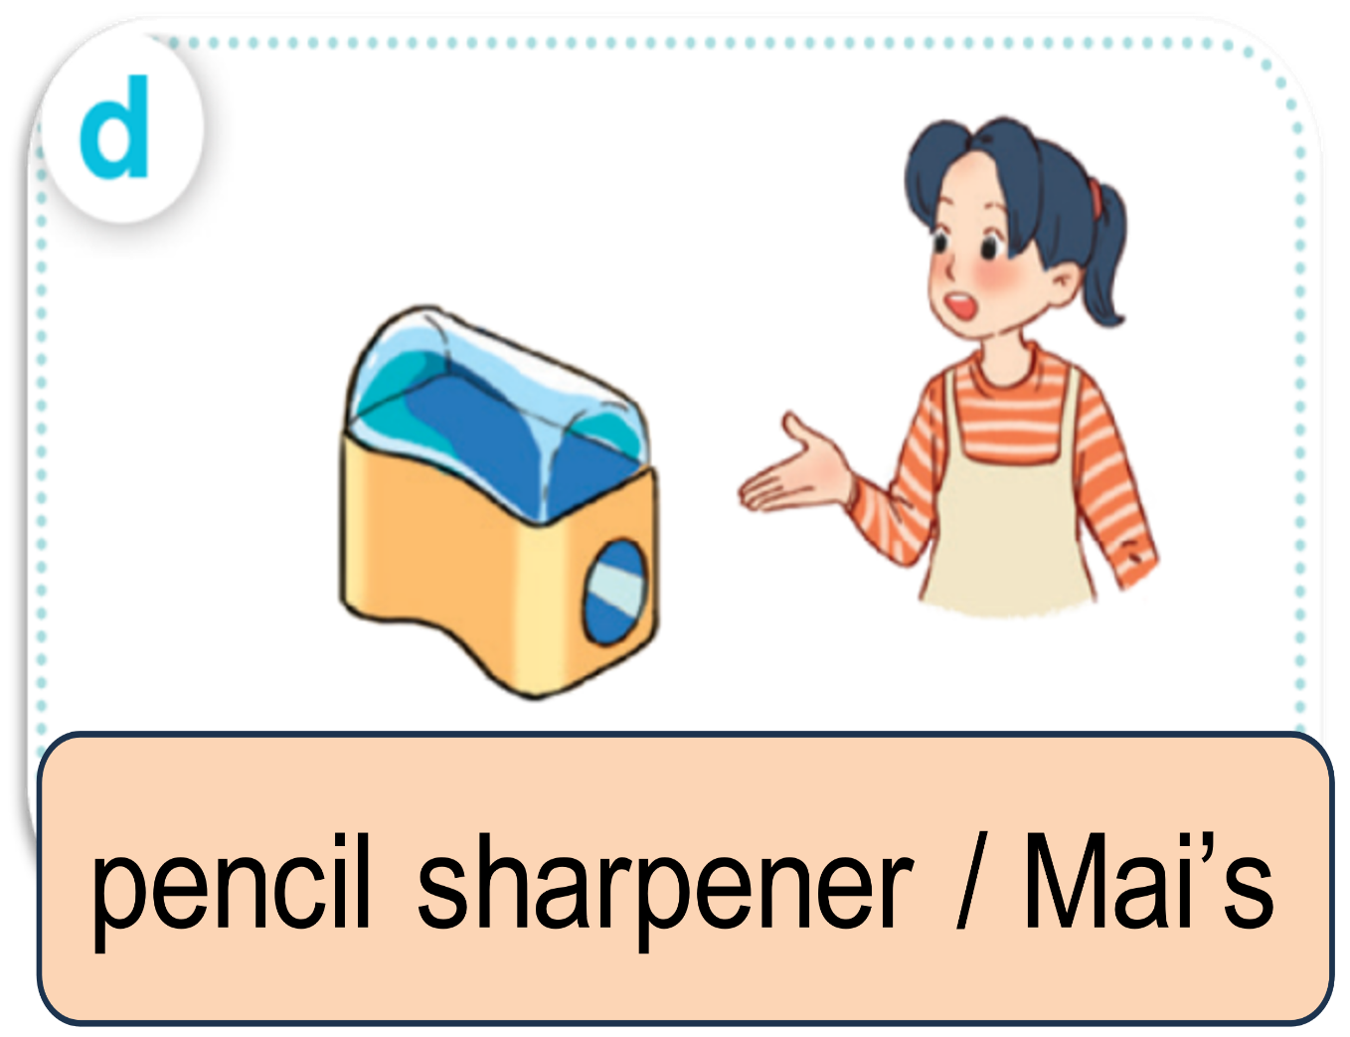
LISTEN AND REPEAT.
Whose pencil sharpener
is this?
It’s Mai’s.

Slide 35

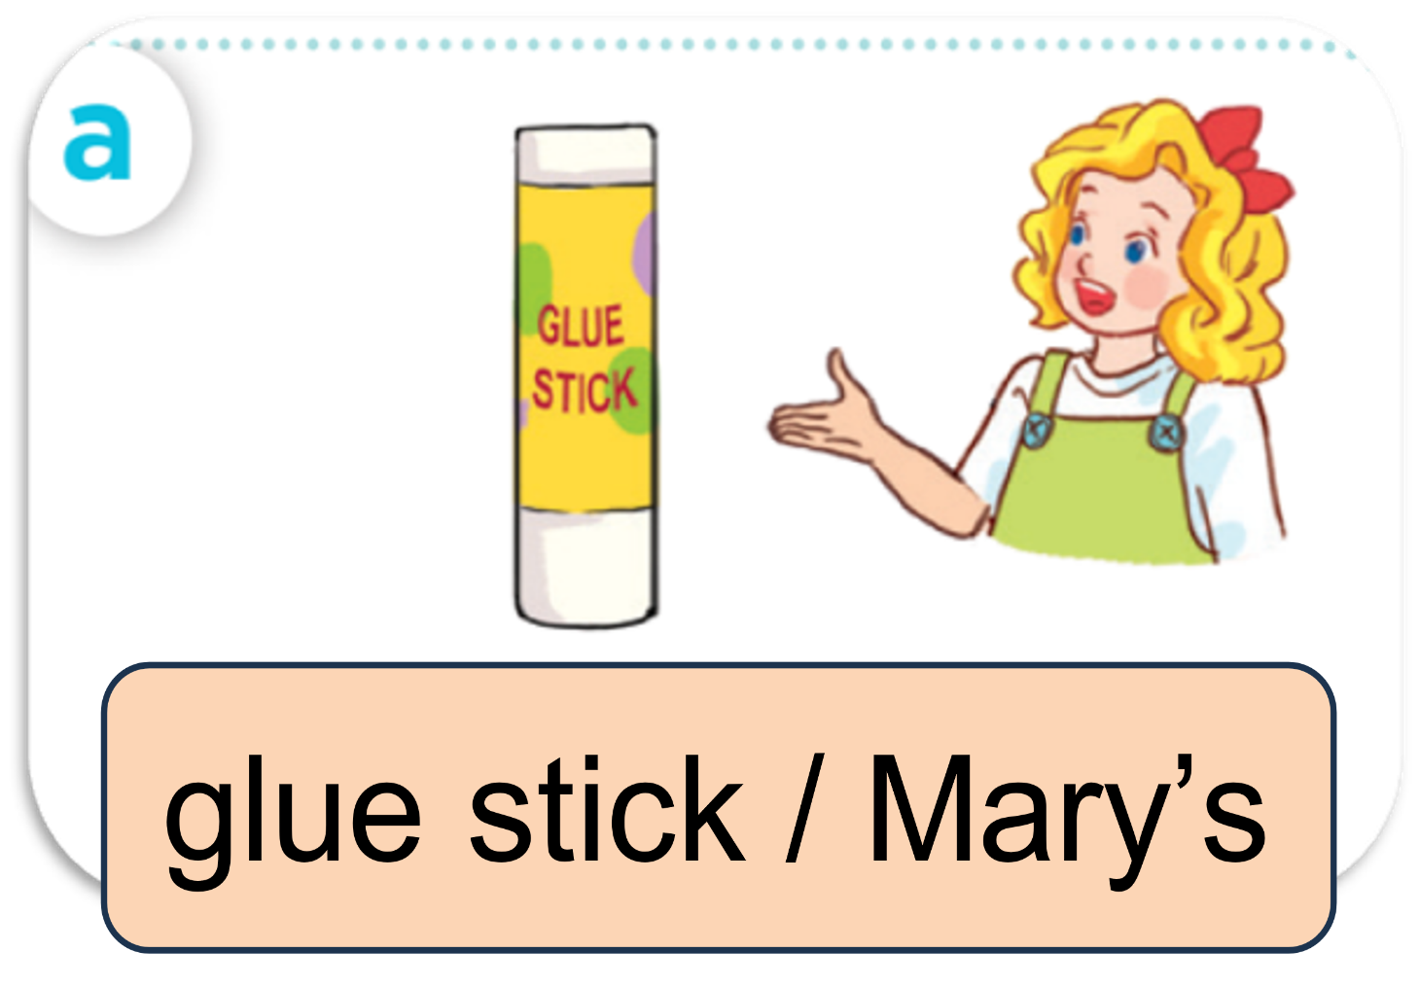




ASK AND ANSWER

Slide 36
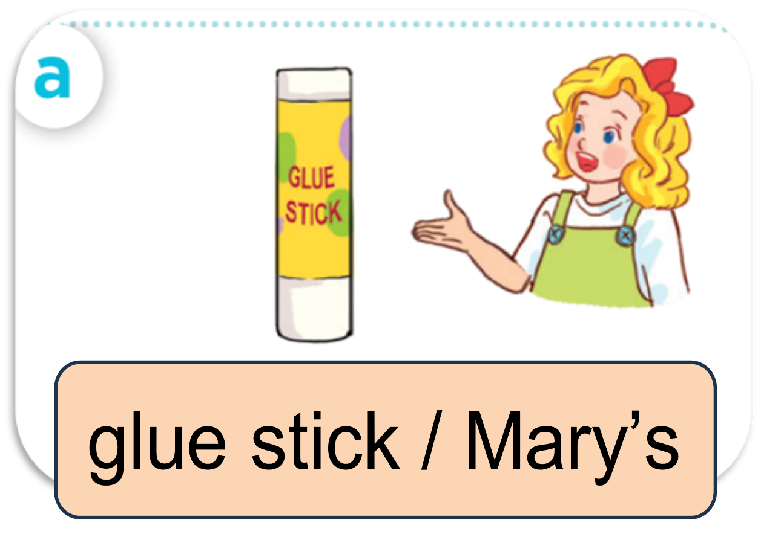
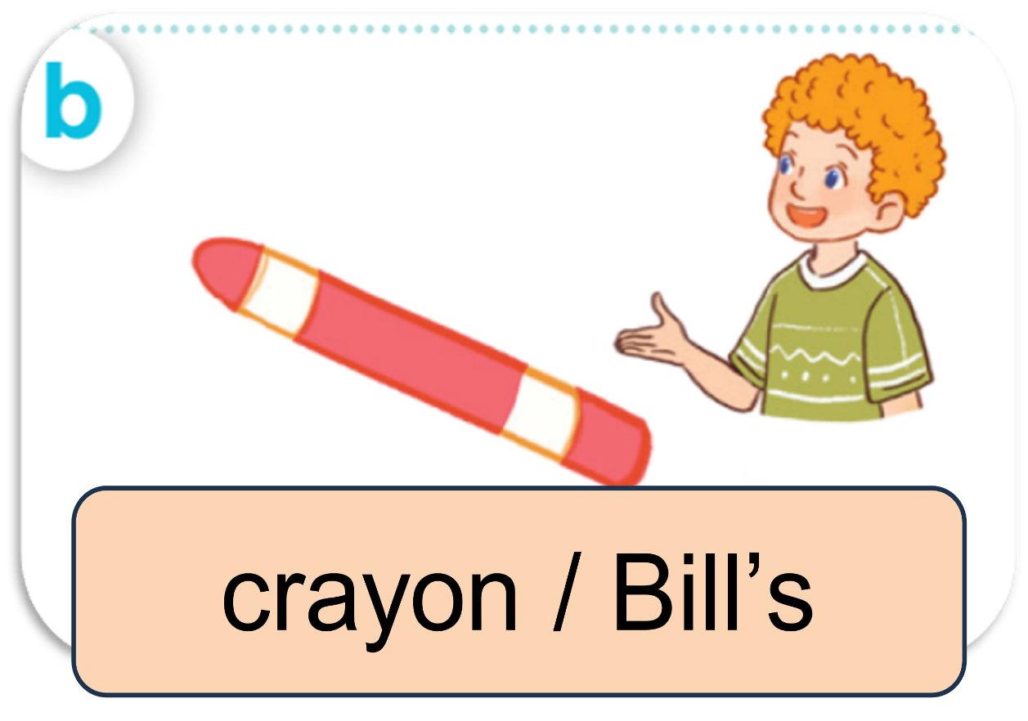
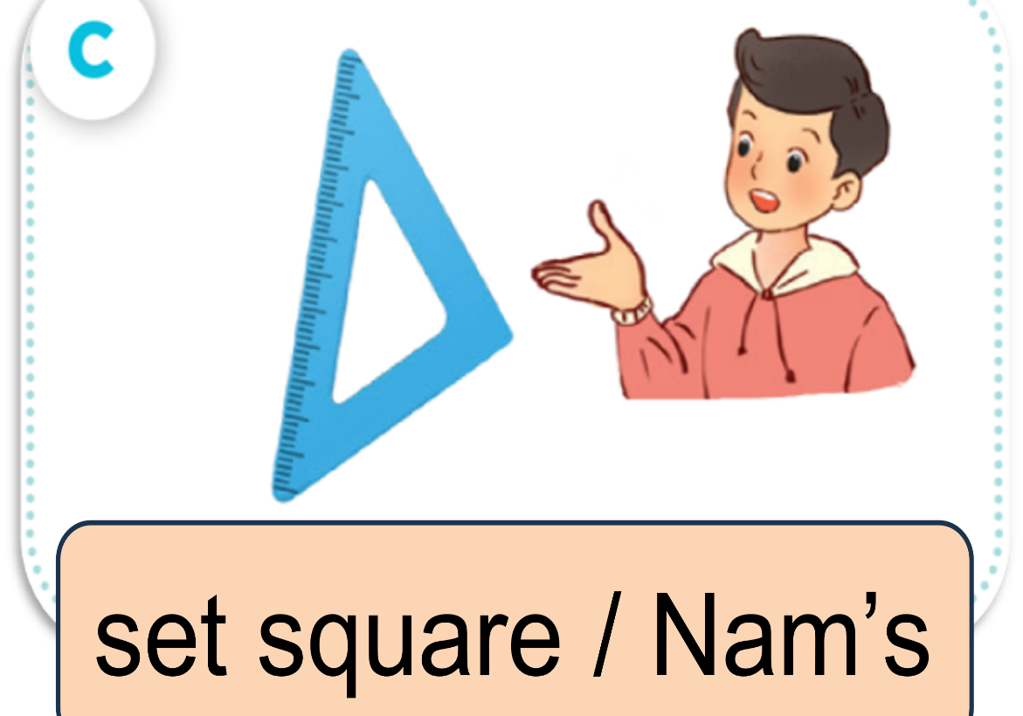

ASK AND ANSWER.

Slide 38
04
Let’s talk.

Slide 39





LOOK AND SAY.
It this your ___?
____.
Whose ___ is this?
____.

Slide 40
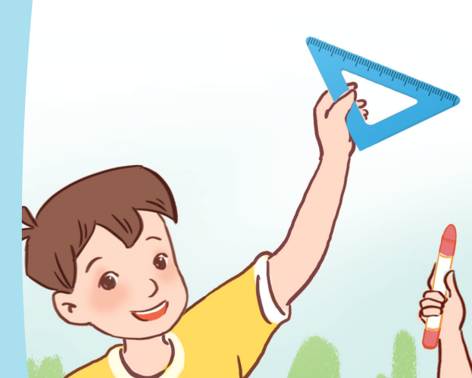
ASK AND ANSWER.
Whose set square is this?
It’s Minh’s.

Slide 41
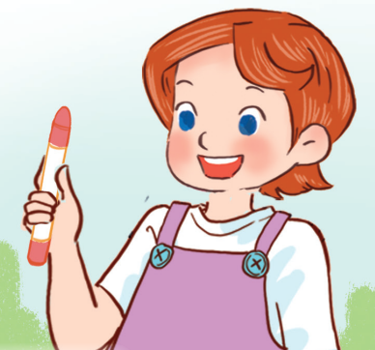
ASK AND ANSWER.
Whose crayon is this?
It’s Lucy’s.

Slide 42

ASK AND ANSWER.
Whose pencil sharpener
is this?
It’s Linh’s.

Slide 43

ASK AND ANSWER.
Whose glue stick is this?
It’s Bill’s.

Slide 44










WORK in PAIRS.
Ask and answer.

Slide 46
05
Fun corner & Wrap-up

Slide 47
Game
DISPPEAR !!!

Slide 48

THE ANSWER IS …..
pencil sharpener

Slide 49
Game
DISPPEAR !!!

Slide 50

THE ANSWER IS …..
glue stick

Slide 51
Game
DISPPEAR!

Slide 52

THE ANSWER IS …..
set square

Slide 53
Game
DISPPEAR !!!

Slide 54

THE ANSWER IS …..
crayon

Slide 56






See you
next time!

Slide 57
Website: hoclieu.vn
Fanpage: https://www.facebook.com/tienganhglobalsuccess.vn/

