Slide 2
Wednesday, january 24th 2024
Unit
12
JOBS
Lesson 1 (1+2+3)

Slide 3
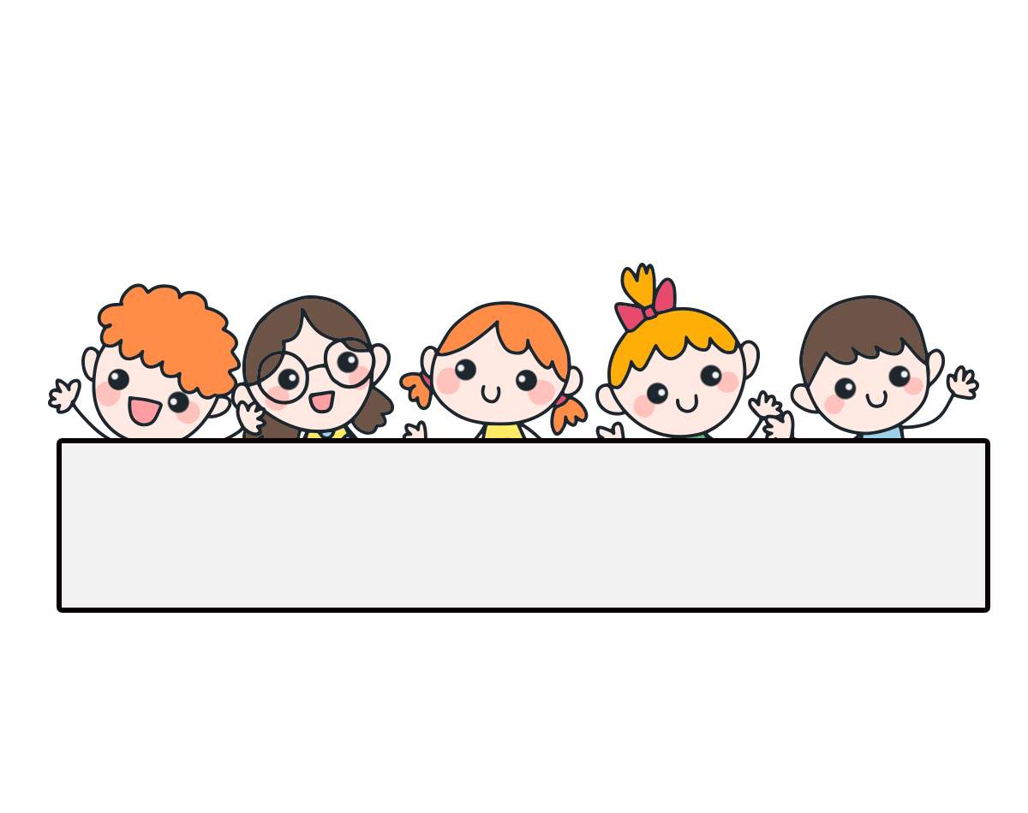
Warm-up

Slide 4
Facebook : Bùi Liễu
0968142780
Sing a song!

Slide 5
Contents
Look, listen and repeat.
Listen, point and say.
Let’s talk.

Slide 6
1. Look, listen and repeat.
How many people are there in your family?
This is my father.
a
b
What does he do?
There are four.
He’s a policeman.
What are they talking about?
Where are they?
Who are they?

Slide 8
Vocabulary

Slide 9
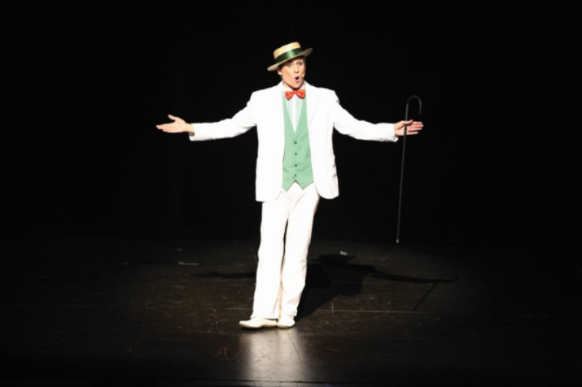
Vocabulary
actor
/ˈæktə/
diễn viên (nam)

Slide 10
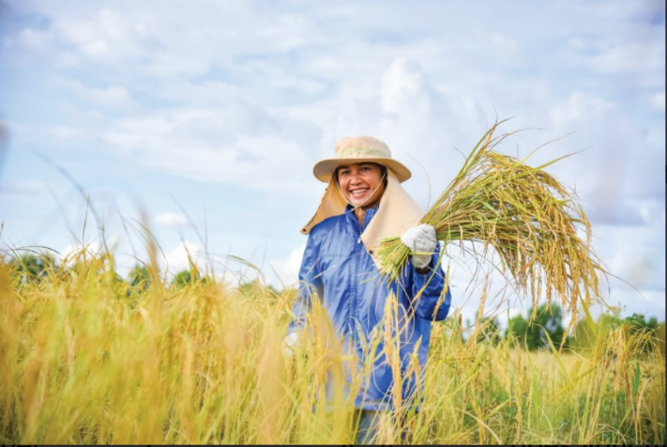
Vocabulary
farmer
/ˈfɑːmə/
nông dân

Slide 11
Vocabulary
office worker
/ˈɒfɪs wɜːkə/
nhân viên văn phòng

Slide 12
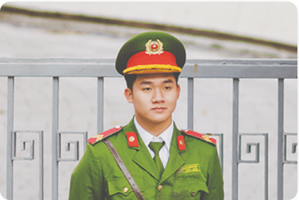
Vocabulary
policeman
/pəˈliːsmən/
cảnh sát (nam)

Slide 13
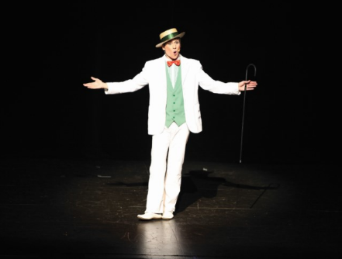
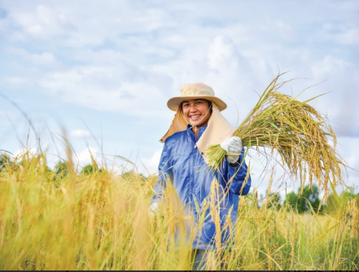
Review
actor
farmer
office worker
policeman

Slide 14
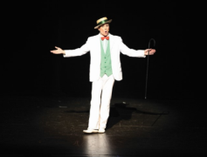
Vocabulary
1. actor
: diễn viên (nam)
2. farmer
: nông dân
3. office worker
: nhân viên văn phòng
4. policeman
: cảnh sát (nam)

Slide 15
Let’s play!

Slide 16
What is missing?
Học sinh có 5 giây để nhớ vị trí của ảnh, ở các slide sau, hs cần nói ra dc từ vựng bị thiếu ở thứ tự ảnh đó là gì.
Notes:
What is missing?

Slide 17
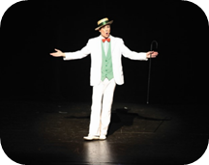
What is missing?
1/4
Notes:
What is missing?

Slide 18
What is missing?
2/4

Slide 19
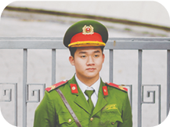
What is missing?
3/4
Notes:
What is missing?

Slide 20
What is missing?
4/4
Notes:
What is missing?

Slide 21
Well done!

Slide 22
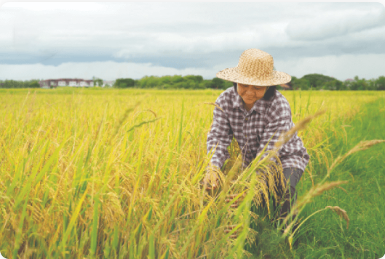
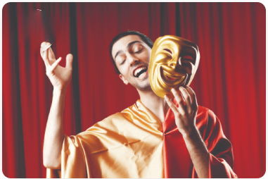
2. Listen, point and say.
a
b
What does he / she do?
a farmer
a policeman
He’s / She’s ______.
c
d
he’s = he is she’s = she is
an office worker
an actor

Slide 23
2. Listen, point and say.
What does he / she do?
He’s / She’s ______.
a farmer
What does she do?
She’s a farmer.

Slide 24
2. Listen, point and say.
What does he / she do?
He’s / She’s ______.
a policeman
What does he do?
He’s a policeman.

Slide 25
2. Listen, point and say.
What does he / she do?
He’s / She’s ______.
an office worker
What does she do?
She’s an office worker.

Slide 26
2. Listen, point and say.
What does he / she do?
He’s / She’s ______.
an actor
What does he do?
He’s an actor.

Slide 27
Structures

Slide 28
Structures
Hỏi “anh ấy, cô ấy làm nghề gì ”:
What does he / she do?
He’s / She’s _________.
he’s = he is she’s = she is
( Anh ấy / Cô ấy làm nghề gì?
Anh ấy / Cô ấy là ________.)

Slide 29
Unit 12 lesson 1 (1+2+3)
What does he / she do?
He’s / She’s ________.
actor
policeman
farmer
office worker

Slide 30
3. Let’s talk.

Slide 31
Wrap up

Slide 32
Unit 12.
What does he / she do?
He’s / She’s ________.
actor
policeman
farmer
office worker

Slide 33
Homework
Learn by heart all the new words.
Read again the dialogue in part 1.

Slide 34
Thank you!

