Slide 1


Slide 2



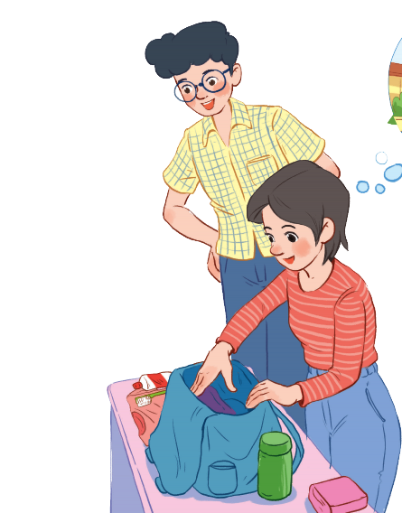
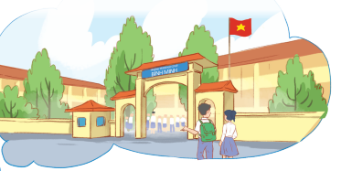
Unit
6
A VISIT TO A SCHOOL
LESSON 1: GETTING STARTED
A visit to Binh Minh Lower Secondary School
Unit
HOBBIES

Slide 3

OBJECTIVES
By the end of the lesson, students will be able to:
identify the topic of the unit
use lexical items: school activities
identify the language features that are covered in the unit.

Slide 4
LESSON 1: GETTING STARTED
WARM-UP
Chatting
PRESENTATION
Vocabulary
Task 1: Listen and read.
Task 2: Read the conversation again and answer the questions by circling A, B, or C.
Task 3: Name the places, using the words and phrases from the box.
Task 4: Complete the following sentences with the phrases in Task 3.
PRACTICE
PRODUCTION
Task 5: Work in pairs. Ask and answer questions about Nick’s timetable, using when and where.
CONSOLIDATION
Wrap-up
Homework

Slide 5

LESSON 1: GETTING STARTED
WARM-UP
Chatting
Aims of the stage:
to introduce the topic
to lead in the lesson

Slide 6

WARM-UP
What did you see when you first came to our school?
How did you feel?
Have you ever had a visit to Chu Van An Lower Secondary school (or a famous school in your area)?

Slide 7
WARM-UP
What is the girl doing?
What are they talking about?

Slide 8

LESSON 1: GETTING STARTED
WARM-UP
Chatting
PRESENTATION
Vocabulary
Aims of the stage:
to provide students with vocabulary
to help students prepare for the listening and reading tasks

Slide 9


PRESENTATION
lower secondary school
/ˈləʊər ˈsekəndrɪ skuːl/
trường trung học cơ sở

Slide 10

PRESENTATION
member (n)
/ˈmembər/
thành viên

Slide 11

PRESENTATION
remind (v)
/rɪˈmaɪnd/
gợi nhớ, nhắc nhở

Slide 12

school library /skuːl ˈlaɪbrəri /
(n): thư viện trường

Slide 13
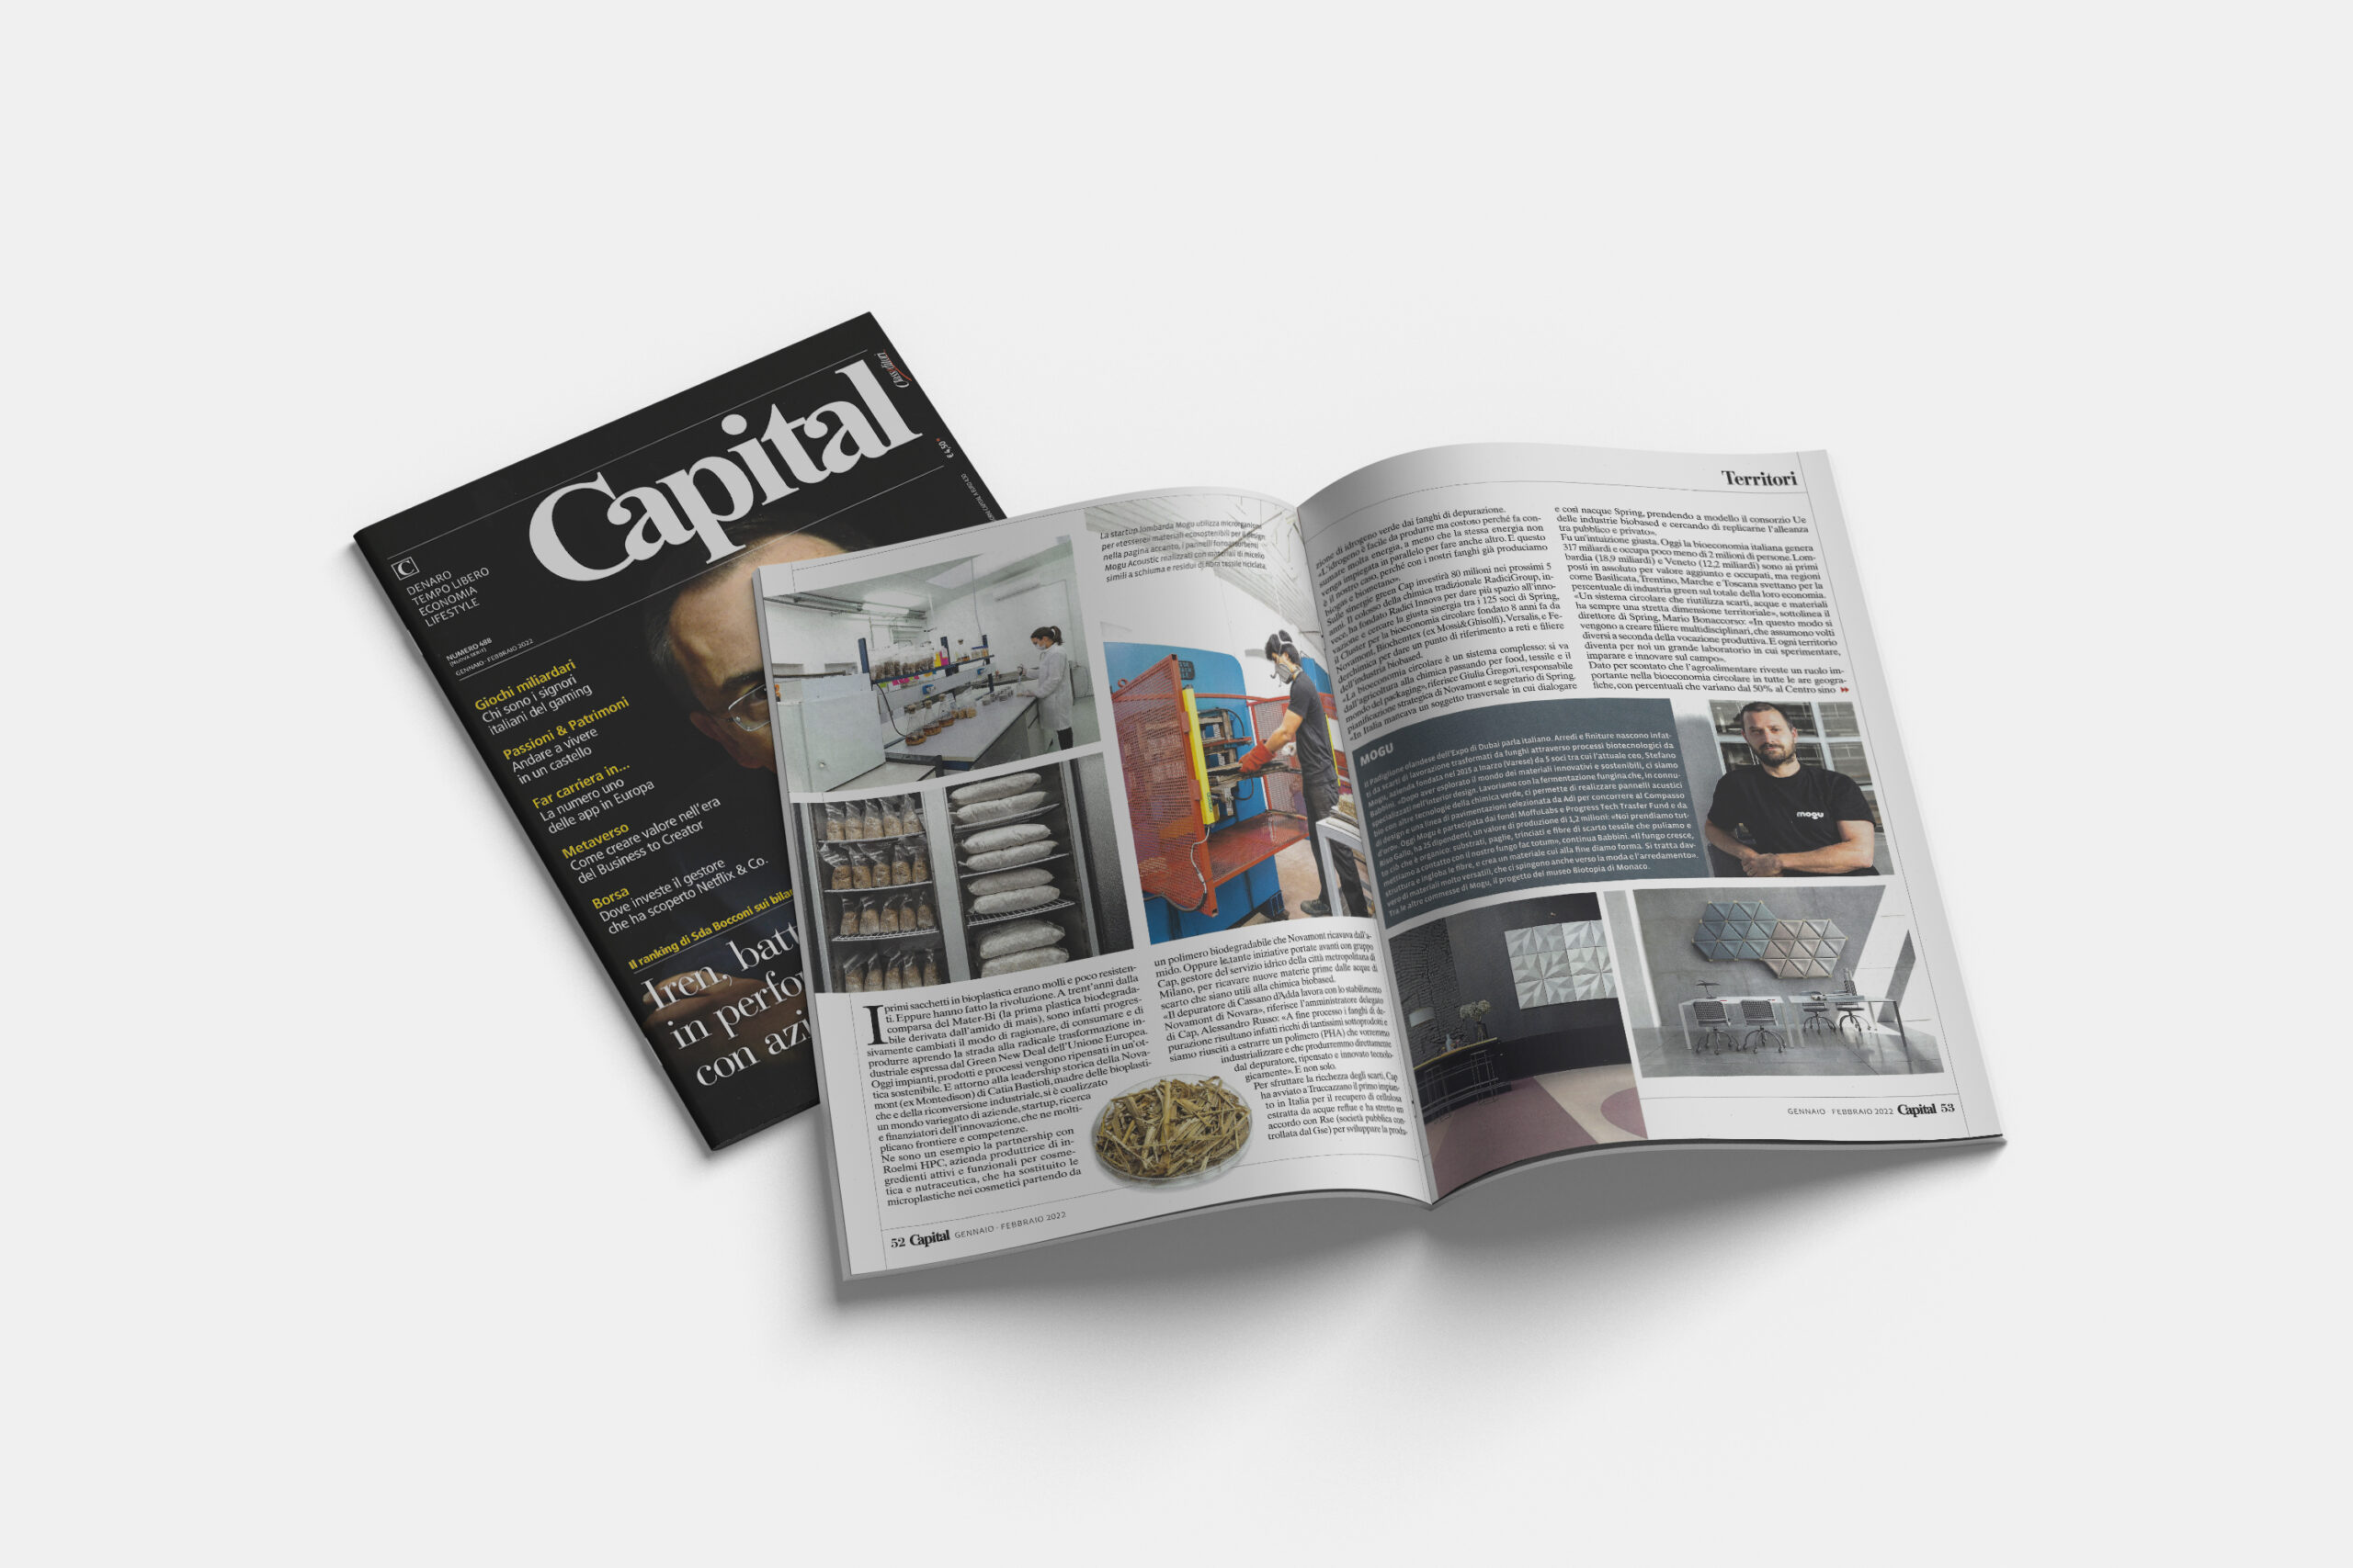
magazine /ˌmæɡəˈziːn/ (n): tạp chí

Slide 14
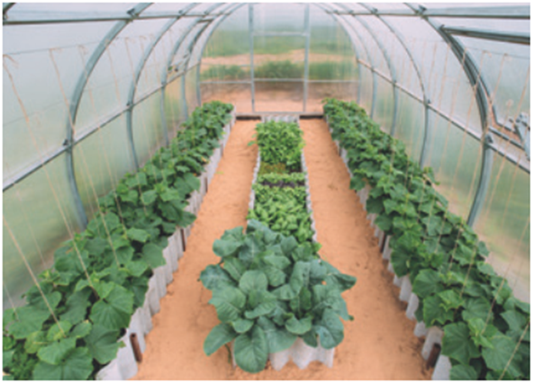
school garden /skuːl/ /ˈgɑːdn/
(n): vườn trường

Slide 15
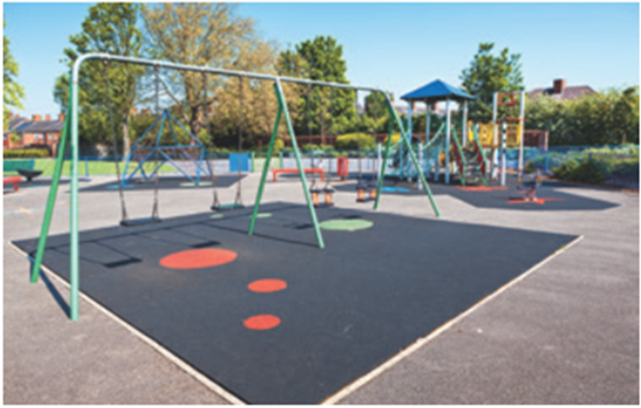
playground /ˈpleɪɡraʊnd/
(n): sân chơi

Slide 16

Biology /baɪˈɒlədʒi/
(n): môn sinh học

Slide 17
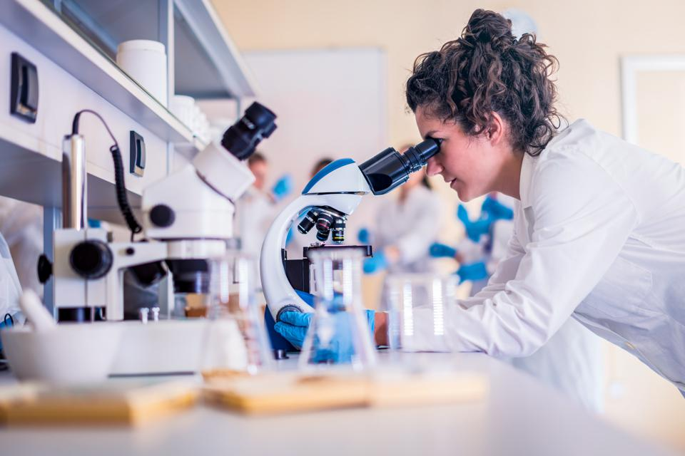
science lab /ˈsaɪəns læb/
(n): phòng thí nghiệm khoa học

Slide 18

Information Technology /ˌɪnfəˌmeɪʃn tekˈnɒlədʒi/
(n): công nghệ thông tin

Slide 19
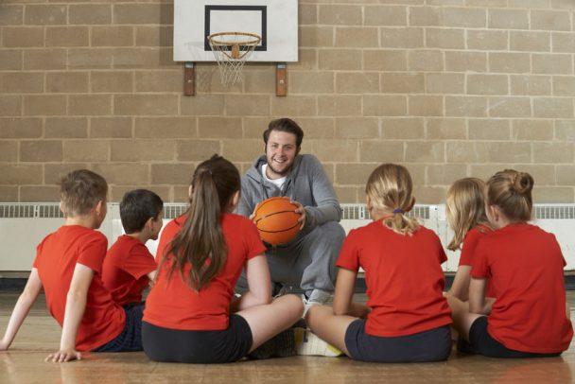
Physical Education /ˈfɪzɪkəl/ /ˌɛdju(ː)ˈkeɪʃən/
(n): môn thể dục

Slide 20

history /ˈhɪstri/ (n): lịch sử

Slide 21
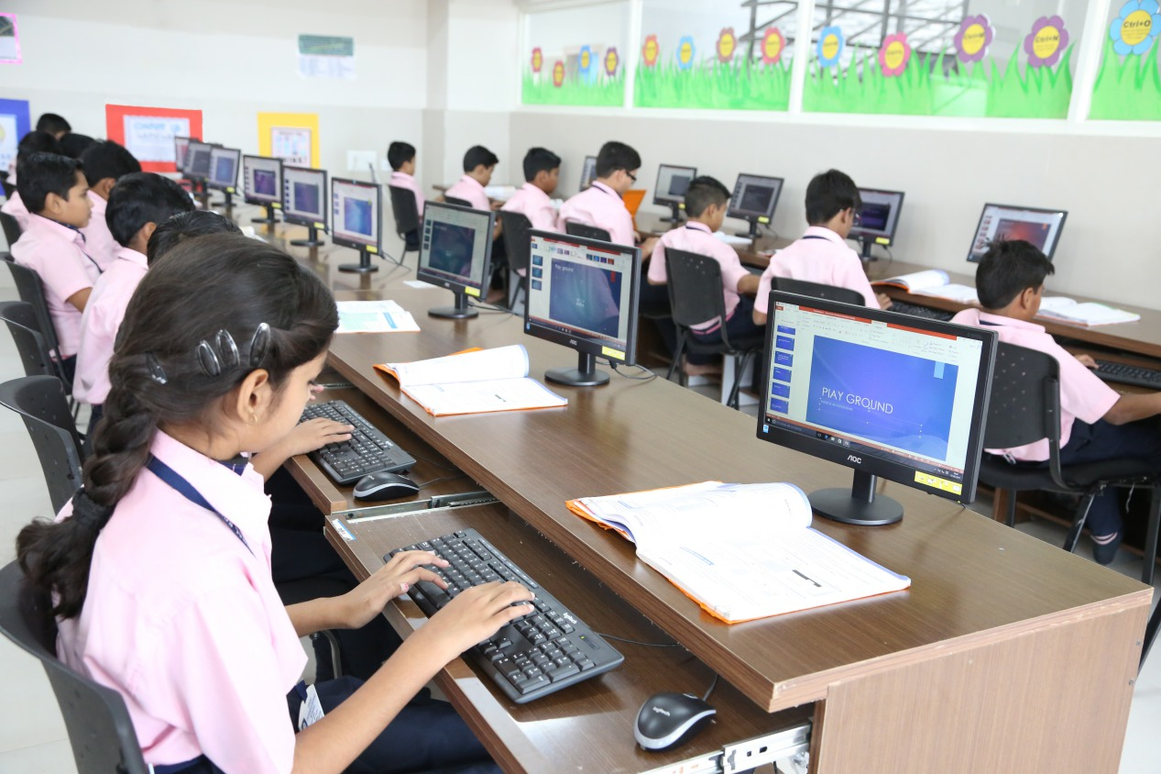
computer room /kəmˈpjuːtə/ /ruːm/
(n): phòng tin học

Slide 22
PRESENTATION
New words | Pronunciation | Meaning
lower secondary school | /ˈləʊər ˈsekəndrɪ skuːl/ | trường trung học cơ sở
member | /ˈmembər/ | thành viên
remind | /rɪˈmaɪnd/ | gợi nhớ/ nhắc nhở

Slide 23
LESSON 1: GETTING STARTED
WARM-UP
Chatting
PRESENTATION
Vocabulary
Task 1: Listen and read.
Task 2: Read the conversation again and answer the questions by circling A, B, or C.
Task 3: Name the places, using the words and phrases from the box.
Task 4: Complete the following sentences with the phrases in Task 3.
PRACTICE

Slide 24
PRACTICE
1
Listen and read.
Phong: What are you doing, Mi?
Mi: I’m preparing to visit Binh Minh Lower Secondary School.
Phong: Sounds great! I think that’s one of the best schools in my neighbourhood. Who is going with you and when?
Mi: My teacher and my classmates. We’re going in the afternoon.
Phong: I see. What will you do there?
Mi: Well, I think we’ll visit the school library, the computer room, and the gym. We’ll meet the students and share ideas for a project in our English class.
Phong: That’s interesting. What else will you do there?
Mi: We’ll meet the members of their Go Green Club and take photos of the school.
Phong: Fantastic! so don’t forget to take your camera.
Mi: I almost forgot. Thanks for reminding me.

Slide 25
PRACTICE
2
Read the conversation again and answer the questions by circling A, B, or C.
1. What are they talking about?
A. A visit to a computer room.
B. A visit to a school.
C. A visit to a school library.
Phong: What are you doing, Mi?
Mi: I’m preparing to visit Binh Minh Lower Secondary School.

Slide 26
PRACTICE
2
Read the conversation again and answer the questions by circling A, B, or C.
2. Who is going to visit the school?
A. Mi and her teacher.
B. Mi and her classmates.
C. Mi, her teacher and her classmates.
Phong: Sounds great! I think that’s one of the best schools in my neighbourhood. Who is going with you and when?
Mi: My teacher and my classmates. We’re going in the afternoon.

Slide 27
PRACTICE
2
Read the conversation again and answer the questions by circling A, B, or C.
3. Where is the school?
A. In the city.
B. In the countryside.
C. In Phong’s neighbourhood.
Phong: Sounds great! I think that’s one of the best schools in my neighbourhood. Who is going with you and when?

Slide 28
PRACTICE
2
Read the conversation again and answer the questions by circling A, B, or C.
4. When are they going?
A. In the morning.
B. In the afternoon.
C. At noon.
Phong: Sounds great! I think that’s one of the best schools in my neighbourhood. Who is going with you and when?
Mi: My teacher and my classmates. We’re going in the afternoon.

Slide 29
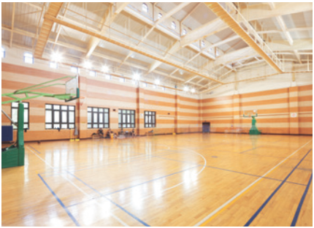
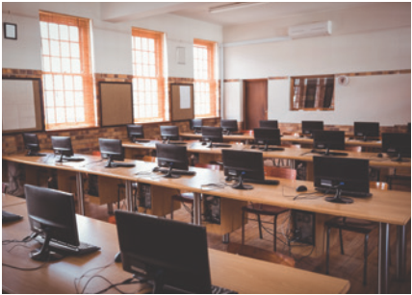

PRACTICE
3
Name these places, using the words and phrases from the box.
gym
computer room
school garden
1. ____________
2. ________________
3. ________________

Slide 30

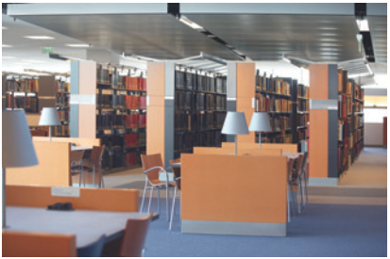
PRACTICE
3
Name these places, using the words and phrases from the box.
playground
4. ____________
school library
5. ______________

Slide 31
PRACTICE
4
Complete the following sentences with the words in the box.
computer room
school library
school garden
playground
gym
1. The school _______________ is very small, so not many children can play in it.
2. We learn how to use the Internet in the _______________ twice a week.
3. They have school meetings in the _______________ when it rains.
4. There are a lot of books, magazines, and newspapers in the _______________.
5. Our class usually waters the vegetables in the _______________ on Friday afternoons.
playground
computer room
gym
school library
school garden

Slide 32
LESSON 1: GETTING STARTED
WARM-UP
Chatting
PRESENTATION
Vocabulary
Task 1: Listen and read.
Task 2: Read the conversation again and answer the questions by circling A, B, or C.
Task 3: Name the places, using the words and phrases from the box.
Task 4: Complete the following sentences with the phrases in Task 3.
PRACTICE
PRODUCTION
Task 5: Work in pairs. Ask and answer questions about Nick’s timetable, using when and where.

Slide 33
PRODUCTION
5
Work in pairs. Ask and answer questions about Nick’s timetable, using when and where.
Subject (1) | Time (2) | Place (3)
Maths | 8 a.m. Monday, Tuesday, Friday | Classroom (room 302)
Biology | 9 a.m. Thursday | Science lab
Information Technology | 2 p.m. Wednesday | Computer room
Physical Education | 3 p.m. Monday, Thursday | School gym
History | 3:30 p.m. Tuesday | School library
Example:
A: When does Nick have maths (1)?
B: At 8 a.m. on Monday, Tuesday, and Friday (2).
A: And where does he have it?
B: In his classroom, room 302 (3)

Slide 34
LESSON 1: GETTING STARTED
WARM-UP
Chatting
PRESENTATION
Vocabulary
Task 1: Listen and read.
Task 2: Read the conversation again and answer the questions by circling A, B, or C.
Task 3: Name the places, using the words and phrases from the box.
Task 4: Complete the following sentences with the phrases in Task 3.
PRACTICE
PRODUCTION
Task 5: Work in pairs. Ask and answer questions about Nick’s timetable, using when and where.
CONSOLIDATION
Wrap-up
Homework

Slide 35
CONSOLIDATION
1
WRAP-UP
Topic of the unit
A visit to a school
Vocabulary
School facilities

Slide 36

CONSOLIDATION
2
HOMEWORK
Exercises in Workbook.

Slide 37

Website: sachmem.vn
Fanpage: facebook.com/sachmem.vn/

