Slide 1
WELCOME TO MY CLASS
10A3

Slide 2
Unit
5
1
Unit
FAMILY LIFE
INVENTIONS
LESSON 8
LOOKING BACK AND PROJECT

Slide 3
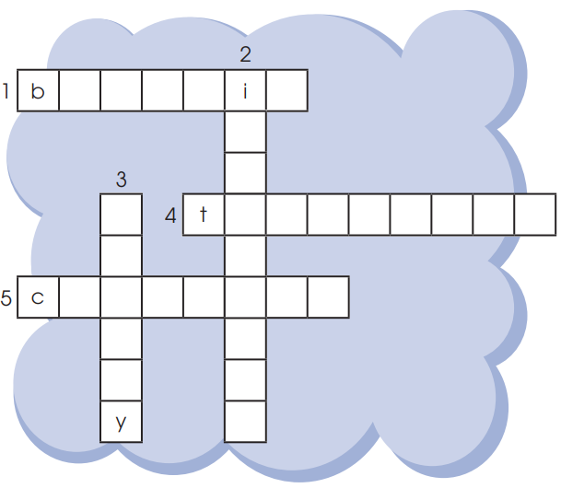
Warm up
Solve the crossword.

Slide 4
ACTIVITY 1: fill in the gaps
SINCE/ FOR …………………………………………..
LAST/ AGO …………………………………………….
SO FAR/ RECENTLY:…………………………………..
YESTERDAY : . ………………………………………….
ALLOW= PERMIT : ……………………………………
SUGGEST/ ENJOY: …………………………………….
IT’S + ADJ + ………………………………………………
INVITE/ DECIDE ……………………………………….
S + have/ has + V₃^{ed}
S + V₂^{ed}
S + have/ has + V₃^{ed}
S + V₂^{ed}
+ to + V₀
+ V_{ing}
+ to + V₀
+ to + V₀

Slide 5
ACTIVITY 2
GRAMMAR
Circle the correct answers.
1. They just installed / have just installed some interesting software on the school computers. The programs are working very well and everyone enjoys to use / using them.
2. Smartphones allow people sending / to send information over long distances. Learn / To learn with a smartphone is fun as well.
3. Since television was invented / has been invented, TV designs
changed / have changed a lot.

Slide 6
ACTIVITY 3: CHOOSE THE CORRECT ANSWERS.
Since the computer ____, it has made considerable changes to our daily life.
A. has invented B. has been invented C. was invented D. invented
2. The robbers ——————— by the police for an hour.
A. have arrested B. have been arrested C. was arrested D. arrested
3. We were all hungry, so she suggested __________ dinner early.
A. to have B. having C. to having D. have
4. Little Tommy enjoys ______ storybooks at night very much.
A. to read B. reading C. to reading D. read
5. Television first _______ in the world a few decades ago
A. appear B. appeared C. was appeared D. appears
6. The report _______ by the committee of experts yet.
A. hasn’t examined B. hasn’t been examined C.is examined D.examines

Slide 7
ACTIVITY 3: Rewrite the sentences using the given words
S+ allow/ permit + O + to V… →S+ let + O + Vo
My parents don’t allow me to go out late at night. (let)
→ My parents don’t………………………………..
2. My father permitted me to use the family motorbike. (let)
My father ……………………………………
3. The teacher permits students up to answer the question. (let)
The teacher ………………………………………
4. My mother lets me go out at night with my best friend(allow)
→My mother …………………………………………
5. My idol allows me to follow her. (let)
→ My idol ………………………………………..….
let me go out late at night
let me use the family motorbike
lets the students up answer the question
allows me to go out at night with my best friends
lets me follow her.

Slide 8
CONSOLIDATION
Review
the vocabulary
grammar of Unit 5;

Slide 9
CONSOLIDATION
Homework
Do PROJECT in 4 groups
Prepare practice test 1.

Slide 10
Website: sachmem.vn
Fanpage: facebook.com/sachmem.vn/

