Slide 2
Unit
1
A long and healthy life
Unit
FAMILY LIFE
LESSON 8
LOOKING BACK AND PROJECT

Slide 3
LESSON 8
LOOKING BACK AND PROJECT
WARM-UP
Lucky number
- Pronunciation: Strong and weak form of auxiliary verbs
- Vocabulary: Healthy life
- Grammar: Past simple and present perfect
LOOKING BACK
PROJECT
Healthy habits posters
CONSOLIDATION
- Wrap up
- Homeword

Slide 4
WARM-UP
LUCKY NUMBER
- Work in 2 teams
- There are 7 numbers, 2 of which are lucky ones
- Choose a lucky number ➔ 1 point without answering
- Other numbers ➔ Pick a piece of paper
- Use words or actions to describe the word (without saying it directly)
- Guess the word correctly ➔ 1 point
- The group with the most points is the winner.

Slide 5
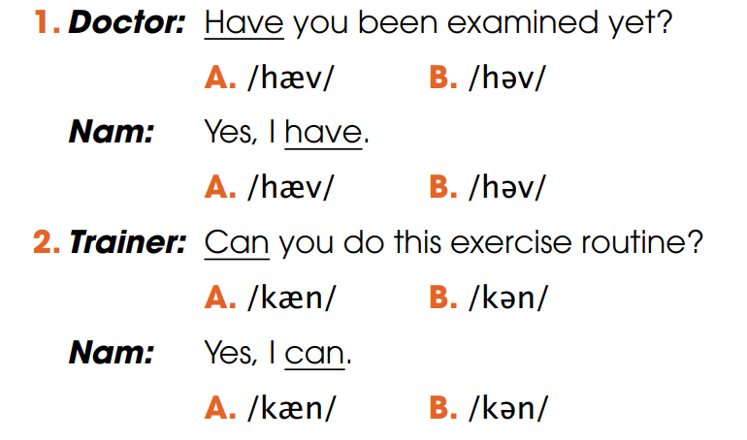
LOOKING BACK
1
Circle the common pronunciation of the underlined auxiliary verbs. Then listen and check. Practise saying the conversations in pairs

Slide 6
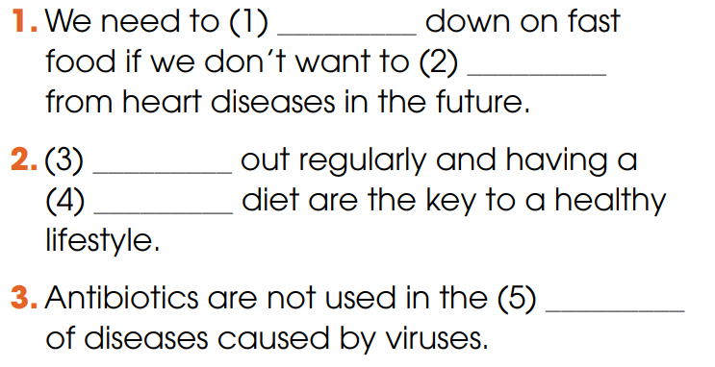
LOOKING BACK
2
Fill in each gap with ONE word. Use the words you have learnt in this unit.
cut
suffer
Working
balanced
treatment

Slide 7
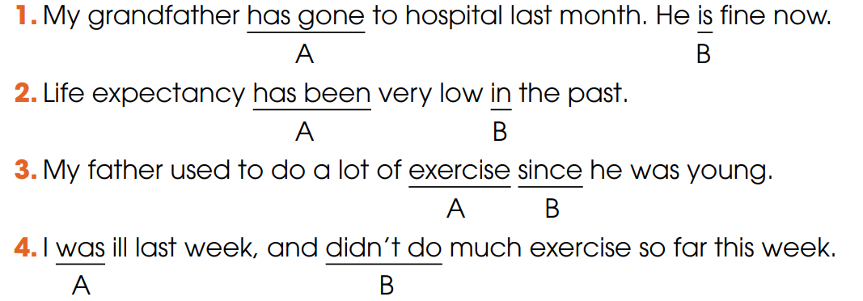
LOOKING BACK
3
Circle the underline part that is incorrect in each of the following sentence. Then correct it.
➔ went
➔ was
➔ when
➔ haven’t done

Slide 8
PROJECT
HEALTHY HABITS POSTERS

Slide 9
CONSOLIDATION
1
Wrap-up
What have you learnt today?
- Review the pronunciation, vocabulary and grammar of Unit 1;
- Apply what you have learnt (vocabulary and grammar) into practice through a project.

Slide 10
CONSOLIDATION
2
Homework
Do exercises in the workbook.
Prepare for Unit 2.

