Slide 1
Healthy living for teens
Unit 3

Slide 2


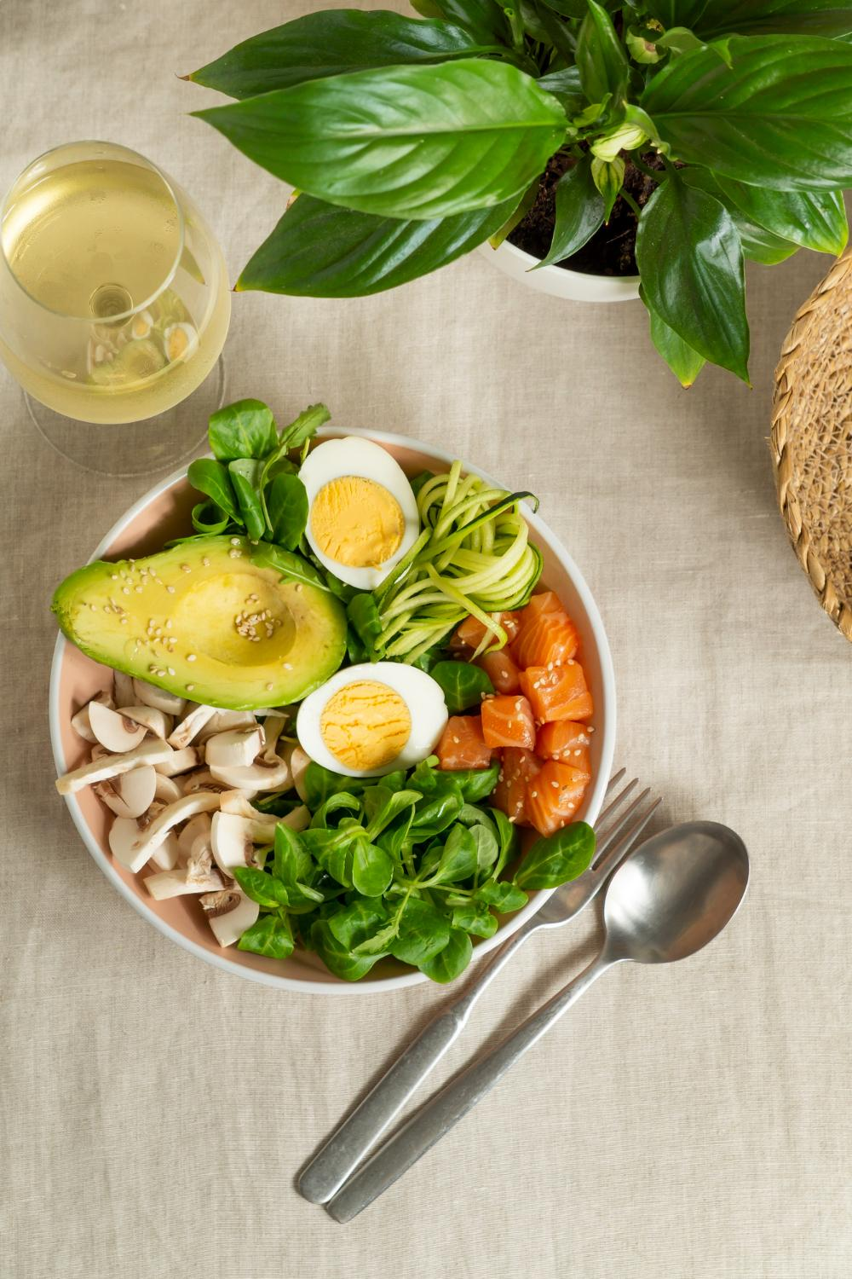
LESSON 2: A CLOSER LOOK 1

Slide 3
LESSON 1: GETTING STARTED
LESSON 1: GETTING STARTED
WARM-UP
Discuss
Task 1: Circle the correct word or phrase to complete each sentence.
Task 2: Match the words and phrases with their definitions.
Task 3: Complete the sentences with the words and phrases from 2.
VOCABULARY
PRONUNCIATION
Task 4: Listen and repeat the words. Pay attention to the sounds /h/ and /r/.
Task 5: Listen and practise the sentences. Pay attention to the bold words with /h/ and /r/.
FURTHER PRACTICE
Game: Tongue Twister Challenge
CONSOLIDATION
Wrap-up
Homework

Slide 4
Warm Up

Slide 5


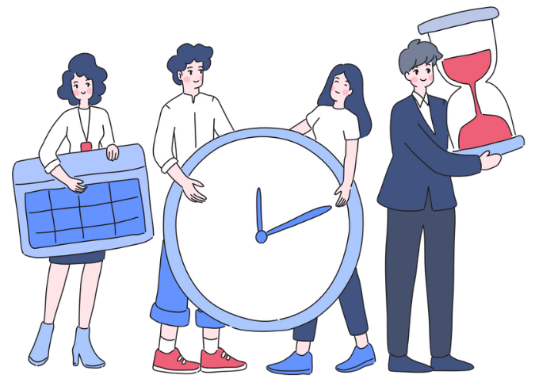
Warm-Up Discussion
Topic: Vocabulary for Time Management and Health

Slide 6
Warm-Up Discussion
Discussion Questions:
1. How do you usually manage your time between school, hobbies, and personal activities?
=> I exercise regularly by jogging and do yoga. I also eat healthy and take time to relax by reading.
2. What activities do you do to stay healthy?
=> I make a schedule each week, prioritizing schoolwork, and then set time for hobbies and relaxation.
3. Have you ever felt stressed or had too many distractions?
=> Yes, I feel stressed sometimes. I take breaks and remove distractions by turning off my phone to focus better.

Slide 7
I. Vocabulary

Slide 8


VOCABULARY
achieve (v)
/əˈtʃiːv/
đạt được, giành được

Slide 9
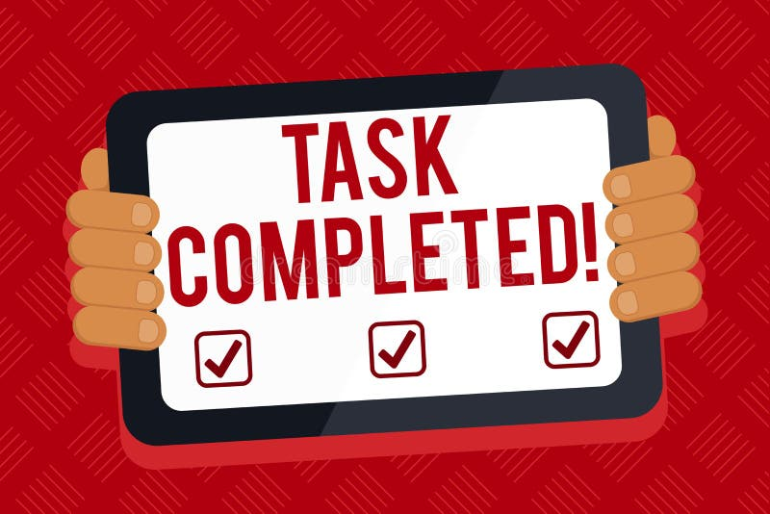
VOCABULARY
accomplish (v)
/əˈkɑːmplɪʃ/
hoàn thành

Slide 10

VOCABULARY
due date (n)
/ˈduː deɪt/
hạn chót

Slide 11

VOCABULARY
distraction (n)
/dɪˈstrækʃn/
điều gây xao lãng

Slide 12

VOCABULARY
optimistic (n)
/ˌɑːp.təˈmɪs.t̬ɪk/
lạc quan

Slide 13
VOCABULARY
New words | Pronunciation | Meaning
1. achieve (v) | /əˈtʃiːv/ | đạt được, giành được
2. accomplish (v) | /əˈkɑːmplɪʃ/ | hoàn thành
3. due date (n) | /ˈduː deɪt/ | hạn chót
4. distraction (n) | /dɪˈstrækʃn/ | điều gây xao lãng
5. optimistic (n) | /ˌɑːp.təˈmɪs.t̬ɪk/ | lạc quan

Slide 14
Review
Vocabulary

Slide 15


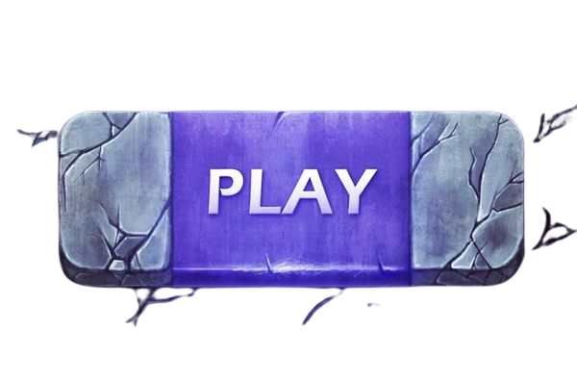

Slide 16

🎮 GAME RULES – THE WACKY ADVENTURE🐊
1️⃣ Click on the numbered steppingstones to answer each question. 2️⃣ Follow the order from 1 to 5 – no skipping allowed! 3️⃣ If you answer correctly, the two characters will automatically jump to the next stone. 4️⃣ Complete all the questions to help the two characters cross the crocodile-filled river safely. 5️⃣ Once you've finished, press the EXIT button to leave the dangerous cave!
💡 Have fun and good luck!

Slide 17
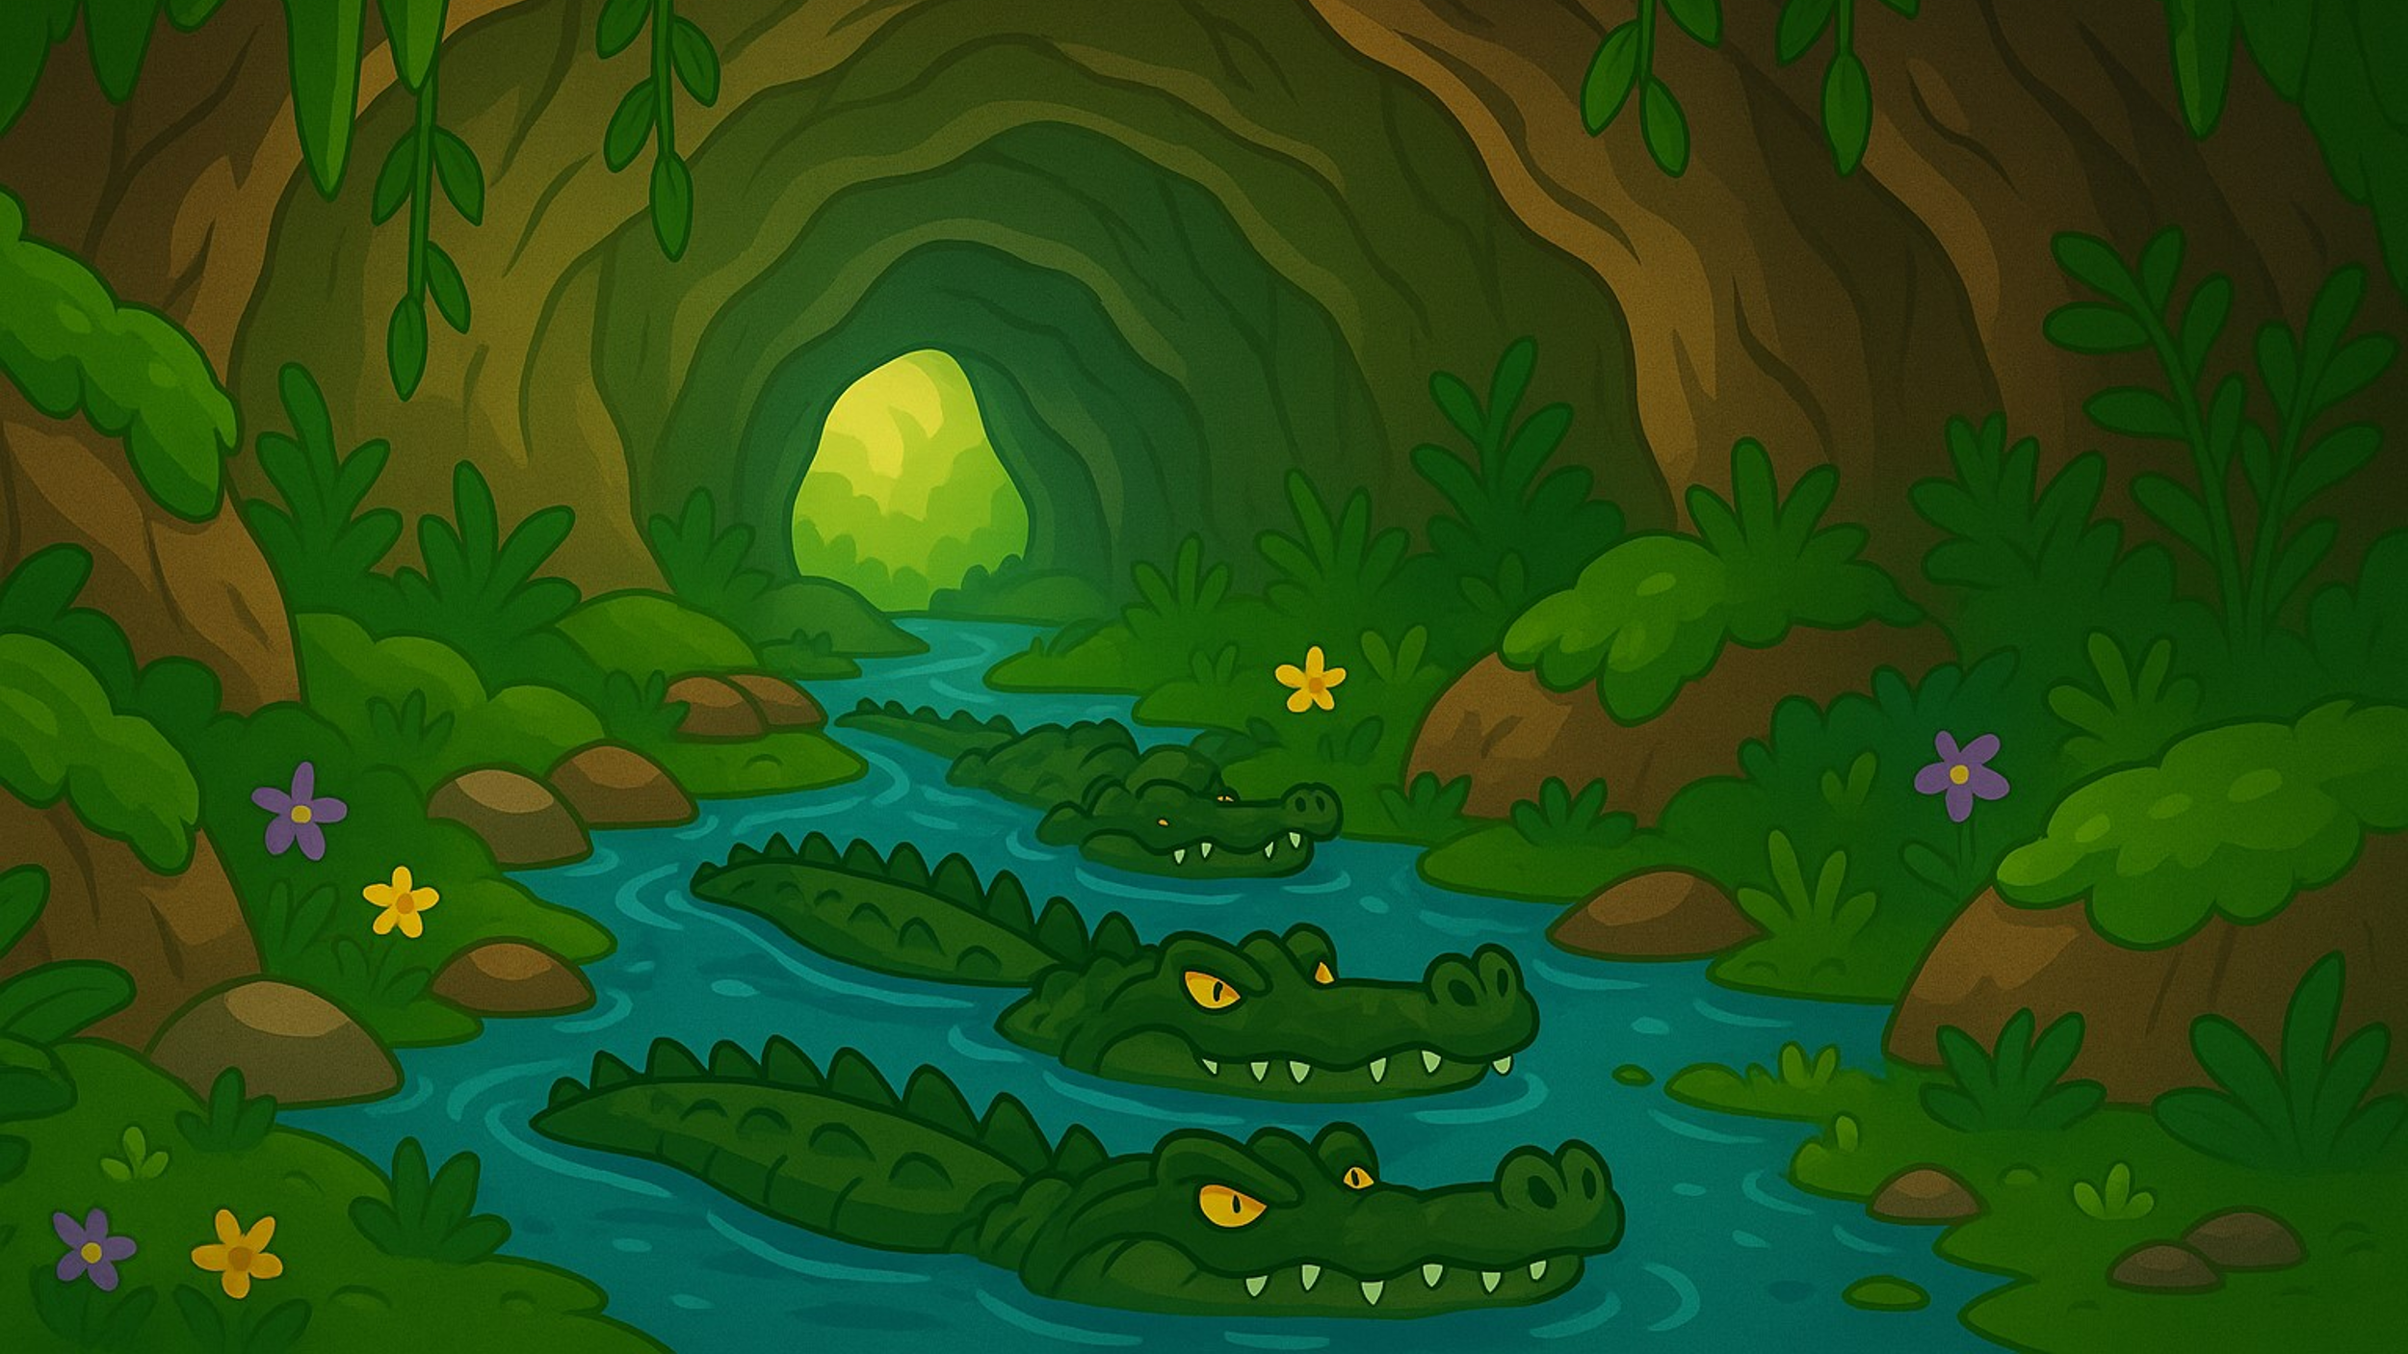



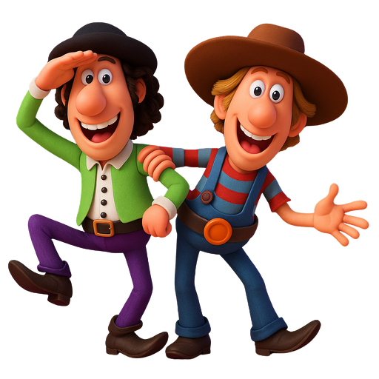
3
4
2
5
1

Slide 18
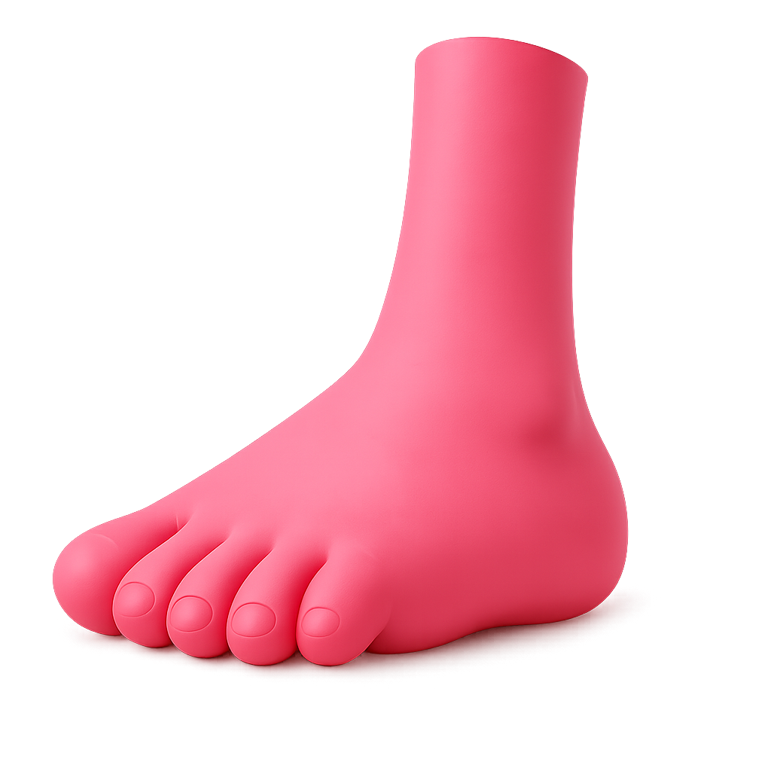

Something that stops you from paying attention.
A. distraction
B. accomplish
C. due date

Slide 19
To finish something well after trying hard.
A. distraction
B. accomplish
C. optimism

Slide 20
The last day to finish or give something.
A. achieve
B. optimistic
C. due date

Slide 21
To get something because you worked hard for it.
A. achieve
B. accomplish
C. optimistic

Slide 22
Being hopeful and thinking about the good side of things.
A. due date
B. optimistic
C. distraction

Slide 23
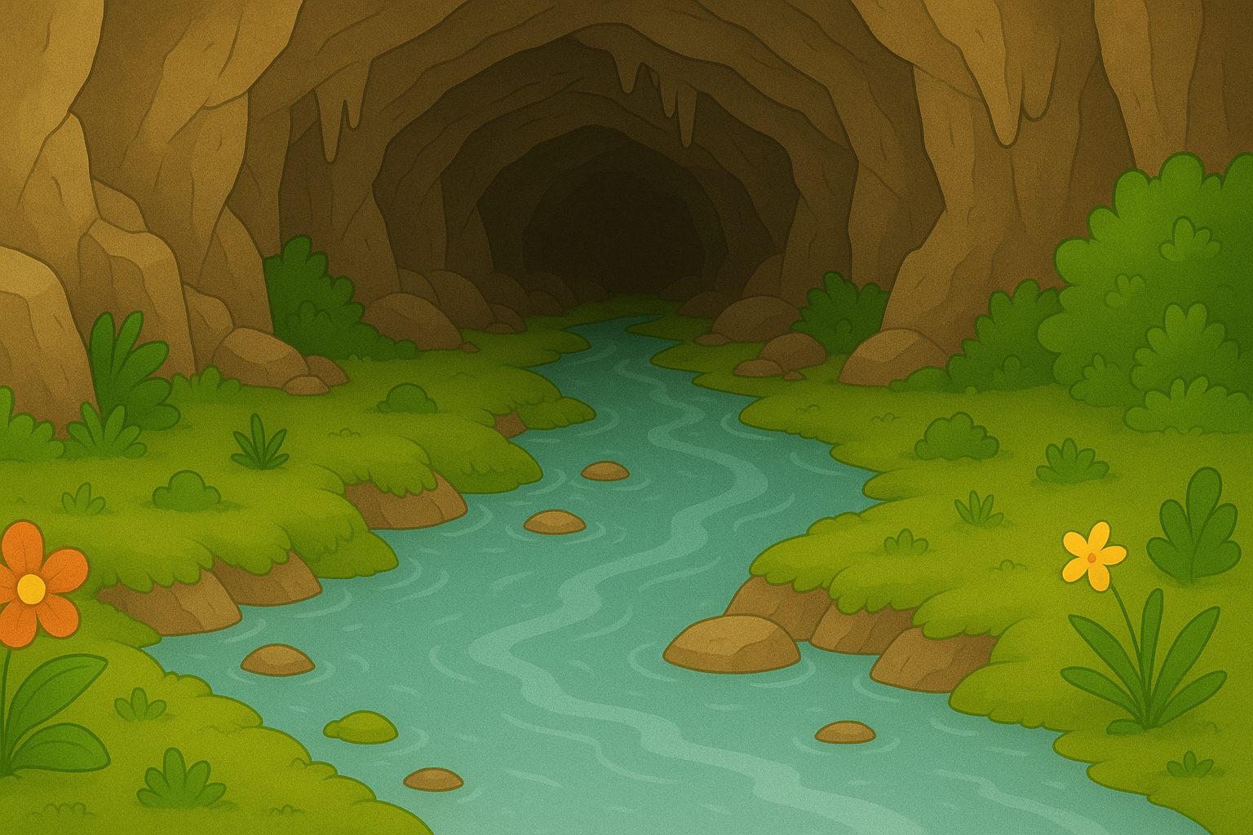

\

Slide 24
VOCABULARY
1
Circle the correct word or phrase to complete each sentence.
1. It’s always difficult for students to give / make priority to work, school, and family.
2. David works out at his home gym to maintain his mental / physical health.
3. Well-balanced / Badly balanced living is hard to achieve if you have many things to do.
4. Managing / Making time means organising and planning how to divide your time between different activities.
5. I tried to accomplish / get my goal of cycling five kilometres a day.

Slide 25

VOCABULARY
2
Match the words and phrases with their definitions.
a. the planned day and time that something is required to be completed
b. believing that good things will happen
c. too anxious and tired to be able to relax
d. things that stop you from paying attention to what you are doing
e. not to do something until a later time
1. delay
1. e
2. a
3. b
4. c
5. d
2. due date
3. optimistic
4. stressed out
5. distractions

Slide 26
VOCABULARY
3
Complete the sentences with the words and phrases from 2.
due date
1. I want to know the _________ for my history assignment.
2. I’m trying to go to bed earlier because I’m feeling _____________ at the moment.
3. He intended to ______ telling her the news, waiting for the right moment.
4. I’m ______________ about the result of the exam I took last week.
5. I prefer to study in the school library because there are too many ____________ at home.
stressed out
delay
optimistic
distractions

Slide 27
II. Pronunciation

Slide 28
PRONUNCIATION
4
Listen and repeat the words. Pay attention to the sounds /h/ and /r/.
/h/ | /r/
healthy happiness habit ahead perhaps | regularly really ready worrying several

Slide 29
FURTHER PRACTICE
RULES:
Work in 2 teams.
T reads out word by word, one student will run to the board and slap on the correct word with the correct sound.
The team with more correct answers will be the winner.

Slide 30
FURTHER PRACTICE
hygiene
handicraft
pottery
preserve
happy
role
pricey
hand
fragrance
tourist
home
arround
free

Slide 31
FURTHER PRACTICE
Circle the letter A, B, C, or D to indicate the word whose
underlined part differs from the other three in pronunciation.
1. A. habit B. hour C. human D. healthy 2. A. really B. ready C. learner D. worry 3. A. honour B. happy C. hurry D. ahead 4. A. several B. start C. regular D. parent 5. A. where B. honest C. homesick D. chorus
B.
C.
A.
B.
C.

Slide 32

CONSOLIDATION
1
Wrap-up
List some phrases learned in the lesson.
List some other learned words / phrases related to students’ life and schoolwork.
Pronounce 2 sounds learned in the lessons and give examples.

Slide 33

CONSOLIDATION
2
Homework
- Do exercises in the workbook.

Slide 34
Goodbye

