Slide 1
We’re having a picnic
We’re having a picnic
Fun! Fun! Fun!
We’re bringing some biscuits
We’re bringing some biscuits
Yum! Yum! Yum!
We’re playing together
We’re playing together
Hurrah! Hurrah! Hurrah!

Slide 2
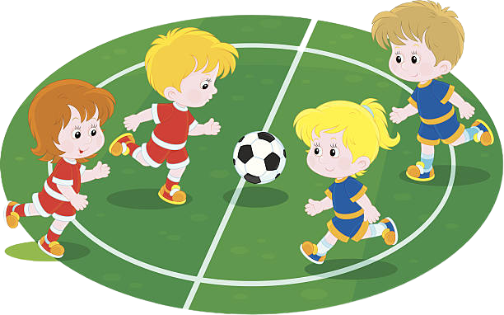
She is watching TV now
They are playing football at the moment.

Slide 3
UNIT 3: MY FRIENDS PERIOD: 17 - LESSON 3: A CLOSER LOOK 2

Slide 4
I. Grammar

Slide 5
1/ Usage :
The present continuous Thì hiện tại tiếp diễn
- Action now
Eg: She is watching TV now .
- Plans for future
Eg: We are going to the zoo this weekend.

Slide 6
The present continuous Thì hiện tại tiếp diễn
Ex: You learn English.
2/ Form:
S V O
(+) S + is/am/are + V-ing + O
(+) You are learning English.
(-) S + is/am/are + not+ V-ing + O.
(-) You are not learning English.
(?) Is/Am/Are + S + V-ing + O?
(?) Are you learning English?
Yes, S + is/am/are
No, S +is/am/are + not.
Yes, I am
- No, I am not.
3. Adv:
now / right now
at the moment
at the present, tonight, tomorrrow, this evening
Look ! / Listen! / Be careful !....

Slide 7
Grammar
The present continuous
We use the present continuous for actions happening now.
Example: - She’s talking.
- They’re not talking.
We can use the present continuous with now, at present, or at the moment.
Example: - I’m doing my homework at present.
- A: Are you reading now?
B: Yes, I am.

Slide 8
learn- learning
have- having
4. V_ing
swim- swimming
lie- lying

Slide 9
II. Practice

Slide 10
Put the verbs in brackets in the present continuous.
(+) S + is/am/are + V-ing + O.
(-) S + is/am/are + not+ V-ing + O.
(?) Is/Am/Are + S + V-ing + O?
Yes, S + is/am/are.
No, S +is/am/are + not.
is reading
a book now.
1.
Nam (read)
a book now.
They (play)
are playing
football at the moment.
2.
football at the moment.
isn’t making
a sandwich at present.
3.
My sister (not make)
a sandwich at present.
I (go) to the supermarket at the moment.
4.
am going
5.
Are
they (talk) about their new friends?
they (talk) about their new friends?
talking

Slide 11
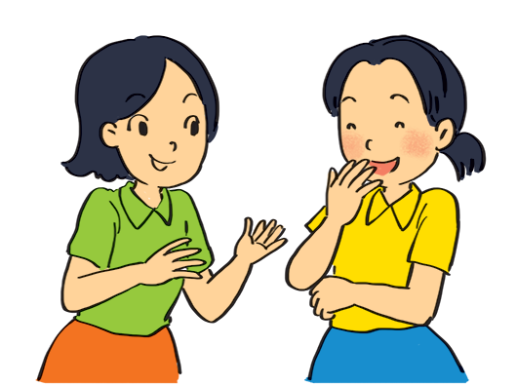
Look at the pictures. Write sentences like the example. Use positive or negative present continuous verbs.
Example:
She’s talking to Mai. (talk)

Slide 12
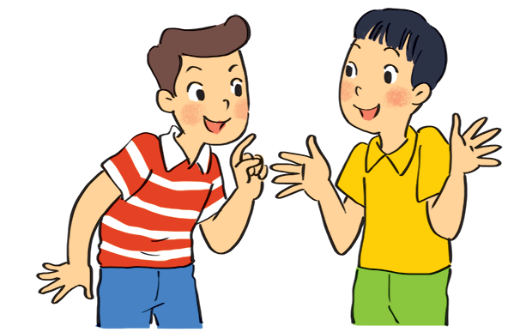
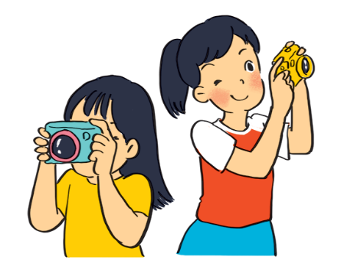
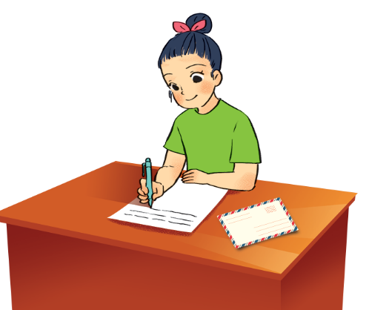
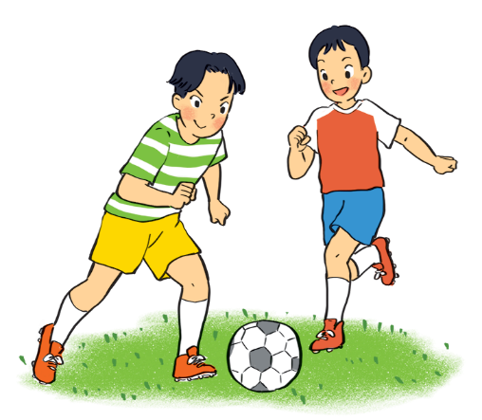
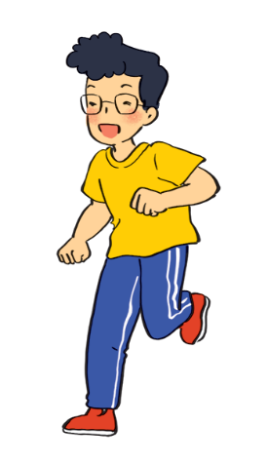
.
1.
Nam and Ba
(eat ice cream)
are not / aren’t eating ice cream.
2.
are taking photos.
Lan and Trang
(take photos)
.
3.
Ha
(write a letter)
is / Ha’s writing a letter.
.
4.
Duong and Hung
(play badminton)
are not / aren’t playing badminton.
.
is not / isn’t drawing a picture.
5.
.
Phong
(draw a picture)

Slide 13
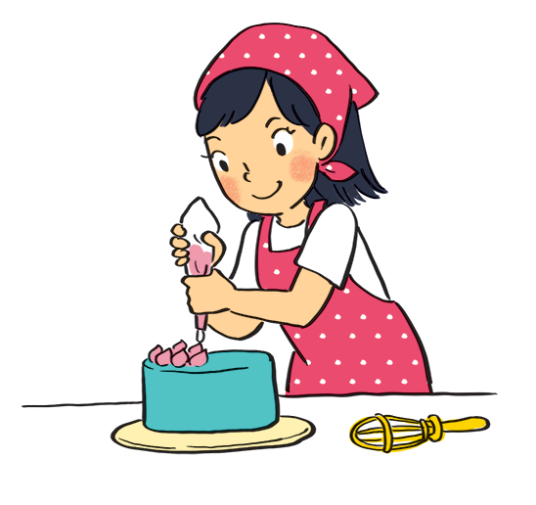
Work in pairs. Look at the pictures. Ask and answer.
At home
(?) Is/Am/Are + S + V-ing + O?
Yes, S + is/am/are.
No, S +is/am/are + not.
Example:
A: your sister / make a cake?
Is your sister making a cake?
B: Yes, she is.

Slide 14
Phân biệt thì hiện tại đơn và hiện tại tiếp diễn
hiện tại đơn
(+) V (s,es)
(-) don’t/ doesn’ + V inf
(-) do/ does +S+ + V inf?
Từ nhận biết:
- Always/ usually / often / frequently / sometimes / seldom / rarely / hardly / never /generally / regularly / every…
hiện tại tiếp diễn
(+)Tobe + V-ing
(-) am/is/are + V_ing
(?) am/is/are +S+ V_ing?
Từ nhận biết:
now/ at the moment/ at the present
- Look! Listen!…

Slide 15
Present simple vs. present continuous
START

Slide 16
doesn’t/
does not walk
cycles
My best friend (not walk _____
to school every day.
Sometimes she (cycle)______________
Don’t/do not walk - cycle
Doesn’t/ doesnot walk- cycles
Don’t/do not walking - cycle
Doesn’t/does not walking- cycles

Slide 17
2. Look! What ___ he ________?
Is playing
Is playing
am playing
are playing
do playing

Slide 18
3. __________your friend _______ in the library every afternoon?
Do study
Is - study
Am - play
Do - study
Does - study

Slide 19
4. I ___________ an email to my friend now.
am/ ‘m writing
is/ ‘s writing
are/ ‘re writing
am/ ‘m writing
do/ does writing

Slide 20
5. He ___________ his homework now. He ___________
is / ‘s reading
is not / isn‘t doing
am / ‘m reading
am not doing
do reading
don’tdoing
are / ‘re reading
are not / aren‘t doing
is / ‘s reading
is not / isn‘t doing

Slide 21
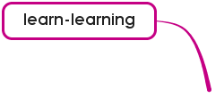
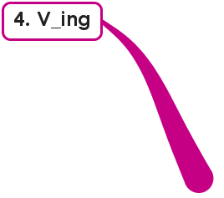
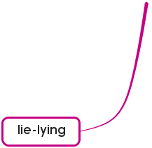
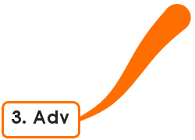
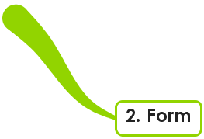
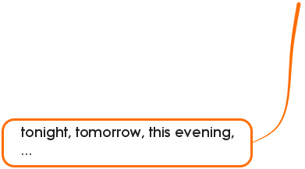
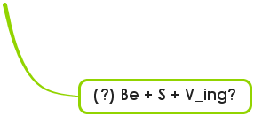

Slide 22
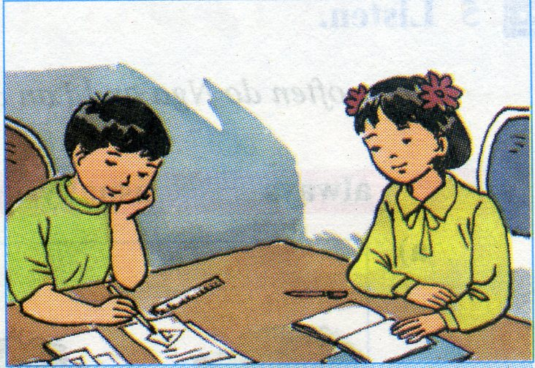
Học thuộc kiến thức thì hiện tại tiếp diễn
phân biệt thì hiện tại đơn và hiện tại tiếp diễn
làm bài tập 3 vào vở
Chuẩn bị bài mới:
Unit 3. Lesson 4. Communication
Home work

