Slide 1



Slide 2

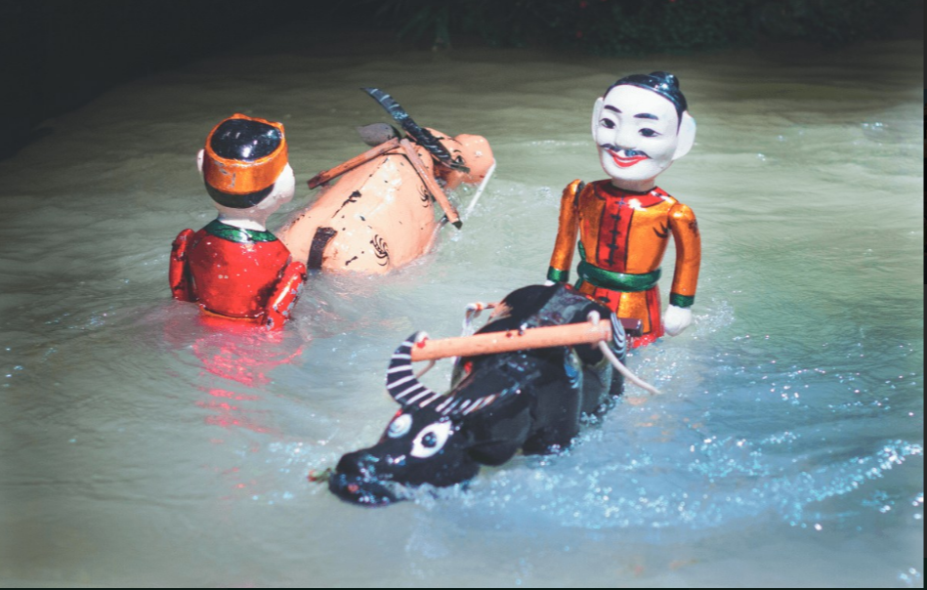

1. What is the type of art?
concert
painting
A:
B:
C: water puppetry
Water puppetry
C:

Slide 3
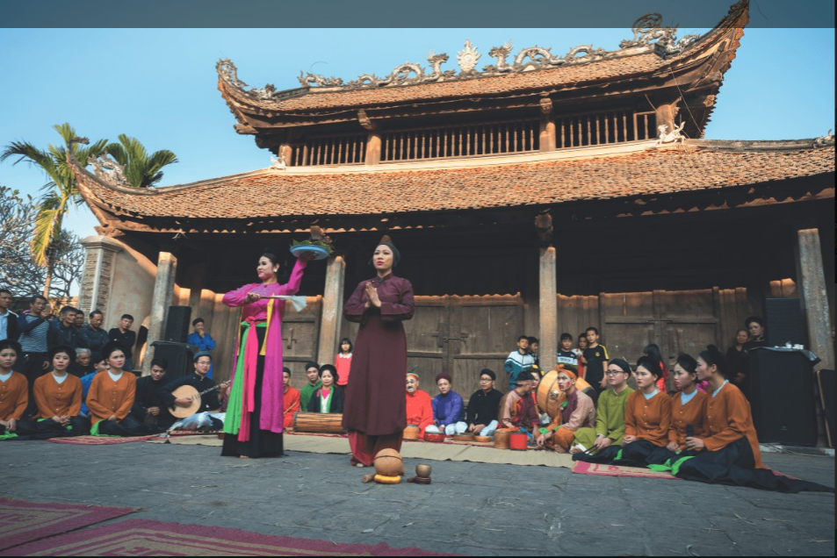
2. Quan Ho singing is a traditional music form of_____.
Bac Giang
Bac Ninh
A:
B:
Bac Kan
C:

Slide 4
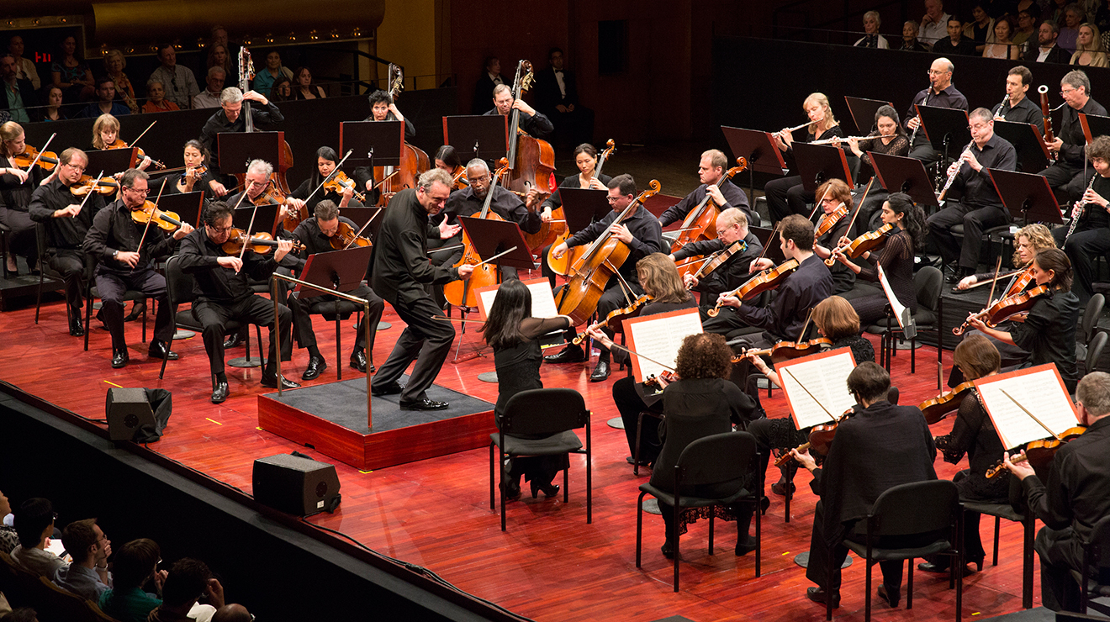
3. What is the type of art?
A:
Painting
B:
Film
Concert
C: Concert
C:

Slide 5
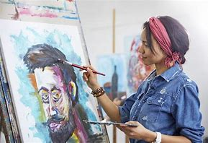
4. What is she doing ?
Singing
Dancing
A:
B:
C: Painting
Painting
C:

Slide 6
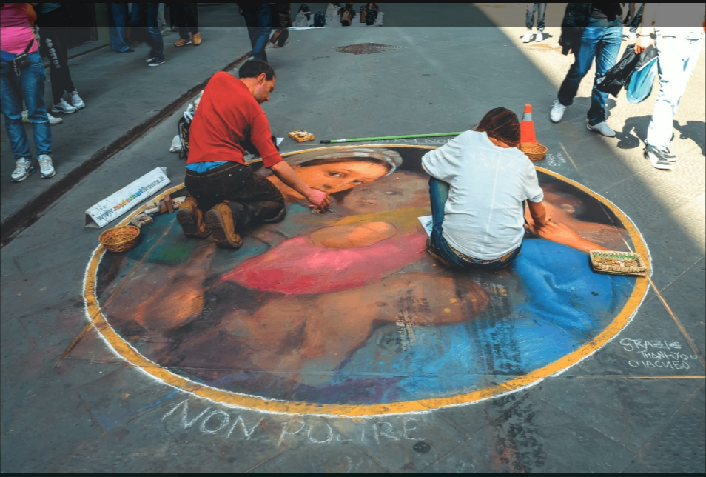
5. What is the type of art?
A:
Street dancing
Street painting
B:
C:
Cleaning street

Slide 7
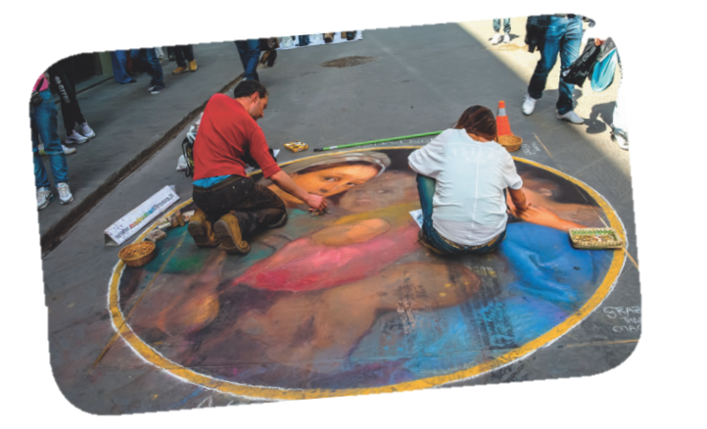
1. What do you know about street painting?
Street painting is a form of artwork that is displayed in public on surrounding buildings, on streets, trains, and other publicly viewed surfaces.
Street painting

Slide 8
Grade 7
Unit 4:
Music and Arts
Period 32nd: Skills 2

Slide 9
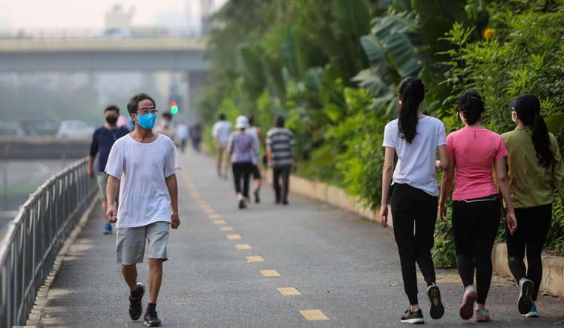
Vocabulary
01
pavement (n)
/ˈpeɪvmənt/
vỉa hè, đường dành cho người đi bộ

Slide 10

Vocabulary
02
occur (v)
/əˈkɜːr/
xuất hiện

Slide 11

Vocabulary
03
support (v,n)
/səˈpɔːt/
ủng hộ/ sự ủng hộ

Slide 12

Vocabulary
04
huge (adj)
/hjuːdʒ/
to lớn

Slide 13
Vocabulary
01
pavement (n)
02
occur (v)
support (n, v)
03
huge (adj)
04
/ˈpeɪvmənt/
vỉa hè
xuất hiện
/əˈkɜːr/
ủng hộ
/səˈpɔːt/
/hjuːdʒ/
to lớn

Slide 14

Listen tick the words you hear (page 47).
02
✓
1. artists
✓
4. enjoy
2. music
5. museum
✓
3. painting
Notes:
Answer key: 1 3 4

Slide 15
Listen again and choose correct answer.
Underline the keywords.
03
1. Street painting began ______________.
A. in the 16th century B. in the 6th century C. in 1994
2. At a street painting event, you can ______________.
A. buy a painting B. talk to artists C. become an artist
3. The Lake Worth Street Painting Festival happens ______________.
A. only sometimes B. every month C. every year
4. About ______________ artists take part in the Lake Worth Street Painting Festival.
A. 100,000 B. 600 C. 60
Notes:
Answer key: 1 3 4

Slide 16
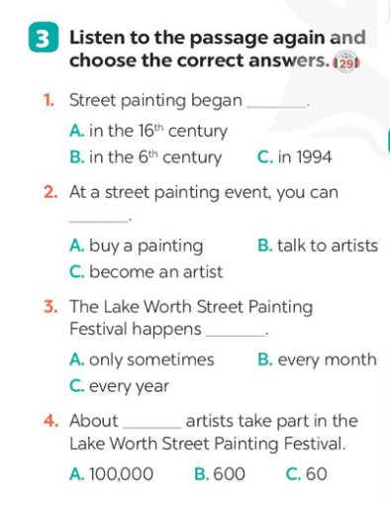
Listen again and choose correct answer.
03
1. Street painting began ______________.
A. in the 16th century B. in the 6th century C. in 1994
2. At a street painting event, you can ______________.
A. buy a painting B. talk to artists C. become an artist
3. The Lake Worth Street Painting Festival happens ______________.
A. only sometimes B. every month C. every year
4. About ______________ artists take part in the Lake Worth Street Painting Festival.
A. 100,000 B. 600 C. 60
Notes:
Play the tape twice.

Slide 17
Check your answer
03
1. Street painting began ______________.
A. in the 16th century B. in the 6th century C. in 1994
In the 16th century artists began to draw on the pavement using chalk. Today, you can see street painting events everywhere.
Notes:
Call Ss to give answer on the board

Slide 18
Check your answer
03
2. At a street painting event, you can ______________.
A. buy a painting B. talk to artists C. become an artist
They attract many people who come to enjoy and take part in them. Many of them are free too. So join in and become an artist yourself!
Notes:
Answer key: 1A 2C 3C 4B

Slide 19
Check your answer
03
3. The Lake Worth Street Painting Festival happens ______________.
A. only sometimes B. every month C. every year
One of the largest events in the United States is the Lake Worth Street Painting Festival. It began in 1994 and now occurs every February with the support of artists and volunteers.
Notes:
Answer key: 1A 2C 3C 4B

Slide 20
Check your answer
03
4. About ______________ artists take part in the Lake Worth Street Painting Festival.
A. 100,000 B. 600 C. 60
It is free for everyone. About 100,000 visitors come to enjoy it. About 600 artists work on the pavement to make the street a huge art gallery!
Notes:
Answer key: 1A 2C 3C 4B ( After checking, Ask the number of Sts got from 4 answers upper)

Slide 21
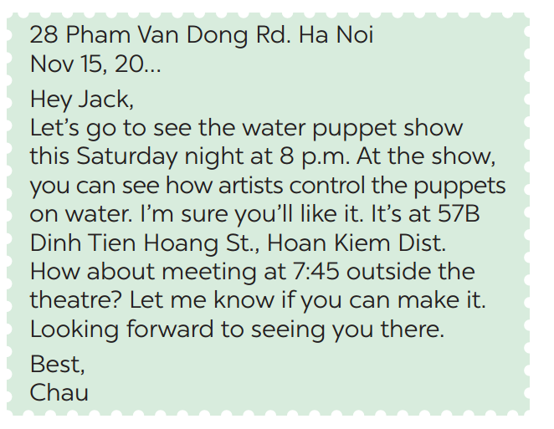
Read the letter and choose the correct answers.
04
1. This letter is from Chau to
A. a friend
B. a teacher
C. an old man
2. Chau writes this letter to
A. order Jack to perform a show B. invite Jack to see a show
C. make a complaint

Slide 22
Read the letter again and discuss with your friends
05
→ Event
+ the water puppet show
→ Start time
+ Saturday night at 8 p.m
→ Place
+ at 57B Dinh Tien Hoang St. Hoan Kiem Dist.
→ Activities
+ see how artists control the puppets on water.
→ Time to
meet
+ at 7.45.

Slide 23
Format of informal letter of invitation
    * Event: _____
    * Start time: _____
    * Place: _____
    * Activities: _____
    * Time to meet: _____
Writing tips:
In an informal letter of invitation, you can use:
- Let's ...
- How about + V-ing?

Slide 24

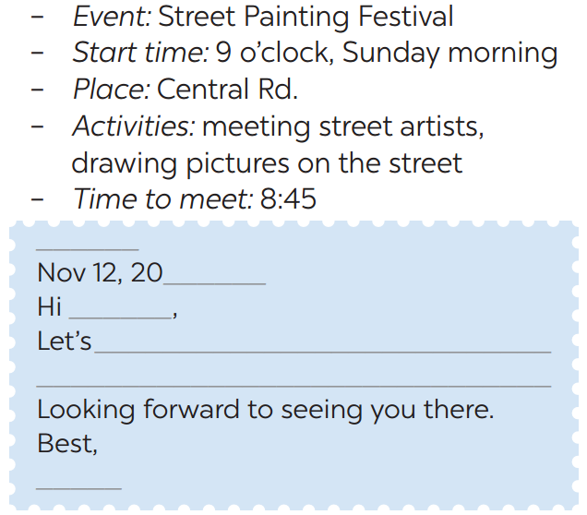

Using this following cue to write invite someone to a street painting festival.
06
Notes:
While Sts write, go around and help them if necessary. Note Sts’ writing

Slide 25

Class gallery
Students give feedback to each other
1. Does your friend’s letter include?
* Event: _____
* Start time: _____
* Place: _____
* Activities: _____
* Time to meet: _____
2. Does he/she have spelling mistakes?
Notes:
Choose good one / bad one of Sts to check => Show the common mistakes of Sts. Then ask Ss to check in pairs.

Slide 26
Re-cap
01
What skills do we learn today?
A. Listening and Reading
B. Listening and Writing
C. Reading and Writing

Slide 27
Re-cap
02
True or False?
We have learnt to write a formal letter to invite friend.
A. True
B. False
An informal letter to invite friend.

Slide 28
Homework
1. Prepare for the next lesson: Looking back (Review all vocab & gram of Unit 4; Use pencils to do exercises in textbooks)
2. Do homework Part E- Exercise 1,2,3 - WB (page 34).

Slide 29
Thank you

