Slide 1

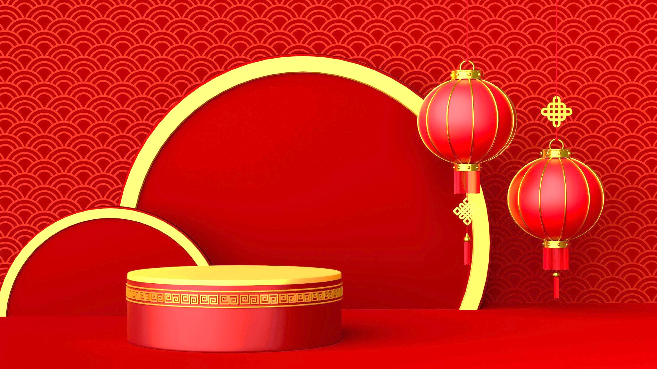





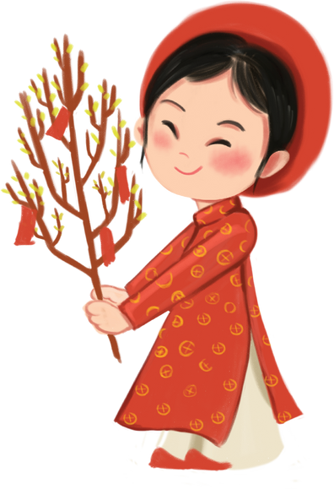



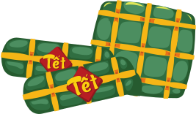
Unit 6:
Our Tet holiday
A closer look 2

Slide 2
1
Warm-up

Slide 3
WARM-UP
SHOULD OR SHOULDN’T

Slide 4
WARM-UP
You give lucky money during Tet.
SHOULD
SHOULDN’T
You should give lucky money during Tet.

Slide 5
WARM-UP
You wear black clothes during Tet.
SHOULD
SHOULDN’T
You shouldn’t wear black clothes during Tet.

Slide 6
WARM-UP
You say bad or unlucky words.
SHOULD
SHOULDN’T
You shouldn’t say bad or
unlucky words.

Slide 7
WARM-UP
You visit your relatives.
SHOULD
SHOULDN’T
You should visit your relatives.

Slide 8
WARM-UP
You break dishes.
SHOULD
SHOULDN’T
You shouldn’t break dishes.

Slide 9
WARM-UP
You make a wish.
SHOULD
SHOULDN’T
You should make a wish.

Slide 10



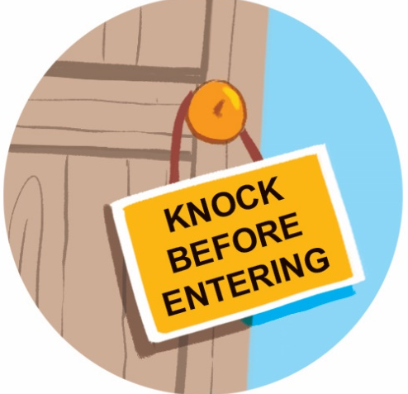
SHOULD OR SHOULDN’T
Look at the signs at the library and complete the sentences with should or shouldn’t.
1. You ________ keep quiet. | 2. You ________ eat or drink. | 3. You ______ knock before you enter. | 4. You ________ run.
should
should
shouldn’t
shouldn’t

Slide 11
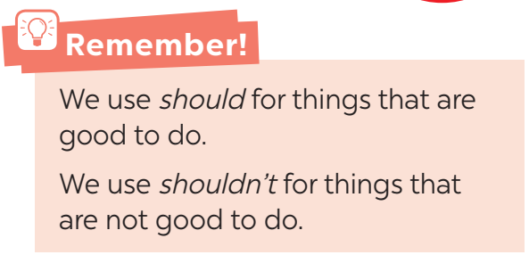
SHOULD OR SHOULDN’T
Should / shouldn’t for advice

Slide 12

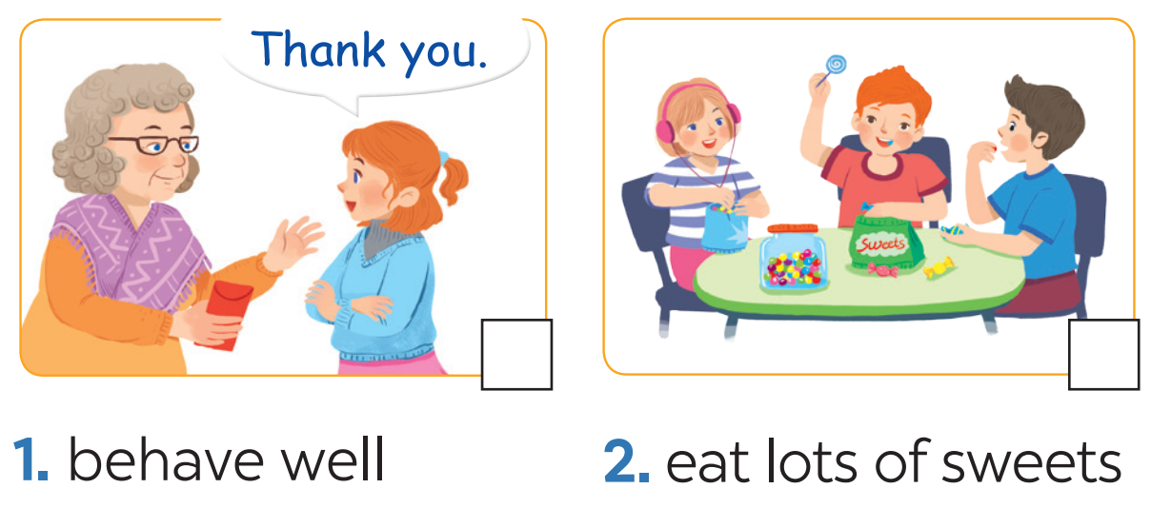
SHOULD OR SHOULDN’T
Tick the activities children should do at Tet and cross the ones they shouldn’t.



Slide 13
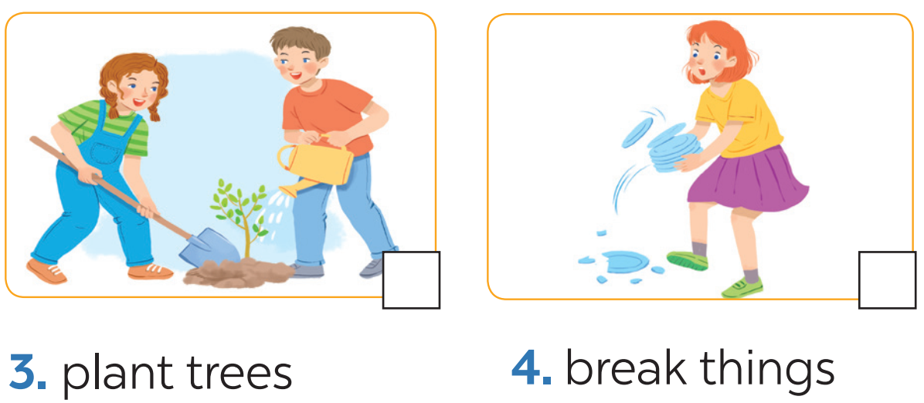
SHOULD OR SHOULDN’T
Tick the activities children should do at Tet and cross the ones they shouldn’t.



Slide 14
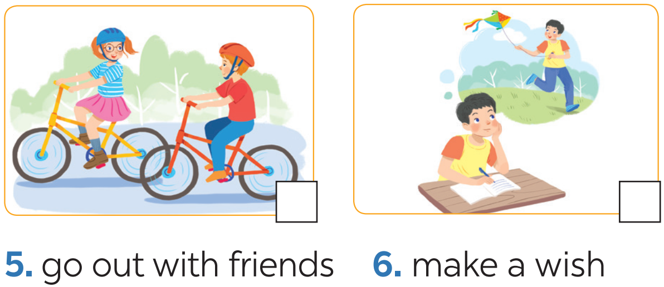
SHOULD OR SHOULDN’T
Tick the activities children should do at Tet and cross the ones they shouldn’t.



Slide 15
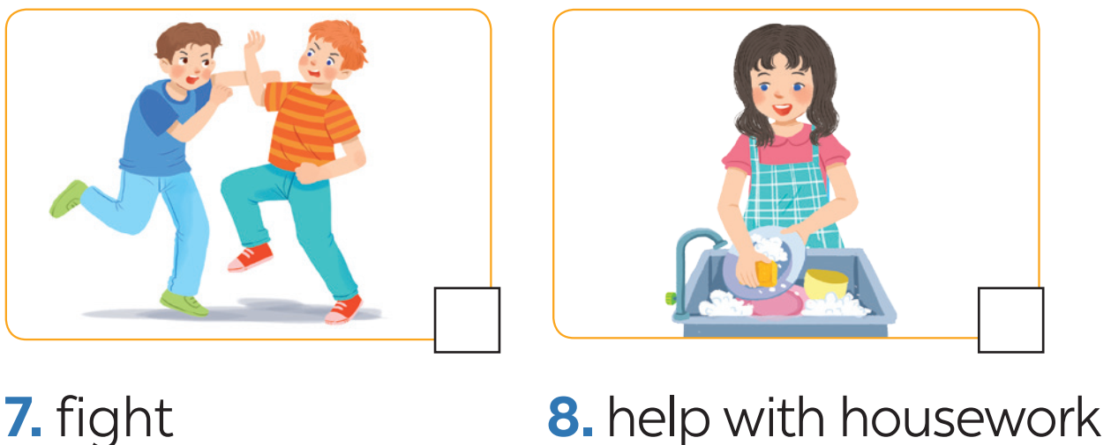
SHOULD OR SHOULDN’T
Tick the activities children should do at Tet and cross the ones they shouldn’t.



Slide 16
SHOULD OR SHOULDN’T
3
Look at the activities in 2. Take turns to say what you think children should / shouldn’t do.
Example:
Children should behave well.
Children shouldn’t eat lots of sweets.

Slide 17
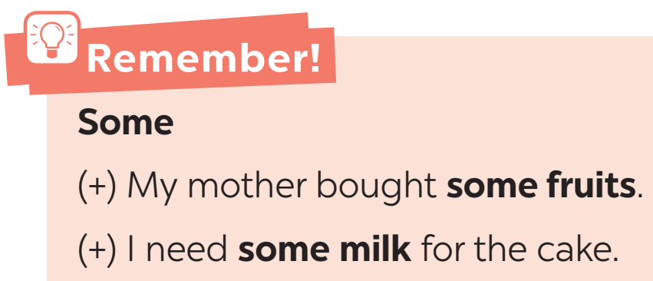
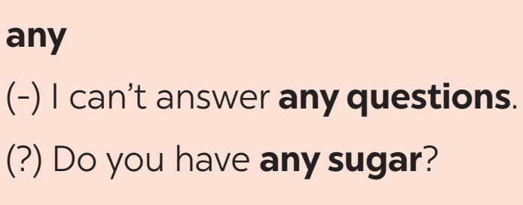
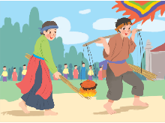
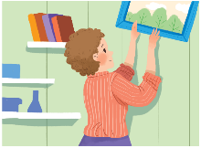
SOME/ANY
some / any for amount

Slide 18

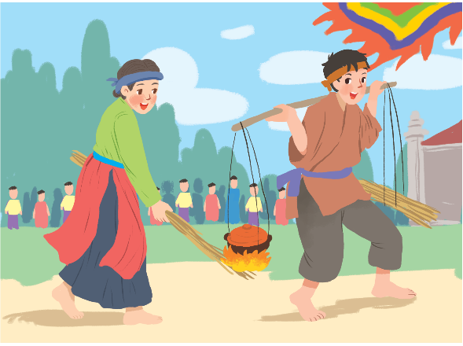
SOME/ANY
4
Complete the sentences with some and any.
1. – What do you need to decorate your room?
– I need _______ colour paper and _______
pictures.
2. – Do you have _______ free time for sports?
– Yes, I do.
3. – Are there _______ interesting activities here
during Tet?
– Yes, there are _______ traditional games like
human chess, running and cooking.
some
some
any
any
some

Slide 19
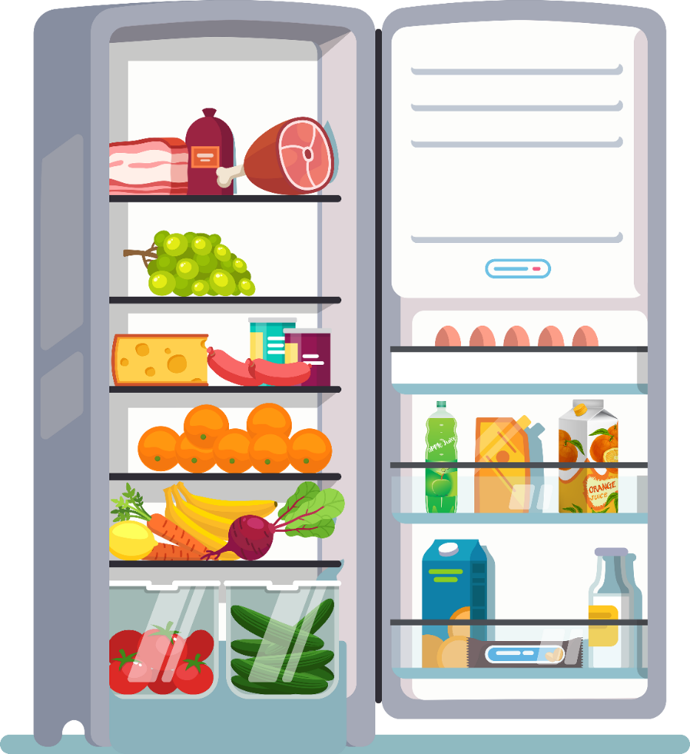
SOME/ANY
5
Look at the fridge. Make sentences with the words/phrases provided, using some or any.
Example:
ice cream
There is not any ice cream.
cucumbers
There are some cucumbers.

Slide 20






Website: hoclieu.vn
Fanpage: facebook.com/www.tienganhglobalsuccess.vn/

