Slide 1

What do you love about your school?

Slide 2
UNIT 1
My new school
6th grade
Lesson 6: Skills 2

Slide 3
OBJECTIVES
After this lesson, students will be able to:
LISTENING
WRITING
write a paragraph about one's school.
listen for specific information about school activities

Slide 4
01
Listening

Slide 5
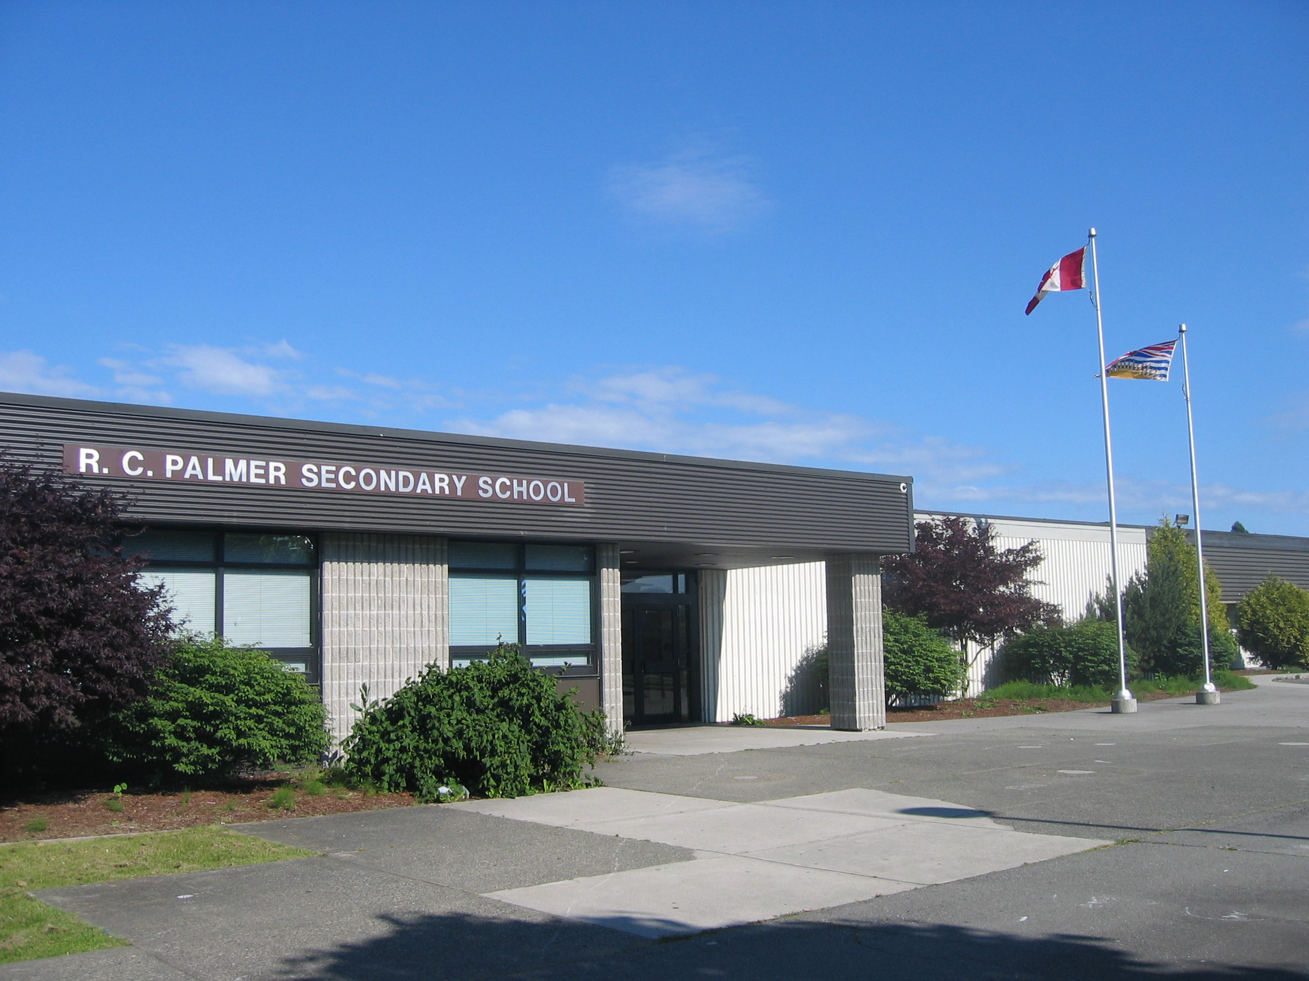
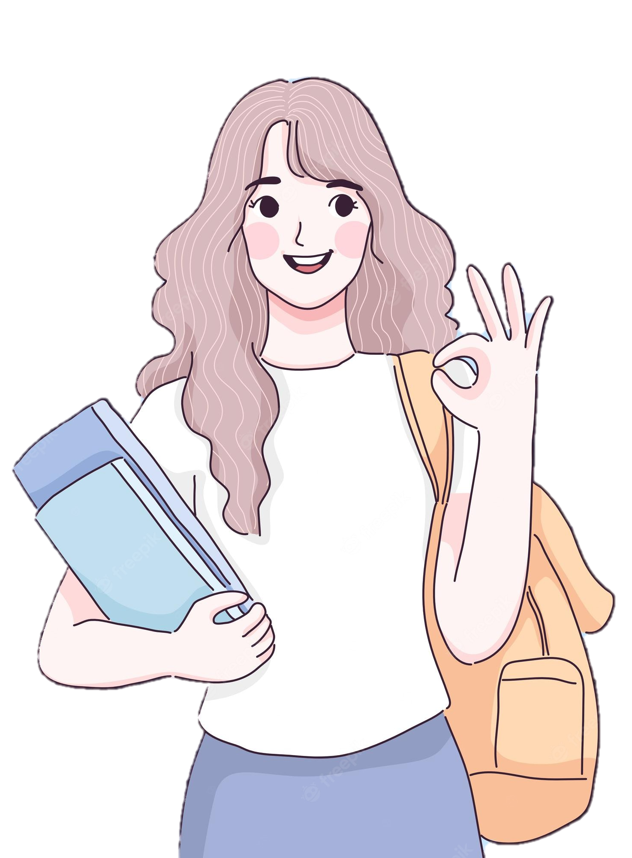

Guess
1. Do you think the students there wear uniforms?
Janet
2. Do they learn Vietnamese as a foreign language?
Listen and check.
Palmer School, America

Slide 6
Guess
1. Do you think the students there wear uniforms?
We wear our uniforms every day.
Yes
Janet
2. Do they learn Vietnamese as a foreign language?
I have two hours to study Vietnamese every week.
Yes

Slide 7
Before listening, underline the key words.
2. Listen again & choose A or B. (p.13)
1. Janet's favourite teacher is her ___________ teacher.
A. Maths B. science
2. Today Janet ___________ her uniform.
A. is wearing B. isn't wearing
3. Janet studies ___________ for two hours a week.
A. English B. Vietnamese
4. Janet usually does her homework ___________.
A. in the library B. at home
5. Her class is going to have a biology lesson ___________.
A. on a farm B. in the classroom

Slide 8
2. Listen again & choose A or B. (p.13)
1. Janet's favourite teacher is her ___________ teacher.
A. Maths B. science
… and my favourite teacher is Mrs. Smith. She teaches us Maths.
2. Today Janet ___________ her uniform.
A. is wearing B. isn't wearing
We wear our uniforms every day, but today we aren't.
Notes:
Hi. My name's Janet. I'm eleven years old. I'm now in year 6 at Palmer School. I like it here. My classmates are friendly. The teachers at my school are nice and very helpful, and my favourite teacher is Mrs. Smith. She teaches us maths. I have two hours to study Vietnamese every week. I usually do my homework in the library. We wear our uniforms every day, but today we aren't. We're going to have a biology lesson on a farm.

Slide 9
2. Listen again & choose A or B. (p.13)
3. Janet studies ___________ for two hours a week.
A. English B. Vietnamese
I have two hours to study Vietnamese every week.
4. Janet usually does her homework ___________.
A. in the library B. at home
I usually do my homework in the library.
5. Her class is going to have a biology lesson ___________.
A. on a farm B. in the classroom
We're going to have a biology lesson on a farm.
Notes:
Hi. My name's Janet. I'm eleven years old. I'm now in year 6 at Palmer School. I like it here. My classmates are friendly. The teachers at my school are nice and very helpful, and my favourite teacher is Mrs. Smith. She teaches us maths. I have two hours to study Vietnamese every week. I usually do my homework in the library. We wear our uniforms every day, but today we aren't. We're going to have a biology lesson on a farm.

Slide 10
What about your school?
Janet’s school

Slide 11
02
Writing

Slide 12
3. Brainstorm about your school.
What is the name of your school?
What do you like about your school?
A picture of your school
Where is your school?
What do students do at your school?
How many classes does your school have?
…
Notes:
1. What is the name of your school?
2. Where is your school?
3. How many classes does your school have?
4. What do students do at your school?
5. What do you like about your school?

Slide 13
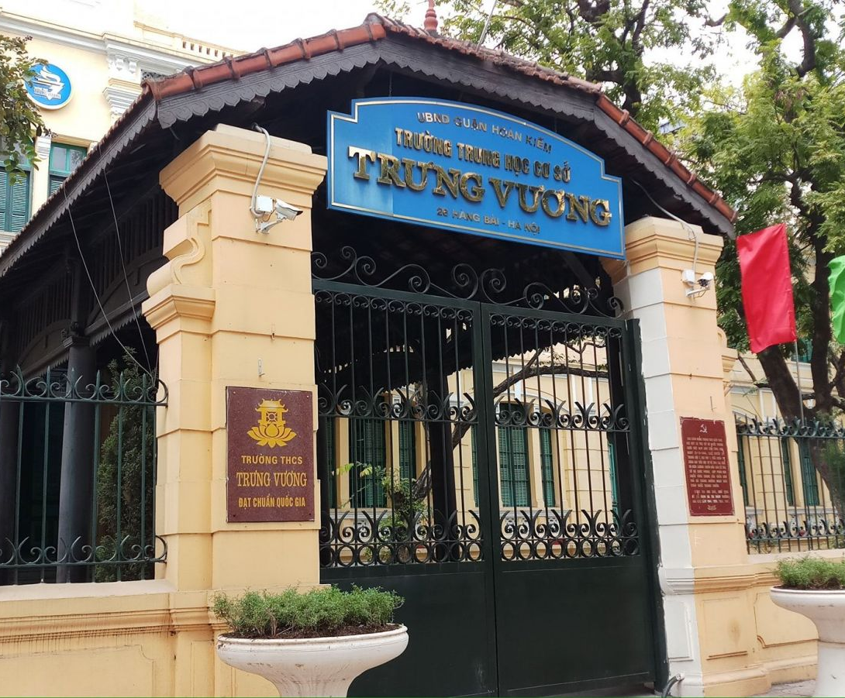
Example
Gia Phu N01 Secondary School
My teachers are friendly, and my friends are helpful.
We study many subjects: Maths, History, Science, and of course, English. We often play badminton during break time.
Gia Phu
13 classes
My school is very beautiful and big.
Notes:
1. What is the name of your school?
2. Where is your school?
3. How many classes does your school have?
4. What do students do at your school?
5. What do you like about your school?

Slide 14

4. Use the information in ex 3 to write a paragraph (50 words) about your school.
What is the name of your school?
What do you like about your school?
A picture of your school
Where is your school?
What do students do at your school?
How many classes does your school have?
…

Slide 15
Sample
My school is Trung Vuong School. My school is very beautiful and big. It is 32 Ly Thuong Kiet Street. It has 57 classes with over 2600 students. We study many subjects: Maths, History, Science, and of course, English. We often play badminton during break time. My teachers are friendly, and my friends are helpful. I love my school. (59 words)

Slide 16
Swap with your partner. Check.
 | Yes | No
Begin with a capital letter (My school ……)
Have correct spelling
Use present simple tense
All sentences have verbs

Slide 17
WRAP-UP
In this lesson, student have
LISTENING
WRITING
written a paragraph about one's school.
listened for specific information about school activities

Slide 18
Thanks for your attention!
Please keep this slide for attribution

