Slide 1










UNIT 8: WILDLIFE CONSERVATION
Lesson 4: Speaking
Activities for conserving wildlife
Giáo viên soạn: Trần Thị Nhung

Slide 2




TABLE OF CONTENTS
04
Post-Speaking
Presentation & Voting
01
Warm-up
Pre-Speaking
vocab and ranking
02
05
Wrap-up - reflection
03
While-Speaking
group discussion

Slide 3

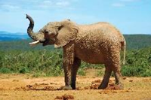

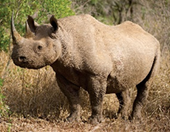
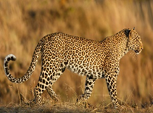
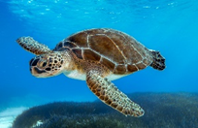

WARM-UP
What do these animals have in common?"
“Can you name them?

Slide 4



Suggested answers:
1.They are at risk /endangered.
2.They are Rhino, Leopard, Sea turtle, Elephant

Slide 5

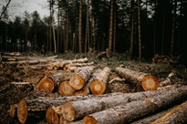
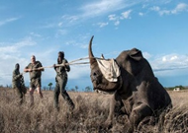
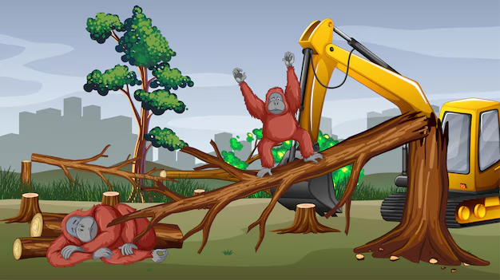

Why are these animals at risk or endangered?/ What can people do to protect them?
Deforestation
Poaching
habitat destruction

Slide 6


2. PRE-SPEAKING
Ranking the Activities
1.Organizing art or photography exhibitions of wildlif
2.Volunteering to help local wildlife
3.Avoiding activities that may harm the ecosystem
4.Inviting guest speakers to talk about conservation
5.Watching documentaries about wildlife
6.Raising funds for endangered species
7.Holding writing and speaking competitions

Slide 7

  JUSTIFICATION PHRASES
1. I think … is the most important because …
2. In my opinion, … should be ranked higher/lower because …

Slide 8


SAMPLE
Example 2:
A: I think volunteering is the most important because it involves real action to help animals.
B: I agree, but raising funds is also crucial because many organizations need money to protect wildlife.
C: What about guest speakers? If people are educated about conservation, they might change their behavior.

Slide 9
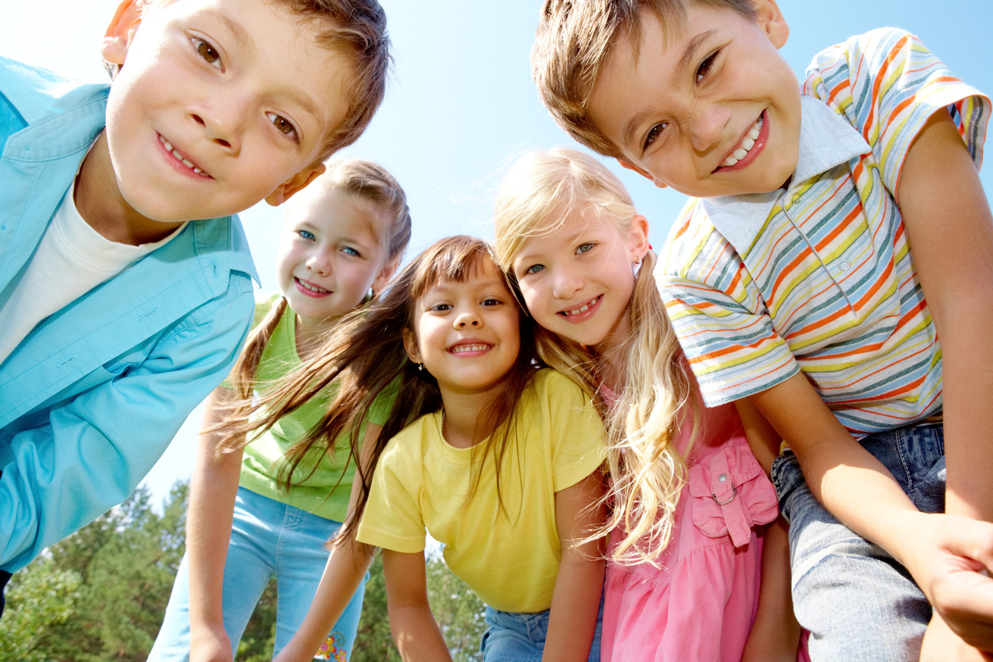


3. WHILE - SPEAKING
Presentation
Work in groups. Read the notice. Then brainstorm a list of activities you want to organize for the event. Explain how the activities will help conserve wildlife. Use the list in 1 and the example below to help you.

Slide 10


Example Activities:
1.Wildlife painting competition/ wildlife photography exhibition.→ Raises awareness through art
2.Tree planting campaign → Restores natural habitats
3.Debate on wildlife protection laws → Encourages critical thinking
4.Charity run to raise funds → Provides financial support for conservation
5.Social media campaign → Spreads awareness online
6. The event with a speaking competition about wildlife conservation. → debate the importance of wildlife

Slide 11




PROMPTS
1.How about organizing …?
2. This activity will help raise awareness because …
3. We could also … to make the event more engaging.

Slide 12
Suggested answers
A: Our group suggests organizing a wildlife photography exhibition. It will allow students to showcase pictures of nature and endangered species.
B: This activity raises awareness by showing the beauty of wildlife and the need for conservation.
C: We also plan to donate part of the ticket sales to a local animal rescue center.
A: I like your idea, but how will a speaking competition help preserve wildlife

Slide 13






POST – SPEAKING
Work in groups. Summarize your ideas and present the activities for the World Wildlife Day to the class. Vote for the best ideas.

Slide 14



Example
A: Our group suggests organizing a wildlife photography exhibition. It will allow students to showcase pictures of nature and endangered species.
B: This activity raises awareness by showing the beauty of wildlife and the need for conservation.
C: We also plan to donate part of the ticket sales to a local animal rescue center.

Slide 15
Homework
- Write a short speech (100-150 words) about why wildlife conservation is important.
- Record yourself presenting the speech and submit it via email.
- Prepare for the next lesson Unit 8- Listening lesson.

Slide 16








DO YOU HAVE ANY QUESTIONS?
THANK YOU

